Slide 1
Remote Audit During Crisis –
Roadmap for Cybersecurity strategy
for Small audit Firms
Team members:
Archana Narayanan
Bassam Abdulkhalek

Slide 2
Agenda:
Cyber attacks
Information gathered from articles – Lit review summary
Cybersecurity strategy development
Plan/Roadmap for end deliverable
Cybersecurity solutions development
High level overview on Toolkit
Advantages of proposed methodology
Cost effective tools

Slide 3
Remote work is prone to below cyberattacks….
•Phishing attacks
•Malware attacks
•Ransomware attacks
•Man-in-the-middle (MitM) attacks
•Denial-of-service (DoS) attacks
•SQL injection attacks
•Cross-site scripting (XSS) attacks
•Advanced persistent threats (APTs)
•Social engineering attacks
•Zero-day attacks

Slide 4
Information gathered from articles – Lit review summary
pre-audit analysis and preparation
Discusses on blockchain
Teleworking produces more risks >>>>>>>> Robust Data Management Systems is required
Capability
Rationalization
Pressure
Fraud Pentagon
Theory
Opportunity
Arrogance

Slide 5
Information gathered from articles – Lit review summary (continued..)
Balance between human expertise and technology.
Crisis management strategies, efficiency of human capital during economic disruptions.
The role of digital transformation, automation, and technology

Slide 6
Teleworking leads to cost savings and improve performance
Its effective as in-person audits, provided that auditor competency is good and adequate support from auditee is received
Study suggests that working closely with auditees and ensuring adequate technological support are key to successful remote audits
Challenges : Reduced assurance, Difficulties in communication , building trust, and limited access to auditee individuals and data.
Recommendations :
Having the right technological infrastructure and software/hardware are crucial for successful remote audits.
Password Vaults, Proper user access management, Information technology governance, Security control procedures during the crisis, Microsoft teams during videoconferences

Slide 7
Findings are organized into three main themes: Legal implications, Best practices, and International regulations
Risks by emerging new technologies like AI, IoT, Cloud
ISO/IEC 27001, NIST – Compliance with these frameworks can help organizations demonstrate their commitment to cyber-security and reduce the risk of cyber threats.
GDPR - sets strict guidelines for the collection, use, and storage of personal data and requires organizations to implement appropriate technical and organizational measures to ensure the security of personal data
Suggested critical tools: VPN, MFA
Techniques mentioned: Secure data storage, Encryption of sensitive data
Other techniques : Regular security awareness training, Firewalls, Intrusion detection systems, and Endpoint protection software
Regular security audits and vulnerability assessments is recommended.

Slide 8
Attacks happened during covid crisis:
In video-conferencing platforms, such as ‘Zoom-bombing’
Emotet Malware to steal sensitive and private information
Use of personal device
Directory Traversal Vulnerability
Credential-stuffing attacks
Phishing attacks, Cross site scripting, Lack of Awareness
• Advance Fraud Scam or A 419 or Advance fee scam
• Isolation and lack of support staff
• Poor internet access
• Swapping Attacks, SIM Swapping, or SIMJacking
Mitigation ideology:
VPN, DMARC, Secure Wifi, CIA Security Triad, Moving to Zero Trust Environments, Equipment and Services

Slide 9
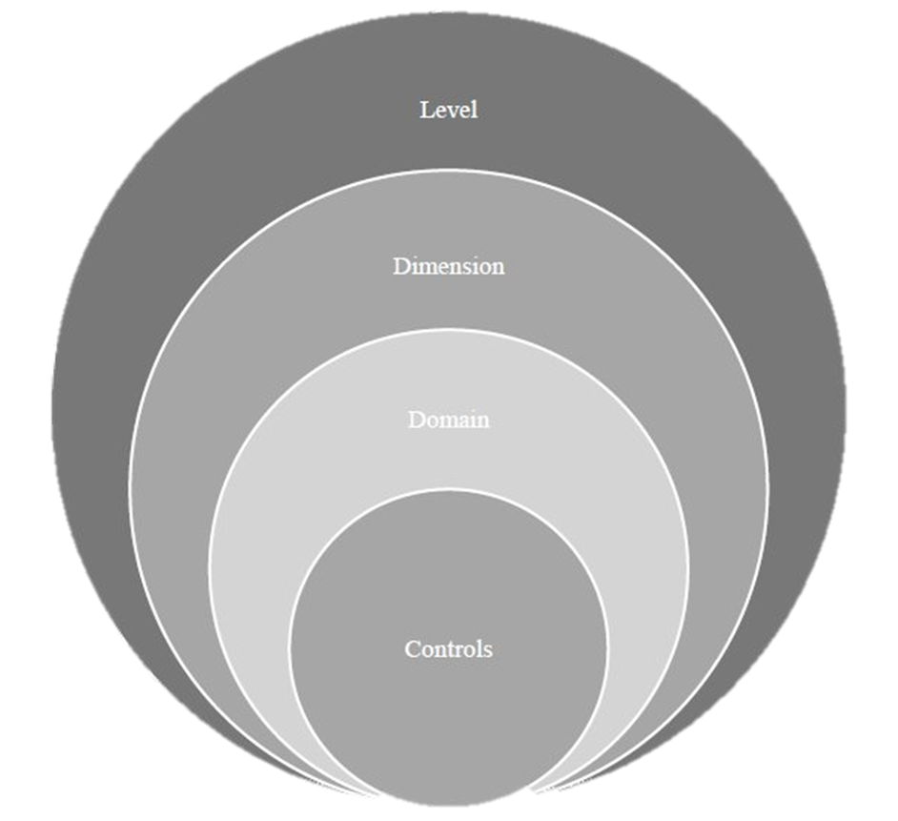
Security Culture Framework:
• Dimensions are categorized as Assets, Continuity, Access&Trust,
Operations, Defense, Security Governance
In the individual level, the Attitude, Behaviour, Competency and Awareness perspective dimension are categorized with domains and controls.

Slide 10
Advantages discussed in articles:
Avoiding traveling to difficult audit locations
Expanding audit coverage and more efficient audits
Strengthens documentation, reviews and reporting
Logistics related to auditing are not needed anymore
Challenges discussed in articles:
More opportunities for fraud
High costs and difficulties in offering modern technology
Insufficient training and experience of internal auditors
Reliability and trust of the audit

Slide 11
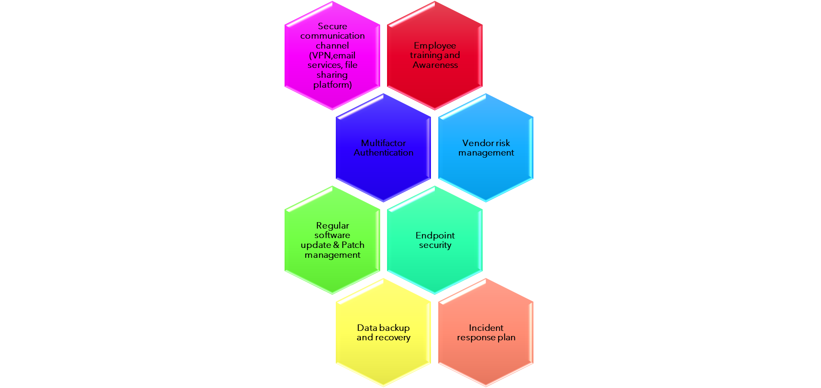
Let’s assume small audit firms have disorganized or no process in place..
Dimensions for CS Strategy

Slide 12
We will guide the audit firm in 3 phases…
Before Remote Audit
During Remote Audit
After Remote Audit
Initial Assessment to find the approach(Unified/Combined)
Assessment of auditee system to prevent virus/malware transfer
User awareness training
Tools/Software installation
Basic checks
Connectivity using secure collaboration tool
Checks to be done for secure audit
Checks on compliance and regulation
Collection of evidences
Secure storage of
evidences to prevent
data exfiltration

Slide 13
Toolkit to contain….
Cybersecurity Policies documentation with categorized areas to focus
Approach selection checklist
Employee Awareness training presentation
Incident response plans documentation with severity-based target dates
Secure Installation practices for tools and resources
Secure Installation practices for updates and support
Checklist for Secure Remote Audit – Technical controls
Checklist for Compliance and regulation requirement – Data privacy
A web page will be created with above data in its respective tabs for easy navigation to guide auditors.
Notes:
Example: https://www.linkedin.com/pulse/best-practices-conducting-cybersecurity-audits-crisis/

Slide 14
Advantages of proposed strategy:
Secure Audit: Lead to trustworthy and reliable reports. Assured Data protection and secure environment.
Cost Savings: Toolkit guides to setup a highly secure environment with low cost or free tools.
Low risk: Focuses on high secure audits preventing cyberattacks and data breaches.
Technological Advancement: Forced familiarization with new technologies for both auditors and auditees.

Slide 15
Cost effective tools

Slide 16
THANK YOU

