Slide 1
Article 4
Member Sign Up and Initial member Home Page

Slide 2
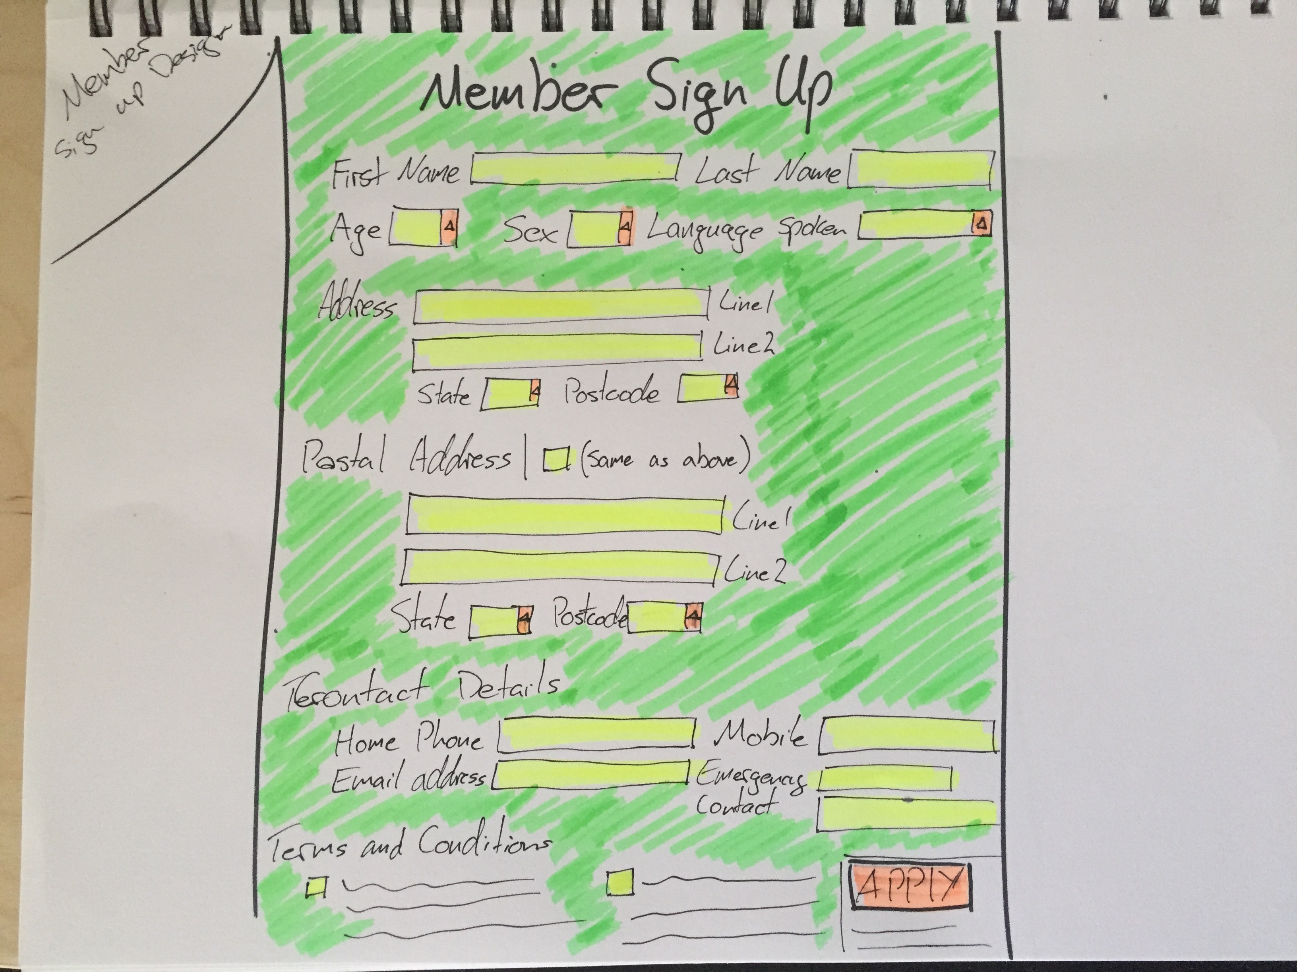

Slide 3
