Slide 1
MAD DEP Production Designs
Splash Screen and initial web Home Page

Slide 2
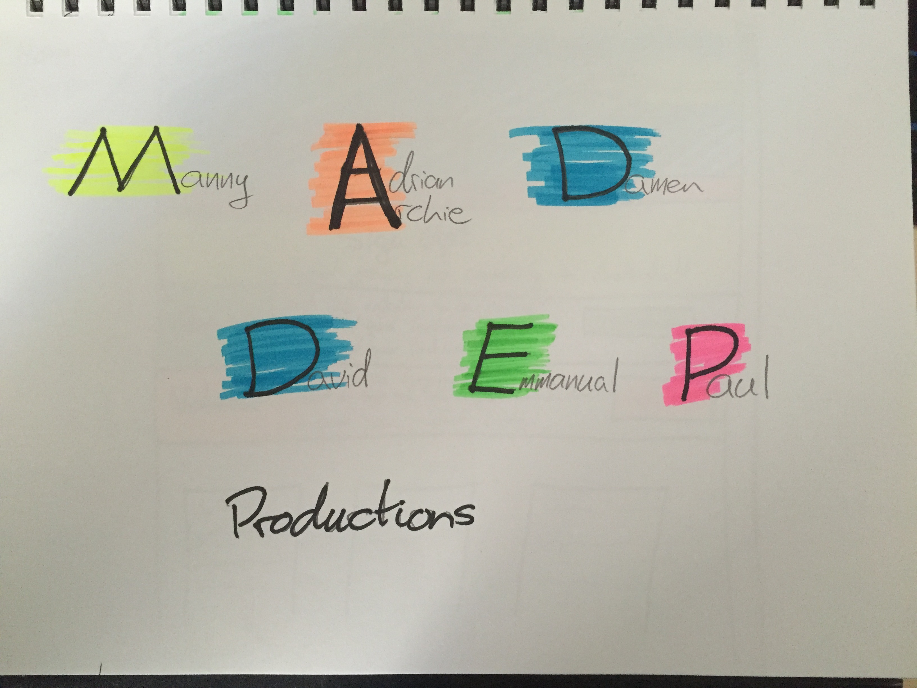

Slide 3
