Slide 1
Article 5
Volunteer Application and initial Home Page

Slide 2
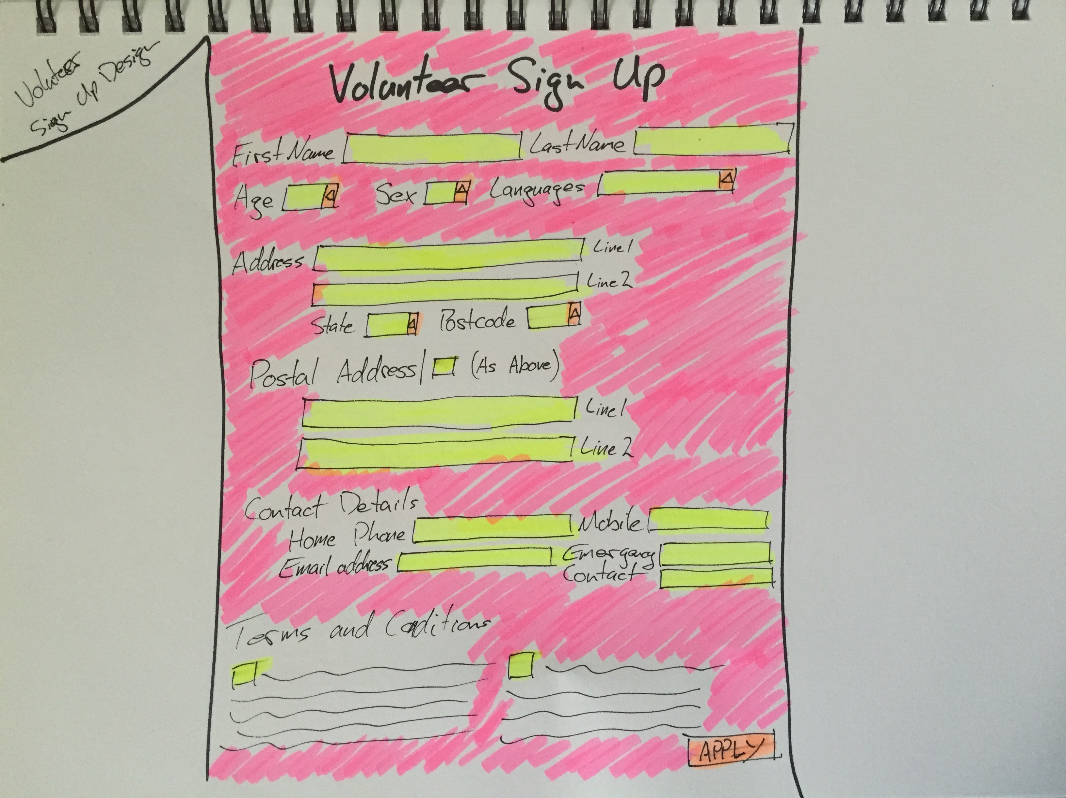

Slide 3
