Slide 1
Digital Design & Computer Arch. Lab 8.1 Supplement: Full System Integration
Prof. Onur Mutlu
ETH Zürich
Spring 2023
9 May 2023

Slide 2
Lab 8 Overview
You will build a whole single-cycle processor and write assembly code that runs on the FPGA board.
Don’t worry! You have 2 sessions for the lab, and it will give you up to 14 points (+6 points from the reports).
You will learn how a processor is built.
Learn how the processor communicates with the outside world.
Implement the MIPS processor and demonstrate a simple “snake” program on the FPGA starter kit.

Slide 3
Lab 8 Sessions
Session I: The Crawling Snake
Session II: Speed Up the Snake

Slide 4
Lab 8 Session I: The MIPS Processor
Download the Vivado project from the course website
A lot of parts are already implemented for you!
What you will have to implement:
Compute the Instruction Memory address and read the instruction.
Connect the ALU.
Compute the Data Memory address and add the necessary wires.
Instantiate the Control Unit.

Slide 5
Lab 8 Session I: Memory-Mapped I/O
Your goal is to control the 7-segment display with your assembly program.
You will need to complete the I/O controller so the output of the processor will be correctly mapped to the display.

Slide 6
I/O in Assembly
How do we communicate with the display?
Memory Mapped I/O
We designate specific addresses for the I/O
We can read and write to those addresses.
Example
# write contents of $t0 into memory at address 0x7FF0
# so that the I/O controller can send it to the display
sw $t0, 0x7FF0($0)

Slide 7
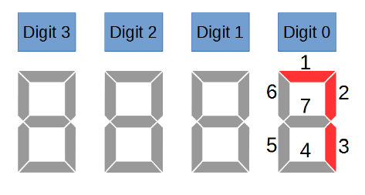
Lab 8 Session I : The Crawling Snake
You learned how to write assembly code in Lab 7
We provide you with the code for a crawling snake on the 7-segment display
We will run this program on the processor you build in this lab!

Slide 8
Last Words
You will build a whole single-cycle processor and write assembly code that runs on the FPGA board.
You will learn how a processor is built.
Learn how the processor communicates with the outside world.
Implement the MIPS processor and demonstrate a simple “snake” program on the FPGA starter kit.
You will have some questions to answer in the report.

Slide 9
Report Deadline
23:59, 26 May 2023

Slide 10
Digital Design & Computer Arch. Lab 8.1 Supplement: Full System Integration
Prof. Onur Mutlu
ETH Zürich
Spring 2023
9 May 2023

