Slide 1

TrustRAG: A Trustworthy Offline Retrieval-Augmented Generation Framework with Explainable Multi-Signal Hallucination Detection
Project Phase 1
Review 1
Guide: Dr Ramya G R
Name | Roll Number | Internship details
ARCHA BIJU | CB.SC.P2CSE25001 | NetApp Private Limited , Banglore

Slide 2
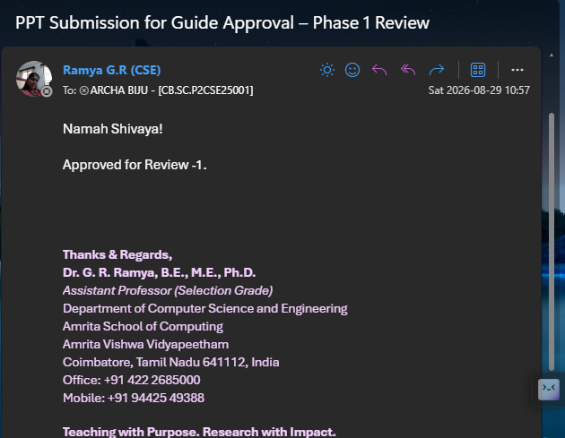
Guide Approval Mail

Slide 3
Introduction and Motivation
Retrieval-Augmented Generation (RAG) improves knowledge access by retrieving relevant documents before generating an answer. However, retrieval alone does not guarantee that every generated statement is supported by the retrieved evidence.
Motivation
Build a knowledge system, not a chatbot.
Retrieve relevant domain-specific documents and explain why they were selected.
Generate answers only after establishing evidence support.
Detect and control unsupported or weakly supported claims.
Enable operation in offline, privacy-sensitive, and resource-constrained environments.
Avoid dependence on cloud APIs, external validation models, and black-box verification.

Slide 4
Problem Statement
Despite retrieval support, RAG systems can still generate statements that are unsupported or weakly supported by retrieved evidence.
Existing hallucination detection approaches often rely on:
External fact-checking or validation models
Heavyweight entailment classifiers
Cloud-based APIs or computationally expensive verification
These approaches can introduce high computational overhead, limited transparency, and dependence on external services, making them less suitable for offline and resource-constrained environments.

Slide 5
Literature Review
Ref. | Author(s) | Paper | Year | Contribution | Limitation / Gap
[1] | Brown et al. | Language Models are Few-Shot Learners | 2020 | Strong few-shot LLM capabilities | No evidence retrieval/verification
[2] | Ji et al. | Survey of Hallucination in NLG | 2023 | Taxonomy of hallucination causes/types | No operational detection framework
[3] | Ji et al. | Survey on Hallucination in LLMs | 2025 | Reviews detection & mitigation | No unified retrieval–verification framework
[4] | Lewis et al. | Retrieval-Augmented Generation | 2020 | Introduced retrieval-based generation | No sentence-level verification
[5] | Guu et al. | REALM | 2020 | Integrates document retrieval with LM pre-training | No post-generation evidence verification
[6] | Karpukhin et al. | Dense Passage Retrieval | 2020 | Efficient neural passage retrieval | Does not verify generated responses

Slide 6
Literature Review
[7] | Shuster et al. | Retrieval Augmentation Reduces Hallucination | 2021 | Retrieval reduces conversational hallucination | No sentence-level factual verification
[8] | Manakul et al. | SelfCheckGPT | 2023 | Sampling-based hallucination detection | No retrieved-evidence verification
[9] | Min et al. | FActScore | 2023 | Atomic-level factuality evaluation | No real-time response control
[10] | Es et al. | RAGAS | 2024 | RAG faithfulness & retrieval evaluation | No sentence-level trust decisions
[11] | Ribeiro et al. | Why Should I Trust You? | 2016 | Model-agnostic explanations using LIME | No RAG evidence-to-generation mapping
[12] | Lundberg & Lee | A Unified Approach to Interpreting Model Predictions | 2017 | SHAP-based feature attribution | No RAG statement provenance

Slide 7
Literature Review
Ref. | Author(s) | Paper | Year | Contribution | Limitation / Gap
[13] | Bowman et al. | SNLI / NLI | 2018 | Entailment, contradiction & neutral inference | Not a complete hallucination framework
[14] | Kryściński et al. | FactCC | 2020 | Factual inconsistency detection | Mainly summarization-focused
[15] | Laban et al. | SummaC | 2022 | NLI-based inconsistency detection | No RAG provenance/control
[16] | Honovich et al. | TRUE | 2022 | Benchmark for factual consistency metrics | No integrated online verification
[17] | He et al. | DeBERTa-v3 | 2023 | Improved transformer representations | Not an end-to-end hallucination detector
[18] | Zhang et al. | BERTScore | 2020 | Contextual semantic similarity | Similarity ≠ factual correctness

Slide 8
Literature Review
Ref. | Author(s) | Paper | Year | Contribution | Limitation / Gap
[19] | Devlin et al. | BERT | 2019 | Strong bidirectional language representations | No evidence-grounded verification
[20] | Vaswani et al. | Attention Is All You Need | 2017 | Introduced Transformer architecture | No RAG verification mechanism
[21] | Reimers & Gurevych | Sentence-BERT | 2019 | Efficient sentence embeddings | No factual verification
[22] | Johnson et al. | FAISS | 2021 | Efficient vector similarity search | No response reliability assessment
[23] | Grattafiori et al. | The Llama 3 Herd of Models | 2024 | Open LLMs for general-purpose generation | Still susceptible to unsupported generation
[24] | RLSeek authors | RLSeek | 2026 | Evidence-grounded hallucination detection | RL-based verification adds complexity

Slide 9
Literature Review
Ref. | Authors | Paper Title | Year | Key Contribution | Limitation
[25] | R. Jia et al. | Evidence-Aligned Entity Verification for Hallucination Detection in Retrieval-Augmented Generation | 2026 | Entity-level evidence verification | Limited to entity hallucinations
[26] | W. Chen et al. | Rethinking Evaluation for LLM Hallucination Detection: A Desiderata, A New RAG-Based Benchmark, and New Insights | 2026 | New RAG hallucination benchmark | Focuses mainly on evaluation
[27] | N. Yang & K. Huang | Logic Matters in Lightweight Hallucination Classification for RAG Systems | 2026 | Lightweight logic-based classification | No combined multi-signal trust scoring
[28] | Z. Li et al. | MARCH: Multi-Agent Reinforced Check for Hallucination | 2026 | Multi-agent hallucination verification | Higher system complexity
[29] | E. Fadeeva et al. | Faithfulness-Aware Uncertainty Quantification for Fact-Checking the Output of Retrieval-Augmented Generation | 2026 | Confidence estimation for RAG | No explicit provenance + sentence validation
[30] | L. M. Amugongo et al. | Retrieval Augmented Generation for Large Language Models in Healthcare: A Systematic Review | 2025 | Reviews RAG reliability challenges | No concrete integrated offline framework

Slide 10
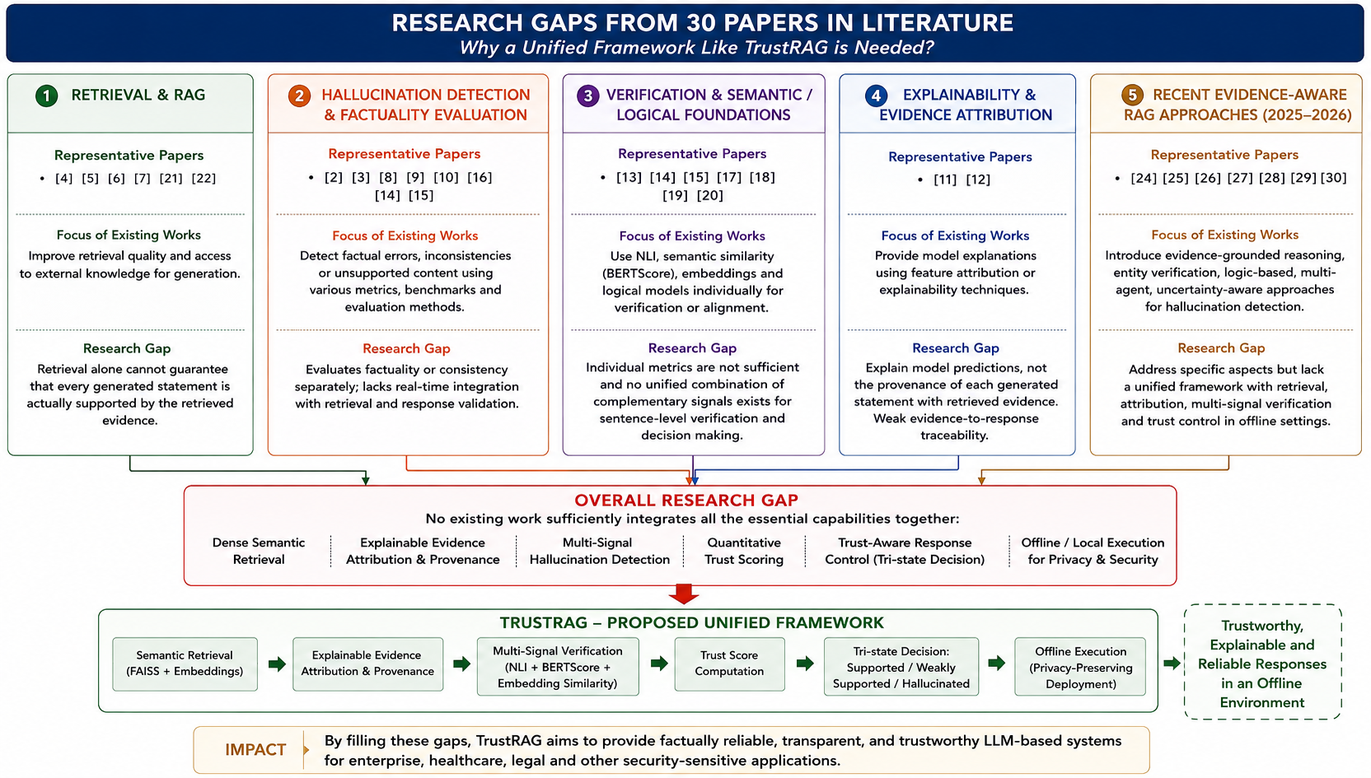
Research Gap

Slide 11
Objectives
Develop an offline RAG framework (TrustRAG) for trustworthy response generation.
Implement semantic retrieval using Sentence-BERT and FAISS.
Integrate evidence attribution for transparent response generation.
Develop multi-signal hallucination detection using NLI, BERTScore, and cosine similarity.
Generate a Trust Score to quantify response reliability.
Control and classify hallucinated outputs as Supported, Weakly Supported, or Hallucinated.

Slide 12
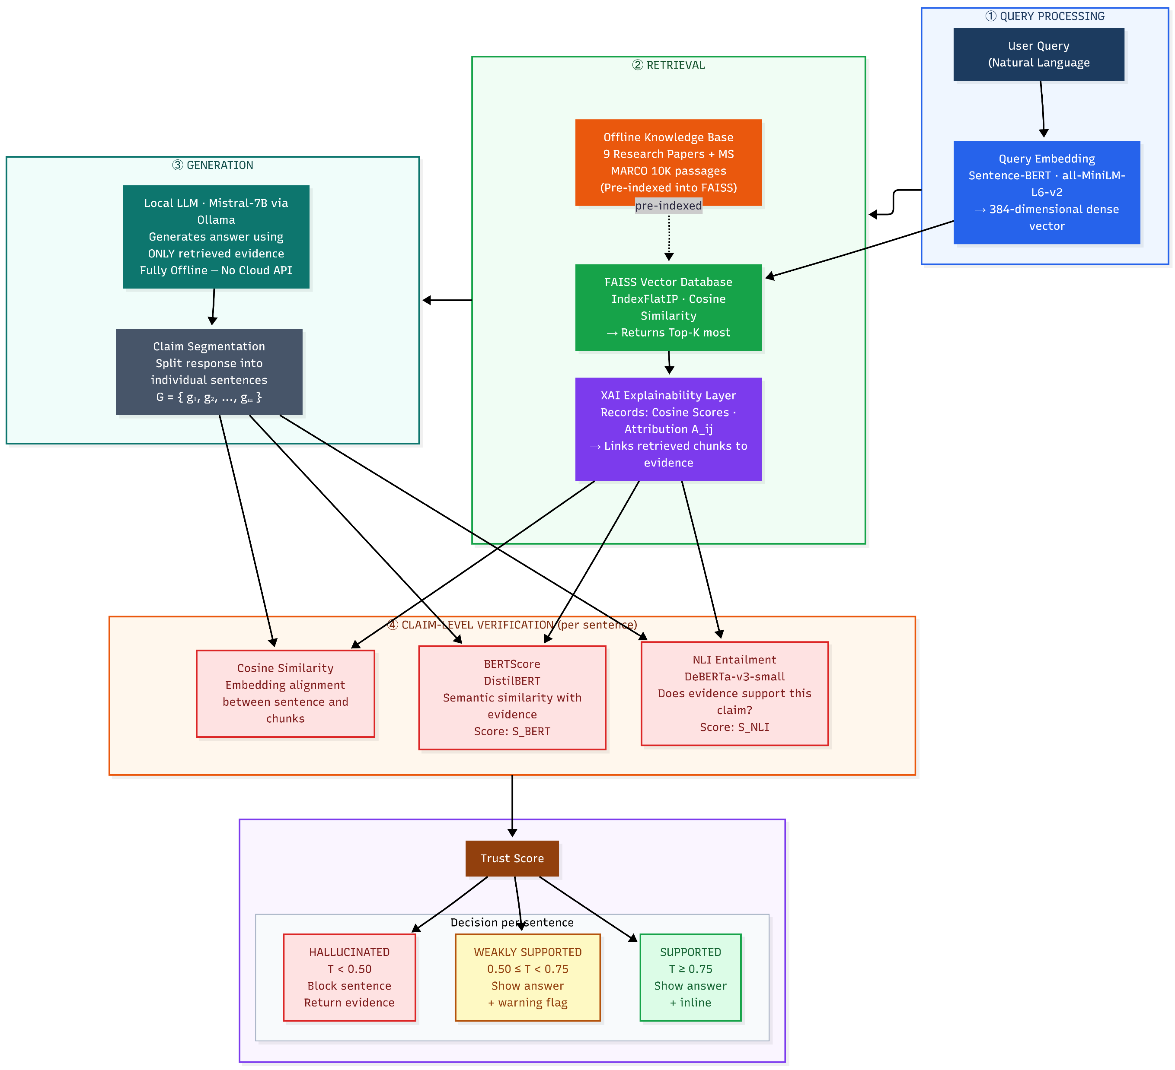
Architecture Diagram

Slide 13
Proposed Methodology: Architecture & Workflow
Query Processing
Query Embedding: The user query q is converted into a 384-dimensional dense vector using the local Sentence-BERT (all-MiniLM-L6-v2) model.
Retrieval
Semantic Retrieval: The query vector is compared against all pre-indexed chunk vectors in the FAISS Vector Database using cosine similarity. The Top-K most relevant document chunks are returned.
XAI Evidence Attribution: The Explainability Layer captures retrieval signals — cosine scores, chunk attribution , and provenance scores — linking each retrieved chunk to its source document.
Generation
Local Generation: The retrieved context is passed to the local Mistral-7B model (via Ollama) to generate an evidence-grounded response — fully offline with no cloud API.
Claim Segmentation: The generated response is divided into individual sentence-level claims: G = {g₁, g₂, ..., gₘ}. Each claim is verified independently

Slide 14
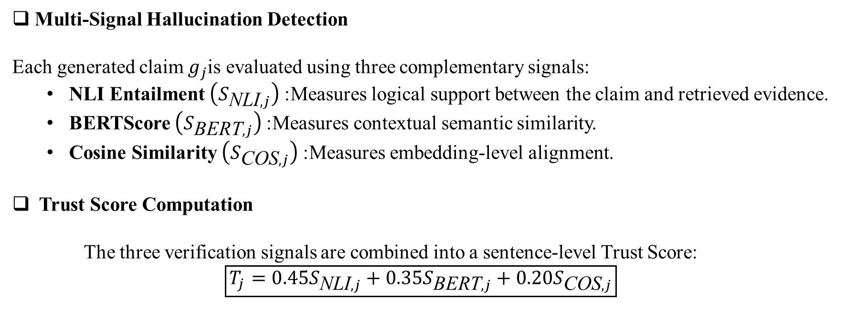
Proposed Methodology:Technical Method
Multi-Signal Hallucination Detection
Each generated claim $g_{j}$is evaluated using three complementary signals:
NLI Entailment $\left(S_{\text{NLI},j}\right)$: Measures logical support between the claim and retrieved evidence.
BERTScore $\left(S_{\text{BERT},j}\right)$: Measures contextual semantic similarity.
Cosine Similarity $\left(S_{\text{COS},j}\right)$: Measures embedding-level alignment.
Trust Score Computation
The three verification signals are combined into a sentence-level Trust Score:
$$\boxed{T_{j}=0.45S_{\text{NLI},j}+0.35S_{\text{BERT},j}+0.20S_{\text{COS},j}}$$

Slide 15
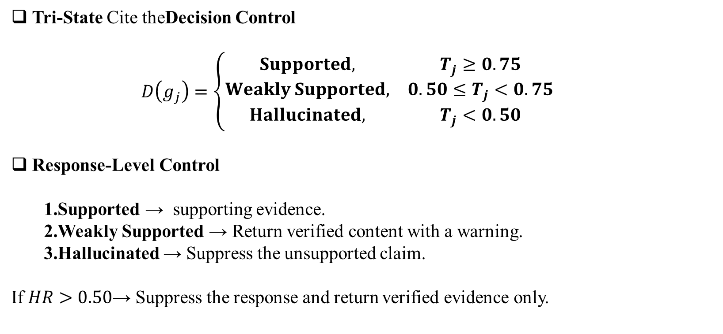
Proposed Methodology: Technical Method
Tri-State Cite theDecision Control
  $$D\left(g_{j}\right)=\left\{\begin{matrix}Supported, & T_{j}≥0.75 \\ Weakly Supported, & 0.50≤T_{j}<0.75 \\ Hallucinated, & T_{j}<0.50\end{matrix}\right.$$
Response-Level Control
Supported → supporting evidence.
Weakly Supported → Return verified content with a warning.
Hallucinated → Suppress the unsupported claim.
If $HR>0.50$→ Suppress the response and return verified evidence only.

Slide 16
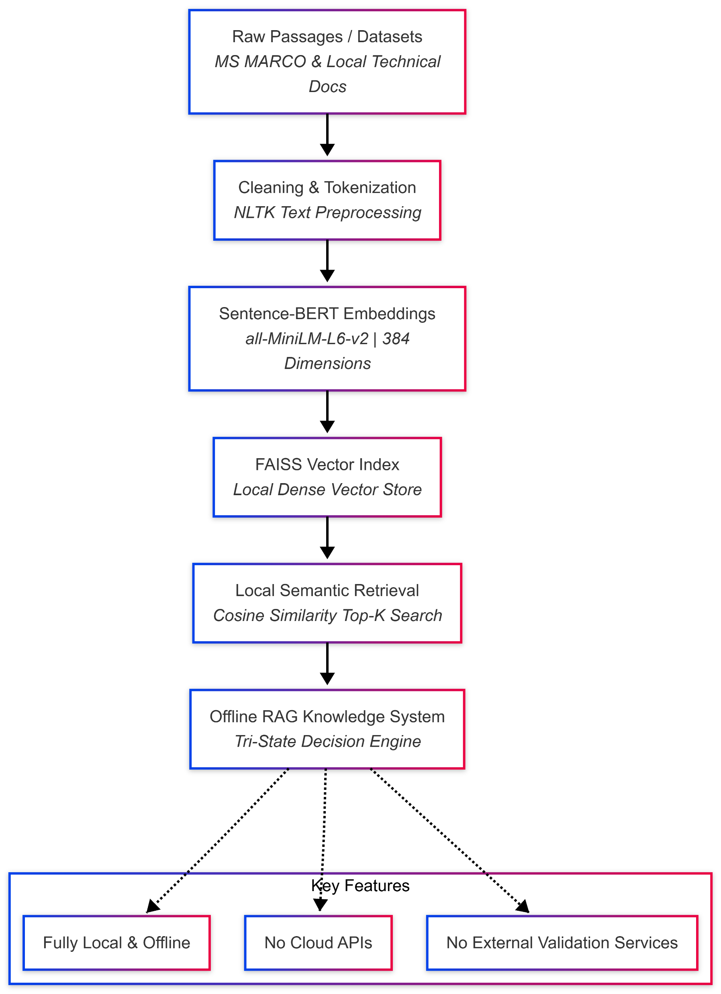
Datasets
1. Local Technical Knowledge Corpus
Source: 9 domain-specific technical documents and research papers (~6.7 MB)
Domain: RAG architectures, hallucination detection, and technical documentation
Purpose: Initial offline testing of retrieval, claim segmentation, explainability signals, and evidence attribution
2. MS MARCO Benchmark Dataset
Source: Microsoft Machine Reading Comprehension (MS MARCO)
Scale: Large-scale benchmark containing real user queries and web passages
Current Experiment Subset: 10,000 passages selected for local offline indexing
Purpose: Benchmark evaluation of retrieval performance and evidence-grounded response generation
Fig: Preprocesing and retrieval pipeline

Slide 17
Implementation, Partial Results & Discussion
Developed an offline RAG pipeline using local documents and MS MARCO.
Completed dataset preprocessing and document chunking.
Generated embeddings using Sentence-BERT
Implemented FAISS-based vector indexing and Top-K semantic retrieval.
Partial Results (Phase 1 — Initial):
✔ Local knowledge base created using technical documents and MS MARCO
✔ Document preprocessing, Sentence-BERT embeddings, and FAISS indexing
Discussion:
High retrieval relevance does not necessarily guarantee that every generated claim is fully supported by the retrieved evidence. Therefore, claim-level verification is required.

Slide 18
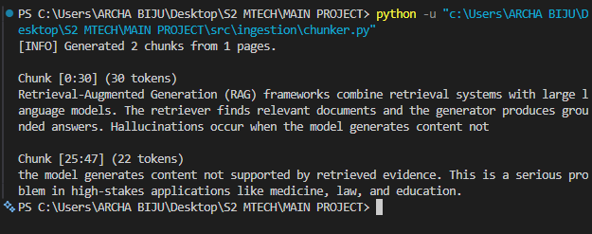
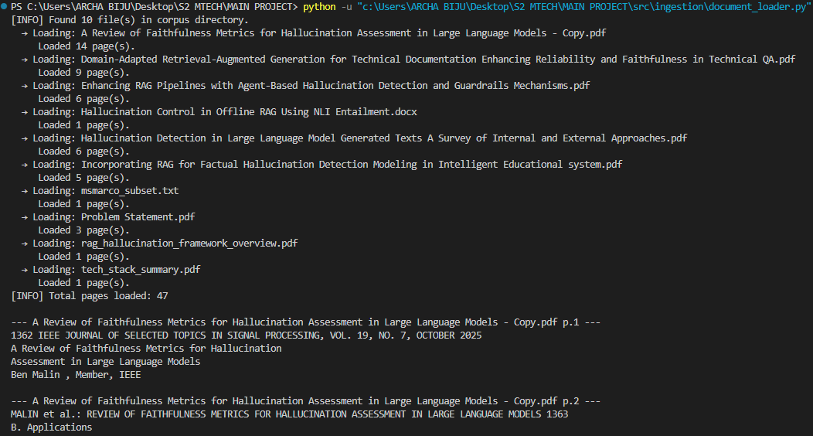
Implementation, Partial Results & Discussion

Slide 19
SDG mapping with Jusification
SDG | Goal | Justification for TrustRAG
SDG 9 | Industry, Innovation and Infrastructure | TrustRAG develops an innovative offline RAG infrastructure that combines semantic retrieval, evidence attribution, multi-signal hallucination detection, and trust-based response control. It supports secure and reliable AI deployment without dependence on cloud APIs.
SDG 16 | Peace, Justice and Strong Institutions | TrustRAG promotes transparent, explainable, and evidence-grounded AI by linking generated claims to supporting evidence and suppressing unsupported claims. This helps reduce misleading AI-generated information and improves accountability.
SDG 4 | Quality Education | TrustRAG can support reliable AI-assisted learning and research by providing evidence-grounded responses rather than unsupported generated information, helping users access and verify knowledge more effectively.

Slide 20
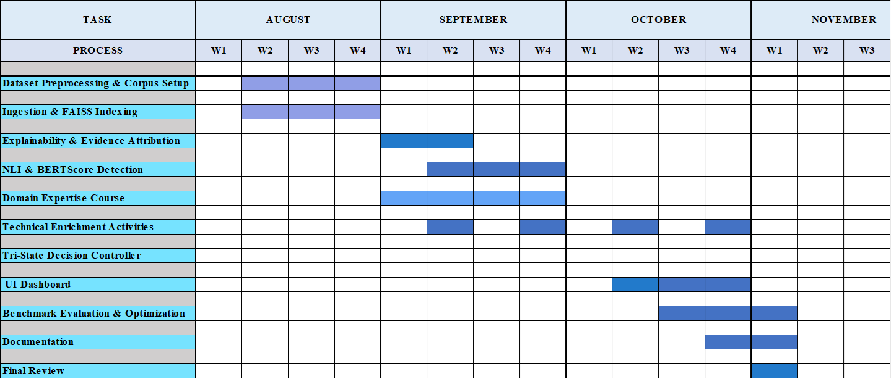
Gantt chart- Project plan for semester 3

Slide 21
Domain Expertise Course – Plan & Progress
Module | Status
Enrolled / Guide approval obtained | ✅ Complete
Module 1: Introduction to RAG | ✅ Complete
Module 2: Semantic Search & Embeddings | 🔄 In Progress
Module 3: Advanced Retrieval Strategies | ⏳
Module 4: Evaluation & Trust in RAG | ⏳
Selected Course: RAG with Python: Build Chatbots That Talk to Your Data
Platform: Udemy
Duration: 10 Hours 34 Minutes
Relevance to Project
Covers the end-to-end RAG pipeline, including document processing, chunking, embeddings, vector databases, and retrieval.
Supports the implementation of FAISS-based semantic retrieval and evidence-grounded generation.
Provides knowledge relevant to RAG evaluation, groundedness, and hallucination reduction.

Slide 22
Technical Enrichment Activities
Activity | Planned Technical Enrichment | Relevance to Project
1. RAG & Vector Database Learning | Hands-on learning on advanced RAG, embeddings, FAISS, chunking and retrieval techniques | Improves the offline knowledge retrieval component
2. Explainable AI (XAI) Study | Explore evidence attribution, similarity visualisation, provenance and confidence-based explainability | Supports transparent evidence grounding and hallucination analysis
3. Hallucination Detection & Evaluation | Study NLI, BERTScore, groundedness metrics and claim-level verification techniques | Supports the proposed hallucination detection and Trust Score mechanism

Slide 23
Conclusion
Developed the TrustRAG offline RAG framework for trustworthy, evidence-grounded responses.
Implemented document processing, Sentence-BERT embeddings, FAISS retrieval, and claim-level verification modules.
Designed Trust Score and Tri-State Controller for Supported, Weakly Supported, and Hallucinated claims.
Designed the XAI layer for evidence provenance and source attribution.
End-to-end integration and formal evaluation are planned for Semester 3.
Future Scope
Complete end-to-end integration and testing.
Evaluate using F1, Recall@K, and Provenance Score.
Explore adaptive thresholds and lightweight NLI models.

Slide 24
References
[1] T. B. Brown et al., “Language Models are Few-Shot Learners,” Advances in Neural Information Processing Systems (NeurIPS), vol. 33, pp. 1877–1901, 2020.
[2] Z. Ji et al., “Survey of Hallucination in Natural Language Generation,” 2023.
[3] Z. Ji et al., “A Survey on Hallucination in Large Language Models: Principles, Taxonomy, Challenges, and Open Questions,” 2025.
[4] P. Lewis et al., “Retrieval-Augmented Generation for Knowledge-Intensive NLP Tasks,” Advances in Neural Information Processing Systems (NeurIPS), vol. 33, pp. 9459–9474, 2020.
[5] K. Guu et al., “REALM: Retrieval-Augmented Language Model Pre-Training,” 2020.
[6] V. Karpukhin et al., “Dense Passage Retrieval for Open-Domain Question Answering,” EMNLP, pp. 6769–6781, 2020.
[7] K. Shuster et al., “Retrieval Augmentation Reduces Hallucination in Conversation,” Findings of ACL: EMNLP, pp. 3784–3803, 2021.
[8] P. Manakul, A. Liusie, and M. J. F. Gales, “SelfCheckGPT: Zero-Resource Black-Box Hallucination Detection for Generative Large Language Models,” EMNLP, pp. 9004–9017, 2023.
[9] S. Min et al., “FActScore: Fine-Grained Atomic Evaluation of Factual Precision in Long-Form Text Generation,” 2023.
[10] S. Es et al., “RAGAS: Automated Evaluation of Retrieval-Augmented Generation,” EACL, pp. 150–158, 2024.

Slide 25
References
[11] M. T. Ribeiro, S. Singh, and C. Guestrin, “Why Should I Trust You?: Explaining the Predictions of Any Classifier,” KDD, pp. 1135–1144, 2016.
[12] S. M. Lundberg and S.-I. Lee, “A Unified Approach to Interpreting Model Predictions,” NeurIPS, vol. 30, 2017.
[13] S. Bowman et al., “A Broad-Coverage Challenge Corpus for Sentence Understanding through Inference,” 2018.
[14] W. Kryściński et al., “Evaluating the Factual Consistency of Abstractive Text Summarization,” 2020.
[15] P. Laban et al., “SummaC: Revisiting NLI-Based Models for Inconsistency Detection in Summarization,” 2022.
[16] O. Honovich et al., “TRUE: Re-evaluating Factual Consistency Evaluation,” 2022.
[17] P. He et al., “DeBERTa-v3: Improving DeBERTa Using ELECTRA-Style Pre-training with Gradient-Disentangled Embedding Sharing,” 2023.
[18] T. Zhang et al., “BERTScore: Evaluating Text Generation with BERT,” ICLR, 2020.
[19] J. Devlin et al., “BERT: Pre-training of Deep Bidirectional Transformers for Language Understanding,” 2019.
[20] A. Vaswani et al., “Attention Is All You Need,” NeurIPS, 2017.

Slide 26
References
[21] N. Reimers and I. Gurevych, “Sentence-BERT: Sentence Embeddings Using Siamese BERT-Networks,” EMNLP-IJCNLP, pp. 3982–3992, 2019.
[22] J. Johnson, M. Douze, and H. Jégou, “Billion-Scale Similarity Search with GPUs,” IEEE Transactions on Big Data, vol. 7, no. 3, pp. 535–547, 2021.
[23] A. Grattafiori et al., “The Llama 3 Herd of Models,” 2024.
[24] RLSeek authors, “RLSeek: Evidence-Grounded Reasoning for RAG Hallucination Detection,” ACL, 2026.
[25] Evidence-Aligned authors, “Evidence-Aligned Entity Verification for Hallucination Detection in Retrieval-Augmented Generation,” Findings of ACL, 2026.
[26] Rethinking Evaluation authors, “Rethinking Evaluation for LLM Hallucination Detection: A Desiderata, A New RAG-Based Benchmark, and New Insights,” 2026.
[27] Logic Matters authors, “Logic Matters in Lightweight Hallucination Classification for RAG Systems,” 2026.
[28] MARCH authors, “MARCH: Multi-Agent Reinforced Check for Hallucination,” 2026.
[29] Faithfulness-Aware authors, “Faithfulness-Aware Uncertainty Quantification for Fact-Checking the Output of Retrieval-Augmented Generation,” 2026.
[30] Healthcare RAG review authors, “Retrieval Augmented Generation for Large Language Models in Healthcare: A Systematic Review,” 2025.

Slide 27
THANK YOU

