Slide 1
TrustRAG: A Trustworthy Offline Retrieval-Augmented Generation Framework with Explainable Multi-Signal Hallucination Detection
Project Phase 1
Review 2
Guide: Dr Ramya G R
Name | Roll Number | Internship details
ARCHA BIJU | CB.SC.P2CSE25001 | NetApp Private Limited, Bangalore
10-10-2026
Amrita School of Computing

Slide 2
Guide Approval Mail

Slide 3
Introduction and Motivation
Large Language Models (LLMs) are increasingly used for knowledge-intensive applications.LLMs can generate fluent and useful responses, but may produce hallucinated or factually unsupported information.
Retrieval-Augmented Generation (RAG) improves factual grounding by retrieving relevant information from external knowledge sources.However, retrieved evidence does not guarantee that every generated claim is supported.
Therefore, reliable RAG systems require effective hallucination detection and verification.
Hallucination detection becomes especially important in technical and knowledge-sensitive applications.
Motivation
Build a knowledge system, not a chatbot.
Retrieve relevant domain-specific documents and explain why they were selected.
Generate answers only after establishing evidence support.
Detect and control unsupported or weakly supported claims.
Enable operation in offline, privacy-sensitive, and resource-constrained environments.
Avoid dependence on cloud APIs, external validation models, and black-box verification.

Slide 4
Problem Statement
Despite retrieval support, RAG systems can generate unsupported or weakly supported claims from retrieved evidence.
Existing hallucination detection approaches often rely on:
External fact-checking or validation models
Entailment-based verification
Post-hoc validation techniques
Computationally expensive or external services
These approaches can introduce computational overhead, limited interpretability, and dependence on external services, making them less suitable for offline and resource-constrained environments.
Moreover, RAG systems lack effective mechanisms to quantify and explain the degree of evidence support for individual generated statements.
Research Problem:
How can explainability signals within an offline RAG framework be systematically leveraged to detect and control hallucinated outputs while maintaining transparency, efficiency, and evidence grounding?

Slide 5
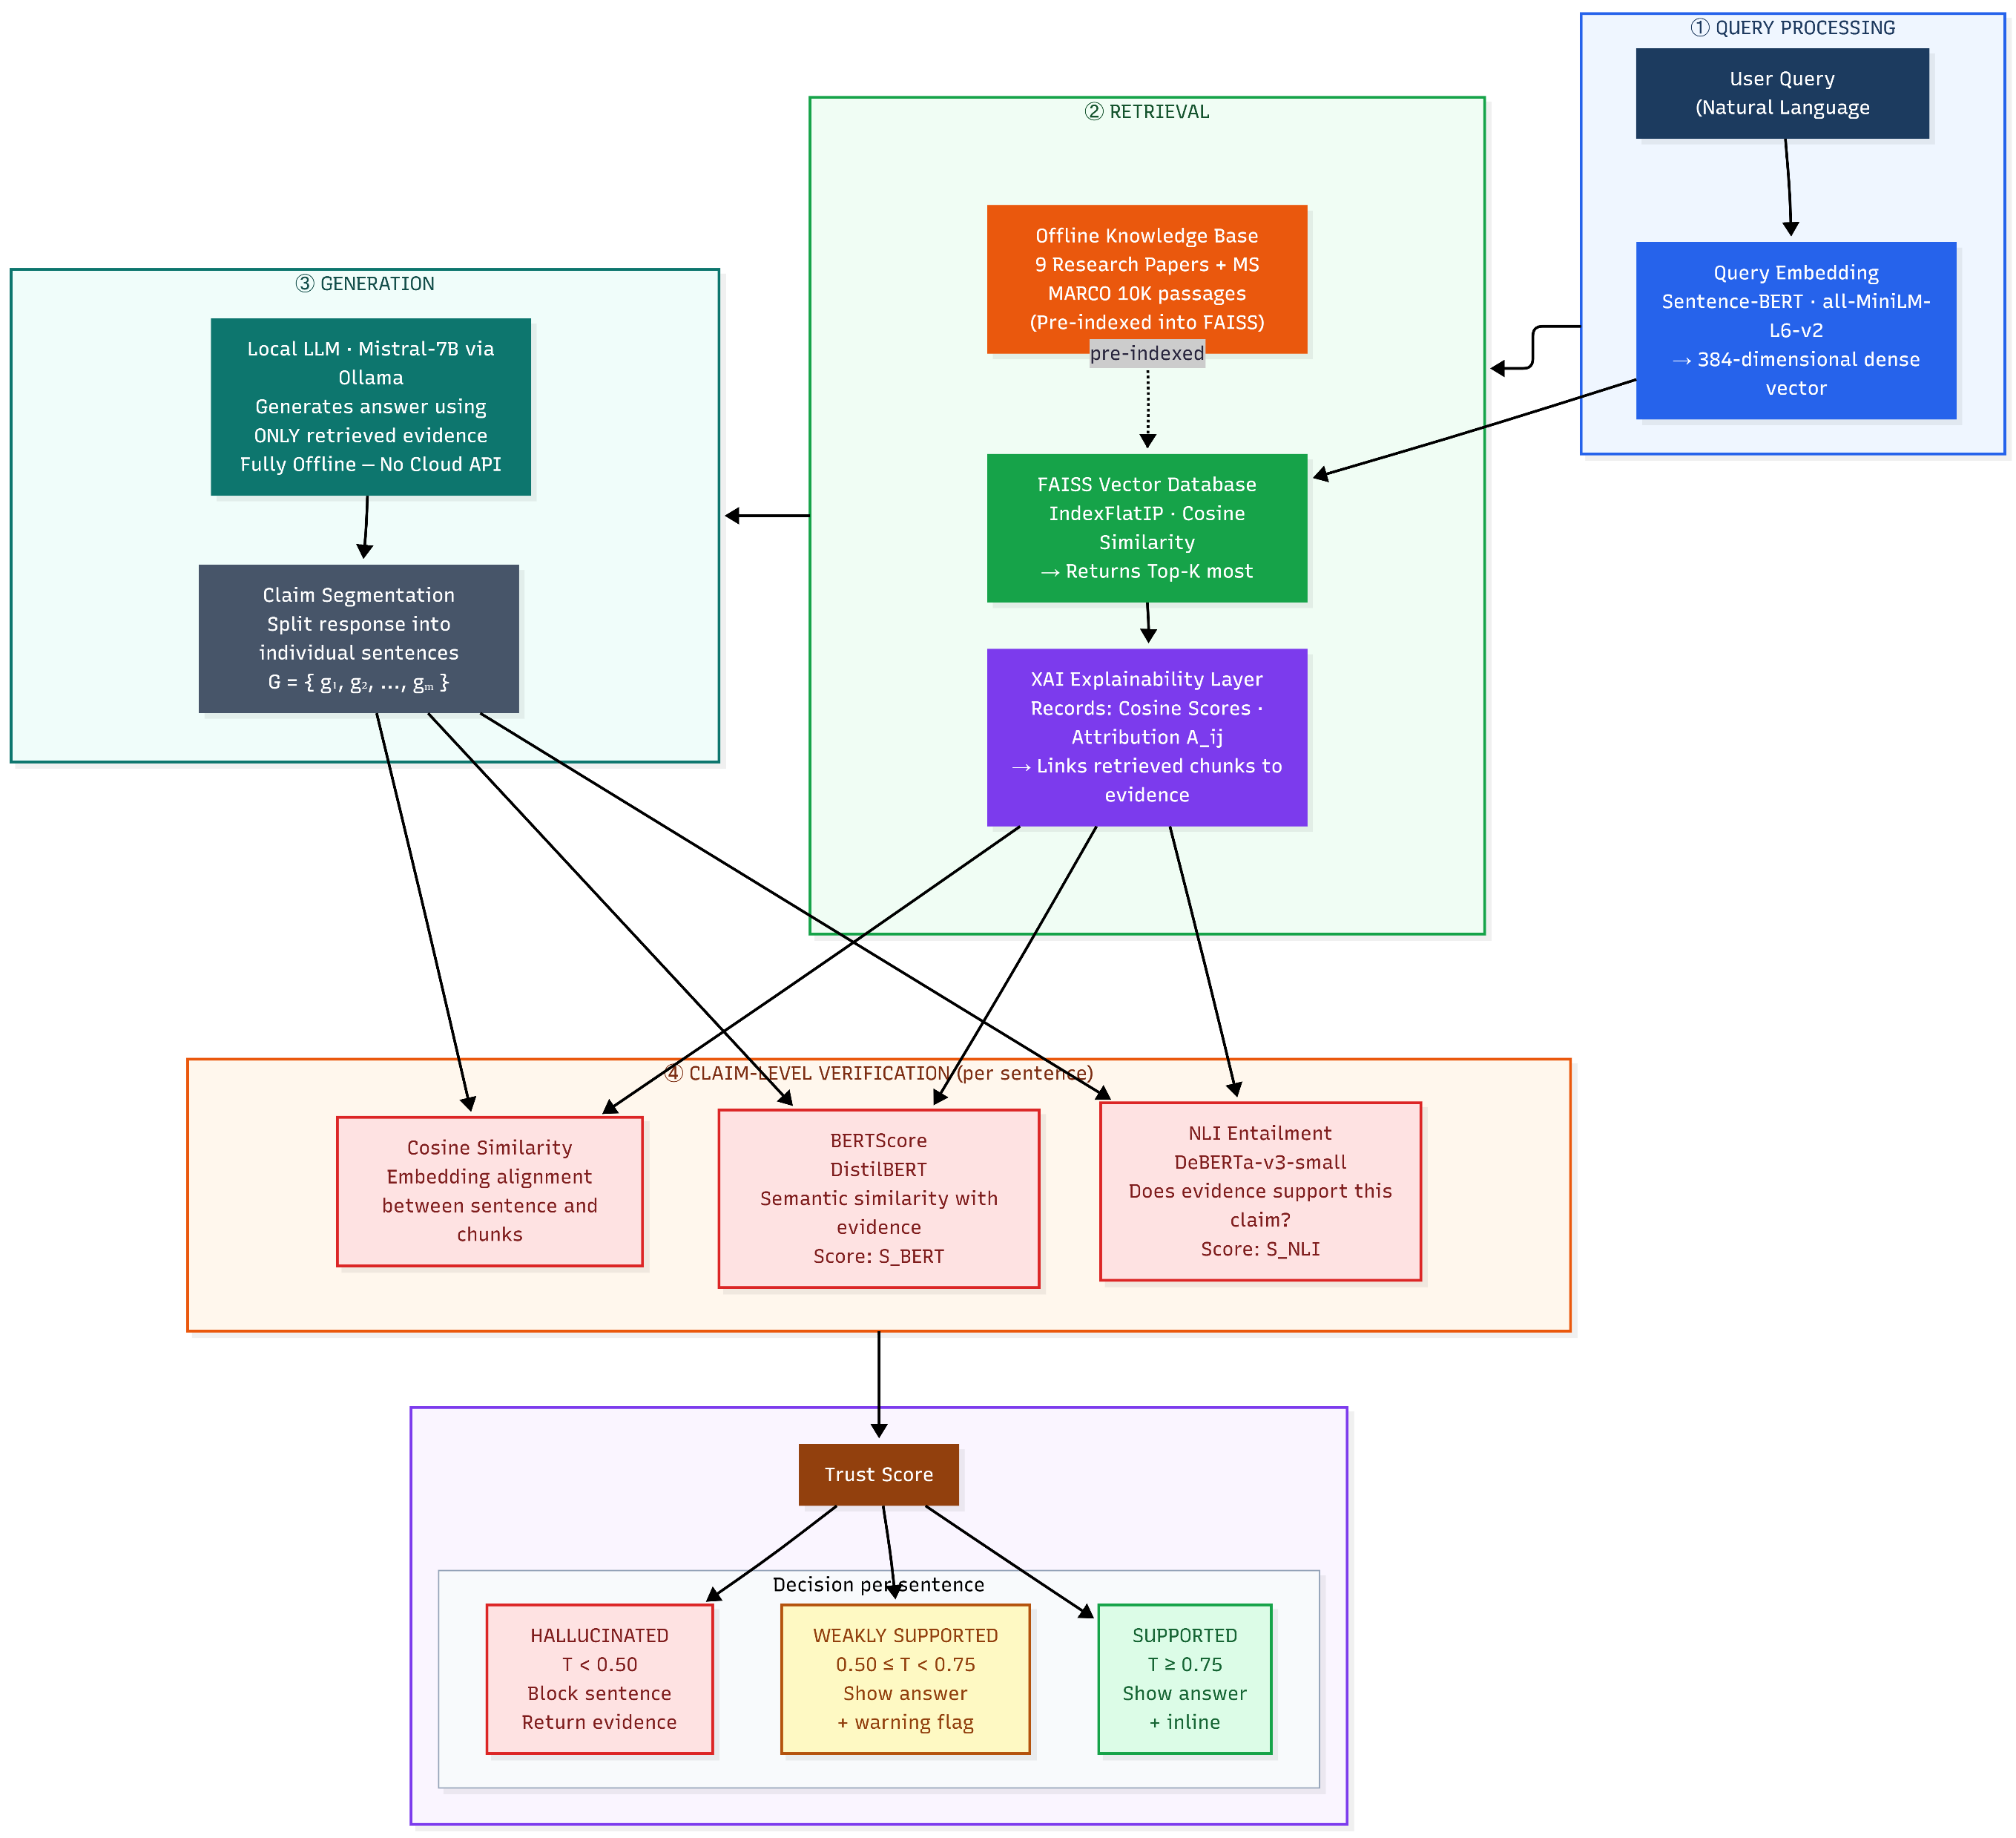
Architecture Diagram

Slide 6
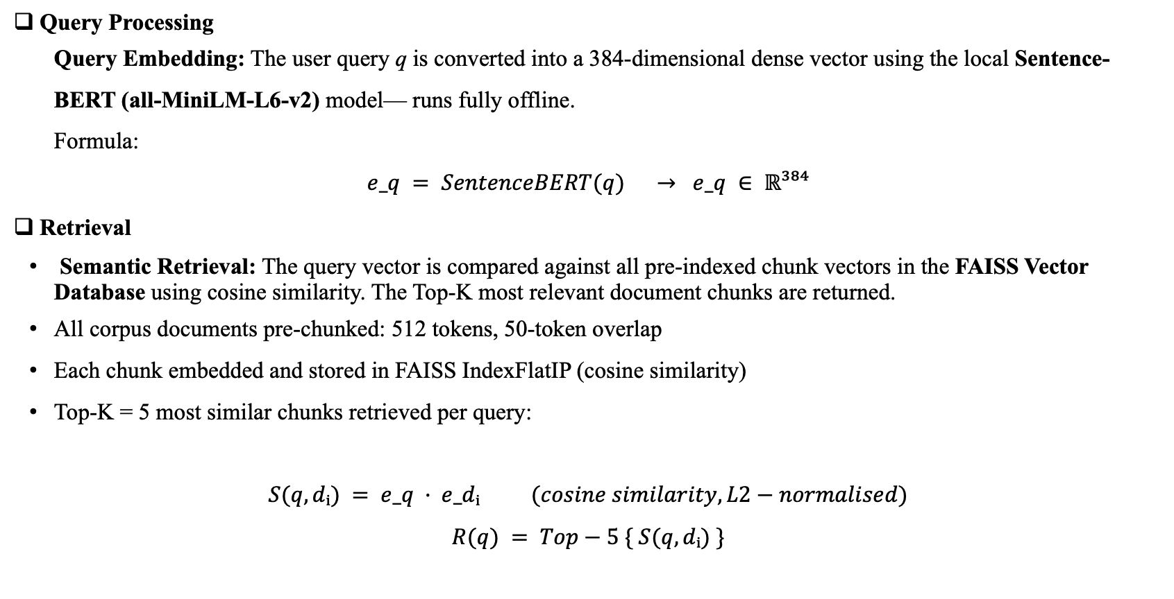
Proposed Methodology: Architecture & Workflow
Query Processing
Query Embedding: The user query q is converted into a 384-dimensional dense vector using the local Sentence-BERT (all-MiniLM-L6-v2) model— runs fully offline.
Formula:
$$e_q = SentenceBERT(q) → e_q ∈ ℝ³⁸⁴$$
Retrieval
Semantic Retrieval: The query vector is compared against all pre-indexed chunk vectors in the FAISS Vector Database using cosine similarity. The Top-K most relevant document chunks are returned.
All corpus documents pre-chunked: 512 tokens, 50-token overlap
Each chunk embedded and stored in FAISS IndexFlatIP (cosine similarity)
Top-K = 5 most similar chunks retrieved per query:
$$S(q, dᵢ) = e_q · e_dᵢ (cosine similarity, L2−normalised)$$

Slide 7
Proposed Methodology: Architecture & Workflow
XAI Explainability Layer
Internal signals captured from retrieval:
Signal | What It Captures
Cosine Similarity Scores | Relevance of each chunk to the query
Chunk Attribution (Aᵢⱼ) | Which chunk best supports each generated sentence
Provenance Score | Fraction of response traceable to evidence
Word Saliency Heatmap | Word-level evidence strength (visual)
Local LLM Response Generation
Local Generation: The retrieved context is passed to the local Mistral-7B model (via Ollama) to generate an evidence-grounded response — fully offline with no cloud API.
Claim Segmentation: The generated response is divided into individual sentence-level claims: G = {g₁, g₂, ..., gₘ}. Each claim is verified independently

Slide 8
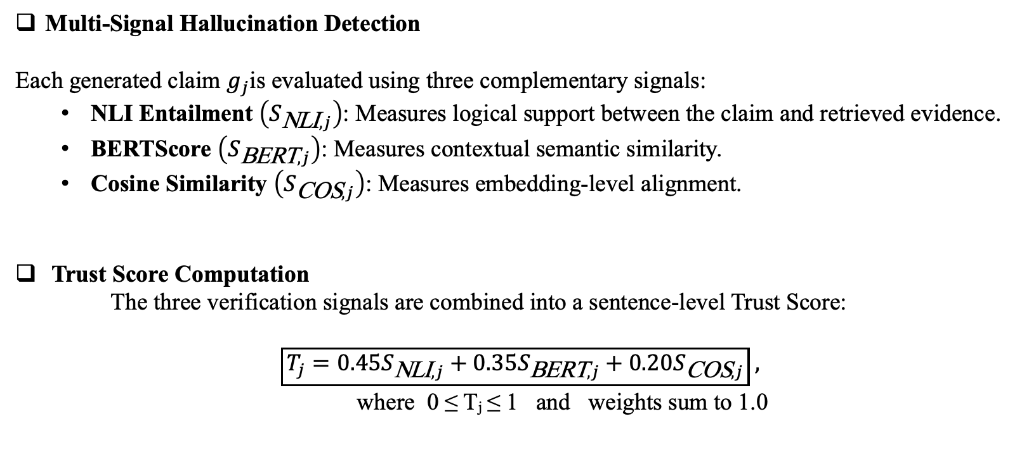
Proposed Methodology:Technical Method
Multi-Signal Hallucination Detection
Each generated claim $g_{j}$is evaluated using three complementary signals:
NLI Entailment $\left(S_{\text{NLI},j}\right)$: Measures logical support between the claim and retrieved evidence.
BERTScore $\left(S_{\text{BERT},j}\right)$: Measures contextual semantic similarity.
Cosine Similarity $\left(S_{\text{COS},j}\right)$: Measures embedding-level alignment.
Trust Score Computation
The three verification signals are combined into a sentence-level Trust Score:
$$\boxed{T_{j}=0.45S_{\text{NLI},j}+0.35S_{\text{BERT},j}+0.20S_{\text{COS},j}} ,$$
where 0 ≤ Tⱼ ≤ 1 and weights sum to 1.0

Slide 9
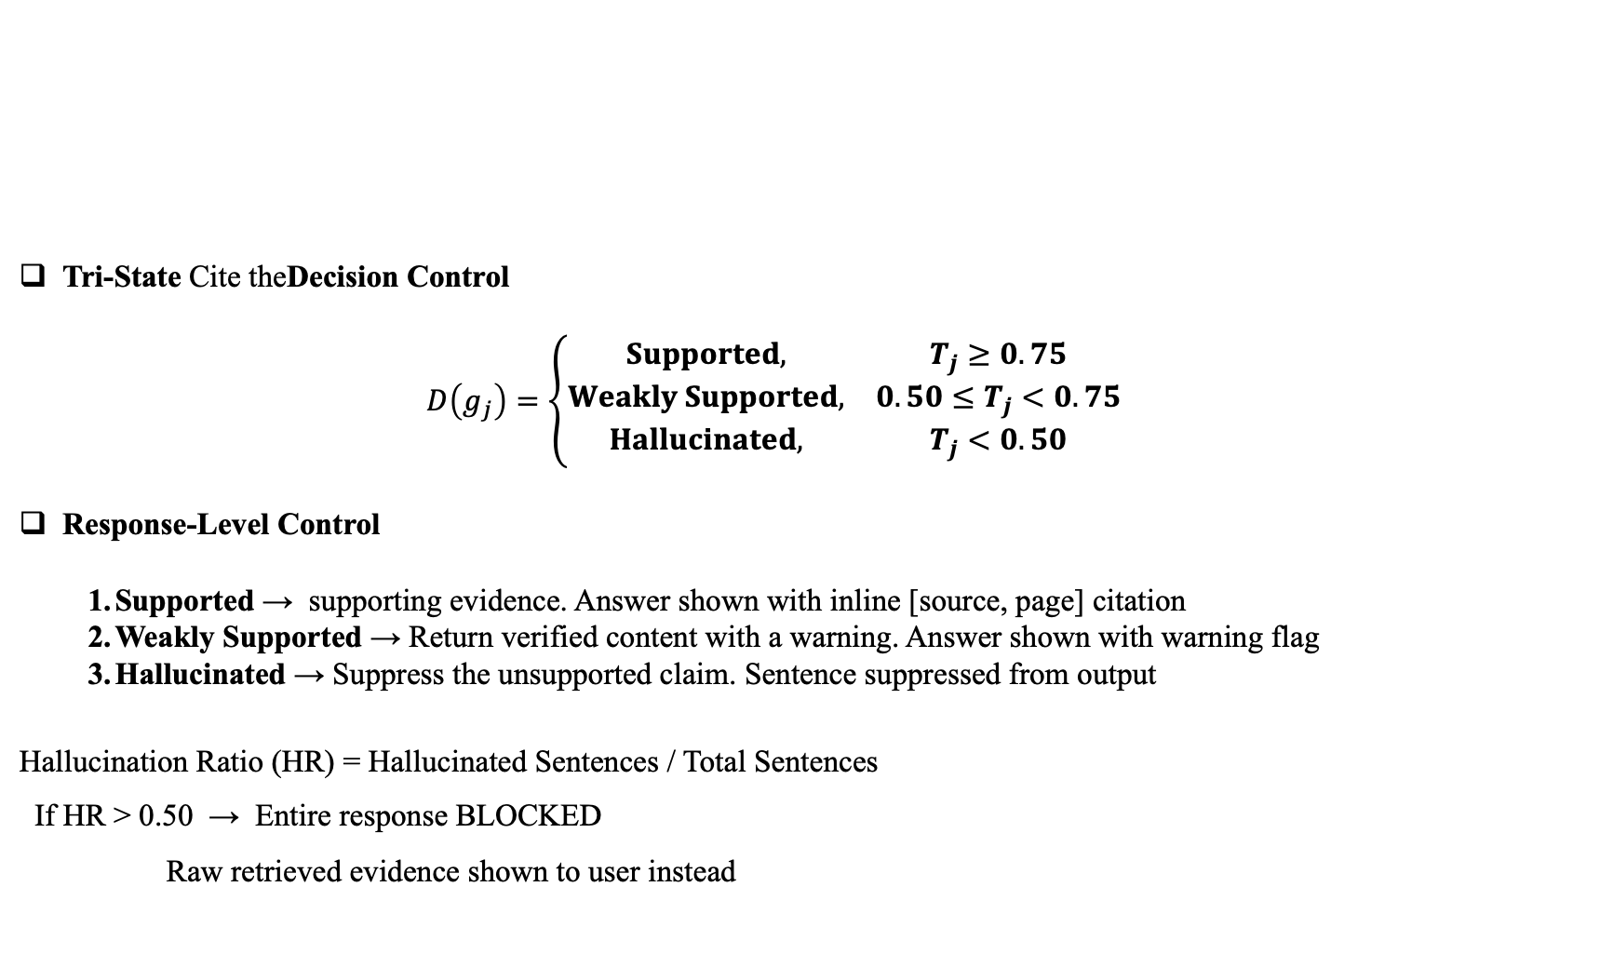
Proposed Methodology: Technical Method
Tri-State Cite theDecision Control
  $$D\left(g_{j}\right)=\left\{\begin{matrix}Supported, & T_{j}≥0.75 \\ Weakly Supported, & 0.50≤T_{j}<0.75 \\ Hallucinated, & T_{j}<0.50\end{matrix}\right.$$
Response-Level Control
Supported → supporting evidence. Answer shown with inline [source, page] citation
Weakly Supported → Return verified content with a warning. Answer shown with warning flag
Hallucinated → Suppress the unsupported claim. Sentence suppressed from output
Hallucination Ratio (HR) = Hallucinated Sentences / Total Sentences
If HR > 0.50 → Entire response BLOCKED
Raw retrieved evidence shown to user instead

Slide 10
Implementation Progress
Module | Status
Ingestion & Chunking | Complete — PDF/DOCX/TXT loaders, 512-token chunks, 50-token overlap
Retrieval | Complete — Sentence-BERT embeddings + FAISS (IndexFlatIP) Top-K search
Generation | Complete — Local LLM via Ollama (Mistral/LLaMA 3), offline fallback if Ollama is down
Explainability (XAI) | Complete — Cosine attribution, provenance score, word-level saliency
Hallucination Detection | Complete — NLI + BERTScore + Cosine combined into Trust Score
Tri-State Controller | Complete — Supported / Weakly Supported / Hallucinated + auto-block
Interactive Dashboard | Complete — Streamlit UI, live sliders, color-coded verdicts
Quantitative Evaluation | Complete — 37 questions / 109 claims, real models, AUC-ROC 0.70
Knowledge Base | 22 documents, 213 indexed chunks (incl. MS MARCO distractors)

Slide 11
Standard Algorithms
Algorithm / Method | Component | Purpose
Sentence-BERT (all-MiniLM-L6-v2) | Semantic Embedding | Generate dense semantic representations of documents and queries
FAISS IndexFlatIP | Vector Retrieval | Perform exact similarity-based Top-K chunk retrieval
DeBERTa-v3 NLI Cross-Encoder | Entailment Detection | Identify logical support, neutrality, or contradiction between claims and evidence
BERTScore (DistilBERT) | Semantic Similarity | Measure contextual semantic similarity between generated claims and retrieved evidence
Cosine Similarity | Evidence Attribution | Measure similarity between a generated claim and supporting evidence chunks
512-token Sliding Window | Text Chunking | Divide documents into manageable overlapping chunks for retrieval
Trust Score Aggregation | Multi-Signal Verification | Combine NLI, BERTScore, and cosine similarity into a unified trust score
Tri-State Decision Logic | Response Decision | Classify claims as Supported, Weakly Supported, or Hallucinated

Slide 12
Evaluation Metrics
Category | Metric | Purpose
Hallucination Detection | Precision | Measure correctly detected hallucinations
Hallucination Detection | Recall | Measure how many hallucinations are detected
Hallucination Detection | F1-Score | Balance precision and recall
Hallucination Detection | AUC-ROC | Measure overall classification performance
Retrieval | Recall@K | Measure relevant evidence retrieved in Top-K
Retrieval | MRR | Measure ranking quality of the relevant evidence
Retrieval | NDCG@K | Measure quality of ranked retrieval results
Explainability | Provenance Score | Measure how strongly generated claims are traceable to retrieved evidence

Slide 13
Tools & Methods — Hands-on Implementation
Tool / Library | Role in TrustRAG | Why it was chosen
Ollama | Local LLM Engine | Runs tinyllama locally in 4-bit quantization on CPU
Python requests | LLM Orchestration | Direct API calls to localhost:11434 (No LangChain needed)
Python re (Regex) | Text Processing | Pure Python sentence splitting (No NLTK dependency)
sentence-transformers | Embedding Generation | Generates 384-dimensional vectors efficiently
faiss-cpu | Vector Database | Industry standard for scalable vector indexing
transformers (HuggingFace) | NLI Inference | Runs the DeBERTa-v3-small model locally
bert-score | Semantic Scoring | Computes F1 token overlap score
streamlit & plotly | User Interface | Builds the chat dashboard and explainability heatmaps

Slide 14
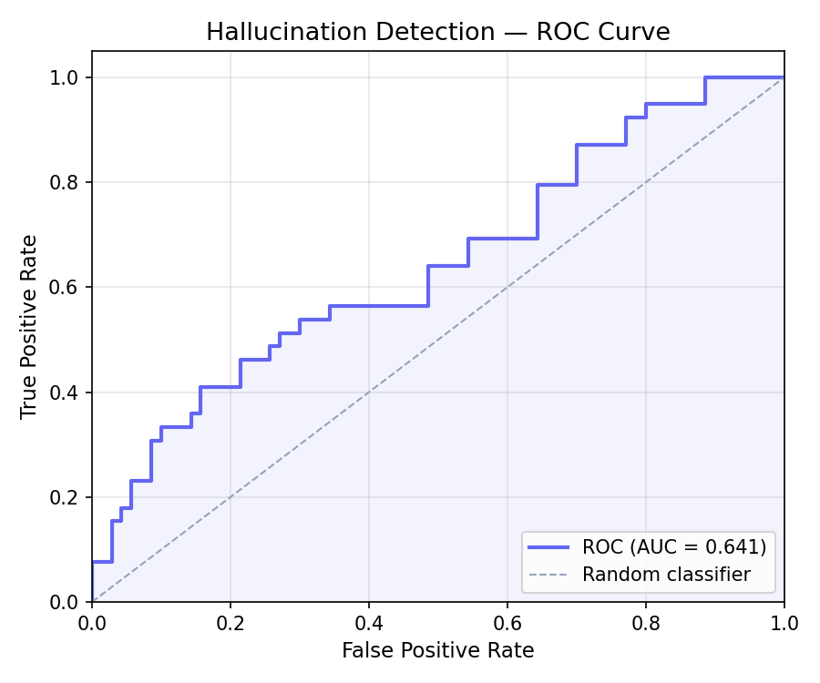
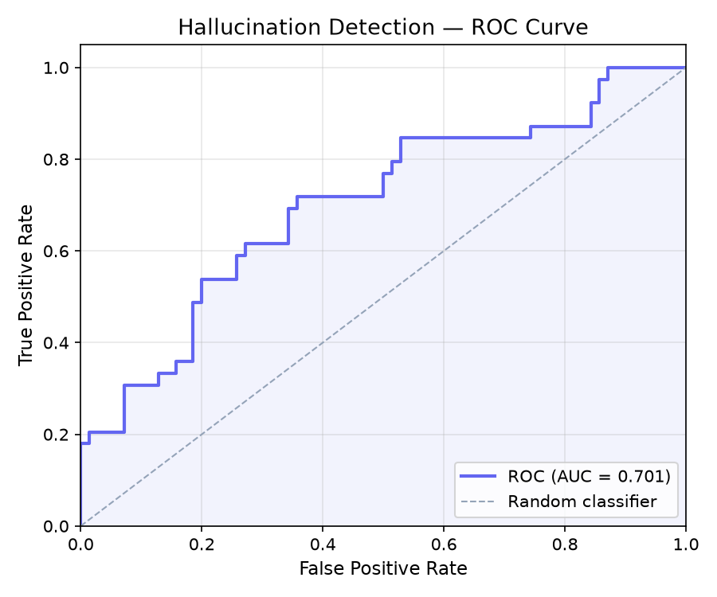
Preliminary Verification & Results
Multi-Signal Hallucination Detection
TrustRAG Detection Performance (Shipped Setup):
AUC-ROC: 0.641 (vs 0.599 whole-chunk)
Best-F1 Score: 0.557 (at 0.80 threshold)
Accuracy: 57.8% (at default 0.50 cutoff)
Signal Used | AUC-ROC | Best-F1
NLI Only | 0.604 | 0.506
BERTScore Only | 0.787 | 0.667
Cosine Only | 0.564 | 0.546
TrustRAG (All 3) | 0.641 | 0.557

Slide 15
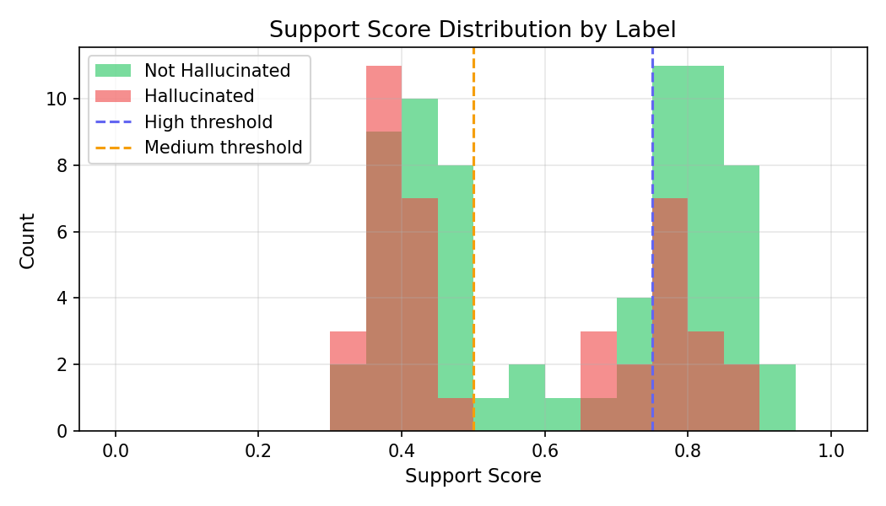
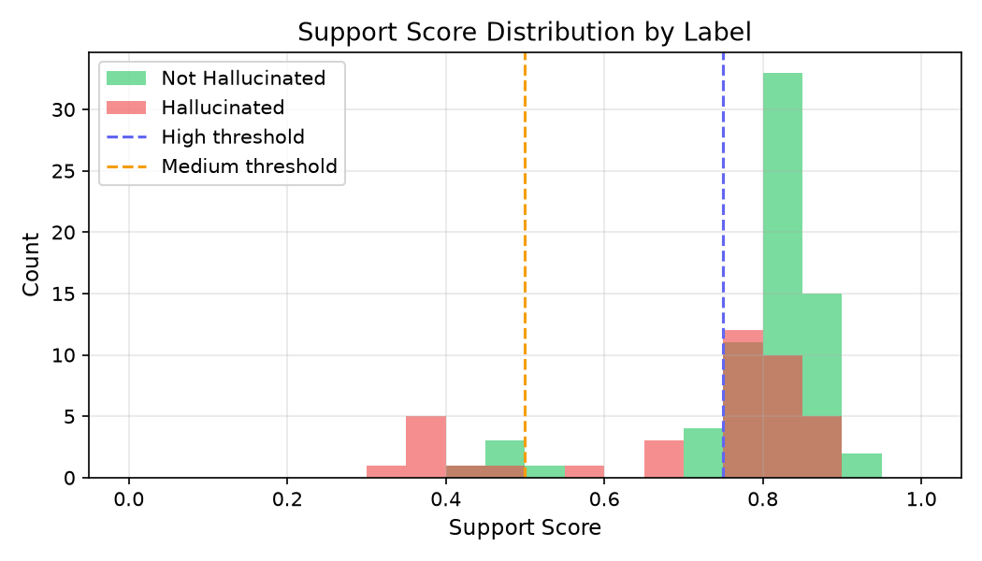
Preliminary Verification & Results
Retrieval Quality & Tri-State Control
FAISS Retrieval Performance (Top-5)
Recall@5: 0.851
MRR (Mean Reciprocal Rank): 0.811
NDCG@5: 0.805
Tri-State Classification Breakdown
When running the 109 claims through the Tri-State Controller:
Actual Ground Truth | Classified as Supported | Classified as Weak | Classified as Hallucinated
Truly Supported (70) | 45.7% | 12.9% | 41.4%
Truly Hallucinated (39) | 30.8% | 12.8% | 56.4%
Limitation: small near-miss benchmark; thresholds/weights not yet calibrated — adaptive calibration and a larger benchmark are the next step

Slide 16
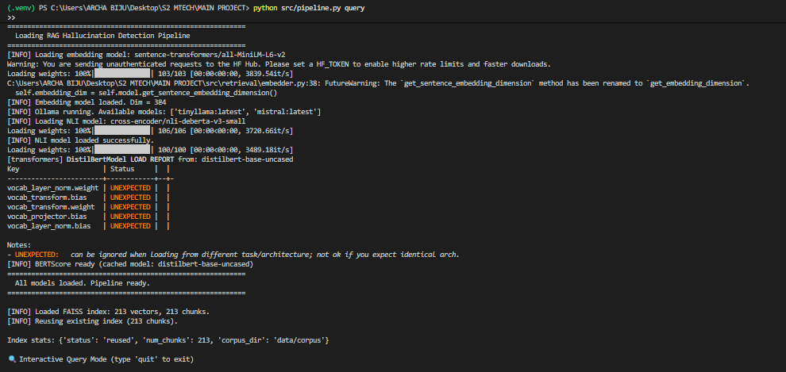
Results

Slide 17
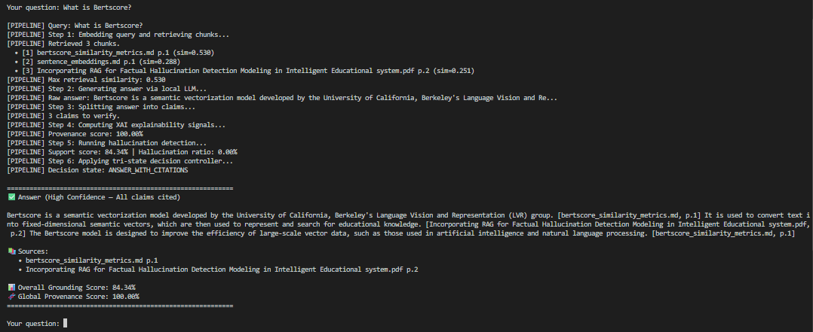
Results

Slide 18
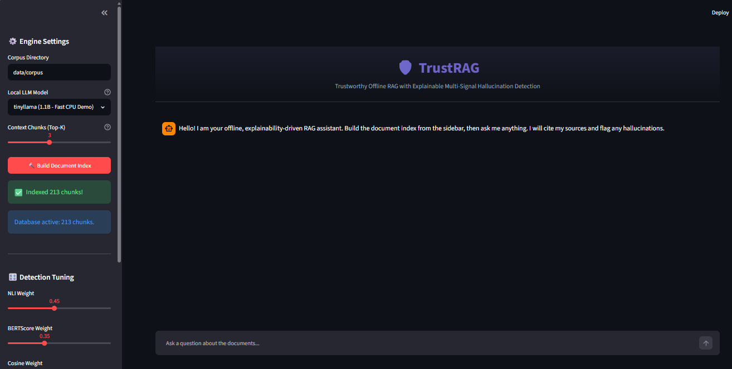
Results

Slide 19
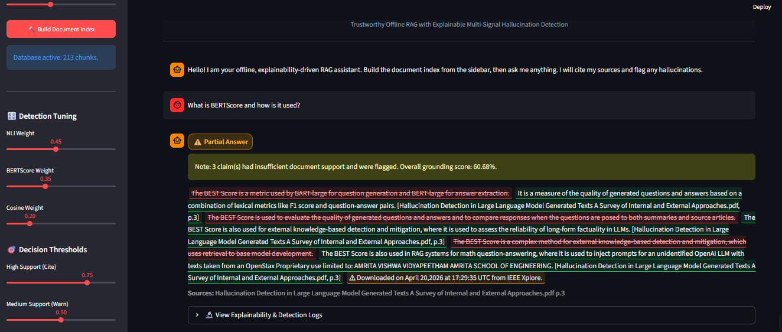
Results

Slide 20
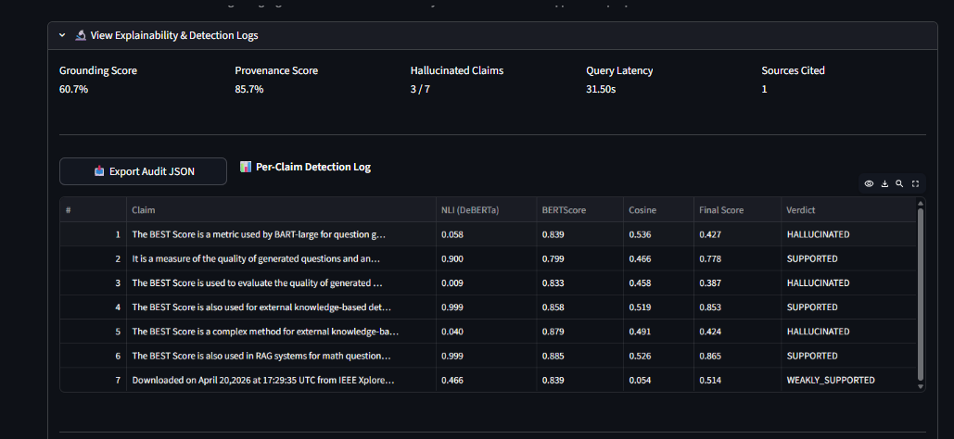
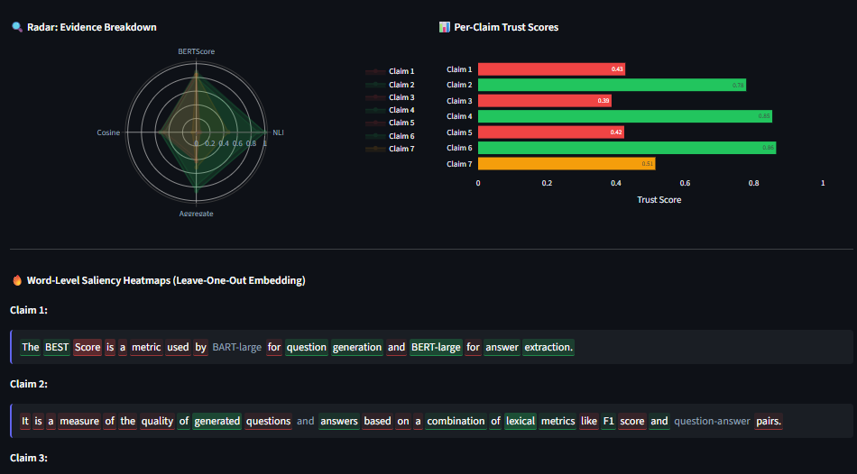
Results

Slide 21
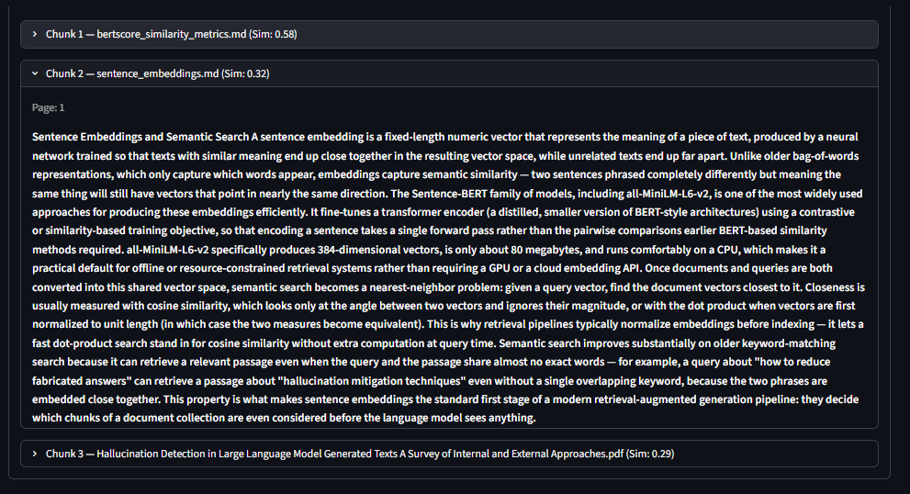
Results

Slide 22
Datasets
1. Local Technical Knowledge Corpus
Source: 22 documents — 12 curated domain notes plus research papers and project reports (~12 MB)
Domain: RAG architecture, embeddings, FAISS, NLI, BERTScore, XAI, hallucination detection, evaluation
Indexed: Chunked into 213 passages (512 tokens, 50-token overlap) — the live FAISS index
Purpose: Primary knowledge base for retrieval, generation, and claim-level hallucination detection
2. MS MARCO Benchmark Dataset
Source: Microsoft Machine Reading Comprehension (MS MARCO)
Scale: Large-scale benchmark containing real user queries and web passages
Current Experiment Subset: 2,000 passages (119 chunks) merged into the live FAISS index
Purpose: Retrieval distractors — stress-tests whether the system still retrieves the right evidence when surrounded by irrelevant passages
3. Hand-Labelled Claim Benchmark
Source: Built in-house against the local corpus (evaluation/test_set.json)
Scale: 37 questions / 109 claims (70 supported, 39 hallucinated)
Purpose: Ground truth for measuring real detection performance — Trust Score AUC-ROC 0.70, Recall@5 0.85

Slide 23
Technical Enrichment Activities — Update
Activity | Applied In Implementation | Status
1. RAG & Vector Database Learning | FAISS-based retrieval module (embedder.py, faiss_store.py) | Applied — Complete
2. Explainable AI (XAI) Study | Evidence attribution & provenance layer (xai_layer.py) | Applied — Complete
3. Hallucination Detection & Evaluation | NLI + BERTScore detection engine (nli_detector.py, bertscore_detector.py, hallucination_engine.py) | Applied — Complete

Slide 24
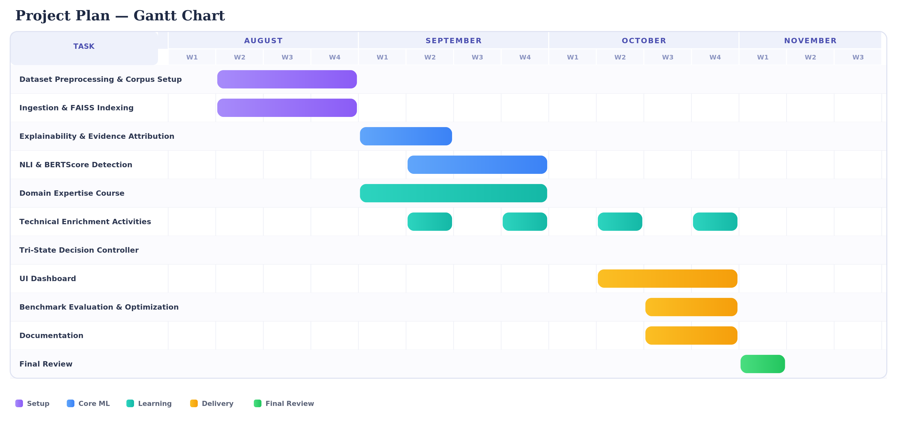
Project Plan for Semester 3 — Progress
Task | Status
Document ingestion & chunking | Complete (Phase 1)
Sentence-BERT embeddings + FAISS retrieval | Complete (Phase 1)
Local LLM generation via Ollama | Complete
XAI evidence-attribution layer | Complete
NLI + BERTScore + cosine detection | Complete
Tri-state decision controller | Complete
Streamlit verification dashboard | Complete
Full quantitative evaluation (real models, annotated test set) | In Progress
MS MARCO merge & benchmark retrieval evaluation | Planned
Signal-ablation study | Planned
Baseline comparison (conventional RAG vs. this system) | Planned
IEEE paper — methodology & implementation sections | In Progress
Final review preparation | Planned

Slide 25
Domain Expertise Course — Plan & Progress
Selected Course: RAG with Python: Build Chatbots That Talk to Your Data
Platform: Udemy
Duration: 10 Hours 34 Minutes
Relevance: Covers the end-to-end RAG pipeline — document processing, chunking, embeddings, vector databases, retrieval, and evaluation/groundedness — directly supporting this implementation.
Module | Status
Enrolled / Guide approval obtained | Complete
Module 1: Introduction to RAG | Complete
Module 2: Semantic Search & Embeddings | Complete
Module 3: Advanced Retrieval Strategies | Complete
Module 4: Evaluation & Trust in RAG | Complete

Slide 26
Conclusion
The complete offline RAG pipeline — ingestion, retrieval, generation, XAI attribution, multi-signal detection, and tri-state control — is implemented and integrated end-to-end.
Developed TrustRAG, a fully offline RAG hallucination detection framework.
Integrated NLI + BERTScore + Cosine Similarity for multi-signal verification.
Implemented Tri-State Decision: Supported / Weakly Supported / Hallucinated.
Achieved AUC-ROC = 0.701 in the current evaluation.
Future Scope
NLI model optimization for lower latency
Large-scale evaluation using MS MARCO
  Complete large-scale evaluation (Precision / Recall / F1 / AUC-ROC) against an annotated test set.
  Merge the MS MARCO subset and report retrieval metrics (Recall@K, MRR, NDCG).
  Run the signal-ablation study and the baseline (conventional RAG) comparison.

Slide 27
References
[1] T. B. Brown et al., “Language Models are Few-Shot Learners,” NeurIPS, vol. 33, pp. 1877–1901, 2020.
[2] Z. Ji et al., “Survey of Hallucination in Natural Language Generation,” 2023.
[3] Z. Ji et al., “A Survey on Hallucination in Large Language Models: Principles, Taxonomy, Challenges, and Open Questions,” 2025.
[4] P. Lewis et al., “Retrieval-Augmented Generation for Knowledge-Intensive NLP Tasks,” NeurIPS, vol. 33, pp. 9459–9474, 2020.
[5] K. Guu et al., “REALM: Retrieval-Augmented Language Model Pre-Training,” 2020.
[6] V. Karpukhin et al., “Dense Passage Retrieval for Open-Domain Question Answering,” EMNLP, pp. 6769–6781, 2020.
[7] K. Shuster et al., “Retrieval Augmentation Reduces Hallucination in Conversation,” Findings of ACL: EMNLP, pp. 3784–3803, 2021.
[8] P. Manakul, A. Liusie, and M. J. F. Gales, “SelfCheckGPT: Zero-Resource Black-Box Hallucination Detection for Generative Large Language Models,” EMNLP, pp. 9004–9017, 2023.
[9] S. Min et al., “FActScore: Fine-Grained Atomic Evaluation of Factual Precision in Long-Form Text Generation,” 2023.
[10] S. Es et al., “RAGAS: Automated Evaluation of Retrieval-Augmented Generation,” EACL, pp. 150–158, 2024.

Slide 28
References
[11] M. T. Ribeiro, S. Singh, and C. Guestrin, “Why Should I Trust You?: Explaining the Predictions of Any Classifier,” KDD, pp. 1135–1144, 2016.
[12] S. M. Lundberg and S.-I. Lee, “A Unified Approach to Interpreting Model Predictions,” NeurIPS, vol. 30, 2017.
[13] S. Bowman et al., “A Broad-Coverage Challenge Corpus for Sentence Understanding through Inference,” 2018.
[14] W. Kryściński et al., “Evaluating the Factual Consistency of Abstractive Text Summarization,” 2020.
[15] P. Laban et al., “SummaC: Revisiting NLI-Based Models for Inconsistency Detection in Summarization,” 2022.
[16] O. Honovich et al., “TRUE: Re-evaluating Factual Consistency Evaluation,” 2022.
[17] P. He et al., “DeBER Ta-v3: Improving DeBERTa Using ELECTRA-Style Pre-training with Gradient-Disentangled Embedding Sharing,” 2023.
[18] T. Zhang et al., “BERTScore: Evaluating Text Generation with BERT,” ICLR, 2020.
[19] J. Devlin et al., “BERT: Pre-training of Deep Bidirectional Transformers for Language Understanding,” 2019.
[20] A. Vaswani et al., “Attention Is All You Need,” NeurIPS, 2017.

Slide 29
References
[21] N. Reimers and I. Gurevych, “Sentence-BERT: Sentence Embeddings Using Siamese BERT-Networks,” EMNLP-IJCNLP, pp. 3982–3992, 2019.
[22] J. Johnson, M. Douze, and H. Jégou, “Billion-Scale Similarity Search with GPUs,” IEEE Transactions on Big Data, vol. 7, no. 3, pp. 535–547, 2021.
[23] A. Grattafiori et al., “The Llama 3 Herd of Models,” 2024.
[24] RLSeek authors, “RLSeek: Evidence-Grounded Reasoning for RAG Hallucination Detection,” ACL, 2026.
[25] Evidence-Aligned authors, “Evidence-Aligned Entity Verification for Hallucination Detection in Retrieval-Augmented Generation,” Findings of ACL, 2026.
[26] Rethinking Evaluation authors, “Rethinking Evaluation for LLM Hallucination Detection: A Desiderata, A New RAG-Based Benchmark, and New Insights,” 2026.
[27] Logic Matters authors, “Logic Matters in Lightweight Hallucination Classification for RAG Systems,” 2026.
[28] MARCH authors, “MARCH: Multi-Agent Reinforced Check for Hallucination,” 2026.
[29] Faithfulness-Aware authors, “Faithfulness-Aware Uncertainty Quantification for Fact-Checking the Output of Retrieval-Augmented Generation,” 2026.
[30] Healthcare RAG review authors, “Retrieval Augmented Generation for Large Language Models in Healthcare: A Systematic Review,” 2025.

Slide 30
THANK YOU

