Slide 1
24CS798 Project Review-1
Project Title | TrustRAG: A Trustworthy Offline Retrieval-Augmented Generation Framework with Explainable Multi-Signal Hallucination Detection
Name Of the Scholar | ARCHA BIJU
Roll No: | CB.SC.P2CSE25001
Campus/School (or Center) | Department of CSE, Amrita School of Computing, AVV, Coimbatore.
Date of Review | 29-08-2026
Notes:
OM

Slide 2
Introduction
Large Language Models (LLMs) have demonstrated strong capabilities in natural language understanding, reasoning, and text generation.
LLMs are increasingly used in knowledge-intensive applications such as healthcare, finance, education, legal services, and scientific research.
Despite their capabilities, LLMs can generate hallucinations, producing information that is fluent but factually incorrect or unsupported.
Retrieval-Augmented Generation (RAG) addresses this issue by retrieving relevant information from external knowledge sources to ground LLM responses.
RAG combines information retrieval with language generation, improving the factual consistency of generated responses.
However, ensuring that generated responses are reliably supported by retrieved evidence remains an important challenge.
Notes:
AUM

Slide 3
Problem Statement
Despite retrieval support, RAG systems can generate hallucinated responses that are weakly supported or unsupported by retrieved evidence, especially in offline settings.
Existing approaches provide limited integration of explainability signals for hallucination detection and control.
This project addresses the problem of detecting and controlling hallucinations using internal explainability signals within the RAG pipeline to ensure trustworthy, evidence-grounded generation.
Notes:
AUM

Slide 4
Research Gap Identified
Lack of unified integration: Existing approaches do not simultaneously integrate semantic retrieval, evidence attribution, hallucination detection, and trust assessment.
Limited inherent explainability: Explainability is often treated as an after-the-fact analysis rather than being integrated into response validation.
Absence of quantitative trust assessment: Most RAG systems lack a unified Trust Score to quantify the reliability of generated responses.
Incomplete hallucination detection: Existing methods often rely on a single verification signal, limiting robust identification of unsupported responses.
Limited offline deployment: Many existing approaches depend on cloud-based infrastructures, making them unsuitable for privacy- and security-sensitive environments.
Need for response-level validation: There is a need for a framework that provides evidence-grounded, explainable, and trust-aware validation of generated responses.
Notes:
AUM

Slide 5
Objectives & Deliverables
Objectives
Develop an offline RAG framework (TrustRAG) for trustworthy response generation.
Implement semantic retrieval using Sentence-BERT and FAISS.
Integrate evidence attribution for transparent response generation.
Develop multi-signal hallucination detection using NLI, BERTScore, and cosine similarity.
Generate a Trust Score to quantify response reliability.
Control and classify hallucinated outputs as Supported, Weakly Supported, or Hallucinated.
Deliverables
TrustRAG system architecture and workflow
Local semantic retrieval module using Sentence-BERT + FAISS
Evidence attribution and provenance module
Multi-signal hallucination detection module
Trust Score and tri-state decision mechanism
Working offline RAG prototype
Performance evaluation against a baseline RAG system
Notes:
AUM

Slide 6
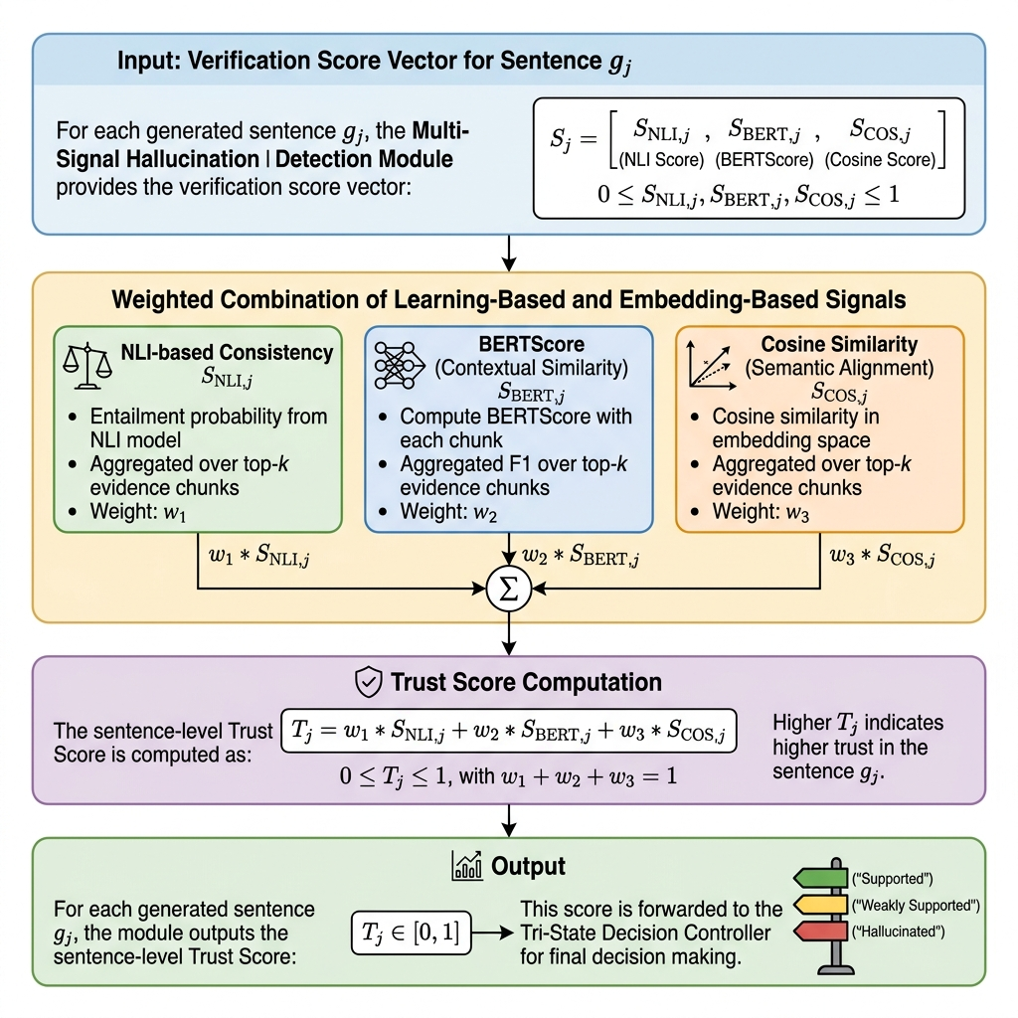
Architectural Diagram
Notes:
AUM

Slide 7
Proposed Methodology: Overall Workflow
Input: User query
Semantic Retrieval: Sentence-BERT embeddings + FAISS retrieve relevant evidence.
Response Generation: LLM generates a response using retrieved evidence.
Evidence Attribution: Map retrieved documents/chunks to generated sentences using provenance and cosine similarity.
Multi-Signal Verification:
  NLI → logical consistency
  BERTScore → contextual semantic similarity
  Cosine Similarity → embedding-level alignment
Trust Score: Combine verification signals into a sentence-level reliability score.
Tri-State Decision: Classify sentences as Supported / Weakly Supported / Hallucinated.
Response Control: Retain or suppress the response based on the hallucination ratio.
Workflow to show visually
User Query → Sentence-BERT → FAISS Retrieval → LLM Response → Evidence Attribution → NLI + BERTScore + Cosine Similarity → Trust Score → Tri-State Decision → Final Response
Notes:
AUM

Slide 8
Proposed Methodology:Proposed Architecture / Technical Method
1. Semantic Retrieval
Convert documents and query into Sentence-BERT embeddings.
Store document embeddings in local FAISS index.
Retrieve top-k relevant evidence.
2. Evidence Attribution
Calculate evidence–sentence similarity.
Track supporting document/chunk for each generated sentence.
Provide provenance information.
3. Multi-Signal Hallucination Detection
NLI: Measures whether evidence entails the generated claim.
BERTScore: Measures semantic similarity between evidence and response.
Cosine Similarity: Measures embedding alignment.
4. Trust-Aware Validation
Combine the three signals into a Multi-Signal Trust Score.
Apply predefined thresholds:
  Supported
  Weakly Supported
  Hallucinated
Notes:
AUM

Slide 9
Proposed Methodology:Response Control + Evaluation
Response-Level Control
Calculate Hallucination Ratio:
Hallucination Ratio = Hallucinated Sentences / Total Generated Sentences
If ratio exceeds the suppression threshold → Response suppressed.
Otherwise → Response retained with evidence and provenance.
Provides both sentence-level reliability and response-level safety control.
Dataset & Implementation
Knowledge/Document Dataset: MS MARCO
Document preprocessing and chunking
Sentence-BERT embedding generation
FAISS vector database construction
Baseline RAG implementation
TrustRAG verification modules
Offline/local deployment
Evaluation Strategy
Evaluate TrustRAG against baseline RAG using:
Hallucination detection performance
Factual consistency
Retrieval performance
Semantic similarity
Trust Score reliability
Response suppression/control effectiveness
Provenance and explainability
Notes:
AUM

Slide 10
Literature Review
Paper | Methodology | Techniques Used | Strengths | Limitations
Lewis et al. (2020) | Baseline RAG (DPR + Sequence Gen) | High hallucination rate (18.6%); no verification | Addressed in TrustRAG | High computational cost, requires large datasets, not lightweight
Kryściński (2020) | FactCC (Weakly Supervised NLI) | Binary classification; limited to summarization | Addressed via Tri-State | Limited contextual understanding, lower adaptability to complex attacks
Manakul et al. (2023) | SelfCheckGPT (Sampling Consistency) | Extreme latency (5-10 LLM samples required) | Deterministic single-pass | Resource-intensive, less suitable for real-time lightweight systems
Min et al. (2023) | FActScore (Atomic Fact Extraction) | Requires online Wikipedia / web searches | 100% Offline execution | Reveals lack of explainability and hybrid deployment models
Es et al. (2024) | RAGAS (Automated RAG Evaluation) | Post-hoc evaluation; no real-time response filter | Real-time decision control | Limited deep semantic understanding compared to transformers
Notes:
AUM

Slide 11
Tools, Technologies & Experimental Setup
Component | Tool / Library | Purpose
Embedding Model | all-MiniLM-L6-v2 | 80MB, fast CPU inference, 384-dim normalized dense vectors
Vector Database | FAISS (FlatIP, IVF-PQ, HNSW) | In-memory C++ backend, sub-millisecond graph & quantized lookup
Local LLM Generator | Mistral-7B / Llama-3-8B (Ollama) | 4-bit quantized GGUF models running locally on consumer hardware
NLI Cross-Encoder | cross-encoder/nli-deberta-v3-small | Fine-tuned DeBERTa for sentence-level Entailment/Neutral/Contradiction
Semantic Overlap | BERTScore (Local) | Contextual token similarity without calling cloud services
User Interface | Streamlit Dashboard | Interactive UI visualizing citation colors, heatmaps, and Trust Scores
Notes:
AUM

Slide 12
Key Outcomes (as on)
Project Outcomes (Planned)
Actual Status
• Offline TrustRAG framework for trustworthy RAG. | • TrustRAG concept and objectives finalized.
• Semantic retrieval using Sentence-BERT and FAISS. | • MS MARCO dataset selected and downloaded.
• Explainable evidence attribution and provenance tracking. | • Architecture and methodology prepared Research Documentation: Prepared comprehensive journal and conference paper draft covering architecture, formulas, and baseline evaluation plans.
• Multi-signal hallucination detection using NLI, BERTScore and cosine similarity. | • Verification approach and evaluation metrics defined.
• Trust Score and tri-state response validation. | • Initial implementation planning completed.
• Evaluation against baseline RAG. | • Implementation initiated; full evaluation planned for Semester 3.

Slide 13
SDG Mapping with Justification
SDG | Mapping | Justification
SDG 9 | Industry, Innovation & Infrastructure | Develops an innovative, secure and offline trustworthy AI framework.
SDG 16 | Peace, Justice & Strong Institutions | Promotes transparent, explainable and accountable AI-generated information.
SDG 3 | Good Health & Well-being | Potential application in reliable, evidence-grounded healthcare systems.
Notes:
AUM

Slide 14
Project Status Update
Targets for the review period ()
Actual Status ()
Problem statement, research gap and objectives finalized.
TrustRAG architecture and methodology prepared.
MS MARCO dataset selected and downloaded; preprocessing initiated.
Initial implementation plan and evaluation strategy defined.
Finalize problem statement, research gap and objectives.
Finalize TrustRAG architecture and methodology.
Select dataset and set up development environment.
Initiate implementation and define evaluation strategy.

Slide 15
Plan for furtherance of Project Outcomes
Period | Research & Implementation | Technical Enrichment / Domain Expertise | Expected Deliverable
August – Week 3–4 | Finalize methodology; prepare MS MARCO dataset and preprocessing pipeline | Finalize/obtain guide approval for RAG certification + 3 technical activities | Dataset ready + finalized implementation plan
September – Week 1–2 | Generate Sentence-BERT embeddings and build FAISS index; implement semantic retrieval | Start RAG Domain Expertise course | Working retrieval module
September – Week 3–4 | Implement baseline RAG with local LLM and retrieved evidence | Continue RAG course | Working baseline RAG + initial results
October – Week 1 | Implement evidence attribution and provenance tracking | Technical Activity 1: Open-Source Technical Repository | Explainability module + GitHub repository

Slide 16
Plan for furtherance of Project Outcomes
October – Week 2 | Implement NLI + BERTScore + Cosine Similarity for hallucination detection | Technical Activity 2: Working Demonstration | Multi-signal verification module
October – Week 3 | Develop Trust Score + Tri-State Decision Controller and response control | Complete RAG course / certification | Complete TrustRAG prototype
October – Week 4 | Conduct evaluation, baseline comparison, error analysis and optimization | Technical Activity 3: Submission-Ready Research Paper | Final results + paper + demo
November – Week 1 | Final testing, documentation and presentation preparation | Submit supporting evidence for activities | Final External Review

Slide 17
Challenges & Opportunities
Challenges
Persistent hallucinations despite retrieval support.
Incomplete or irrelevant evidence can affect response reliability.
Computational overhead from multi-signal verification and evidence attribution.
Trust Score thresholds require careful tuning.
Scalability of semantic retrieval and verification for large document collections.
Domain adaptation may be required for specialized applications.
Opportunities
Trustworthy offline RAG for privacy-sensitive environments.
Improved hallucination detection and response reliability.
Transparent evidence attribution and provenance tracking.
Quantitative trust assessment through the Multi-Signal Trust Score.
Extension to healthcare, legal, enterprise, and other knowledge-intensive domains.
Future support for adaptive thresholds, multi-hop retrieval, and multilingual RAG.

Slide 18
Datasets
MS MARCO – Microsoft Machine Reading Comprehension
Preprocessing Pipeline
> Scale: ~1M real user queries from Bing + ~8.8M passages
> Source: Microsoft Research (publicly available)
Why MS MARCO?
> Represents real-world information-seeking queries
> Human-annotated answers - ideal for factual consistency
> Diverse domains: healthcare, science, general knowledge
> Industry-standard benchmark for RAG and retrieval evaluation
1
10,000 passages selected (dev subset)
2
NLTK tokenization + cleaning
3
Sentence-BERT embeddings
(all-MiniLM-L6-v2)
4
FAISS index for semantic retrieval
5
Fully offline local storage

Slide 19


Thank you

Slide 20
References
P. Lewis et al., “Retrieval-Augmented Generation for Knowledge-Intensive NLP Tasks,” Advances in Neural Information Processing Systems (NeurIPS), vol. 33, pp. 9459–9474, 2020.
V. Karpukhin et al., “Dense Passage Retrieval for Open-Domain Question Answering,” EMNLP, pp. 6769–6781, 2020.
K. Shuster et al., “Retrieval Augmentation Reduces Hallucination in Conversation,” Findings of ACL: EMNLP, pp. 3784–3803, 2021.
P. Manakul, A. Liusie, and M. J. F. Gales, “SelfCheckGPT: Zero-Resource Black-Box Hallucination Detection for Generative Large Language Models,” EMNLP, pp. 9004–9017, 2023.
S. Es et al., “RAGAS: Automated Evaluation of Retrieval-Augmented Generation,” EACL, pp. 150–158, 2024.
M. T. Ribeiro, S. Singh, and C. Guestrin, “Why Should I Trust You?: Explaining the Predictions of Any Classifier,” KDD, pp. 1135–1144, 2016.
S. M. Lundberg and S.-I. Lee, “A Unified Approach to Interpreting Model Predictions,” NeurIPS, vol. 30, 2017.
T. Zhang et al., “BERTScore: Evaluating Text Generation with BERT,” ICLR, 2020.
N. Reimers and I. Gurevych, “Sentence-BERT: Sentence Embeddings Using Siamese BERT-Networks,” EMNLP-IJCNLP, pp. 3982–3992, 2019.
J. Johnson, M. Douze, and H. Jégou, “Billion-Scale Similarity Search with GPUs,” IEEE Transactions on Big Data, vol. 7, no. 3, pp. 535–547, 2021.

Slide 21
SDG Mapping with Justification
SDG 3
Good Health & Well-being
Reduces hallucinations in AI-based medical information systems, improving reliability of AI tools in healthcare Q&A.
SDG 4
Quality Education
Reliable AI tutoring and educational Q&A systems enabled by TrustRAG improve learning outcomes globally.
SDG 9
Industry, Innovation & Infrastructure
Advances responsible AI infrastructure by adding verifiability and explainability to LLM-based knowledge systems.
SDG 16
Peace, Justice & Strong Institutions
Explainable and accountable AI reduces risk of misinformation in institutional knowledge bases.
Primary SDG: SDG 9 – Industry, Innovation and Infrastructure

Slide 22
Implementation & Partial Results
Module | Status | Technology
MS MARCO Preprocessing | ✅ Complete | Python, NLTK
FAISS Index Creation | ✅ Complete | FAISS, Sentence-BERT
Semantic Retrieval Module | ✅ Complete | all-MiniLM-L6-v2
Baseline RAG Pipeline | ✅ Complete | Ollama + LLaMA 3 (local)
Evidence Attribution Module | ✅ Complete | Cosine similarity
Multi-Signal Hallucination Detection | ✅ Complete | NLI (DeBERTa), BERTScore
Decision Controller (Tri-State) | ✅ Complete | Rule-based Python
Explainability (XAI) Layer | ✅ Complete | Custom XAI module
Streamlit UI | ✅ Complete | Streamlit
Key Partial Results
▸ Semantic retrieval returns top-k relevant MS MARCO passages for any natural language query.
▸ NLI + BERTScore + Cosine pipeline detects low-confidence sentences in generated responses.
▸ Trust Score computed per sentence → responses classified as Supported / Weakly Supported / Hallucinated.
▸ Baseline RAG (without TrustRAG) showed hallucinations in ~35% of queries in preliminary tests.
▸ Full quantitative evaluation (ROUGE, Faithfulness, F1) planned for Semester 3 – Oct Week 4.

Slide 23
Project Plan for Semester 3
Period | Research & Implementation | Tech Enrichment / Domain Expertise | Deliverable
Aug W3–W4 | Finalize methodology; MS MARCO preprocessing | Approve RAG certification + 3 activities plan | Dataset ready + implementation plan
Sep W1–W2 | Sentence-BERT embeddings + FAISS index | Start RAG Domain Expertise course | Working retrieval module
Sep W3–W4 | Baseline RAG with local LLM + retrieved evidence | Continue RAG course | Baseline RAG + initial results
Oct W1 | Evidence attribution & provenance tracking | Activity 1: Open-Source GitHub Repository | Explainability module + repo
Oct W2 | NLI + BERTScore + Cosine for hallucination detection | Activity 2: Working Demonstration | Multi-signal verification module
Oct W3 | Trust Score + Tri-State Decision Controller | Complete RAG course / certification | Complete TrustRAG prototype
Oct W4 | Evaluation, baseline comparison & optimization | Activity 3: Research Paper Draft | Final results + paper + demo
Nov W1 | Final testing, documentation & presentation | Submit supporting evidence for activities | All final deliverables ready

Slide 24
Conclusion
TrustRAG: Offline RAG framework for evidence-grounded and trustworthy generation.
Multi-Signal Verification: Combines NLI, BERTScore, and Cosine Similarity for sentence-level Trust Scores.
Tri-State Control: Classifies responses as Supported, Weakly Supported, or Hallucinated.
Explainability & Privacy: Provides evidence provenance and citation mapping with fully offline processing.
Future Scope
Adaptive thresholds, lightweight NLI models, and multi-hop reasoning.

Slide 25
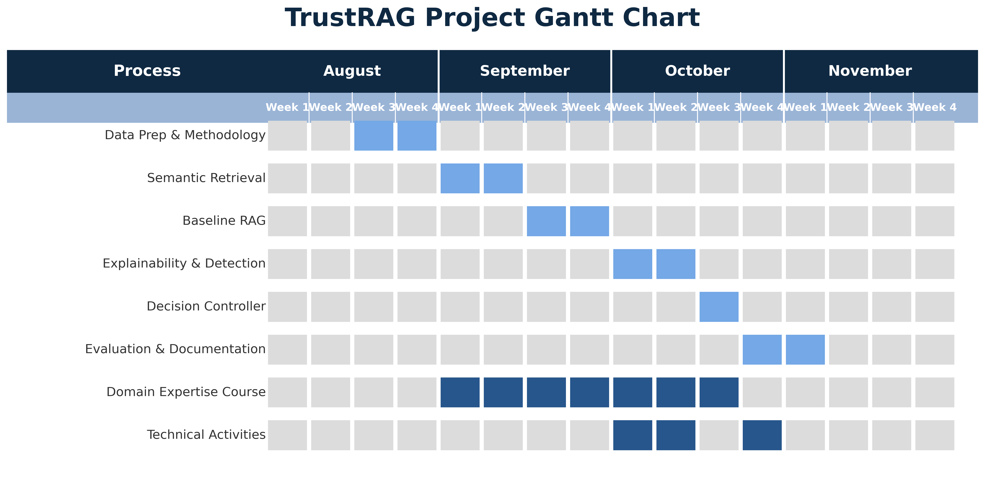
Semester 3 Timeline – GANTT Chart

Slide 26
Domain Expertise Course
Course: RAG with Python: Build Chatbots That Talk to Your Data
Platform: Udemy | Duration: 10 Hours 34 Minutes | Status: Course Details & Summary Retained
Why This Course?
Progress
✔ Directly covers RAG development, semantic search & Python embeddings
✔ Practical vector indexing with FAISS & sentence-transformers
✔ Includes evaluation metrics, faithfulness & hallucination reduction
✔ Satisfies 10–20 hour domain expertise mandate (10h 34m total)
Module | Status
Enrolled / Guide approval obtained | ✅ Complete
Module 1: Introduction to RAG | ✅ Complete
Module 2: Semantic Search & Embeddings | 🔄 In Progress
Module 3: Advanced Retrieval Strategies | ⏳ Sep 2026
Module 4: Evaluation & Trust in RAG | ⏳ Oct 2026
Certification Exam | ⏳ Oct Week 3

Slide 27
Technical Enrichment Activities
Open-Source Technical Repository
🗓 October – Week 1
01
▸ Create a well-documented public GitHub repository for TrustRAG
▸ Includes: source code, README, architecture diagrams, setup instructions
▸ Evidence: GitHub repository link + contribution history
Working Demonstration
🗓 October – Week 2
02
▸ Build & present a live Streamlit demo of TrustRAG
▸ Shows: query → retrieval → generation → Trust Score → Tri-State decision
▸ Evidence: Recorded demo video + screenshots
Submission-Ready Research Paper
🗓 October – Week 4
03
▸ Write a research paper on TrustRAG methodology, experiments & results
▸ Target: ICACDS / INDICON / Springer CCIS
▸ Evidence: Paper draft + submission receipt

