Slide 1

TrustRAG: A Trustworthy Offline Retrieval-Augmented Generation Framework with Explainable Multi-Signal Hallucination Detection
Project Phase 1
Supervisor: Dr Ramya G R
Name | Roll Number | Internship details
ARCHA BIJU | CB.SC.P2CSE25001 | NetApp Banglore

Slide 2
Guide Approval Mail

Slide 3
Introduction and Motivation
Retrieval-Augmented Generation (RAG) improves knowledge access by retrieving relevant documents before generating an answer. However, retrieval alone does not guarantee that every generated statement is supported by the retrieved evidence.
Motivation
Build a knowledge system, not a chatbot.
Retrieve relevant domain-specific documents and explain why they were selected.
Generate answers only after establishing evidence support.
Detect and control unsupported or weakly supported claims.
Enable operation in offline, privacy-sensitive, and resource-constrained environments.
Avoid dependence on cloud APIs, external validation models, and black-box verification.

Slide 4
Problem Statement
Despite retrieval support, RAG systems can still generate statements that are unsupported or weakly supported by retrieved evidence.
Existing hallucination detection approaches often rely on:
External fact-checking or validation models
Heavyweight entailment classifiers
Cloud-based APIs or computationally expensive verification
These approaches can introduce high computational overhead, limited transparency, and dependence on external services, making them less suitable for offline and resource-constrained environments.

Slide 5
Literature Review
Paper / Approach | Key Contribution | Limitation / Relevance to Our Work
Lewis et al. (2020) – RAG | Introduced retrieval-augmented generation by combining retrieved documents with language generation for knowledge-intensive tasks. | Retrieval improves factual grounding but does not completely eliminate hallucinations or provide claim-level verification.
Karpukhin et al. (2020) – DPR | Proposed dense passage retrieval using dual encoders for efficient semantic document retrieval. | Focuses primarily on retrieval accuracy; does not verify whether generated claims are supported by retrieved passages.
Shuster et al. (2021) | Demonstrated that retrieval augmentation can reduce hallucination in generated responses. | Reducing hallucination is not equivalent to detecting or controlling unsupported claims.
Manakul et al. (2023) – SelfCheckGPT | Detects hallucinations by checking consistency across multiple sampled outputs without requiring external knowledge. | Requires multiple generations and additional inference, increasing computational cost and latency.
Es et al. (2024) – RAGAS | Proposed automated metrics for evaluating RAG, including faithfulness and answer relevance. | Primarily an evaluation framework; does not provide an integrated real-time hallucination control mechanism.

Slide 6
Literature Review
Ribeiro et al. (2016) – LIME | Introduced local explanations to identify features influencing individual model predictions. | General XAI technique; not specifically designed to use internal RAG explanations for hallucination detection.
Lundberg & Lee (2017) – SHAP | Provided a unified framework for feature attribution and interpretable model predictions. | Focuses on model interpretability rather than evidence-grounded hallucination detection in RAG.
Zhang et al. (2020) – BERTScore | Evaluates generated text using contextual semantic similarity. | Semantic similarity alone cannot guarantee factual support from retrieved evidence.
Reimers & Gurevych (2019) – Sentence-BERT | Developed efficient sentence embeddings for semantic similarity and retrieval tasks. | Supports retrieval and similarity measurement but does not directly detect hallucinated generation.
Johnson et al. (2021) – FAISS | Enables efficient large-scale vector similarity search for dense retrieval. | Supports efficient retrieval infrastructure but does not assess generation reliability or evidence support.

Slide 7
Research Gap
Limited use of internal RAG explainability signals for hallucination detection.
Lack of claim-level evidence support assessment within the RAG pipeline.
Existing methods are often independent post-hoc modules rather than intrinsically integrated with RAG.
Need for a transparent, lightweight, and offline-capable framework that connects retrieval explainability with generation reliability.

Slide 8
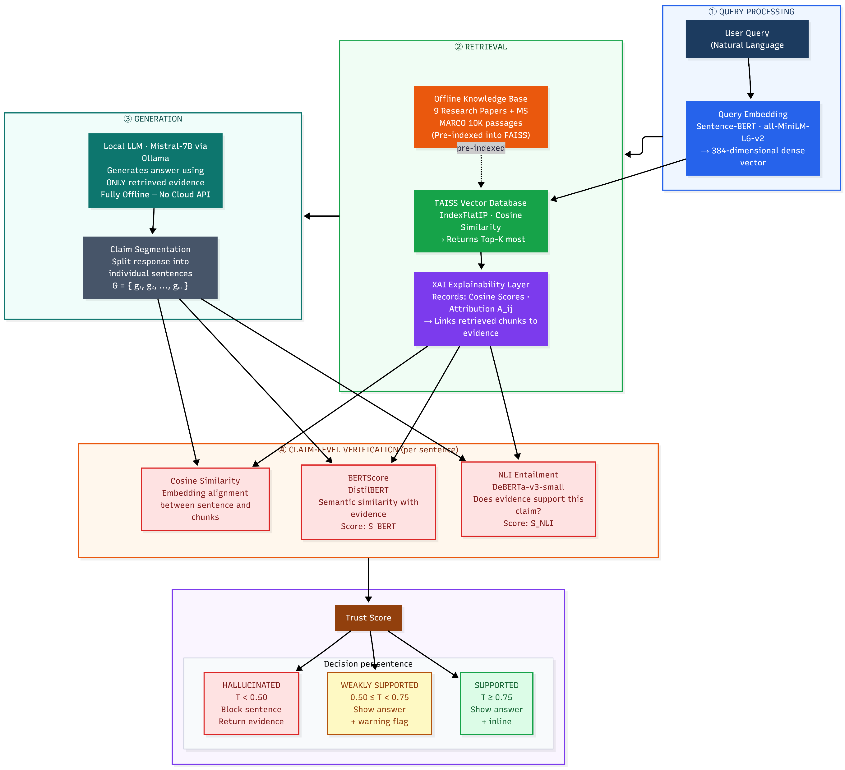
Proposed Methodology:Architecture Diagram

Slide 9
Proposed Methodology: Architecture & Workflow
Query Processing
Query Embedding: The user query q is converted into a 384-dimensional dense vector using the local Sentence-BERT (all-MiniLM-L6-v2) model.
Retrieval
Semantic Retrieval: The query vector is compared against all pre-indexed chunk vectors in the FAISS Vector Database using cosine similarity. The Top-K most relevant document chunks are returned.
XAI Evidence Attribution: The Explainability Layer captures retrieval signals — cosine scores, chunk attribution , and provenance scores — linking each retrieved chunk to its source document.
Generation
Local Generation: The retrieved context is passed to the local Mistral-7B model (via Ollama) to generate an evidence-grounded response — fully offline with no cloud API.
Claim Segmentation: The generated response is divided into individual sentence-level claims: G = {g₁, g₂, ..., gₘ}. Each claim is verified independently

Slide 10
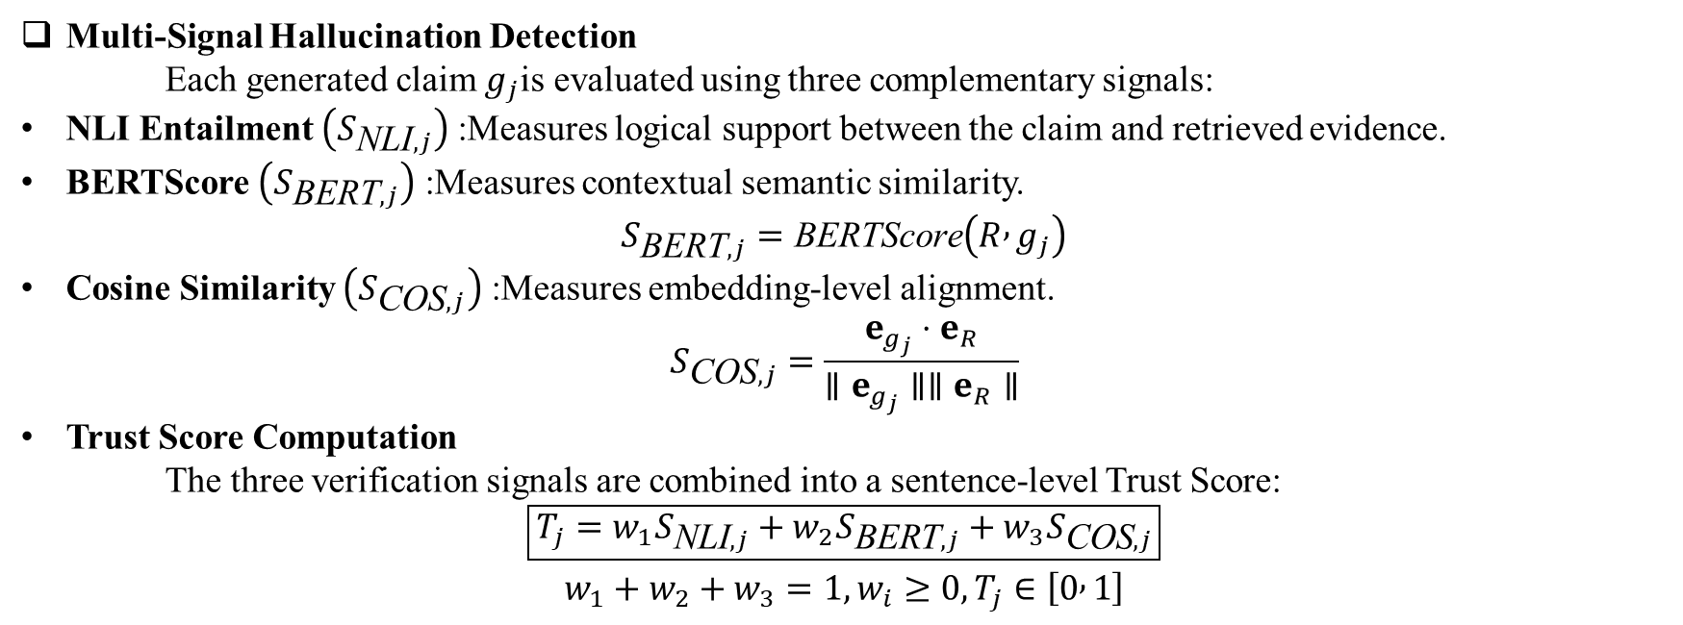
Proposed Methodology:Technical Method
Multi-Signal Hallucination Detection
Each generated claim $g_{j}$is evaluated using three complementary signals:
NLI Entailment $\left(S_{\text{NLI},j}\right)$: Measures logical support between the claim and retrieved evidence.
BERTScore $\left(S_{\text{BERT},j}\right)$: Measures contextual semantic similarity.
$$S_{\text{BERT},j}=\text{BERTScore}\left(R , g_{j}\right)$$
Cosine Similarity $\left(S_{\text{COS},j}\right)$: Measures embedding-level alignment.
$$S_{\text{COS},j}=\frac{e_{g_{j}}⋅e_{R}}{∥e_{g_{j}}∥∥e_{R}∥}$$
Trust Score Computation
The three verification signals are combined into a sentence-level Trust Score:
$$\boxed{T_{j}=w_{1}S_{\text{NLI},j}+w_{2}S_{\text{BERT},j}+w_{3}S_{\text{COS},j}}$$
$$w_{1}+w_{2}+w_{3}=1, w_{i}≥0, T_{j}∈\left[0 , 1\right]$$

Slide 11
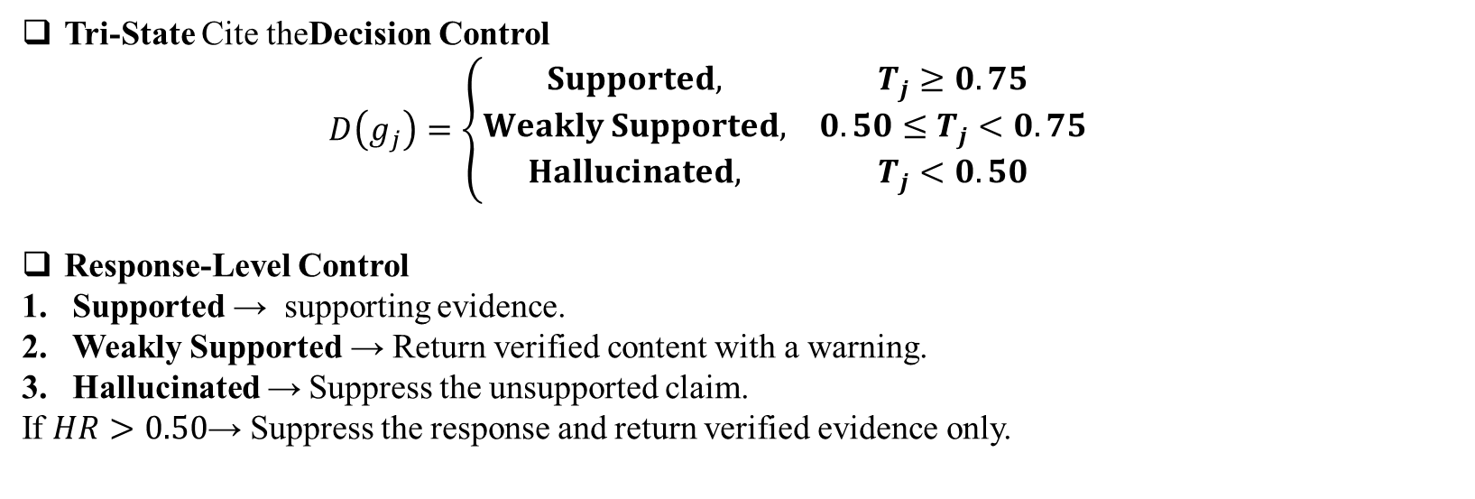
Proposed Methodology:Technical Method
Tri-State Cite theDecision Control
  $$D\left(g_{j}\right)=\left\{\begin{matrix}Supported, & T_{j}≥0.75 \\ Weakly Supported, & 0.50≤T_{j}<0.75 \\ Hallucinated, & T_{j}<0.50\end{matrix}\right.$$
Response-Level Control
Supported → supporting evidence.
Weakly Supported → Return verified content with a warning.
Hallucinated → Suppress the unsupported claim.
If $HR>0.50$→ Suppress the response and return verified evidence only.

Slide 12
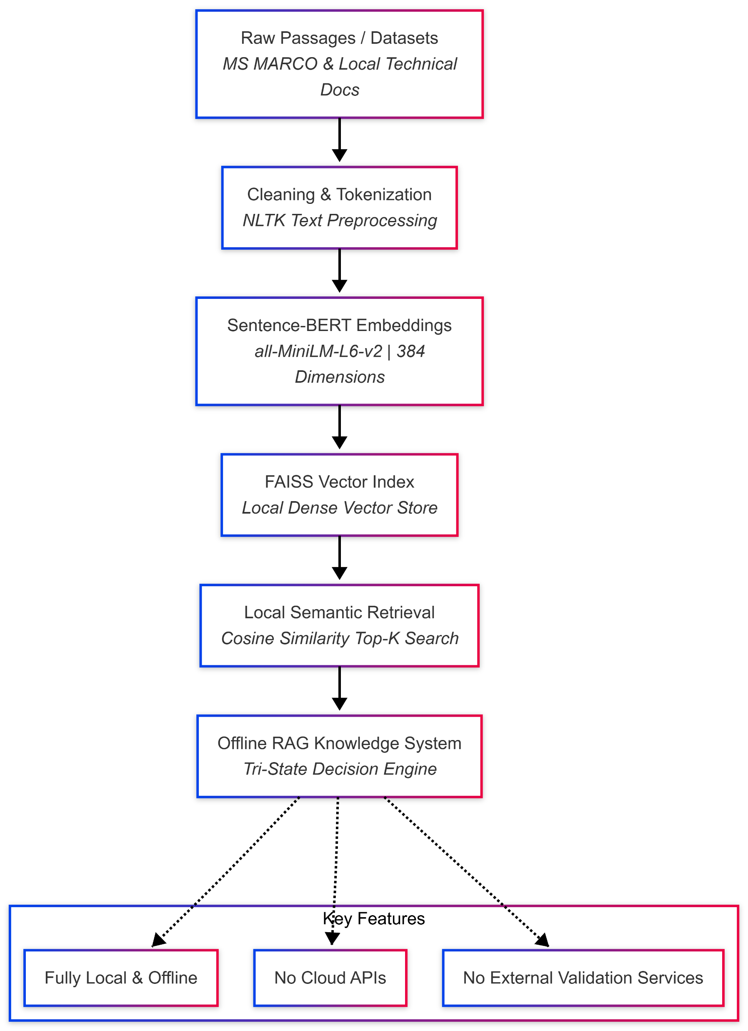
Datasets
1. Local Technical Knowledge Corpus
Source: 9 domain-specific technical documents and research papers (~6.7 MB)
Domain: RAG architectures, hallucination detection, and technical documentation
Purpose: Initial offline testing of retrieval, claim segmentation, explainability signals, and evidence attribution
2. MS MARCO Benchmark Dataset
Source: Microsoft Machine Reading Comprehension (MS MARCO)
Scale: Large-scale benchmark containing real user queries and web passages
Current Experiment Subset: 10,000 passages selected for local offline indexing
Purpose: Benchmark evaluation of retrieval performance and evidence-grounded response generation
Fig: Preprocesing and retrieval pipeline

Slide 13
Implementation, Partial Results & Discussion
Developed an offline RAG pipeline using local documents and MS MARCO.
Completed dataset preprocessing and document chunking.
Generated embeddings using Sentence-BERT
Implemented FAISS-based vector indexing and Top-K semantic retrieval.
Partial Results (Phase 1 — Initial):
✔ Local knowledge base created using technical documents and MS MARCO
✔ Document preprocessing, Sentence-BERT embeddings, and FAISS indexing
Discussion:
High retrieval relevance does not necessarily guarantee that every generated claim is fully supported by the retrieved evidence. Therefore, claim-level verification is required.

Slide 14
SDG mapping with Jusification
SDG | Mapping | Justification
SDG 9 | Industry, Innovation & Infrastructure | Develops an innovative, secure, and offline trustworthy AI framework using Retrieval-Augmented Generation and explainability-driven hallucination detection.
SDG 16 | Peace, Justice & Strong Institutions | Promotes transparent, explainable, and evidence-grounded AI-generated information, helping reduce unsupported or misleading outputs.
SDG 4 | Quality Education | Supports reliable knowledge access by providing evidence-grounded responses, which can improve trust in AI-assisted learning and research systems.

Slide 15
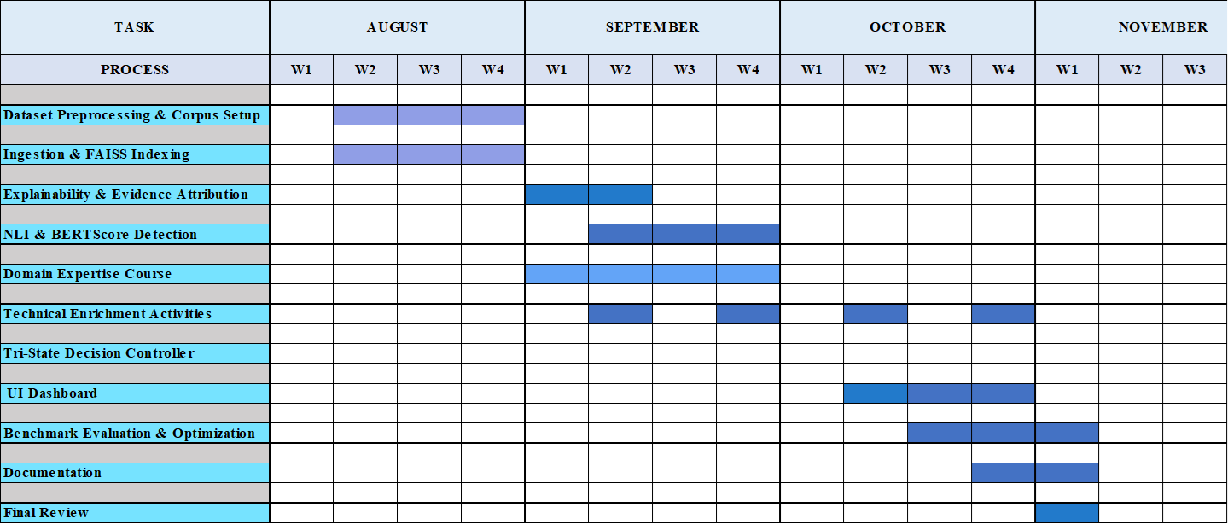
Gantt chart- Project plan for semester 3

Slide 16
Domain Expertise Course – Plan & Progress
Selected Course: RAG with Python: Build Chatbots That Talk to Your Data
Platform: Udemy
Duration: 10 Hours 34 Minutes
Relevance to Project
Covers the end-to-end RAG pipeline, including document processing, chunking, embeddings, vector databases, and retrieval.
Supports the implementation of FAISS-based semantic retrieval and evidence-grounded generation.
Provides knowledge relevant to RAG evaluation, groundedness, and hallucination reduction.
Module | Status
Enrolled / Guide approval obtained | ✅ Complete
Module 1: Introduction to RAG | ✅ Complete
Module 2: Semantic Search & Embeddings | 🔄 In Progress
Module 3: Advanced Retrieval Strategies | ⏳
Module 4: Evaluation & Trust in RAG | ⏳
Certification Exam | ⏳

Slide 17
Technical Enrichment Activities
Activity | Planned Technical Enrichment | Relevance to Project
1. RAG & Vector Database Learning | Hands-on learning on advanced RAG, embeddings, FAISS, chunking and retrieval techniques | Improves the offline knowledge retrieval component
2. Explainable AI (XAI) Study | Explore evidence attribution, similarity visualisation, provenance and confidence-based explainability | Supports transparent evidence grounding and hallucination analysis
3. Hallucination Detection & Evaluation | Study NLI, BERTScore, groundedness metrics and claim-level verification techniques | Supports the proposed hallucination detection and Trust Score mechanism

Slide 18
Conclusion
Developed the TrustRAG offline RAG framework for trustworthy, evidence-grounded responses.
Implemented document processing, Sentence-BERT embeddings, FAISS retrieval, and claim-level verification modules.
Designed Trust Score and Tri-State Controller for Supported, Weakly Supported, and Hallucinated claims.
Designed the XAI layer for evidence provenance and source attribution.
End-to-end integration and formal evaluation are planned for Semester 3.
Future Scope
Complete end-to-end integration and testing.
Evaluate using F1, Recall@K, and Provenance Score.
Explore adaptive thresholds and lightweight NLI models.

Slide 19
References
P. Lewis et al., “Retrieval-Augmented Generation for Knowledge-Intensive NLP Tasks,” Advances in Neural Information Processing Systems (NeurIPS), vol. 33, pp. 9459–9474, 2020.
V. Karpukhin et al., “Dense Passage Retrieval for Open-Domain Question Answering,” EMNLP, pp. 6769–6781, 2020.
K. Shuster et al., “Retrieval Augmentation Reduces Hallucination in Conversation,” Findings of ACL: EMNLP, pp. 3784–3803, 2021.
P. Manakul, A. Liusie, and M. J. F. Gales, “SelfCheckGPT: Zero-Resource Black-Box Hallucination Detection for Generative Large Language Models,” EMNLP, pp. 9004–9017, 2023.
S. Es et al., “RAGAS: Automated Evaluation of Retrieval-Augmented Generation,” EACL, pp. 150–158, 2024.
M. T. Ribeiro, S. Singh, and C. Guestrin, “Why Should I Trust You?: Explaining the Predictions of Any Classifier,” KDD, pp. 1135–1144, 2016.
S. M. Lundberg and S.-I. Lee, “A Unified Approach to Interpreting Model Predictions,” NeurIPS, vol. 30, 2017.
T. Zhang et al., “BERTScore: Evaluating Text Generation with BERT,” ICLR, 2020.
N. Reimers and I. Gurevych, “Sentence-BERT: Sentence Embeddings Using Siamese BERT-Networks,” EMNLP-IJCNLP, pp. 3982–3992, 2019.
J. Johnson, M. Douze, and H. Jégou, “Billion-Scale Similarity Search with GPUs,” IEEE Transactions on Big Data, vol. 7, no. 3, pp. 535–547, 2021.
Fig: Preprocesing and retrieval pipeline

