Slide 1
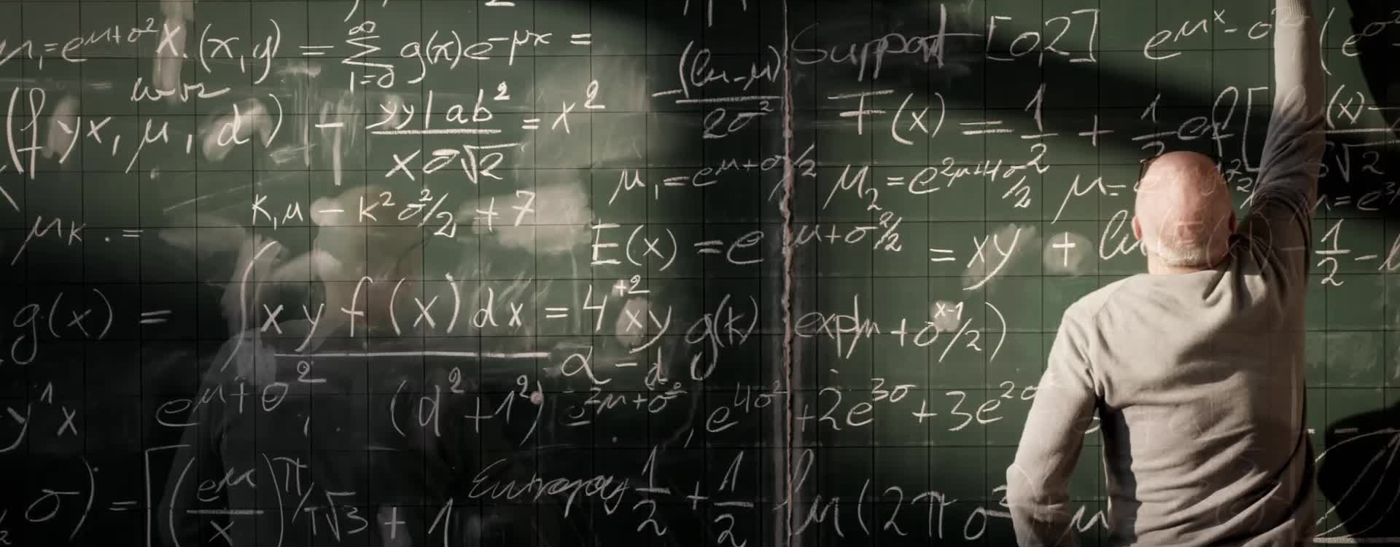
Why is there Math in my Archaeology?
John Justeson’s “Limitations of Archaeological Inference: An Information-Theoretic Approach with Applications in Methodology”
Notes:
Fifty years ago, what was arguably one of the most important papers written for modern work in quantitative archaeology was published in American Antiquity. Unfortunately for its author, and generations of archaeologists, it received relatively little attention. With a small number of citations, more than half of which have occurred in just the last few years, its elegance and mathematical precision went largely unappreciated – even by the growing cohorts of computational and quantitative archaeologists whose work would have greatly benefited from John’s brilliant work.

Slide 2
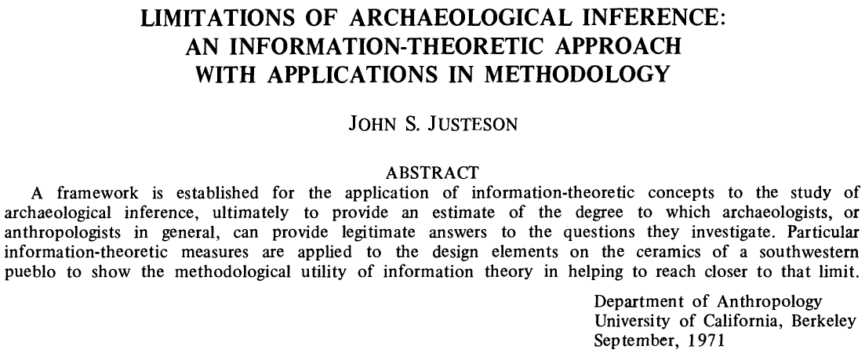
Notes:
John Justeson’s 1973 article “Limitations of Archaeological Inference” was not only correct, even if the field at large hadn’t realized it, but also still very much at the forefront of digital archaeology.
The premise was actually quite straightforward – behavioral information is “encoded” in the material artifacts deposited within an archaeological site, and the archaeologist’s motive is to “decode” that information on the other end.
The novelty was that John saw this "encoding-decoding" process as an information flow, which could be described by what was (at the time) a relatively esoteric set of mathematical tools known as *information theory*.

Slide 3
Limits of Inference
Limitations imposed by the degree of preservation of culturally significant remains and by the skewing of their relationships through time until their recovery
Limitations on the interpretability of archaeological data for the cultural descriptions.
Notes:
In particular, he was addressing two *inherent* limitations of the archaeological record:
1. limitations imposed by the degree of preservation of culturally significant remains and by the skewing of their relationships through time until their recovery; and
2. limitations on the interpretability of archaeological data for the cultural descriptions.
The first limitation is analogous degradation of a signal due to noise or interference affecting a transmission, and the second to the encoding and decoding of that signal between sender and receiver.

Slide 4
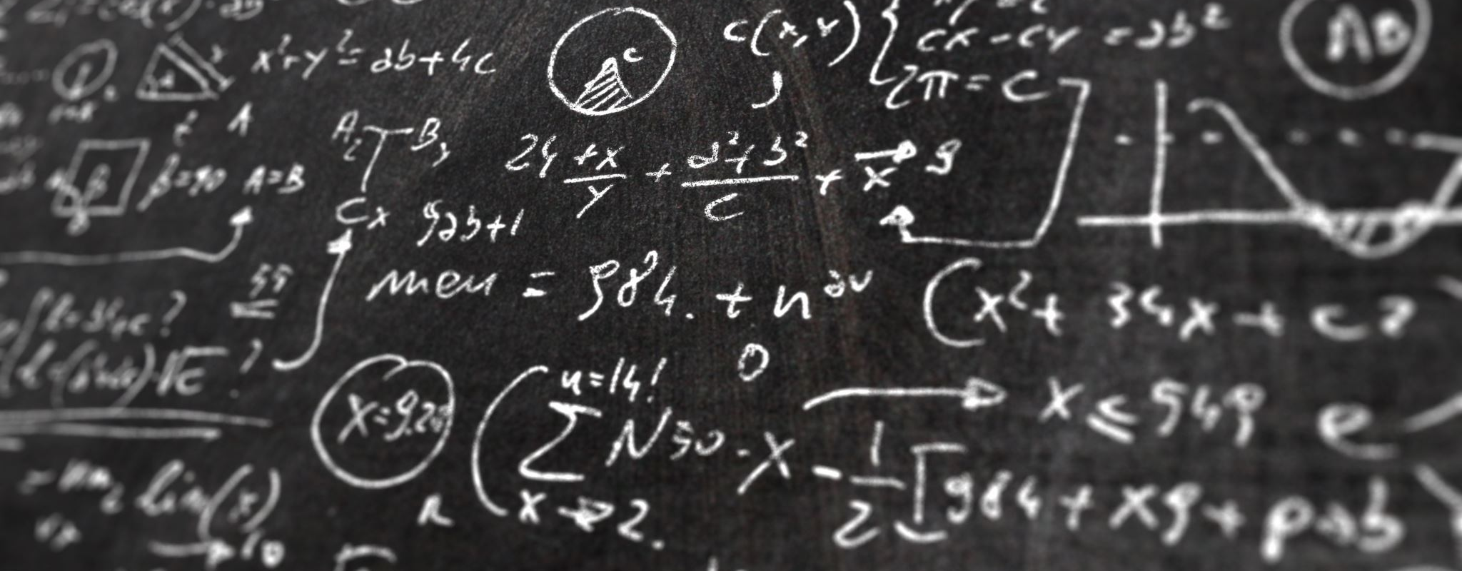
Part I: A Theoretical Framework
Understanding the Archaeological Record as an Information Problem

Slide 5
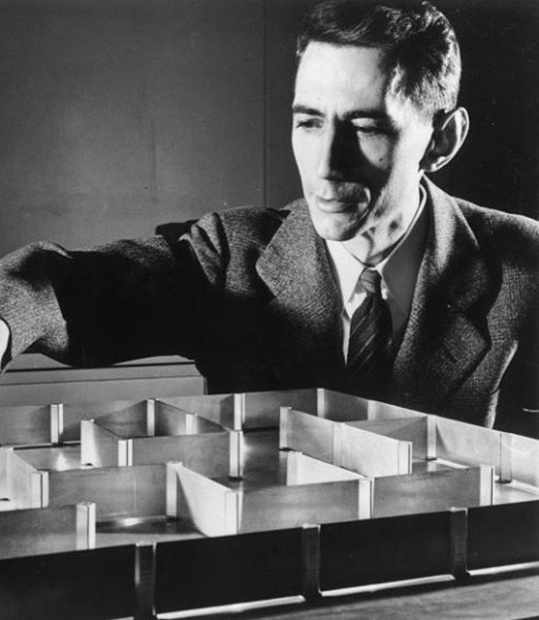
Information Theory
“The fundamental problem of communication is that of reproducing at one point either exactly or approximately a message selected at another point. Frequently the messages have meaning; that is, they refer to or are correlated according to some system with certain physical or conceptual entities.“
– Claude Shannon
Notes:
The foundations of information theory were developed by Shannon (1948) as a way to analyze the transmission of information independently of the content of the message.

Slide 6
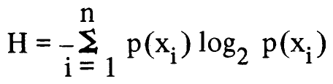
Information and Entropy
limitations on the interpretability of archaeological data for the cultural descriptions
the more events it would take, the less information each observation provides
High entropy means a small amount of information attaches to each piece of data
High information events allow discrimination to distinguish differentiable patterns
Allows calculation of the amount of information per event as a metric
Information is “the attribute of contrast”
Notes:
At the heart of information theory is a single equation that aimed to quantify a measure of information based on the concept of *entropy* from the thermodynamics of physical systems.
The total information entropy $H$ of a system $\cal{X}$, which contains some number of discrete features or attributes ($x_{1}, x_{2}, \ldots x_{n}$), is defined as the negative sum over all features of each attribute's probability of occurrence $p(x_i)$ times the $\log$ of its probability.
What this does, although not immediately obvious to most of us, is to tell us the minimum number of "events" of that system that it would take before we could start detecting a pattern. The more events it would take, the less information each observation is actually giving us.
One easy way to think of it is that, for a high-entropy event we can't reasonably predict any individual occurrence of a completely random event -- i.e., *any* outcome is equally likely -- so we are likely to be *surprised* each time.
After *a lot* of observations we could make a fair prediction of the outcomes over a *large* number of events, but still couldn't accurately predict any single event. Each event gives us only a *small* amount of information, so we would need a large number of observations before we could distinguish it from some other system.
Conversely, it wouldn't take us too long to notice something that regularly (or never) occurs. Each event would tell us a *lot* of information, so we need fewer observations to see a pattern.

Slide 7
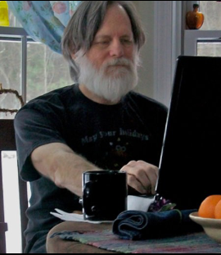
Limits of Inference
"If the empirically measured parameters are not consistent with the relationship between them that is required by the theory for a given material or behavioral system, then the data by which that system is to be interpreted cannot have a consistent susceptibility to decoding; that is, there will be no basis for deriving a coherent archaeological interpretation of the data that will accurately reflect the prehistoric situation.“
“Information in this case will be a particular type of information, namely, the description of the cultural system.”
Notes:
What John did was to apply this concept of how "surprising" information concerning the "event" of an artifact or its attributes would be, given a certain frequency of occurrence. By considering the archaeological record as a transmission channel, one could reasonably compute the integrity of the archaeological "signal" based on the coherency of the codes received.

Slide 8
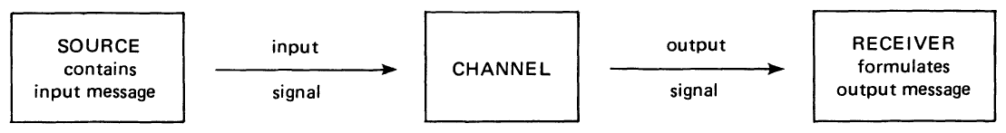
The Idea of an Information “Channel”
“…the archaeologist is in the position of the code-breaker tapping a channel with whose code he is not fully familiar…”
Notes:
Consider the artifacts, features, or attributes as encoding the meaningful categories as would be recognized by the archaeological society. On the other end, we (as archaeologists) establish a system of "decoding" that signal through our categorization and classification schema. The limits of inference, then, would be to determine the translatability between encoding and decoding.

Slide 9
An Archaeological “Channel”
A message is “encoded” by the selection of material objects, attributes, or features
A “signal” of these attributes is “transmitted” through the processes of materializing these intentional selections of meaningful attributes
This transmission passes through the “channel” of the archaeological record
Some degraded form of this signal is received through the process of archeological investigation
The degradation of the signal is comprised by “noise” that renders some part of the message ambiguous due to interference
The information is the unambiguous portion of the signal that can be reasonably decoded
Notes:
Most are familiar with the now canonical work in Schiffer (1987) “Formation Processes of the Archaeological Record” that introduced the idea of various transformations of the archaeological record. Few, however, are likely aware that these transformations were in fact already quantified more than a decade earlier in John’s paper.
The analogy between the archaeological record and a communication channel was a somewhat recent fascination of the “New” archaeology, but John took that analogy to its logical limits by formally applying the mathematics Shannon’s information theory to the problem – something that had only recently been attempted and, at the time of its writing, had only one published example (i.e., Gorman 1970). As John noted at the time, information theory concepts had been introduced but not the actual mathematical formalisms.

Slide 10
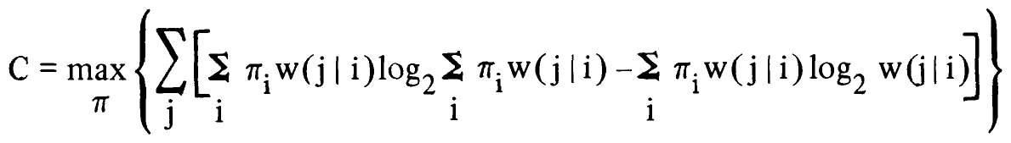
What is the Capacity of a Channel?
The archaeological “channel” is the passage of cultural information from the intentional agents in the past (Source) to the interpretations by the archaeologist (Receiver) transmitted through the medium of the archaeological record (Channel)
The capacity of the channel is a measure of the ability of a channel to transmit information
If the observations of the receiver are not consistent with the capacity of the channel, then the information cannot be adequately decoded
In effect, we can calculate whether the observed information carries enough information to be interpretable

Slide 11
Part II: Application of Information-theoretic Measures
Addressing the Problem of Archaeological Inference through Information Metrics

Slide 12
Applications of Information Measures
Determine if the frequency of design elements on ceramic vessels constituted an interpretable system of encoding
Determine if the empirical observations of those frequencies indicated information loss due to noise
Determine if the classifications of those design elements constitute an adequate system for decoding the signal…
… and calculate the efficiency of that classification system in terms of ambiguity in discriminating differences

Slide 13
Implications
Methods allowed the application of quantitative measures to otherwise qualitative assessments:
Estimate the frequency of various types, features, and attributes of incomplete samples
Estimate the “noise” of the archaeological signal… otherwise known as site integrity
Determine of the observed attributes indicate an intentional system of encoding information… i.e., are we, in fact, identifying a real pattern or just an “artifact” of our classifications of them
Determine the best fit between competing systems of categorization
Showed that, in theory at least, there are no inherent limitations to inference… only the effects of noise and improper decoding

Slide 14
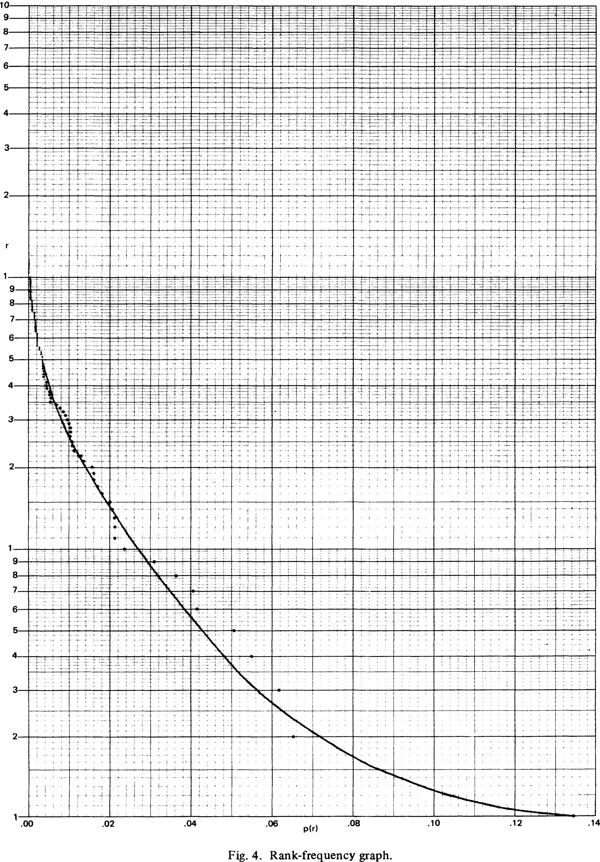
A Hidden Gem…
The encoding of archaeological information follows a power-law distribution
Power-law distributions are innately related to a specific type of relationship between features
“Small-world Networks” are a special type of graph structure, in which the number of connections between nodes follows a power-law
Small-world networks exhibit a special phenomenon of hub and bridge nodes
Essentially, archaeological information exhibits the same innate structure as social networks

