Slide 2

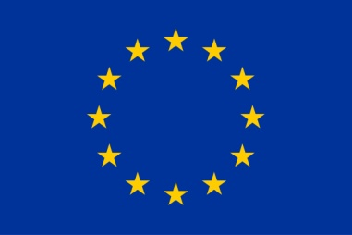

Acknowledgements
This project has received funding from the European Union’s Horizon 2020 research and innovation programme under the Marie Skłodowska-Curie grant agreement No 766311

