Slide 1

ML/DL-based biomedical signal analysis and processing for disease identification and related hardware implementation
Presented By: Archana Kumari & Shwashwat Das
Supervisor: Prof. Sumitra Mukhopadhyay
Institute of Radiophysics and Electronics
University of Calcutta
October 18, 2023

Slide 2
contents
Decision Trees
Random Forests
K-Nearest Neighbor (KNN) Algorithm
DWT

Slide 3
Decision trees
A supervised learning algorithm that can be used for both regression and classification problems.
A decision tree reaches its decision about the input by carrying out a series of tests on the input attributes.
The attribute chosen for test must be such that we can extract maximum information from the data. Or in other words, dissimilar data points must get separated.
To measure how well an attribute separates dissimilar points we can use : 1) Entropy 2)Gini impurity

Slide 4
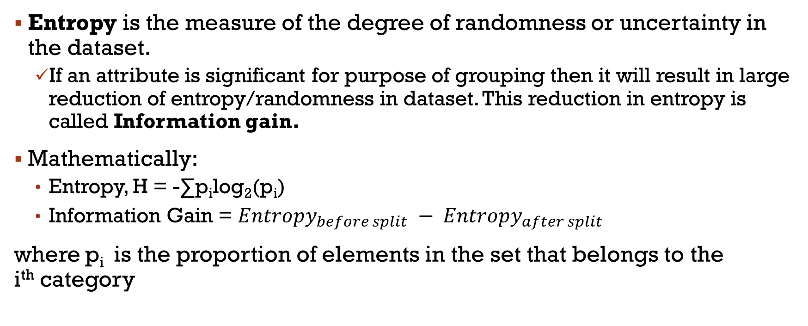
Entropy & Information Gain
Entropy is the measure of the degree of randomness or uncertainty in the dataset.
If an attribute is significant for purpose of grouping then it will result in large reduction of entropy/randomness in dataset. This reduction in entropy is called Information gain.
Mathematically:
Entropy, H = -∑p_{i}log₂(p_{i})
Information Gain = ${Entropy}_{before split} − {Entropy}_{after split}$
where p_{i} is the proportion of elements in the set that belongs to the i^{th} category
Notes:
Entropy: In the case of classifications, it measures the randomness based on the distribution of class labels in the dataset.

Slide 5
GINI impurity
Gini impurity is a measure of impurity. It ranges from 0 (perfectly pure) to 1 (perfectly impure).
In each node of decision tree, attribute with least gini coefficient is preferred as the decision attribute.
Mathematically:
Gini impurity, G = (1 - ∑p_{i}²),where p_{i} is the proportion of elements in the set that belongs to the i^{th} category
Notes:
In decision trees in measures the probability of a random sample being misclassified by the decision tree.

Slide 6
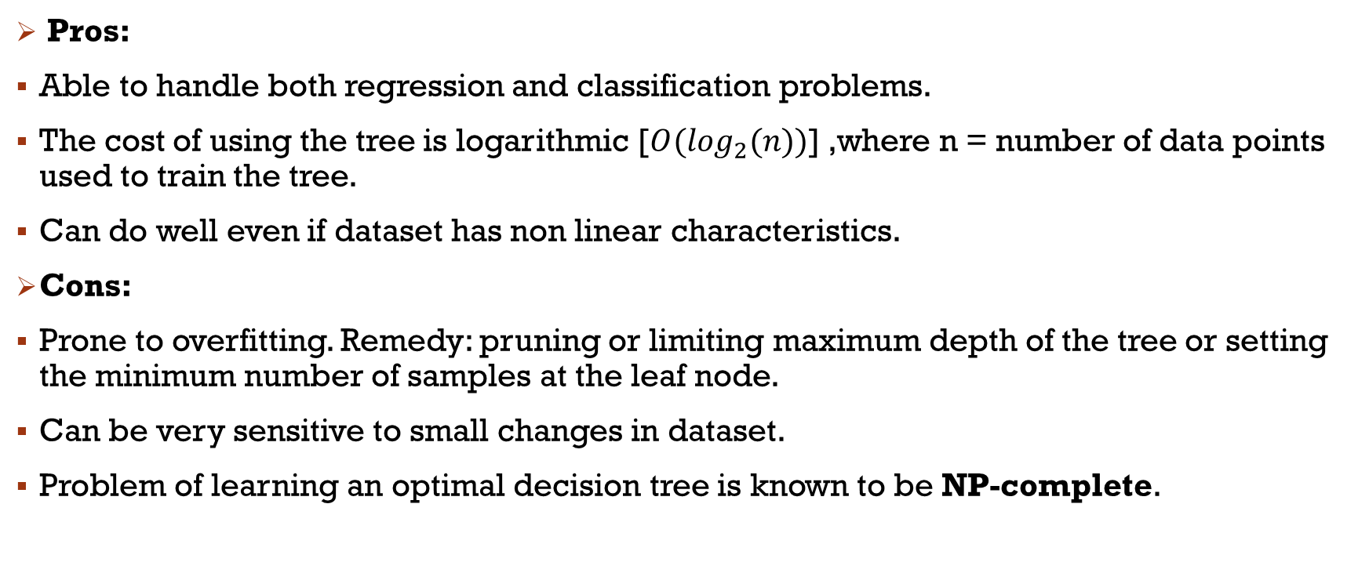
Decision trees: pros & cons
Pros:
Able to handle both regression and classification problems.
The cost of using the tree is logarithmic [$O(\log_{2}(n))$] ,where n = number of data points used to train the tree.
Can do well even if dataset has non linear characteristics.
Cons:
Prone to overfitting. Remedy: pruning or limiting maximum depth of the tree or setting the minimum number of samples at the leaf node.
Can be very sensitive to small changes in dataset.
Problem of learning an optimal decision tree is known to be NP-complete.
Notes:
Pros: Easy to visualize, understand and interpret.
Aftr np complete: So practical decision tree algorithms are based on heuristics and hence cannot give a globally optimal tree. The effect of this can be reduced by using random forests.

Slide 7
Implementation of decision trees
Dataset used: Bulit in wine data set in sci-kits learn library. It is a three class classification problem with 13 attribute.
Steps:
Load the data set from the library.
Shuffle the dataset.
Split it into two parts(test and train) of equal number of samples.
Train the decision tree on the train set.
K-fold cross validation(K = 10) is done to assess the accuracy of the model.
Predicting the labels on the test set and assessing the model’s performance using confusion matrix.

Slide 8
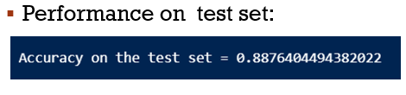

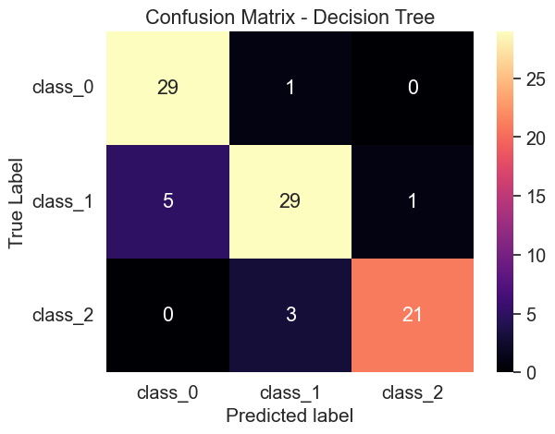
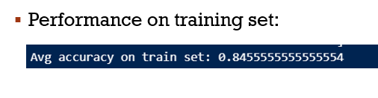
Implementation of decision trees: Results
Characteristics of model:
Fig 1

Slide 9
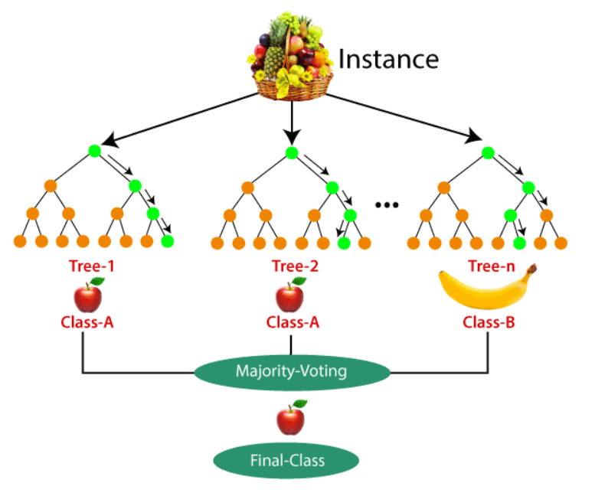
Random forests
It is an advancement over the decision trees.
Random forest is an ensemble learning model. Each decision tree is trained on a subset of the training set.
Each sample in subset of dataset is chosen randomly – this process is called bagging
Number of features are reduced using random subspace method
For a classification problem, assign the new data points to the category that wins the majority votes.
Fig 2 : A Random forest trained to identify fruits
(Adapted from: Machine Learning Random Forest Algorithm – Javatpoint website)
Notes:
Meaning that it is actually a collection of large number of decision trees, all trained on same training set.
Each sample in subset of dataset is chosen randomly – prces is called bagging
If each sample has multiple features then some features are dropped, process is called random subspace method

Slide 10
Random forests: Pros & cons
Pros:
When compared to a single decision tree:
It is more robust model, improves accuracy. Since it works on the principle of majority voting, wrong decision is less likely.
Much less prone to overfitting.
Better generalization capability. It can generalize well to unseen data points.
Cons:
High computation complexity: since we are using multiple trees for the prediction.
Good for classification problems not good for regression problems.

Slide 11
Implementation of random forests
Dataset used: Bulit in wine data set in sci-kits learn library. It is a three class classification problem with 13 attributes.
Steps:
Load the data set from the library.
Shuffle the dataset.
Split it into two parts(test and train) of equal number of samples.
Train the decision tree on the train set.
K-fold cross validation(K = 10) is done to assess the accuracy of the model.
Predicting the labels on the test set and assessing the model’s performance using confusion matrix.

Slide 12
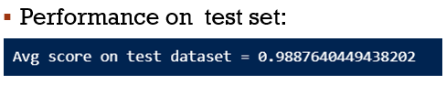

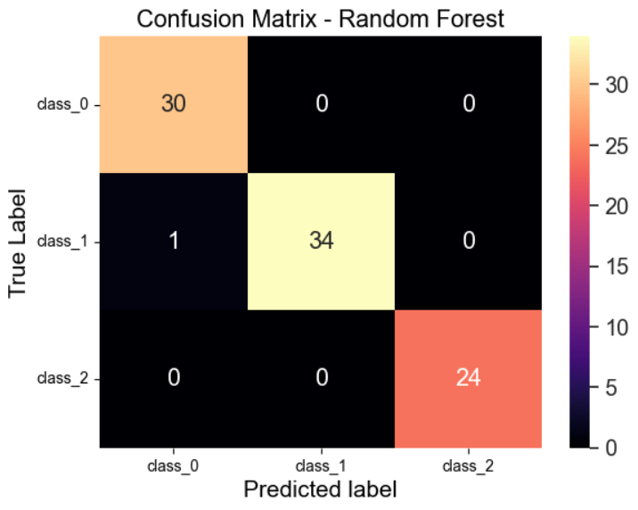
Implementation of decision trees: Results
Characteristics of model:
Fig 3

Slide 13
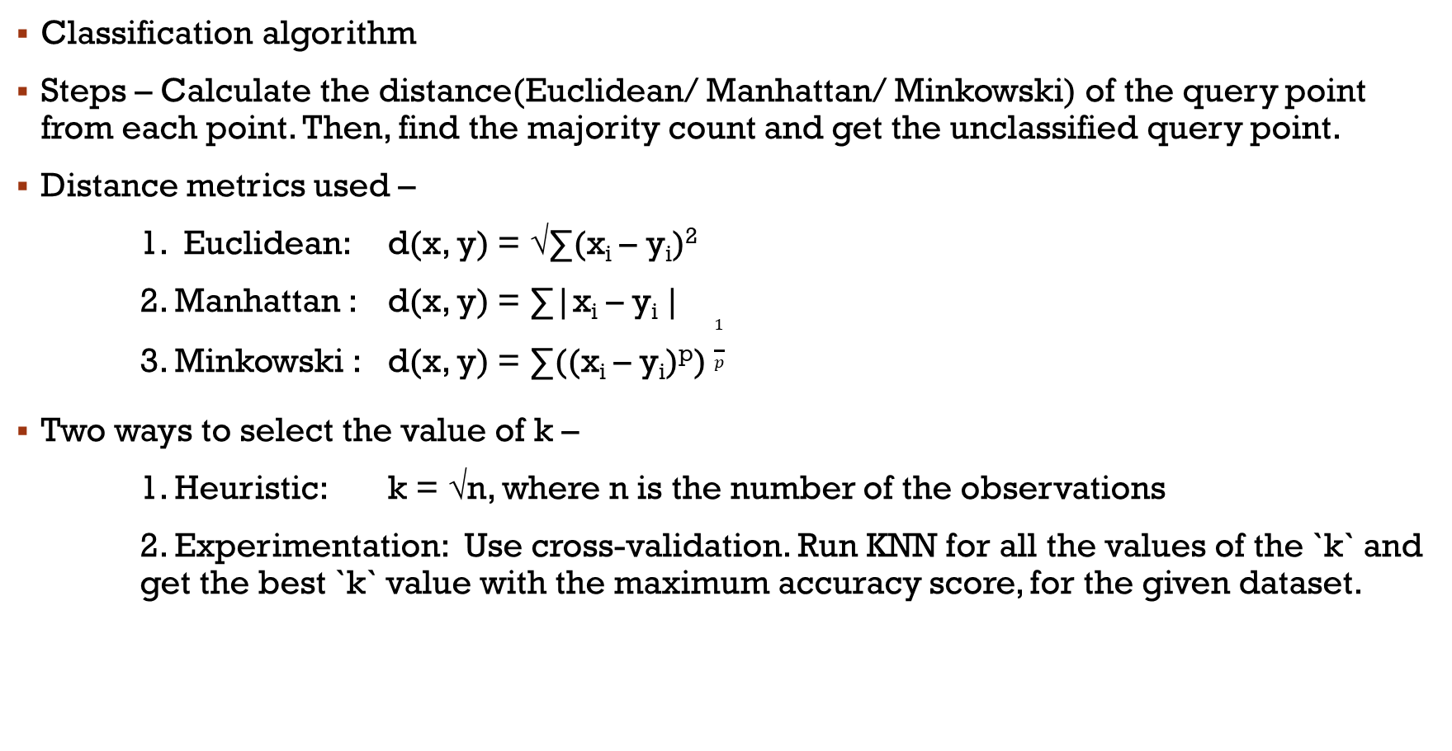
KNN Algorithm
You are the average of the five people you spend most time with.
----- Jim Rohn
Classification algorithm
Steps – Calculate the distance(Euclidean/ Manhattan/ Minkowski) of the query point from each point. Then, find the majority count and get the unclassified query point.
Distance metrics used –
1. Euclidean: d(x, y) = √∑(x_{i} – y_{i})²
2. Manhattan : d(x, y) = ∑|x_{i} – y_{i} |
3. Minkowski : d(x, y) = ∑((x_{i} – y_{i})^{p}) $\frac{1}{p}$
Two ways to select the value of k –
1. Heuristic: k = √n, where n is the number of the observations
2. Experimentation: Use cross-validation. Run KNN for all the values of the `k` and get the best `k` value with the maximum accuracy score, for the given dataset.

Slide 14
Limitations of knn (failure cases)
Large datasets: KNN is a lazy learning technique. Takes no time in the training phase, but a longer time in the prediction phase, for bigger datasets.
CURSE OF DIMENTIONALITY: The algorithm faces a hard time classifying the data points properly when the dimensionality is too high. Distance concept is not reliable for higher dimensions.
Outliers: KNN is very sensitive to outliers, refer Fig6.
Fig6. For k=2, the result should be black but due to 2 outlier points, it is red.

Slide 15




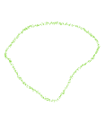
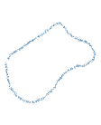
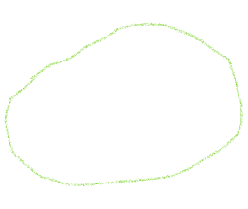
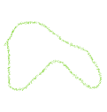



Overfitting and underfitting in knn
K controls the size of the neighborhood used to model the local statistical properties.
Overfitting: A very small value for K makes the model more sensitive to local anomalies and exceptions, giving too much weight to these particular points.
Underfitting: A too-large value of K would make the model ignore the local structure of the distribution you try to learn, and produce an underfitted model.
Fig.4: For, k = 1, learns minor changes, overfitting(high variance)
Fig.5: For, k=n, circle points always wins in majority count, underfitting

Slide 16
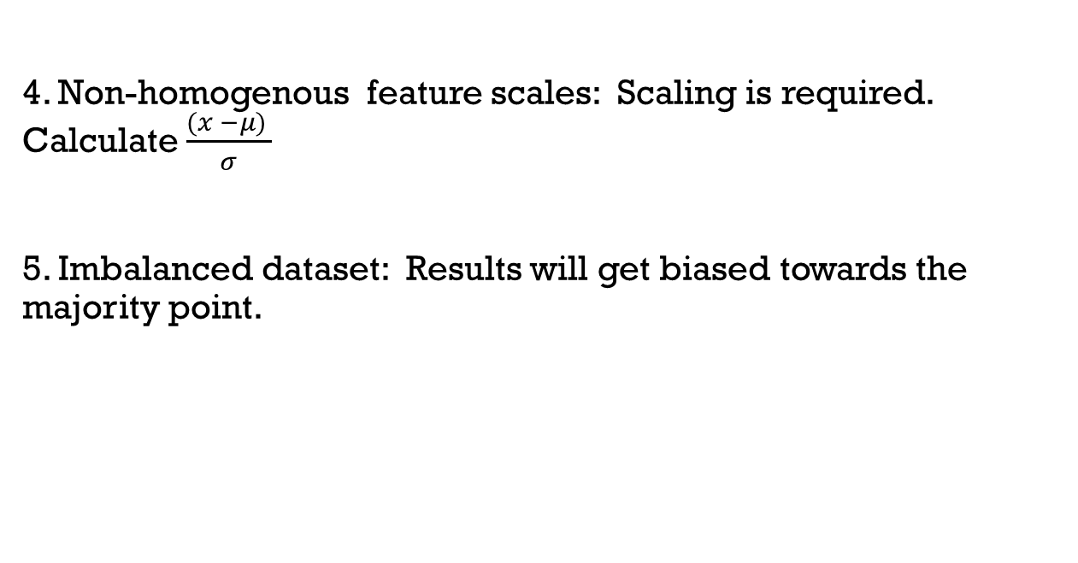
Limitations of knn (failure cases)
4. Non-homogenous feature scales: Scaling is required. Calculate $\frac{(x −μ) }{σ}$
5. Imbalanced dataset: Results will get biased towards the majority point.
Fig 7

Slide 17
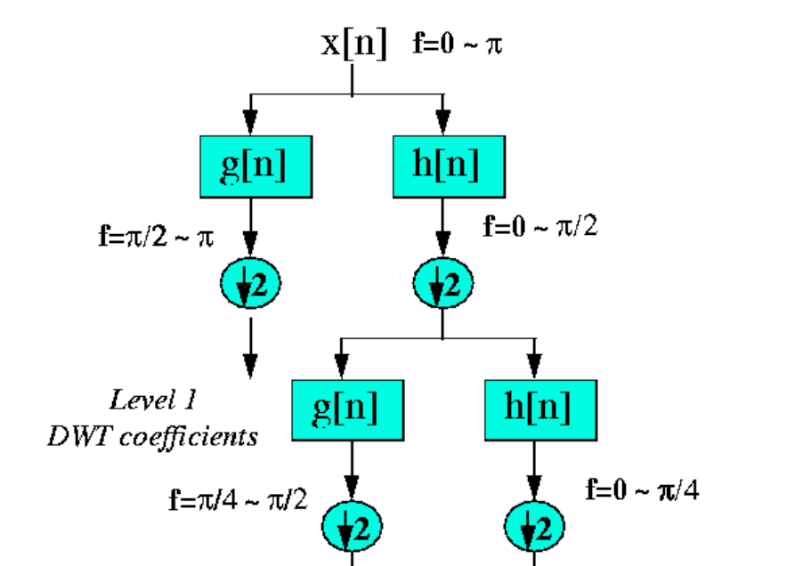
Discrete wavelet transform (dwt)
This is a mathematical tool to assess the frequency band present in a particular interval of time in a given signal.
It does so by decomposing the given signal over a set of mutually orthogonal basis functions (called wavelets).
Due to Heisenberg Uncertainity principle we cannot know the exact frequency present at some give exact time
Fig 8

Slide 18
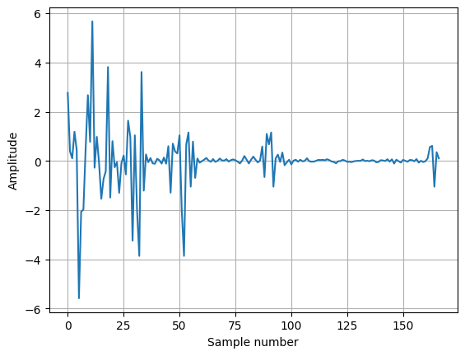
Example of dwt
We implemented the DWT code in python and processed it over an discretized ECG signal downloaded from Kaggle.
Results:
Fig 9

Slide 19
References
Chapter 18 : Artificial Intelligence A modern Approach 3rd Ed. By S.Russell and P.Norvig​
Robi Polikar: The Engineer's Ultimate Guide To Wavelet Analysis - The Wavelet Tutorial
NPTEL lectures: https://www.youtube.com/playlist?list=PLIg1dOXc_acbdJo-AE5RXpIM_rvwrerwR​
ECG dataset: https://www.kaggle.com/datasets/devavratatripathy/ecg-dataset

Slide 20




Thank you

