Slide 1

ML/DL-based biomedical signal analysis and processing for disease identification and related hardware implementation
Presented By: Archana Kumari & Shwashwat Das
Supervisor: Prof. Sumitra Mukhopadhyay
Institute of Radiophysics and Electronics
University of Calcutta

Slide 2
content
Paper Review(1) : Photoplethysmography signal quality assessment using attractor reconstruction analysis(2023)
Paper Review(2): An energy-efficient semi-supervised approach for on-device photoplethysmogram signal quality assessment (2023)

Slide 3
Paper review 1: Photoplethysmography signal quality assessment using attractor reconstruction analysis
Authors : Jean Schmith , Carolina Kelsch , Beatriz Cappelozza Cunha , Lucio Rene Prade ,Eduardo Augusto Martins , Armando Leopoldo Keller, Rodrigo Marques de Figueiredo.
Introduction
According to WHO reports, cardiovascular diseases kills millions of people worldwide every year.
By 2025 it is estimated that there will be 1.56 billion hypertensive patients worldwide.
PPG signal based devices are very popular due to size, sensitivity and scalability.
Challenge is to ensure good quality of PPG signal, used for calculating various health related parameters.
Paper proposes a new method for PPG quality assessment: analytical analysis of the attractor shape of short segments from PPG signals. (The method was applied to blood pressure signals.)
Advantages:
No need of training algorithm.
Low computational cost.
Suitable for real time and wearable applications.
Independent of subject physiology
No calibration required.

Slide 4
Methodology:
MIMIC III DATABASE
1 hour PPG signal
Segmented into 3sec
Attractor Reconstruction
Create attractor for each segment
Calculate the deviation
Find the threshold
Compare the results with hand annotation
100 patients

Slide 5
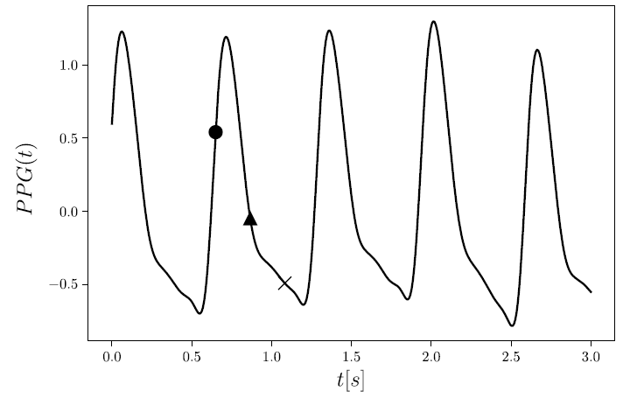
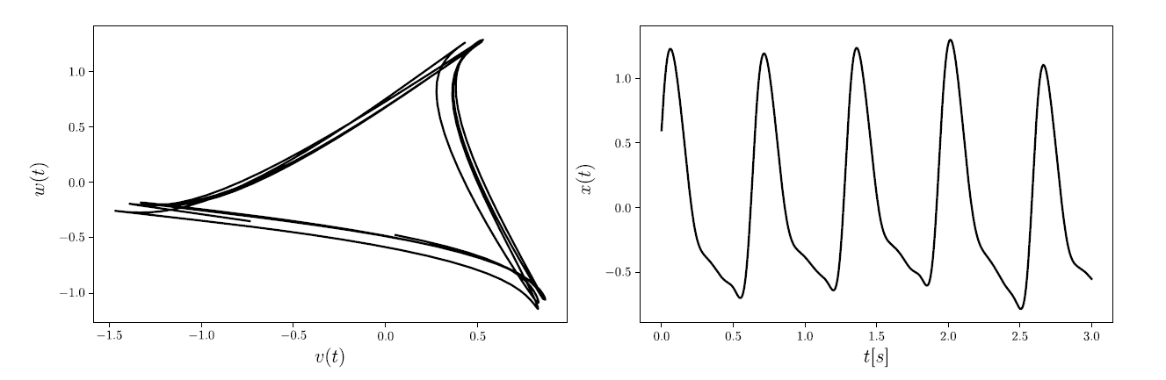

Methodology:
Attractor Reconstruction:
Let original PPG signal =$x\left(t\right)$ and its averaged time period be T.
Define two new variables:
$y(t)$= 𝑥(𝑡 − 𝜏)
𝑧(𝑡) = 𝑥(𝑡 − 2𝜏) , where 𝜏 = T/3
Map the attractor to new plane:
$u\left(t\right)=\{x(t)+y(t)+z(t)\}/√3$
v(𝑡) = {𝑥(𝑡) + 𝑦(𝑡) - 2𝑧(𝑡)}/√6
w(𝑡) = {𝑥(𝑡) - 𝑦(𝑡)}/√2
Neglect u(t) as it represents Baseline wander in the PPG signal segment and plot v(t) against w(t). Get the reconstructed attractor.
We notice that the attractor shape is very similar to a triangle.
x(t)
y(t)
z(t)
Fig1:Illustrating the variables.(Taken from ref[1])
Fig2 : Reconstructed attractor of the signal segment in fig1 (adapted from ref[1])

Slide 6
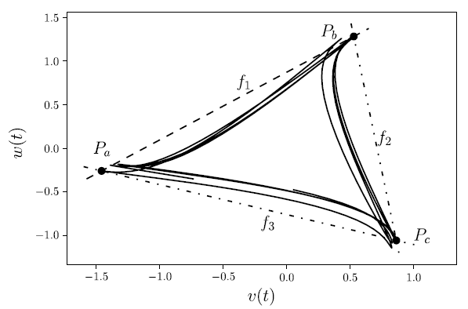
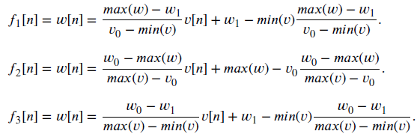
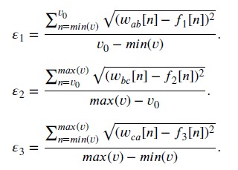

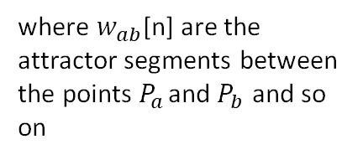
Step 2: Calculate the deviation of the attractor from ideal triangle shape
Find the sides of the ideal triangle:
Calculate the error / deviation of actual PPG attractor from the ideal triangle.
Calculate the global error :
where $w_{ab}$[n] are the attractor segments between the points $P_{a}$ and $P_{b}$ and so on
Fig3: Illustrating the idea

Slide 7
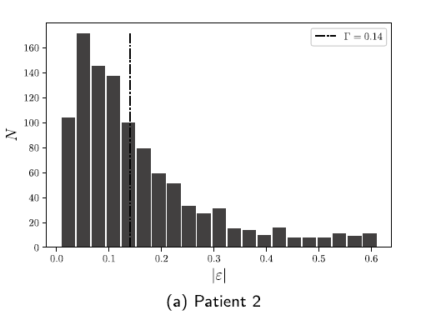

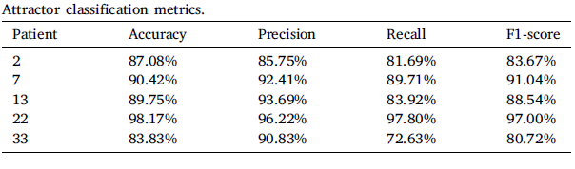
Step 3: Plot the distribution of |𝜀| and find the threshold
Metric to distinguish between “Good”(1) and “Bad”(0):
They selected 2 * Mode of distribution as threshold between “Good” and “Bad” segments:
𝛤 = 2*Mode
where 𝛤 is the threshold chosen by user
Performance:
To measure the performance the PPG segments were hand annotated and compared with the model's prediction.
Fig4: Choosing threshold (ref[1])
Conclusion and shortcomings
Performance is close to CNN and such models.
Model will perform well in controlled environments, where error is low.
Denoising/preprocessing of data can be done to improve performance.

Slide 8
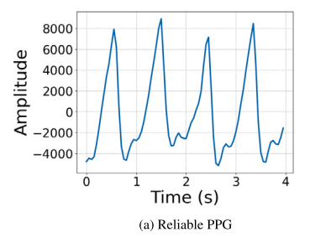
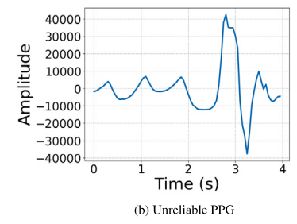
PAPER REVIEW 2: An energy-efficient semi-supervised approach for on-device photoplethysmogram signal quality assessment
Authors: Mohammad Feli , Iman Azimi, Arman Anzanpour, Amir M. Rahmani, Pasi Liljeberg
Motivation: By 2050, 37% of the European population, expected to be aged 60 or over
Introduction:
PPG, an optical method, measures changes in blood tissues
Recorded via transmission or reflection methods
PPG measures vital sign, like heart rate, heart rate variability, and oxygen saturation
Noise and artifacts reduce the signal quality, distort the signal, lead to waste of energy
PPG SQA method: accurate, energy efficient, and fast performance on low-power devices, reduced both false positive rate and false negative rate
Dataset:
46 participants (23 women and 23 men), with diverse age, weight, physical condition, education level, and lifestyle
Data collected 24 h from individuals engaged in everyday routines and activities
Samsung Gear Sport watch (0000) to collect PPG signals
Watch had optical and IMU sensors, run Tizen operating system
Optical sensors sampling frequency = 20 Hz.
Fig5

Slide 9
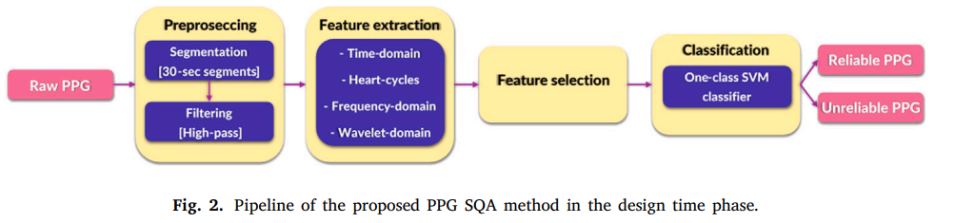
Methodology
The contributions of this paper include the following:
Propose lightweight and energy-efficient PPG SQA method, applicable to low-power devices.
Extract best features from different domains of PPG signals, in terms of accuracy and execution time.
Develop one-class SVM model based on the strong similarity between ‘‘Reliable’’ PPG signals.
Evaluate the proposed method using PPG data collected from 46 persons via smartwatches in free-living conditions.
Compare the proposed method with five state-of-the-art PPG SQA methods in terms of accuracy, execution time, and energy consumption.

Slide 10
four main components in the design time phase
Preprocessing
Includes segmentation and filtering
Divide signal, with 15-minute record(with variable noise level), into 30-sec non-overlapping intervals
Second-order Butterworth high-pass filter with a cut-off frequency of 0.5 Hz, to ensure the noise level is stationary
Annotation: Segments labeled as ‘‘Reliable’’ if cardiac cycles are clear, else, "Unreliable"
Feature Extraction: Extract 45 features from the PPG segments, divided into 4 categories:
1. time-domain, 2. heart-cycles (Template matching),
3. frequency-domain, and 4. wavelet-domain of the signal.
Feature Selection
Recursive Feature Elimination (RFE) method to find the best features in terms of accuracy
Select features based on RFE ranking and latency
Cross-validation with k = 5 gives optimum number of selected features in RFE
(1) Range of energy of heart cycles, (2) Average of Euclidean distances,
(3) Average of their correlations (4) standard deviation of PSD (5) Interquartile range of the signal
Classification
Semi-supervised one-class SVM (OCSVM) method for PPG SQA, OCSVM has only one training class (novelty detection)
OCSVM maps the data into a feature space using a kernel function, to separate them with the maximum margin
K(x1, x2) = (a + x1^{T}x2^{T})^{b} where, a is a constant and b is the degree of the kernel.
Trained by 13338 ‘‘Reliable’’ 30-second PPG segments
Tested by 5329 ‘‘Reliable’’ and 14827 ‘‘Unreliable’’ segments.

Slide 11
achievements
Experimental set up
Two embedded single-board computers:
(1) Raspberry Pi 4, operated by a 64-bit Debian Linux OS
(2) NVIDIA Jetson Nano operated by a 64-bit Ubuntu Linux OS
Docker technology used, same running environment, installed libraries, and their versions
Lightweight PPG SQA method to detect ‘‘Reliable’’ and ‘‘Unreliable’’ PPG signals
Best accuracy and true negative rate, when compared with five existing methods published recently
Lowest execution time and energy consumption compared to the other ML-based methods
(Deep learning) methods: highest true positive rate but, highly time and energy-consuming
Accuracy = 0.97, F1-score(Reliable) = 0.99, F1-score(Unreliable) = 0.98
acknowledgements
This research received support from the Academy of Finland through the SLIM Project (grant numbers 316810 and 316811) and the U.S. National Science Foundation (NSF) through the UNITE Project (grant number SCC CNS-1831918).

Slide 12
references
Schmith, Jean, et al. "Photoplethysmography signal quality assessment using attractor reconstruction analysis." Biomedical Signal Processing and Control 86 (2023): 105142.
Abadi, Martín, Agarwal, Ashish, Barham, Paul, Brevdo, Eugene, Chen, Zhifeng, Citro, Craig, et al. (2015). TensorFlow: Large-scale machine learning on heterogeneous systems
Makowski, Dominique, Pham, Tam, Lau, Zen J., Brammer, Jan C., Lespinasse, François, Pham, Hung, et al. (2021). NeuroKit2: A python toolbox for neurophysiological signal processing. Behavior Research Methods, 53(4), 1689–1696.

Slide 13




Thank you

