Slide 1
ML/DL-based biomedical signal analysis and processing for disease identification and related hardware implementation
Presented By: Archana Kumari & Shwashwat Das
Supervisor: Prof. Sumitra Mukhopadhyay
Institute of Radiophysics and Electronics
University of Calcutta
September 19, 2023

Slide 2
Agenda
Linear Regression
Cost function of Linear Regression
Logistics Regression
Mathematical Interpretation and Cost function
Decision Trees

Slide 3
Machine learning
Supervised Learning
Unsupervised Learning
Reinforcement Learning
Classification
Regression

Slide 4
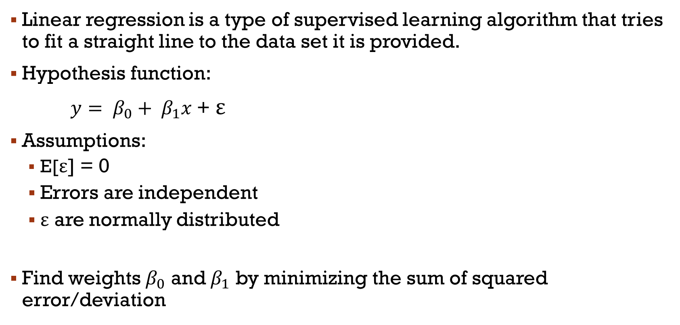
Linear Regression
Linear regression is a type of supervised learning algorithm that tries to fit a straight line to the data set it is provided.
Hypothesis function:
$y= β_{0}+ β_{1}x$+ ε
Assumptions:
E[ε] = 0
Errors are independent
ε are normally distributed
Find weights $β_{0}$ and $β_{1}$ by minimizing the sum of squared error/deviation
Fig1. Linear Regression

Slide 5
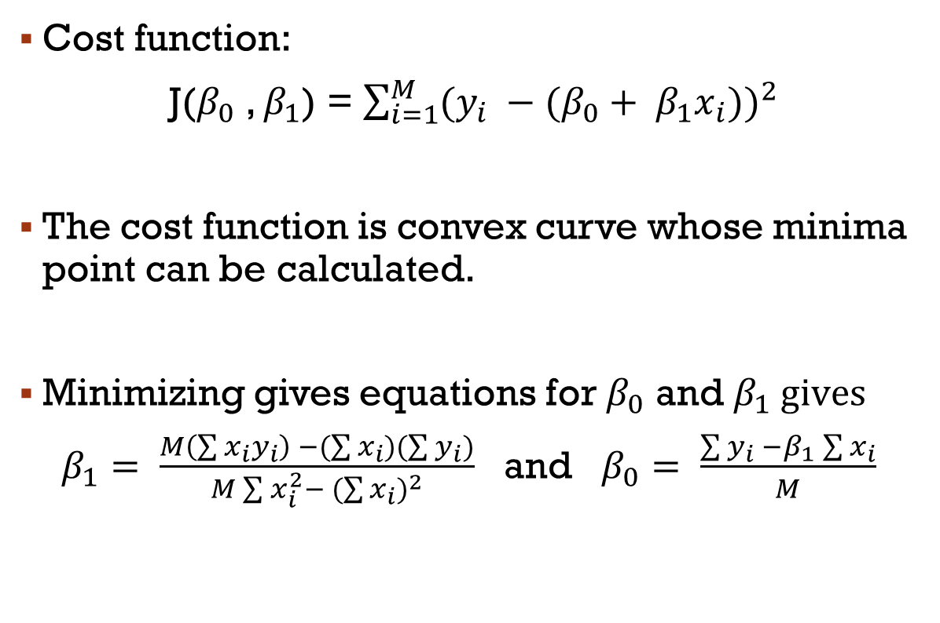
Cost function of Linear Regression
Cost function:
J($β_{0}$ , $β_{1}$) = $\sum_{i=1}^{M}{{({y_{i} −(β}_{0}+ β_{1}x_{i}))}^{2}}$
The cost function is convex curve whose minima point can be calculated.
Minimizing gives equations for $β_{0}$ and $β_{1} gives$
$β_{1}= \frac{M\left(\sum{x_{i}y_{i}}\right) −(\sum{x_{i}})(\sum{y_{i}})}{M\sum{x_{i}^{2}}− {(\sum{x_{i}})}^{2}}$ and $β_{0}= \frac{\sum{y_{i}} −β_{1}\sum{x_{i}}}{M}$
Fig2. Cost function

Slide 6
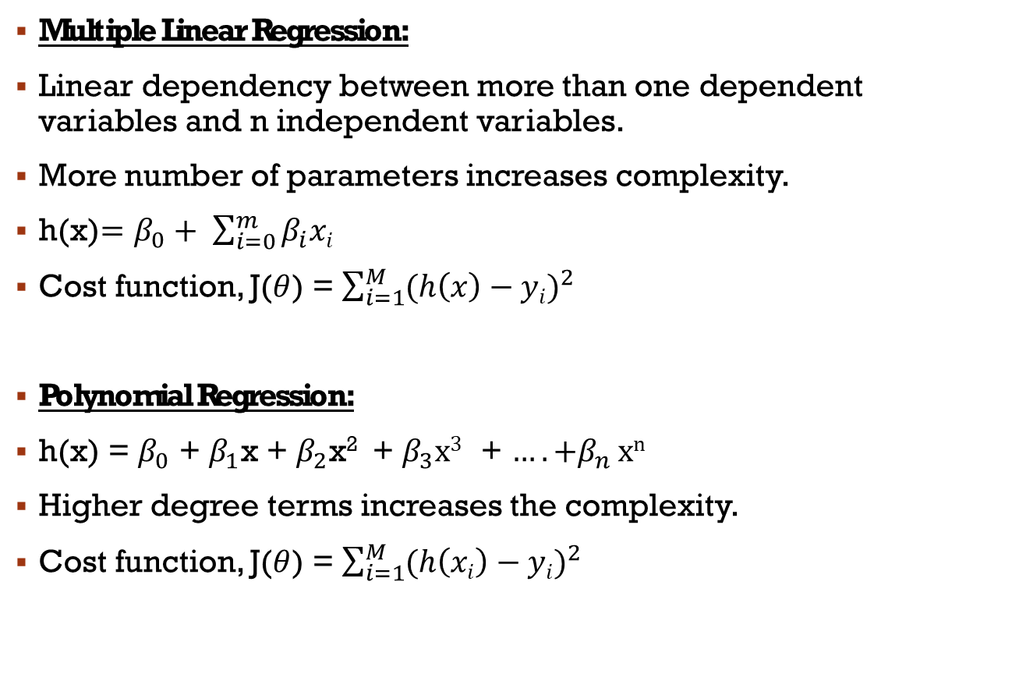
Multivariate linear regression and polynomial regression
Multiple Linear Regression:
Linear dependency between more than one dependent variables and n independent variables.
More number of parameters increases complexity.
h(x)$=β_{0}+ \sum_{i=0}^{m}{β_{i}xi }$
Cost function, J($θ$) = $\sum_{i=1}^{M}{{(h\left(x\right)−yi)}^{2}}$
Polynomial Regression:
h(x) = $β_{0}$ + $β_{1}$x + $β_{2}$x² + $β_{3}x3$ + $….+β_{n}$ $xn$
Higher degree terms increases the complexity.
Cost function, J($θ$) = $\sum_{i=1}^{M}{{(h\left(xi\right)−yi)}^{2}}$
Fig3. Multiple Linear Regression
Fig4. Polynomial Regression

Slide 7
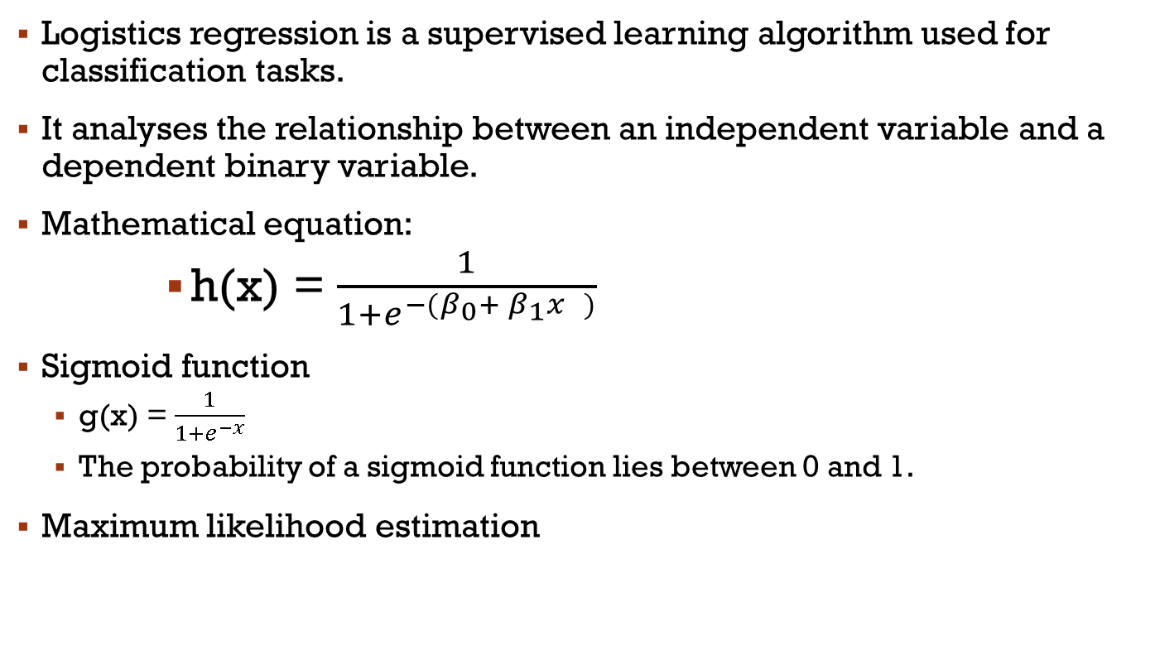
Logistics regression
Logistics regression is a supervised learning algorithm used for classification tasks.
It analyses the relationship between an independent variable and a dependent binary variable.
Mathematical equation:
h(x) = $\frac{1}{1+e^{−(β_{0}+ β_{1}x )}}$
Sigmoid function
g(x) = $\frac{1}{1+e^{−x}}$
The probability of a sigmoid function lies between 0 and 1.
Maximum likelihood estimation
h(x)
0.5
Fig5. Sigmoid FUnction

Slide 8
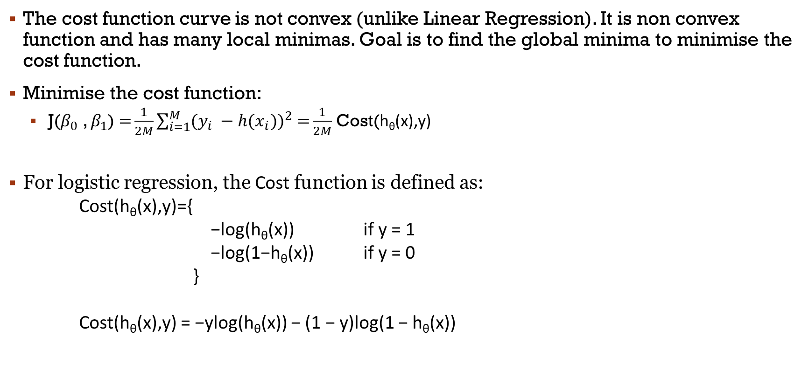
Cost function of logistics regression
The cost function curve is not convex (unlike Linear Regression). It is non convex function and has many local minimas. Goal is to find the global minima to minimise the cost function.
Minimise the cost function:
J($β_{0}$ , $β_{1}$) $={\frac{1}{2M}}\sum_{i=1}^{M}{{({y_{i} −h(x}_{i}))}^{2}}$ $={\frac{1}{2M}}$ Cost(h_{θ}(x),y)
For logistic regression, the Cost function is defined as:
Cost(h_{θ}(x),y)={
−log(h_{θ}(x)) if y = 1
−log(1−h_{θ}(x)) if y = 0
}
Cost(h_{θ}(x),y) = −ylog(h_{θ}(x)) − (1 − y)log(1 − h_{θ}(x))
Fig6. Cost function

Slide 9
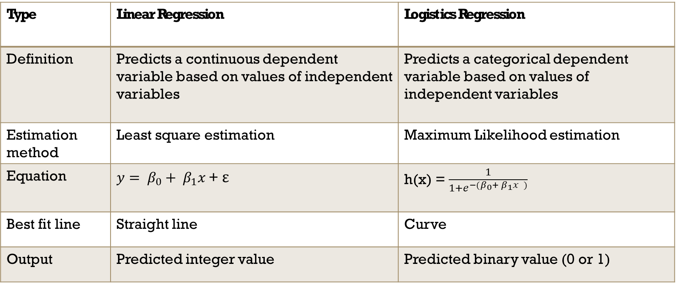
Difference of linear and logistics regression
Type | Linear Regression | Logistics Regression
Definition | Predicts a continuous dependent variable based on values of independent variables | Predicts a categorical dependent variable based on values of independent variables
Estimation method | Least square estimation | Maximum Likelihood estimation
Equation | $y= β_{0}+ β_{1}x$+ ε | h(x) = $\frac{1}{1+e^{−(β_{0}+ β_{1}x )}}$
Best fit line | Straight line | Curve
Output | Predicted integer value | Predicted binary value (0 or 1)

Slide 10
Decision tree
It is a supervised learning algorithm, which can be used for both regression and classification problems.
Basically a tree where every single node represents a test on an input attribute, based on the result, it branches and at leaf nodes the output value or class of the input variable is present.
It selects the best attribute to split the data based on a metric such as entropy or Gini impurity. The goal is to find the attribute that maximizes the information gain or the reduction in impurity after the split.
Entropy, H = -∑p_{i}log₂(p_{i})
Gini impurity, G = (1 - ∑p_{i}) ² where p_{i} is the proportion of elements in the set that belongs to the i^{th} category

Slide 11
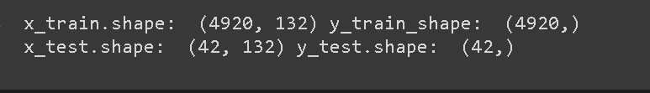

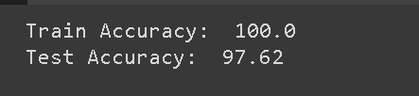
Implementation on a dataset (from Kaggle)
The complete dataset contains 2 CSV files.
Each CSV file has 133 columns. 132 of these columns are symptoms that a person experiences and last column is the prognosis.
These symptoms are mapped to 42 diseases you can classify these set of symptoms to.
The dataset shape after splitting the dataset into attributes and labels
Accuracy score of Logistics Regression on the given dataset
Accuracy score of Decision Tree Algorithm on the given dataset

Slide 12
References
NPTEL lectures: https://www.youtube.com/playlist?list=PLIg1dOXc_acbdJo-AE5RXpIM_rvwrerwR
Google Colab Notebook: https://colab.research.google.com/drive/1WSHYdYFMROglYG647q4RwqugCf6Jtp6t#scrollTo=qxiSySIeX9GR
Data set from Kaggle : https://www.kaggle.com/datasets/kaushil268/disease-prediction-using-machine-learning?resource=download
Chapter 18 : Artificial Intelligence A modern Approach 3rd Ed. By S.Russell and P.Norvig

Slide 13




Thank you

