Slide 1
Introduction to Strength of Materials
ME-203
³⁰ ^{th} APRIL-4 th MAY 2021
ME-203
INTRODUCTION TO STRENGTH OF MATERIALS
Presented by : DM ,Technology Campus, University of Calcutta, Kolkata-700106, India

Slide 2
Contents
Introduction.
Concept of Stress & Strain.
Mathematical Expression for normal & Shearing stress.
Explanations with figure.
Axial Stress
Strain-Linear & Lateral
Stress-Strain relation
Stress-Strain Curves.
Hooke’s Law, Proportionality limit,Yield Point,UTS etc
Factor of Safety
Proof Stress
Relevant Numerical.
Q & Answer Session.

Slide 3
Introduction
Before going to start we must keep in mind that our intention to study this topic for those body are of deformable in nature. Which means under the action of external load or force there will be appreciable deformation. Bodies are of deformable in nature, rather than the concept of rigid body , which in case of Engineering Mechanics we considered. In this chapter the formal definition of stress is explained. The expression for stress and strain are derived with the following assumptions.
For the range of forces applied the material is elastic i.e. it can regain it’s original shape and size, if the applied force is withdrawn.
Material is homogeneous i.e. every particle of the material possesses identical mechanical properties.
Material is isotropic in nature, i.e. the material possess identical mechanical property at any point in any direction.
Presenting the typical stress-strain curve for a typical Mild steel(MS), the commonly referred terms like limits of elasticity and proportionality, yield points, ultimate strength and strain hardening are explained.

Slide 4
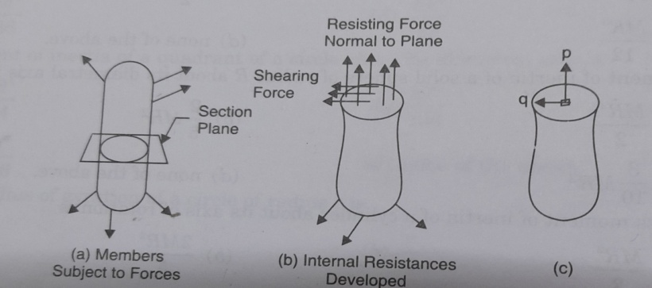
Concept of Stress
When a member is subjected to loads it develops resisting forces. To find the resisting forces developed a section plane may be passed through the member and equilibrium of any one part may be considered. Each part is in equilibrium under the action of applied forces and internal resisting forces. The resisting forces may be conveniently split into normal and parallel to the section plane. The resisting force parallel to the plane is called shearing resistance. The intensity of resisting force normal to the sectional plane is called intensity of normal stress.(Ref fig 1(b))
Figure-1

Slide 5

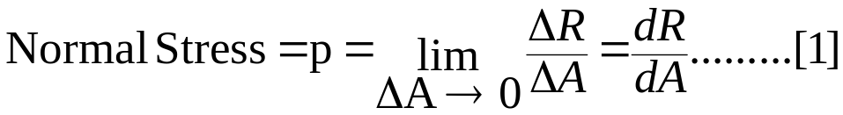
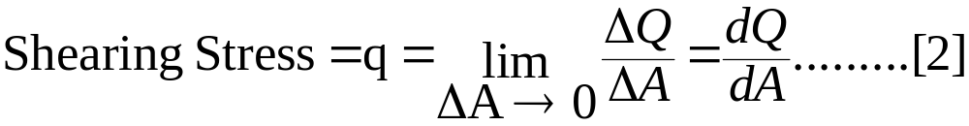
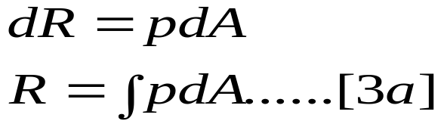

Mathematical expression
In practice, intensity of stress is called as “stress” only. And expressed as mathematically
Where R is normal resisting force. Intensity of resisting force parallel to the sectional plane is
called shearing stress.
Where Q is Shearing Resistance.
Thus, stress at any point may be defined as resistance developed per unit area. From eqn[1] and eqn[2] it follows that
At any cross-section, stress developed may or may not be uniform. In a bar of uniform cross-section subjected to axial concentrated loads as shown in fig 2; but there is variation of stress at the section near applied loads (2c).

Slide 6
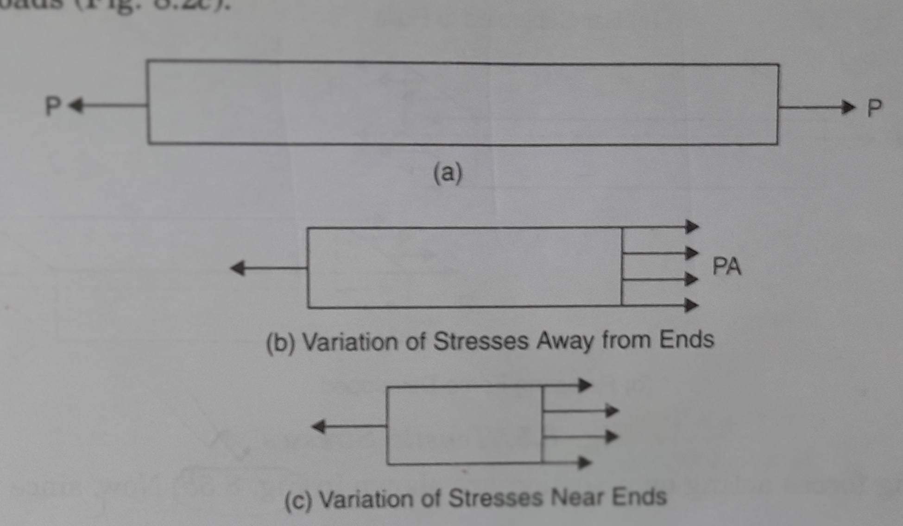
Explanation with figure-2
Figure-2

Slide 7
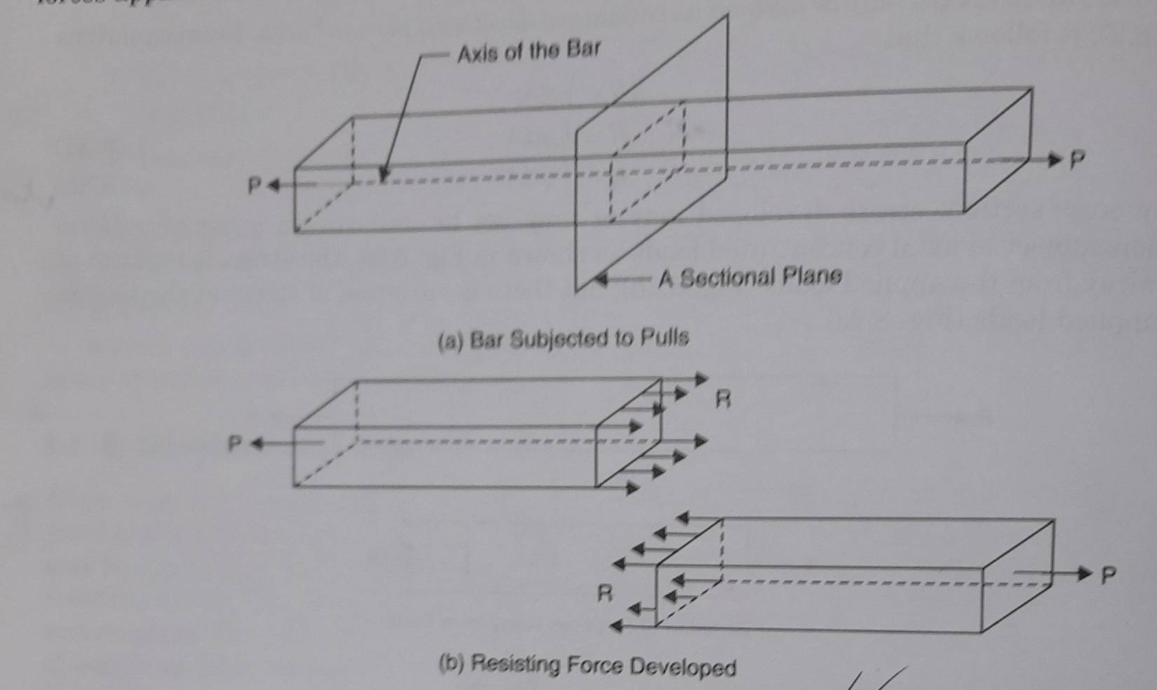
Explanation with figure-3
Axial Stress :
Let us consider a bar of rectangular cross-section is subjected to force P as per figure -3 . To maintain the equilibrium the force applied at the end faces must be same, say P.
Figure-3

Slide 8
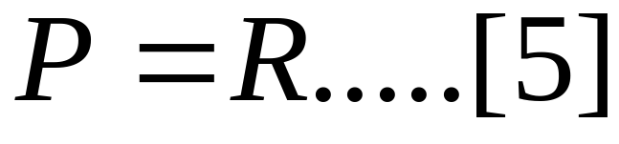
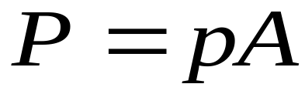
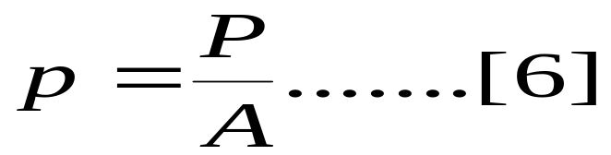
The resisting force acting on a section are shown in figure-3(b). Now, Science the stress are uniform .
Where A is the cross sectional area. Considering equilibrium of cut piece of the bar, we get
From eqn [4] & [5] we get
Thus, in case of axial load P the stress developed is equal to the load per unit area. Under this type of normal stress the bar is being extended. Such stress which is causing extension of the bar is called tensile stress.
A bar subjected to equal forces pushing the bar is shown in fig-4 it causes shortening of the bar. Such forces which are causing shortening , are known as compressive forces and corresponding stress as compressive stresses.

Slide 9
Thus, in case of axial load P the stress developed is equal to the load per unit area. Under this type of normal stress the bar is being extended. Such stress which is causing extension of the bar is called tensile stress.
A bar subjected to equal forces pushing the bar is shown in fig-4 it causes shortening of the bar. Such forces which are causing shortening , are known as compressive forces and corresponding stress as compressive stresses.

Slide 10
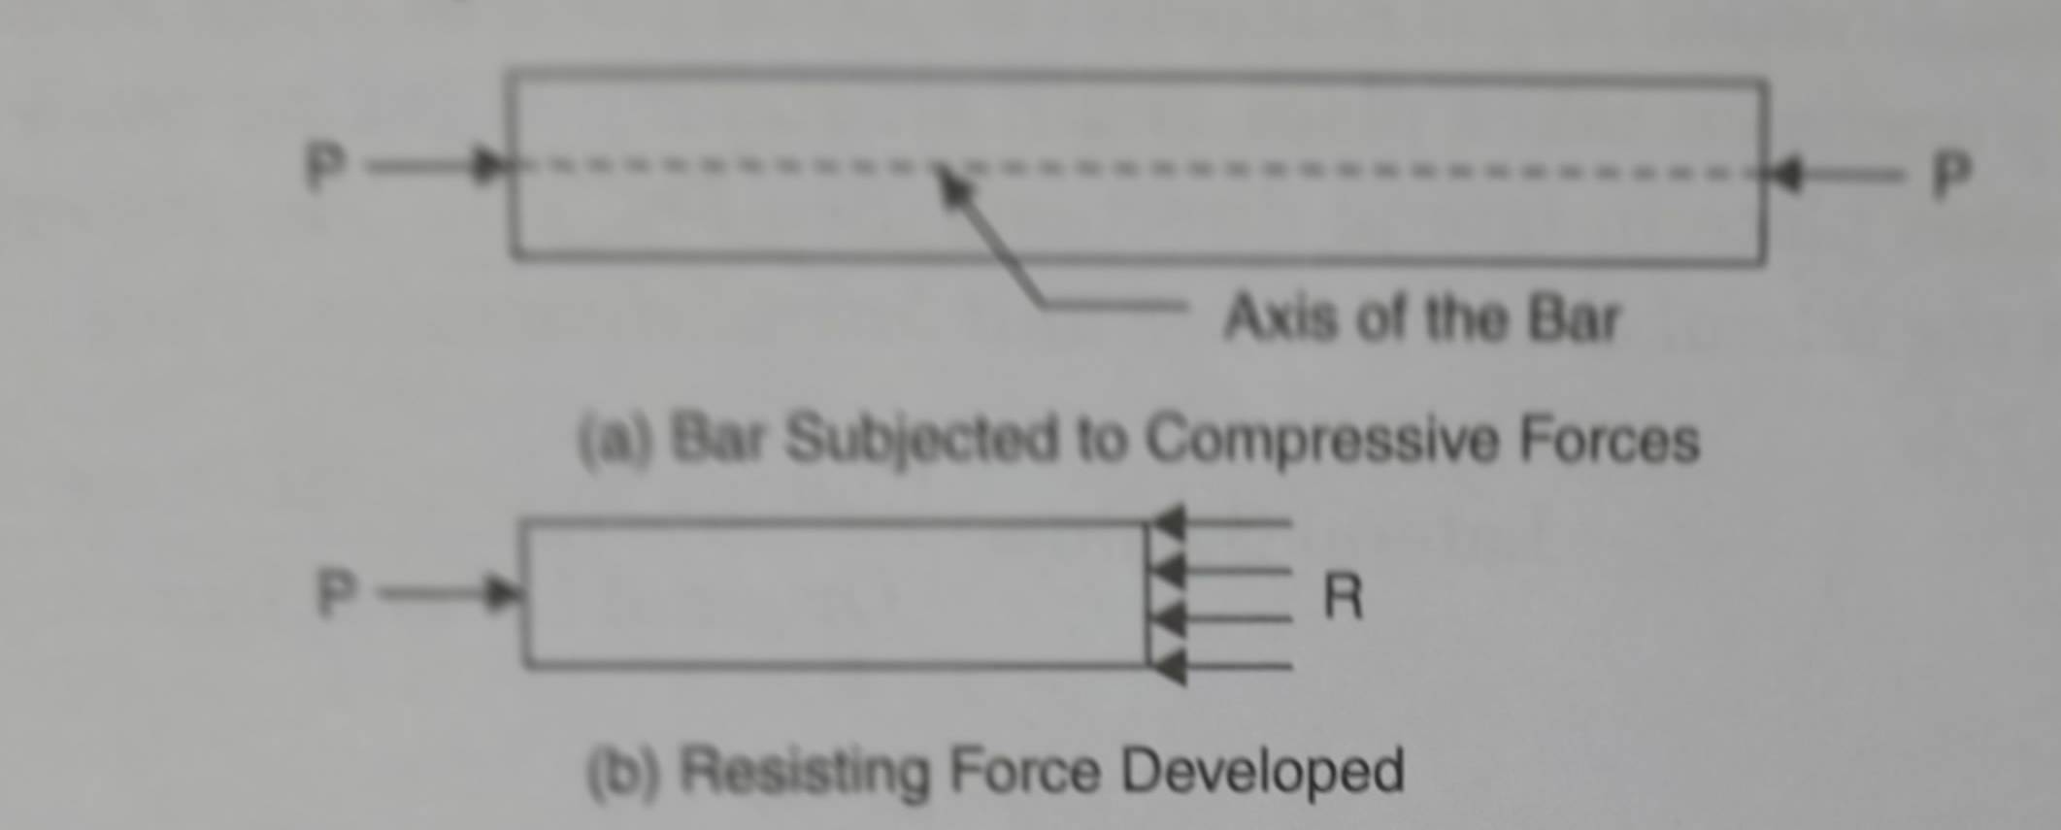
Explanations with figure
Figure-4

Slide 11
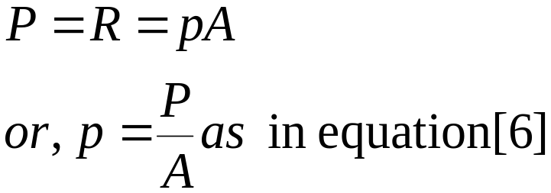
For equilibrium of the piece of the bar
Thus, Whether it is tensile, or compressive, the stress developed
in a bar subjected to axial forces is equal to load per unit area.

Slide 12
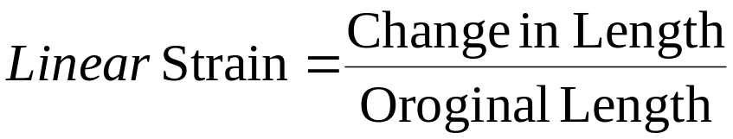
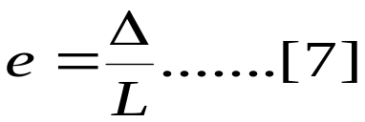
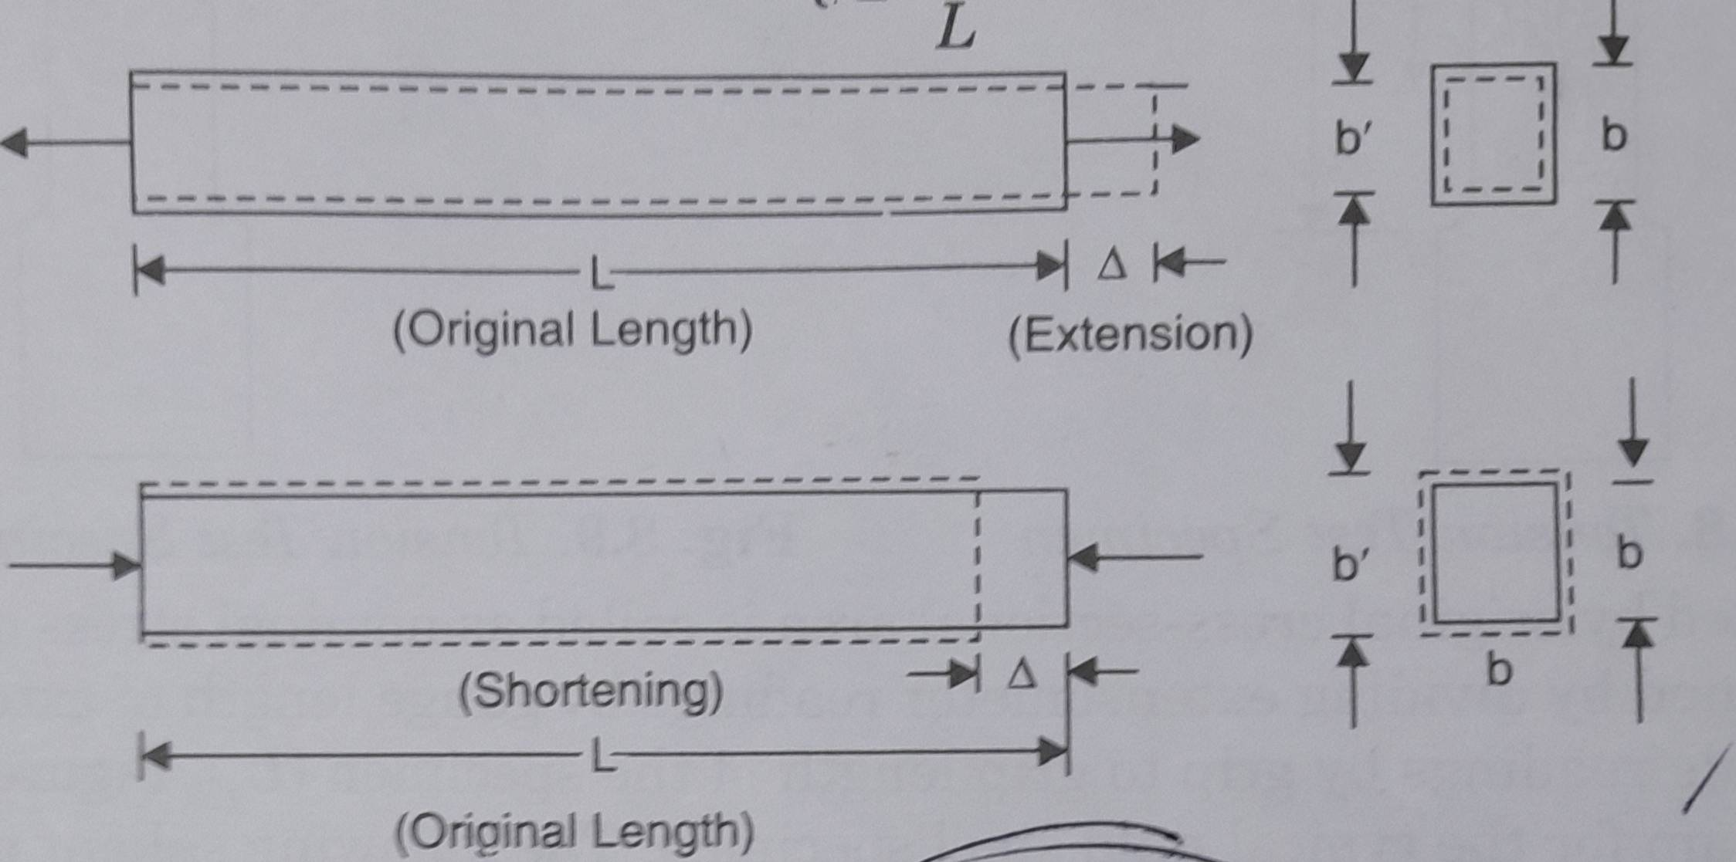
The studies have shown that the bars extend under tensile force and shorten under compressive forces as shown in fig-5. The change in length per unit length is known as linear strain. Thus,
Figure-5

Slide 13
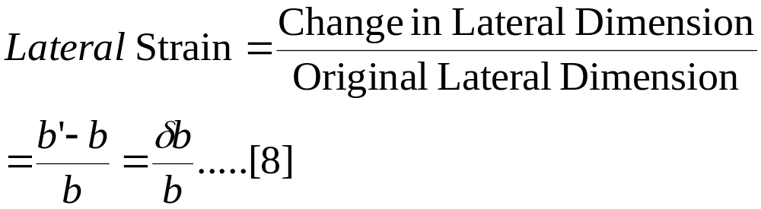
When changes in longitudinal direction is taking place changes in lateral direction also takes place. The nature of these changes in lateral direction are exactly opposite to that of changes in longitudinal direction i.e, if extension is taking place in longitudinal direction, the shortening of lateral dimension takes place and if shortening is takes place in lateral directions (as per figure-5). The lateral strain may be defined as changes in the lateral dimension per unit lateral dimension.
Thus,
Stress-Strain Relation:
The stress-strain relation of any engineering material is obtained by conducting tensile testing in the laboratories on standard specimen. Different materials behaves differently and their behavior in tension and in compression differ slightly.

Slide 14
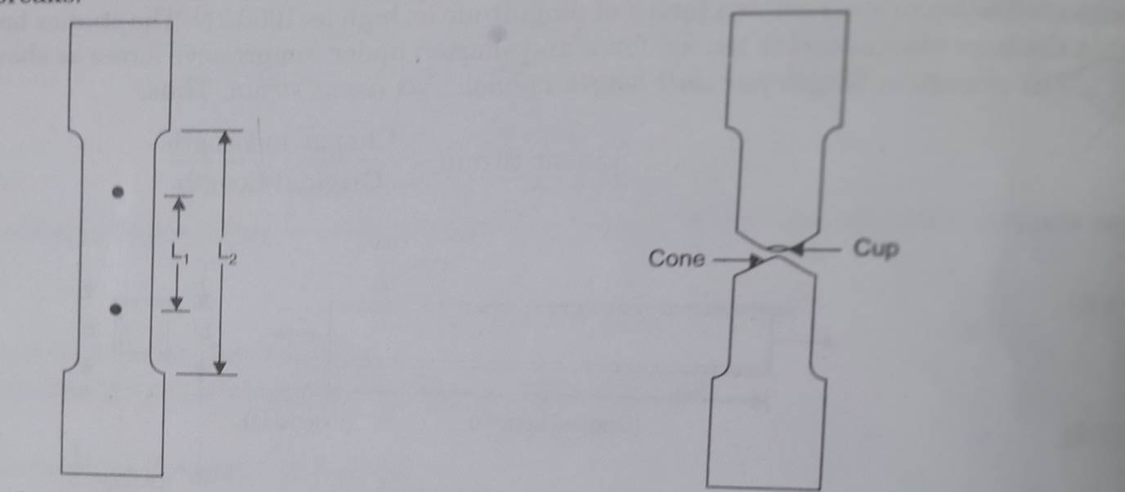
Behaviour in Tension in :
Mild Steel[] [figure-6 ]shows a typical tensile test specimen of mild steel. It’s end are gripped into universal testing machine. Extensometer []is fitted to test specimen which measures extension over the length L₁,(shown in figure-6). The length over which extension is measured is called gauge length. The load is applied gradually and at regular interval of loads and extension is measured . It is observed that after certain load, extension increases at faster rate and capacity of extensometer to measure extension comes to at an end, and hence, it is removed before this stage is reached and extension is measured from the scale on the universal testing machine[]. Further load is increased gradually till the specimen breaks.
Figure-6 and Figure-7

Slide 15
Load divided by original cross-sectional area is called as nominal stress or simply as stress. Strain is obtained by dividing extensometer readings by gauge length(L1).
In investigation of mechanical properties of materials the relation between stress and corresponding strain is usually represented graphically by stress-strain diagram obtained experimentally from a standard tensile test[]. A typical stress-strain diagram for Mild steel (MS)[] is plotted from experimental data,(as shown in figure-8a)where the axial strain are plotted as abscissa and the corresponding stress is given by ordinates of the curve OABCDE. From O to A the stress is proportional to the strain. Beyond A, the deviation from Hook’s law becomes marked; hence the stress at A represents the proportional limit. This is usually found to lie some where in between 206 N/mm² and 248 N/mm²(30000psi and 36000 psi) for a low carbon steel. Upon loading of the specimen beyond the proportional limit, the elongation incase more rapidly and the diagram becomes nonlinear. At B, elongation of the specimen begins to take place without any appreciable increase in load and the material is said to be become plastic. This phenomena called yielding, continues until the test bar may stretch up to the proportional limit. The stress at which this yielding begins is called the yield point of the steel. This behavior results from the slip associated with the appearance of Lueder Lines[will be discussed later on] .

Slide 16
This indicates that the phenomena of yielding is really an indirect manifestation of failure of the material in shear plane along 45⁰ (with the longitudinal axis of specimen) planes of maximum shear stress. At point C, the material begins to strain harden[], recovers some of it’s elastic property, and with further elongation the stress-strain curve climbs to point D, representing the maximum tensile stress or the ultimate strength. Beyond point D, further stretching of the bar is accompanied by a decrease in the load and fracture takes place suddenly at a point E. The fact that the nominal stress at E is less than the ultimate strength at D is somewhat misleading. As failure develops between D and E, the test bar gradually necks down in short region somewhere along it’s length as shown in figure in figure-9 . This phenomena again is the result of shear slip along 45⁰ - planes which causes a pronounced decrease in the cross sectional area at the narrowest part of the neck. If for each value of the strain between C and E, the tensile load P is divided by the reduced cross sectional area, it will be found that the true stress-strain curve will follow the dotted line CE’. However, it is established practice to calculate the ultimate strength on the basis of the original or nominal cross sectional area A of the specimen without regard to the reduction of area. Structural steel is the only material that exhibits a pronounced yield point.

Slide 17
Other materials show a more or less gradual transition from the linear to the nonlinear range, and even the proportional limit is rather indefinite. As an example of the tensile behavior of a brittle material, a stress-strain diagrams for cast- iron[]
Is shown in figure-11. This material has a very low proportional limit and shows no yield point.
Stress-strain diagrams for axial compression of various materials can also be obtained and such characteristic stresses as the proportional limit, yield point, and ultimate strength can be found. In the case of steel this characteristics for compression are found to have the same values as for tension.
Working Stress:
A tensile stress diagram gives valuable information on the mechanical properties of a material. Knowing the limit of proportionality, the yield point, and the ultimate strength of material, it is possible to establish for each particular engineering problem the magnitude of the stress which may be considered a safe stress. This stress is usually called the working stress.
In choosing the magnitude of the working stress for steel it must be taken into consideration that at stresses below the proportional limit the material may be considered as perfectly elastic, and beyond this limit a part of the strain usually remains after unloading the bar ,i.e., permanent set occurs.

Slide 18
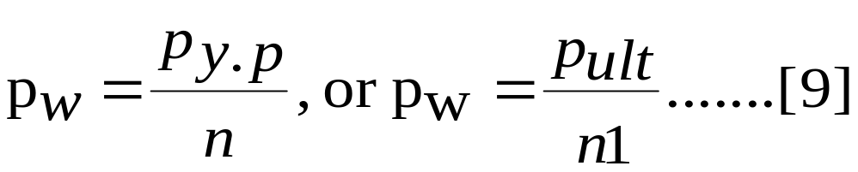
In order to have the structure in an elastic condition and to remove the possibility of a permanent set, it is usual practice to keep the working stress well below the proportional limit. In the experimental determination of this limit, sensitive measuring instruments(extensometers) are necessary and the position of the limit depends to some extent upon the accuracy with which the measurements are made. In order to eliminate this difficulty, one usually takes the yield point or the ultimate strength of the material as a basis for determining the magnitude of the working stress. Denoting p_{w}, p_{y.p}, p_{ult} respectively the working stress , the yield point, and the ultimate strength of material, the magnitude of the working stress will be determined by one of the two following equations:

Slide 19
Here , n and n₁ are usually called factors of safety, which determine the magnitude of working stress. In the case of structural steel, it is logical to take the yield point as the basis for calculating the working stress, because here a considerable permanent set may occur which is not permissible in engineering structures. In such a case a factor of safety n=2 will give a conservative value for the working stress provided that only constant loads are acting upon the structure. In the cases of suddenly applied loads or variable loads(and these occur very often in machine parts) , larger factors of safety may be necessary. For brittle material such as cast iron, concrete , and various kind of stone and for such material as wood, the ultimate strength is usually taken as a basis for determining the working stresses. The magnitude of the factor of safety depends very much upon the accuracy with which the stresses the external forces acting upon a structure are known, upon the accuracy with which the stress in the members of a structure may be calculated , and also upon the homogeneity of materials used. The common practice of speaking of working stresses and factors of safety based on some characteristic stress such as the yield point of steel or ultimate strength of cast iron is somewhat dangerous and misleading. IF P₁, P₂, P₃,……P_{k} are a set of external loads for a structure , what we really mean by a factor of safety n is that if all these loads are increased to nP₁, nP₂, nP₃,……., nP_{k}, the structure will be just on the verge of failure, where “failure” of course must be clearly defined. It may mean, in the case of a steel structure, that collapse due to yielding of some members can occur, or , in case of a concrete structure, that some members is on the verge of fracture.

Slide 20
The Yield strength is defined as the maximum stress at which a marked increase in elongation occurs without increase in the load. Many varieties of steel, especially heat-treated steels and cold drawn steels, do not have a well defined yield point on the stress-strain diagram. As in figure-10, the material yields gradually after passing through the elastic limit E. If the loading is stopped at the point Y at a stress level slightly higher than the elastic limit E, and the specimen is unloaded and readings taken, the curve would follow the dotted line and a permanent set or plastic deformation will exist. The strain corresponding to this permanent deformation is indicated by OA. For such materials, which do not exhibit a well-defined yield point, the yield strength ids defined as the stress corresponding to a permanent set of 0.2% of gauge length. In such cases, the yield strength isb determined by the offset method. A distance OA equal to 0.002 mm/mm strain(corresponding to 0.2% of gauge length) is marked on the X-axis. A line is constructed from the point A parallel to straight line portion OP of the stress-strain curve. The point of intersection of this line and stress-strain curve is called Y or the yield point and the corresponding stress is called 0.2% yield strength.

Slide 21
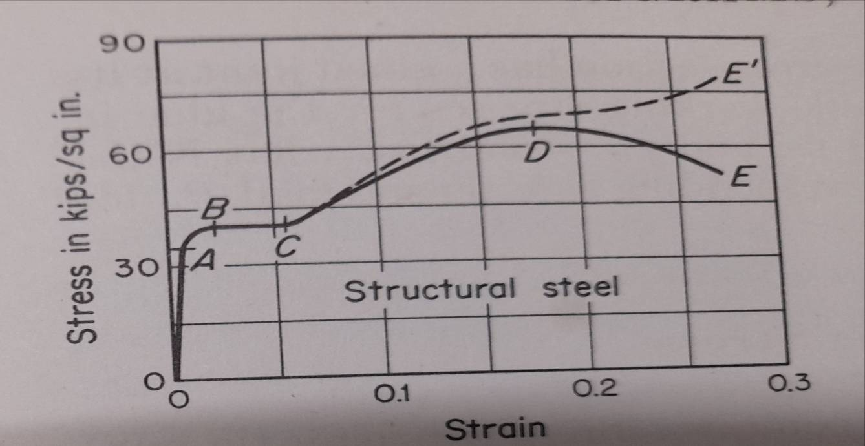
The term proof load or proof strength are frequently used in design of fasteners. Proof strength is similar to yield strength. It is determined by the offset method ; However the offset in this case is 0.001 mm/mm corresponding to a permanent set of 0.1% of gauge length. 0.1% Proof strength denoted by a symbol Rp0.1,is defined as the stress which will produce a permanent extension of 0.1% in the gauge length of the test specimen. The proof load is the force corresponding to proof stress.
Figure-9(a)

Slide 22
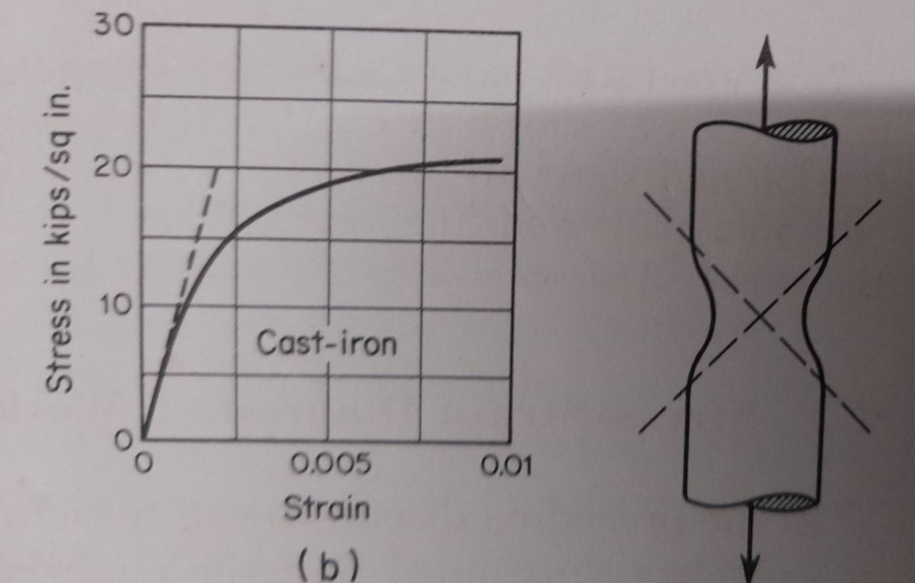
Figure-9[b] and 9[c]

Slide 23
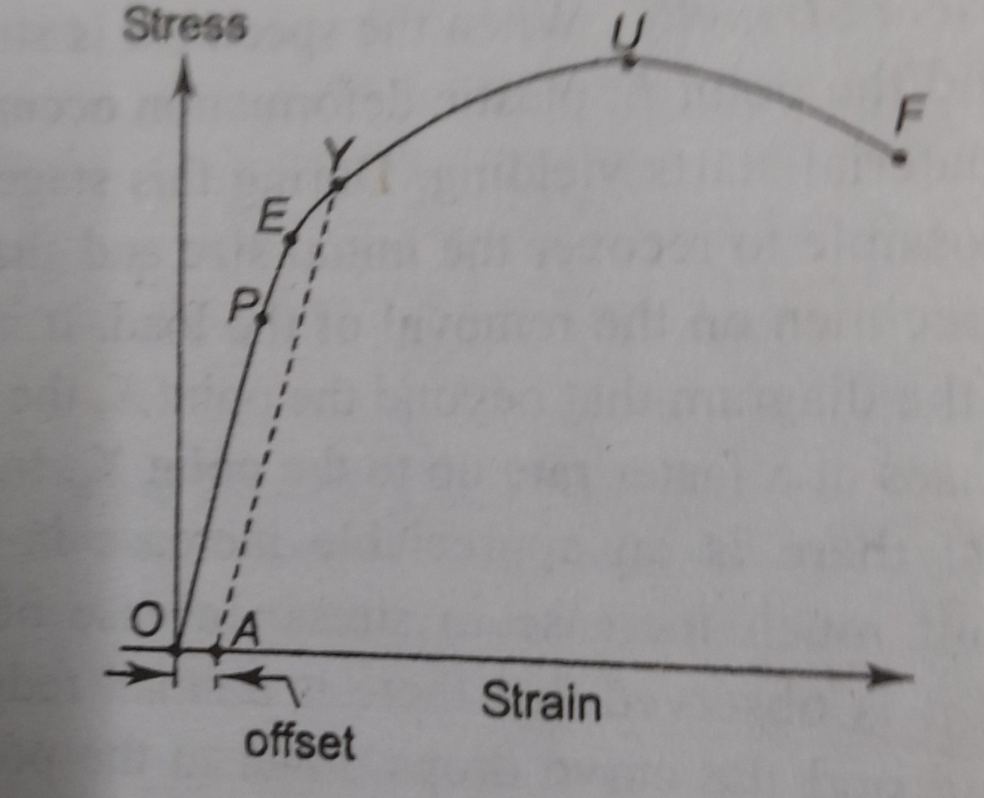
Figure-10

Slide 24
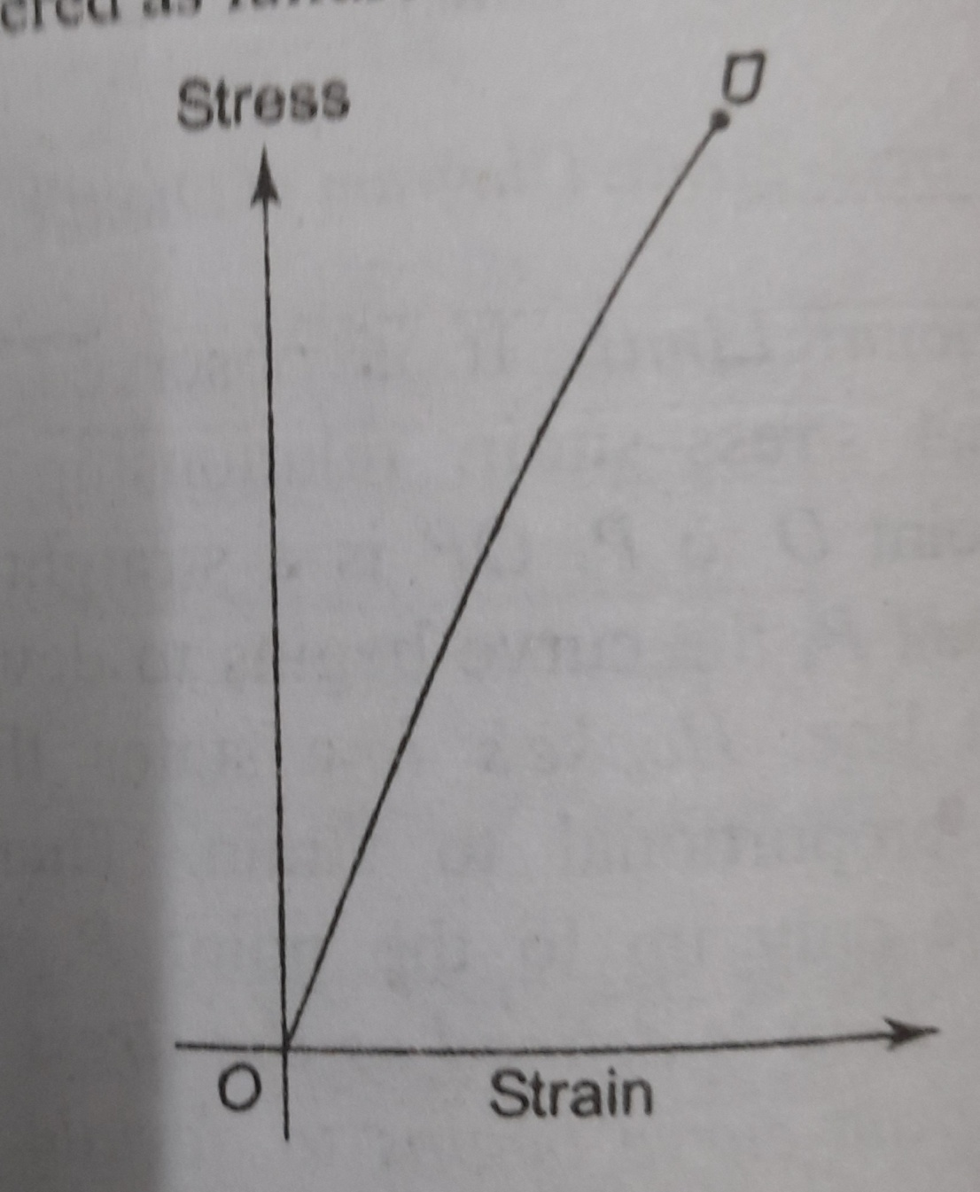
Figure-11

Slide 25
In order to have the structure in an elastic condition and to remove the possibility of a permanent set, it is usual practice to keep the working stress well below the proportional limit. In the experimental determination of this limit, sensitive measuring instruments(extensometers) are necessary and the position of the limit depends to some extent upon the accuracy with which the measurements are made. In order to eliminate this difficulty, one usually takes the yield point or the ultimate strength of the material as a basis for determining the magnitude of the working stress. Denoting p_{w}, p_{y.p}, p_{ult} respectively the working stress , the yield point, and the ultimate strength of material, the magnitude of the working stress will be determined by one of the two following equations:

Slide 26
Thank You…
Q&A
Contact Details of Presenter:
E-mail, Phone Number etc..
E-mail:dmmechanical2021@gmail.com
Phone No. 9903916836

