Slide 1
Electrostatics
Do NOW: What do you think electrostatics means?
Electro- Electricity/charged particles
Static-stationary/ not moving
Electrostatics- the study of stationary charges

Slide 2
Three Particles
Proton (p)
  Charge= +1.6x10⁻¹⁹C=+1e
  Mass=m_{p}=1.66x10⁻²⁷kg
Electron (e)
  Charge= -1.6x10⁻¹⁹C=-1e
  mass=m_{e}=9.11x10⁻³¹kg
Neutron (n)
  Charge= neutral =0e
  Mass=m_{n}=1.67x10⁻²⁷kg
BOTH protons and electrons are elementary charges!

Slide 3
The Coulomb
The basic unit of charge is the Coulomb
  You MUST be in Coulombs when you plug into a formula
1C=6.25x10¹⁸e (elementary charges)
1e=1.6x10⁻¹⁹C

Slide 4
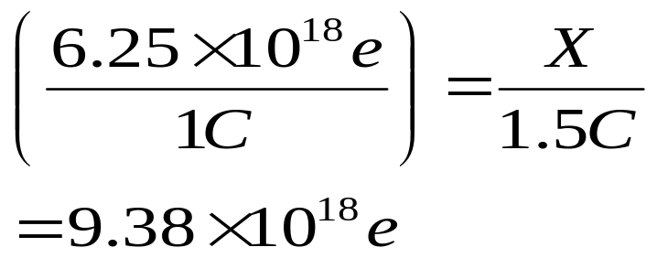
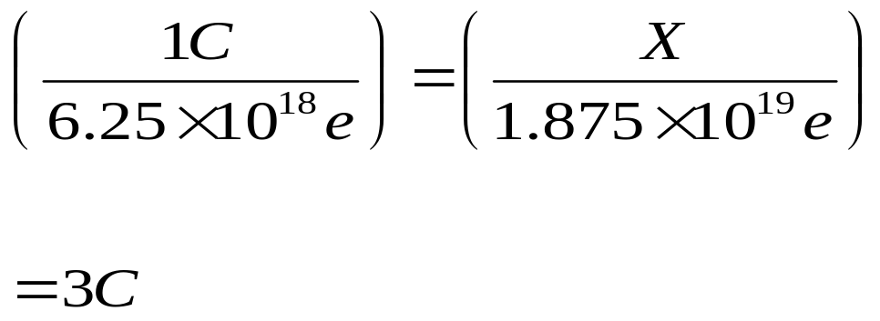
Practice
How many elementary charges are in 1.5C of charge?
How many coulombs of charge are 1.88x10¹⁹ protons?

Slide 5
Conductors vs. Insulators
Conductors
Allow electrons to flow freely through the material
Usually materials with loosely bound valence electrons
  Metals
  Ionic solutions
Insulators
Do not allow electrons to flow freely through the material
Usually materials with tightly bound valence electrons
  Rubber
  Wood

Slide 6
Separation of charge
Neutral objects have an equal number of protons and electrons.
If a charged object is brought near a neutral object, the charged object can cause the charges in the neutral object to separate.
ONLY ELECTRONS CAN MOVE!!!!
Example: Pith Ball
+
NEUTRAL OBJECTS
ATTRACT BOTH
POSITIVE AND
NEGATIVE THINGS!!
+
As the negative rod comes close, it repels the negative charges. Because opposites attract, the positive side of the pith ball will attract to the negative rod.
+
As the positive rod comes close, it attracts the negative charges. Because opposites attract, the negative side of the pith ball will attract to the positive rod.
+
+
+
+
-
-
-
-
-
-
-
+
-
-
+
-
-
+
+
-
+
+
-
-
+
-
+

Slide 7
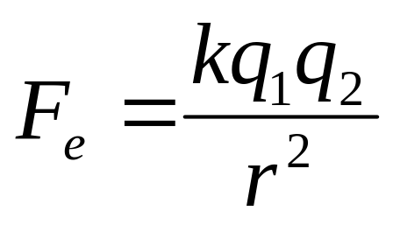
Coulomb’s Law the force between two charges
F_{e} – Electric Force (N)
k – Electrostatic constant (8.99x10⁹Nm²/C²)
q₁ - the charge of the first object (C)
q₂ - the charge of the second object (C)
r - the distance between the centers of the two charged objects(m)

Slide 8
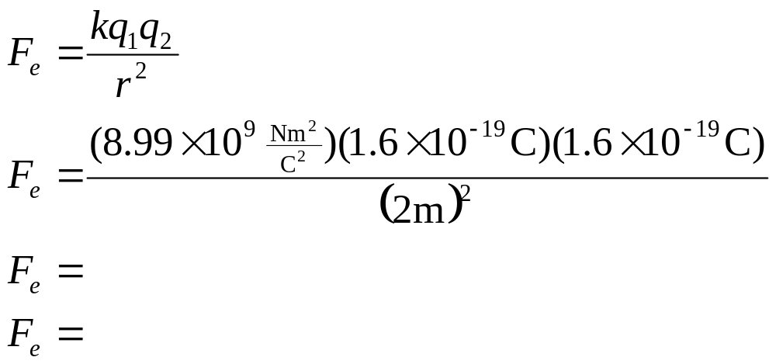
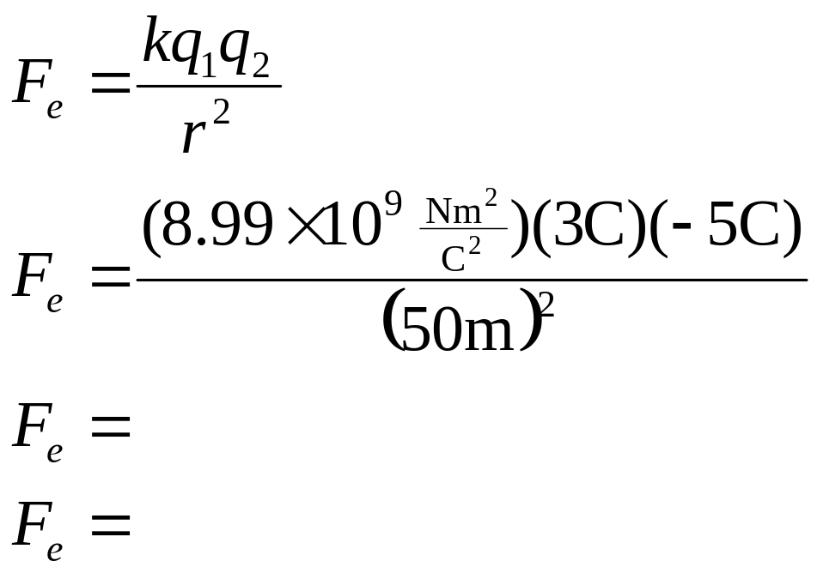
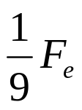
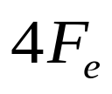

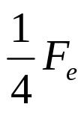
Examples
What is the electrostatic force between two protons separated by a distance of 2m?
What is the electrostatic force between a 3C sphere and a -5C sphere separated by 50m?
What happens to the electrostatic force between two objects if the
  distance is tripled?
  distance is halved?
  charge of one object is quadrupled?
  charge of both objects are halved?

Slide 9

Electrostatic Force Graphically
F_{e}
F_{e}
q
r

Slide 10
Example Problems
What is the magnitude of the electrostatic force between a charge of +3.0x10⁻⁵ C and a charge of + 3.0x10⁻⁶ C separated by 0.3m?
Do they repel or attract?
Example Problems
A point charge of -1.0x10⁻⁹C and a charge of + 3.0x10⁻⁹C separated by 5.0x10⁻² m what is the magnitude of the electrostatic force between them?
Do they repel or attract?

Slide 11
How to charge an object?
Glass and Silk
When a glass rod is rubbed with silk, the silk strips electrons from the glass.
  Silk gains electrons, so it becomes negative
  Glass looses electrons so it becomes positive
Rubber and Fur
When a rubber rod is rubbed with fur, the fur is striped of electrons by the rubber.
  fur looses electrons, so it becomes positive
  rubber gains electrons so it becomes negative

Slide 12
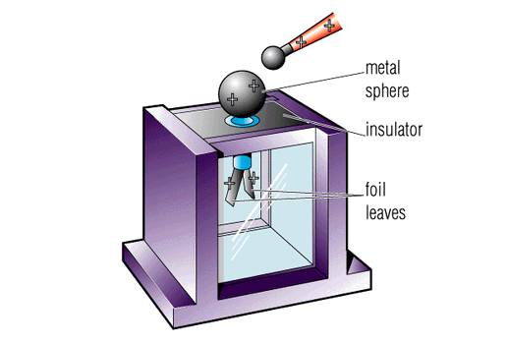
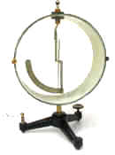
Electroscopes
(devices that shows charge)
Leaf electroscope
Braun Electroscope

Slide 13
Charging by Conduction
(with a negative Rod)
Charging by conduction means there is contact
Charge the rod negatively by rubbing it with fur
  What does that mean about its electrons?
Touch the electroscope with the negative rod
The excess charges from the rod will seek equilibrium and move into the electroscope
Remove the rod
The electroscope ends up with the same (negative) charge as the rod
  How do I know the electroscope is charged?
  What if I bring a negative rod back near it?
  What if I bring a positive rod near it?

Slide 14
Charging by Induction
(with a negative rod)
No contact, the charge is induced
Charge the rod negatively
Bring the rod close to, but do not touch, the electroscope (what do the electrons do)
Ground the electroscope by touching the top or the leaves (what do the electrons do?)
The excess charges seek equilibrium through the ground
Remove the ground first, then remove the charged rod (why?)
The electroscope is charged opposite the charge of the rod
+
+
+
+

Slide 15
Charging an Electroscope by conduction
Name____________________
Date___________________
To Charge it Positive
To charge it Negative
Steps | Movement/ Placement of charges | Picture
Steps | Movement/ Placement of charges | Picture

Slide 16
Charging an Electroscope by induction
To Charge it Positive
To charge it Negative
Steps | Movement/ Placement of charges | Picture
Steps | Movement/ Placement of charges | Picture

Slide 17
GOAL:
How many electrons are on your balloon?
assumptions
  Each balloon has the same charge
  The string has no mass
Hints:
  Free body diagram of each balloon
  Use the protractor to find an angle

Slide 18
Electrostatic Force on Balloons
Setup-uncharged
setup- charged
Materials:
-ring stand
-2 balloons
Tape
String
Protractor
Ruler
scale
Make sure strings are vertical

Slide 19
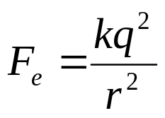
Plan of Action
Goal: number of electrons (elementary charges)
Need charge in Coulombs first (1e=1.6x10⁻¹⁹ C)
How do we get the charge in Coulombs?
  Can find them using coulomb’s law
  They were assumed to be the same so…
Need F_{e} and r
  F_{e} can be found using a free body diagram and the idea of equilibrium
  r can be measured
F_{e} = F_{x} which is the horizontal component
  We need the vertical component and the angle to find it
  The angle can be measured
  The vertical component is equal to the force of gravity
The force of gravity can be calculated (F_{g} =mg)
  g=9.81m/s²
  m can be measured on an electric balance (in Kg)

Slide 20
Balloon Free Body Diagram
F_{t}
F_{e}
F_{g}

Slide 21
Calculations
Show all work neatly on a separate sheet of paper. Include
  Diagrams
  Formulas
  Units
  Verbal explanations

Slide 22
Coulombs spheres
+4C
+4C
+5C
+3C
Examples: What is the charge on each conducting sphere after they are brought together and then separated
1)
2)
3)
-6C
-2C
-4C
-4C
-7C
+3C
-2C
-2C
+3C
-2C
-7C
-2C
-2C
-2C

Slide 23
Example Problems
A proton is located 3.0x10⁻⁷m away from an electron. What is the electric force felt by the proton?
Do they repel or attract?
Example Problems
Two identical charges separated by 5m feel an electric force of +80N. What is the magnitude of the charge of each?
Are the opposite or like charges?

Slide 24
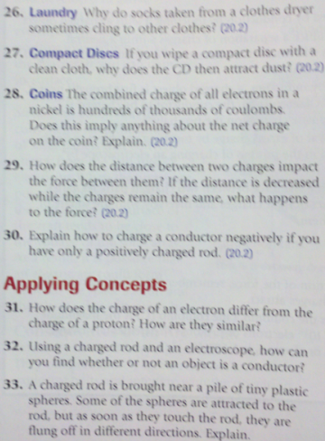
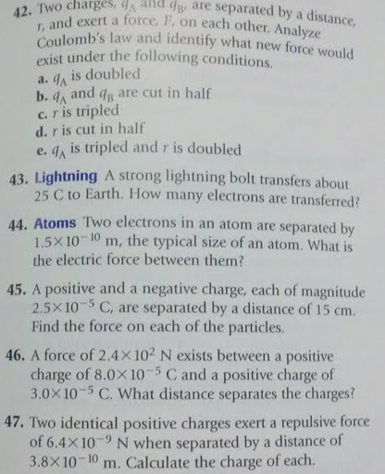

Slide 25
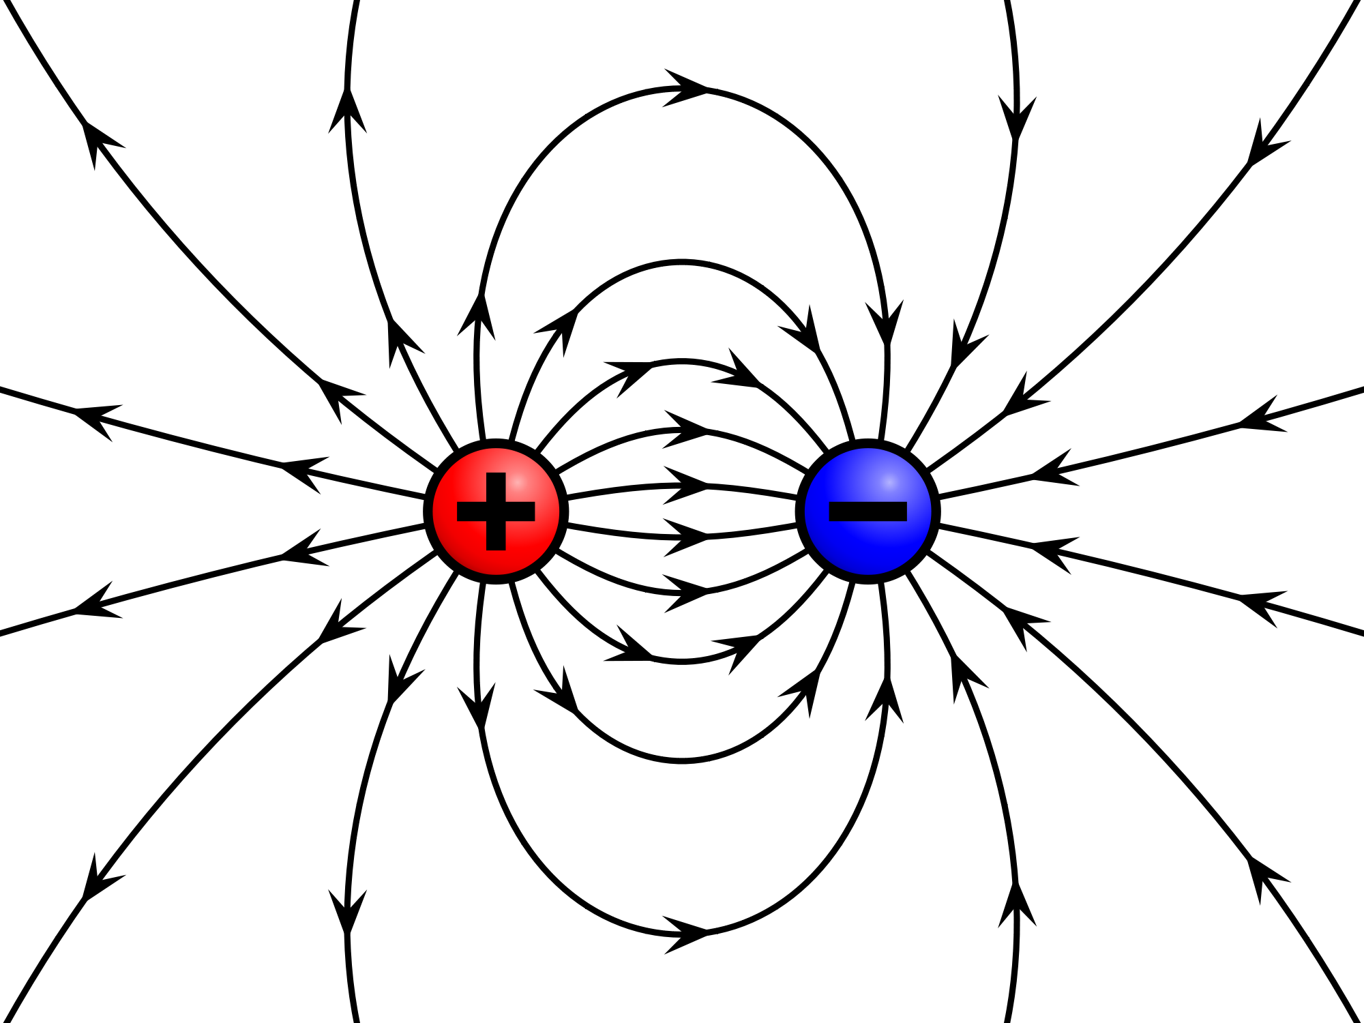
Electric Fields

Slide 26
Electric Fields
(vectors)
Use a Tiny Imaginary Proton (TIP) to see which way it would move near the object in question. The direction the TIP would move is the direction of the electric field.
P+
e-

Slide 27
Examples-Draw the Electric Fields
1. 2.
3. 4.
P+
P+
e-
P+
+ + + + + + + + + +
- - - - - - - - - - - - - -
- - - - - - - - - - - - - -
+ + + + + + + + + +

Slide 28
Electric Field Strength
E=F_{e}/q
What is the field strength if a 3.0C charge feels a force of 12N?
A -3.1µC charge is placed is an electric field of 2.3 N/C directed to the right.
  What is the magnitude of the force acting on the charge?
  What is the direction of that force?

Slide 29
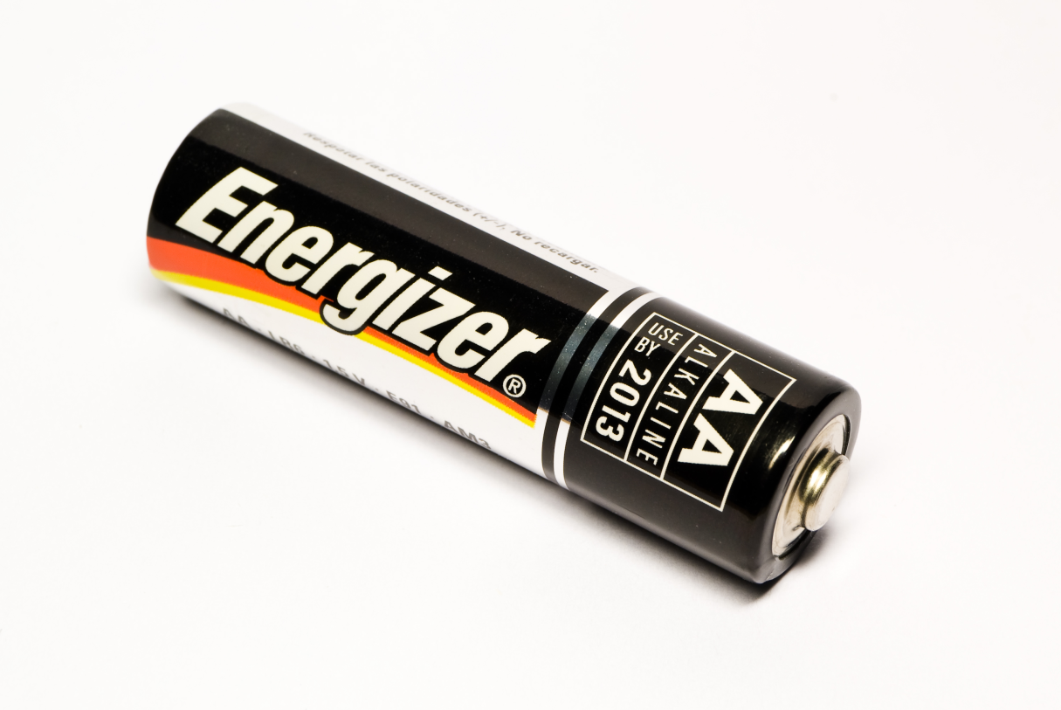
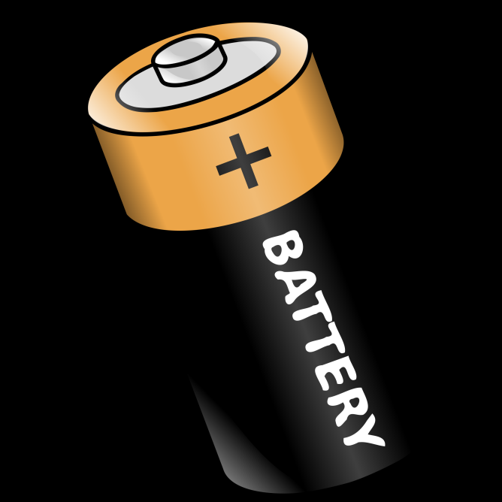
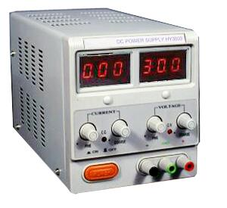
Electric Potential Difference

Slide 30
Electric Potential Difference
V=W/q
V - Electric Potential difference (Voltage): volt = J/C= eV/e
W – Electrical Energy: Joule or eV
q – charge: Coulomb or e
If 5 Joules of work is done on 0.5 coulombs of charge, what is the electric potential difference?
A 4e charge is moved through a potential difference of 40 volts.
  How much energy does it gain?
  Is that energy in eV or Joules?

