Slide 1
Data Scientist Tasks
Solutions to the test
By: Archana Maurya

Slide 2
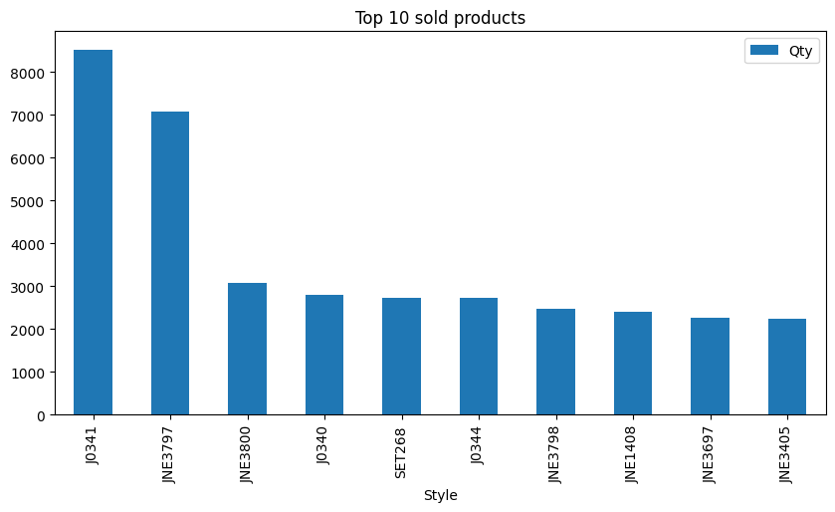
#1. Get the top 10 sold products including their sold quantity

Slide 3
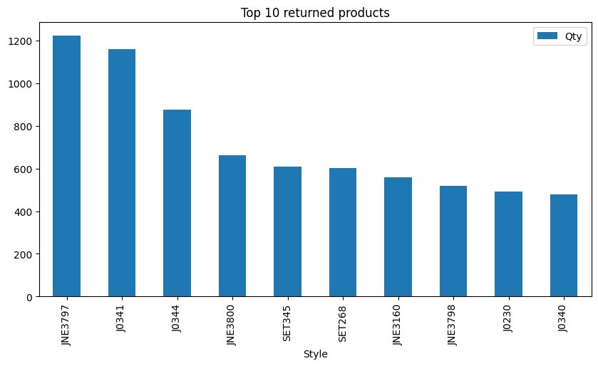
#2. Get the top 10 returned products including their return quantity

Slide 4
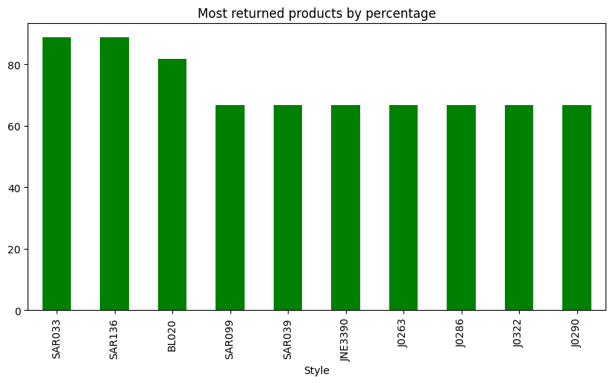
#3. Top 10 returned products by percentage

Slide 5
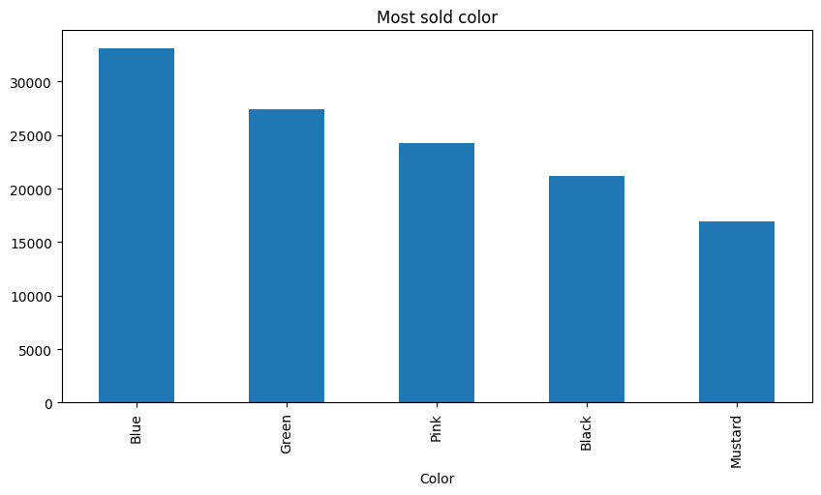
#4. What color is the most sold color

