Slide 1
IBM University Engagement Project Submission
“Exploring the Power of Agentic AI with IBM Granite and LangFlow”

Slide 2

Project Tile – Interview Trainer Agent
Domain of Project – Education
Student Name | Recent Passport Photo | Email ID | Mobile number [WhatsApp]
Archana Sale |  | archana0netha@gmail.com | 6281316387

Slide 3
Problem Statement -
Interview Trainer Agent The Challenge
An Interview Trainer Agent, powered by RAG (Retrieval-Augmented Generation), prepares users for job interviews by generating tailored question sets and preparation strategies based on their profile name, experience level, and job role.
It retrieves role-specific interview questions, industry expectations, behavioral scenarios, and HR guidelines from recruitment portals, professional networks, and company interview databases.
Users can input their resume or job title, and the agent provides targeted questions, model answers, and improvement tips. It supports both technical and soft skill assessment, ensuring a comprehensive interview prep experience.
This AI-driven assistant builds user confidence, sharpens responses, and increases success rates in competitive hiring environments.

Slide 4
Proposed Solution -
Proposed Solution: AI-Powered Interview Trainer Agent
The proposed solution is an AI-powered Interview Trainer Agent built using IBM watsonx.ai, IBM Granite Models, and RAG to provide personalized interview preparation for students and job seekers.
The system uses a RAG pipeline to retrieve relevant technical questions, HR guidelines, behavioral scenarios, and role-specific knowledge from a curated knowledge base stored in ChromaDB. IBM Granite models use this context to generate tailored interview questions and responses.
The system consists of four key components:
Resume Analysis: Extracts skills, projects, and experience from uploaded resumes.
Question Generation: Generates personalized technical, HR, and behavioral questions based on the target job role.
Mock Interview Agent: Conducts interactive interviews and collects user responses.
Answer Evaluation: Provides scores, identifies strengths and weaknesses, and suggests improvements.
A user-friendly React dashboard allows users to manage profiles, practice interviews, and track their performance.
LangChain manages the RAG workflow, while IBM watsonx.ai and Granite models power question generation and answer evaluation.
Overall, the solution provides an end-to-end personalized interview preparation platform that improves interview skills and builds confidence.

Slide 5
Technology Used
IBM watsonx.ai: AI model integration and deployment.
IBM Granite LLM: Interview question generation and answer evaluation.
Granite Embeddings: Converts interview content into vector embeddings.
LangChain: RAG pipeline and retrieval management.
ChromaDB: Vector storage and similarity search.
Python & FastAPI: Backend development.
React & TypeScript: Frontend development.
SQLite: User data and interview history storage.

Slide 6
Langflow component Used -
Document Loader: Extracts content from uploaded resume PDFs.
Text Splitter: Divides documents into smaller chunks.
IBM Granite Embeddings: Converts text into vector embeddings.
ChromaDB: Stores and retrieves document embeddings.
Retriever: Fetches relevant interview-related context.
Prompt Template: Structures prompts for personalized question generation.
IBM Granite LLM: Generates interview questions and evaluates answers.
RetrievalQA Chain: Combines retrieved context with the LLM to generate contextual responses.

Slide 7
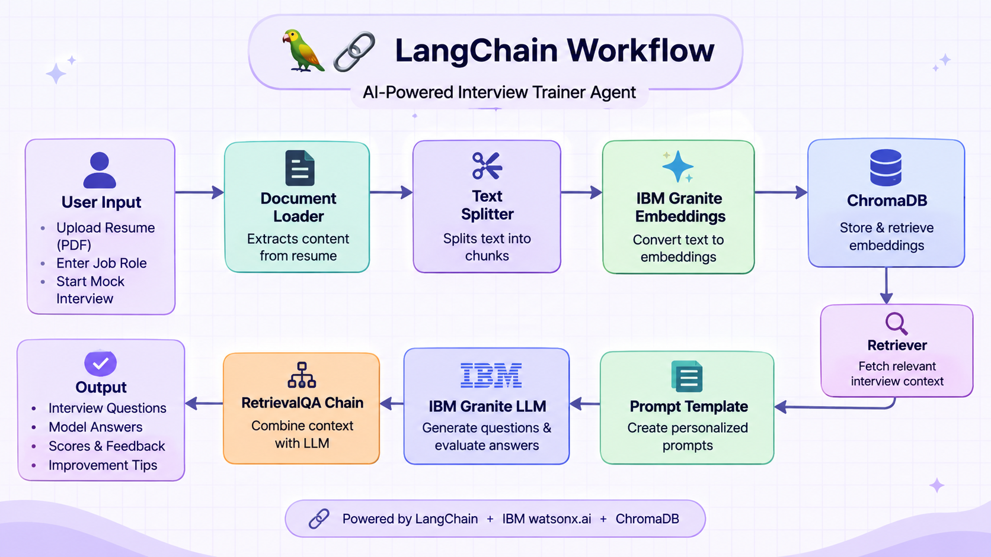
Langflow workflow -

Slide 8
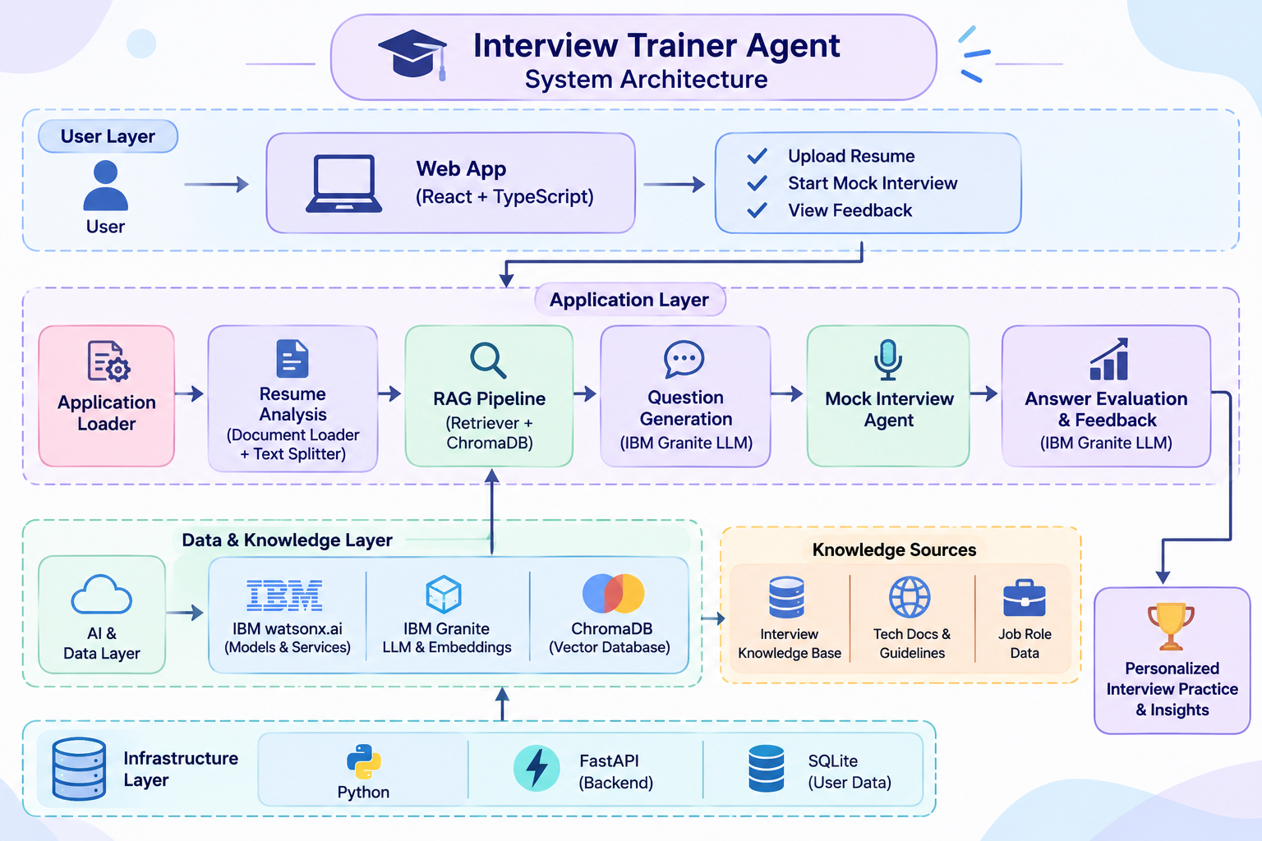
Architecture blueprint

Slide 9

Role of Agentic AI in the solution
Role of Agentic AI in the Solution
Agentic AI acts as an intelligent interview assistant that manages the interview preparation workflow with minimal user effort. It analyzes resumes, understands target job roles, retrieves relevant information using RAG, and generates personalized interview questions using IBM Granite models.
It also conducts interactive mock interviews, evaluates user responses, identifies skill gaps, and provides personalized feedback and improvement suggestions.
Key Roles:
Resume and profile analysis.
Context-aware question generation.
Interactive mock interview sessions.
Automated answer evaluation.
Personalized feedback and performance tracking.

Slide 10
Novelty and Uniqueness
Our solution goes beyond traditional interview preparation platforms by combining RAG and Agentic AI to deliver personalized and interactive interview experiences.
Resume-Based Personalization: Generates questions based on individual skills, projects, and experience.
Context-Aware RAG: Retrieves relevant interview knowledge for accurate and role-specific responses.
Interactive Mock Interviews: Simulates real interview scenarios with dynamic questions.
AI-Powered Evaluation: Analyzes answers, identifies knowledge gaps, and provides actionable feedback.
Continuous Improvement: Tracks performance and helps users focus on weaker areas.
Uniqueness: A single platform combining personalized preparation, mock interviews, AI evaluation, and performance improvement.

Slide 11
Future Scope
Voice-Based Interviews: Enable speech-based mock interviews with real-time feedback.
Multilingual Support: Support interviews in multiple languages.
Company-Specific Preparation: Integrate company interview patterns and job-specific question databases.
Advanced AI Evaluation: Analyze communication, confidence, fluency, and technical accuracy.
Adaptive Learning: Generate personalized preparation plans based on performance.
Resume & Job Matching: Recommend suitable job roles based on users' skills and profiles.
Goal: Evolve into a comprehensive AI-powered career and interview preparation platform.
·
·
·

Slide 12
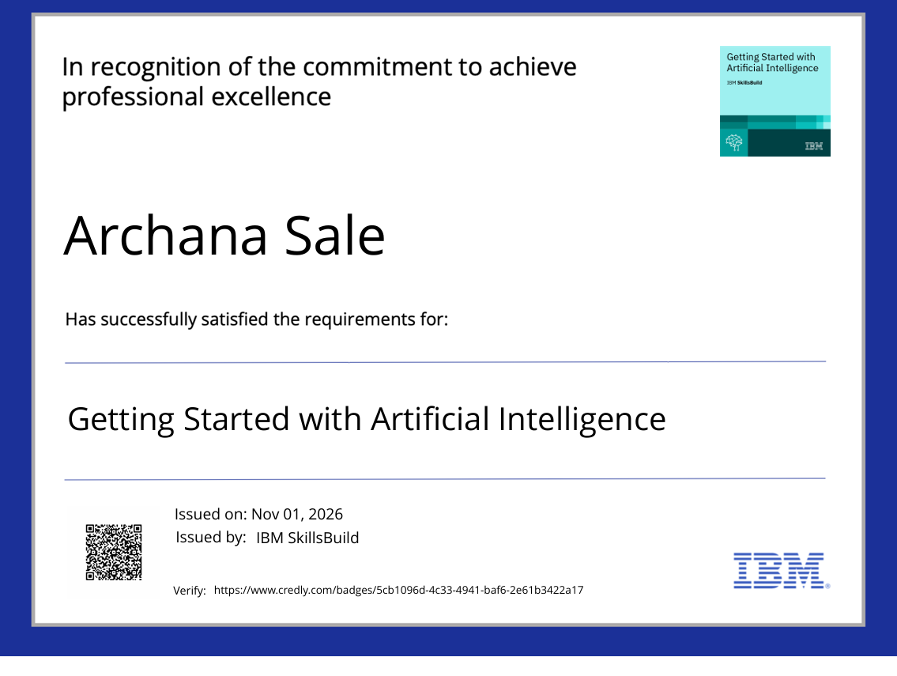
Certificates Earned:
Credly certificate

Slide 13
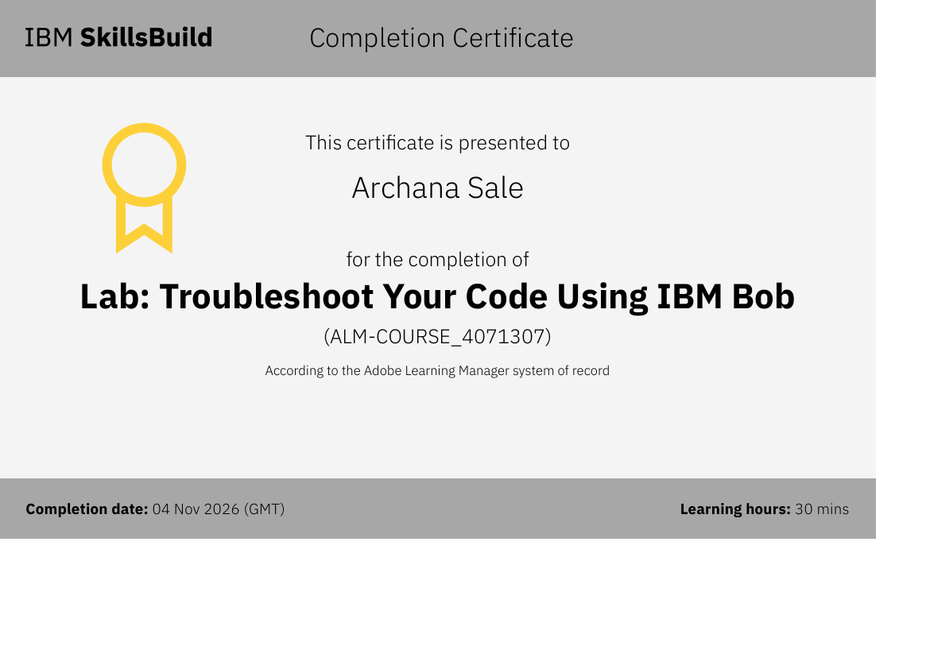
Certificates Earned:​
IBM BOB Certificate

Slide 14


