Slide 1
GIT
Git is a popular version control system. It was created by Linus Torvalds in 2005, and has been maintained by Junio Hamano since then.
It is used for:
Tracking code changes
Tracking who made changes
Coding collaboration

Slide 2
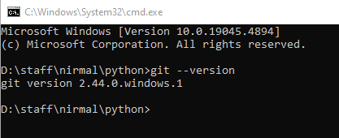
git --version

Slide 3
Download and install:
https://www.git-scm.com/
Configure Git
git config --global user.name "w3schools-test“
git config --global user.email "test@w3schools.com"
Creating Git Folder
mkdir myproject
cd myproject
Initialize Git
git init
Initialized empty Git repository in /Users/user/myproject/.git/

Slide 4
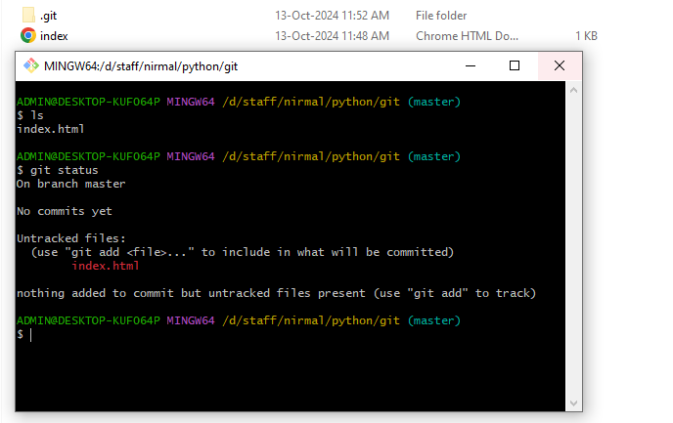
Check status

Slide 5
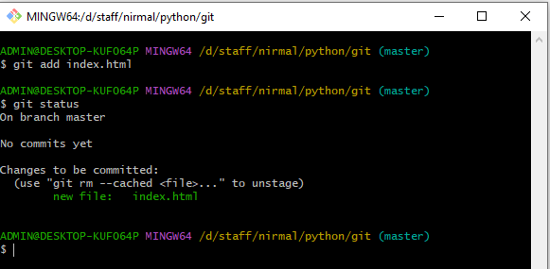
Add files

Slide 6

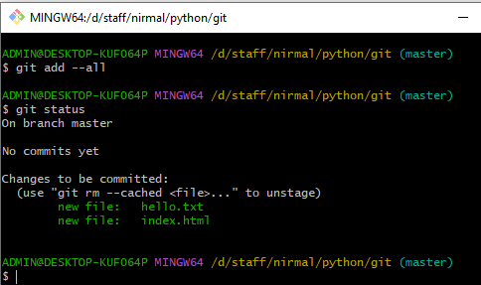
Git Add More than One File
git add –all(or)git add -A

Slide 7
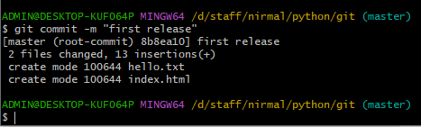
commit

Slide 8

Check any changes
Note: Short status flags are:
?? - Untracked files
A - Files added to stage
M - Modified files
D - Deleted files

Slide 9
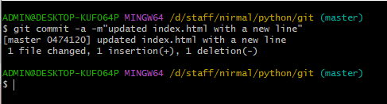
Stagging
Warning: Skipping the Staging Environment is not generally recommended.
Skipping the stage step can sometimes make you include unwanted changes.

Slide 10
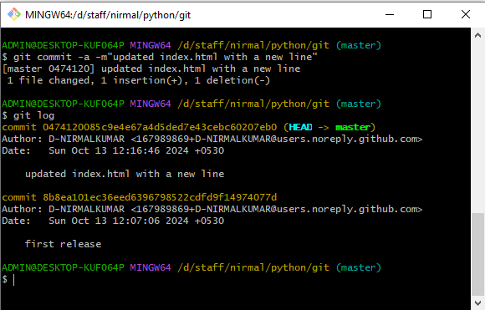
Git log

Slide 11
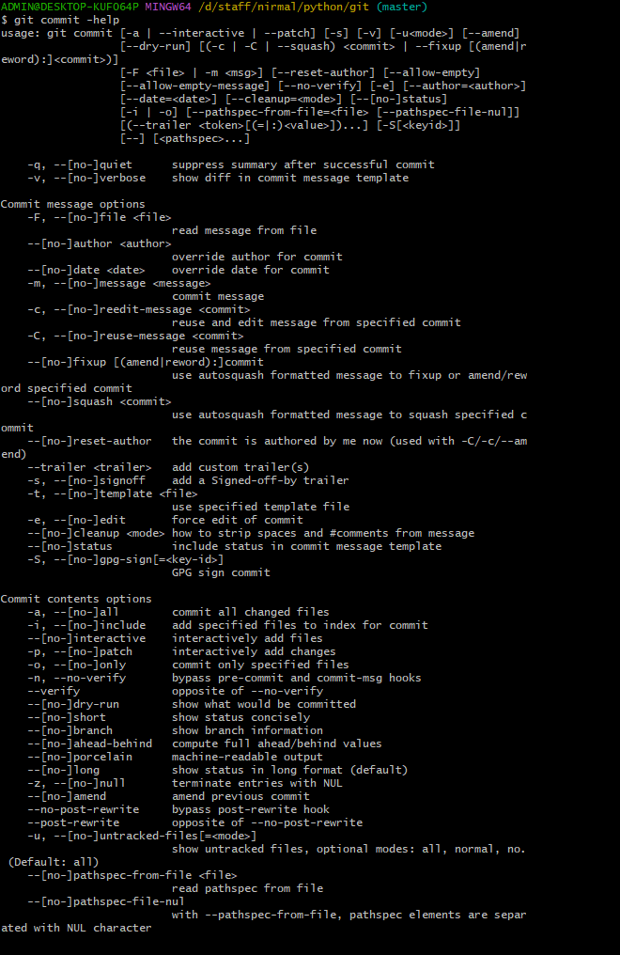
Git Help
git command -help - See all the available options for the specific command
git help --all - See all possible commands

Slide 12
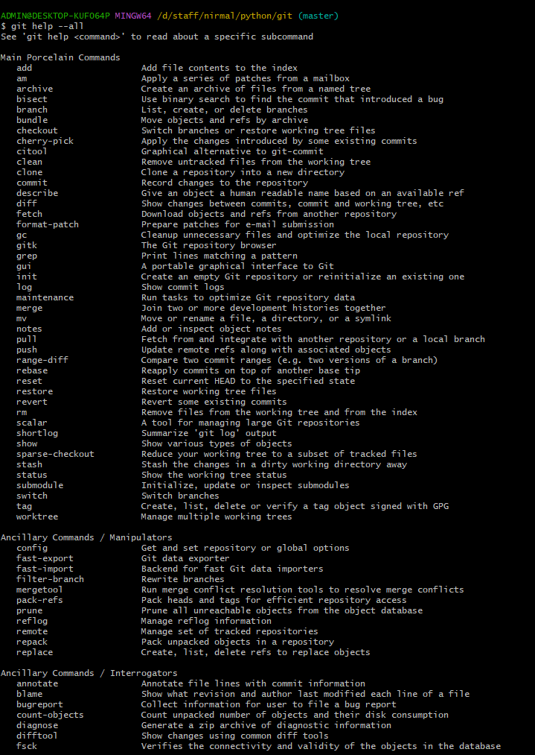
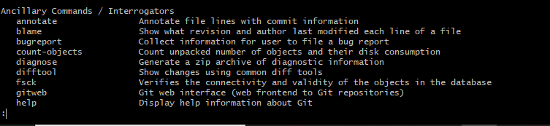
Note: If you find yourself stuck in the list view, SHIFT + G to jump the end of the list, then q to exit the view.

Slide 13

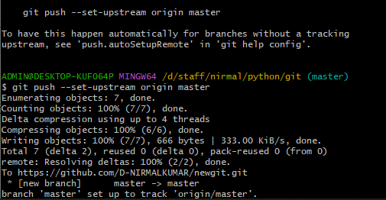
GitHub
Create account and repositories in github first and follow below things

Slide 14
Git GitHub Edit Code
Edit code in github repostery then

Slide 15
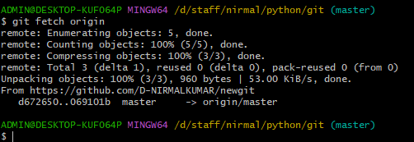
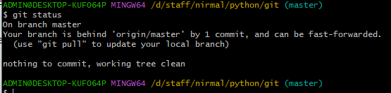
Git Pull from GitHub
pull is a combination of 2 different commands:
fetch
merge
Git Fetch

Slide 16
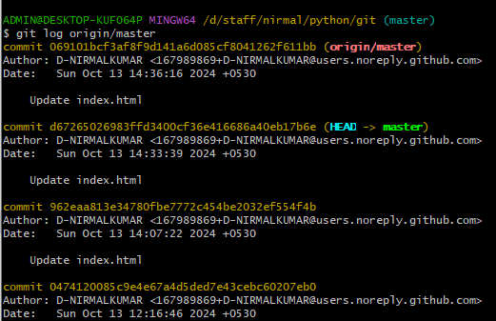
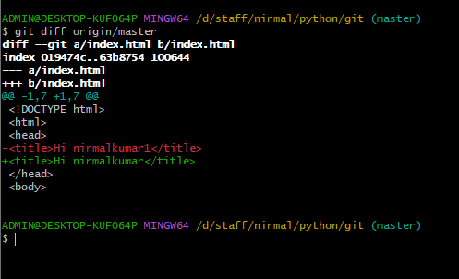
Press Q

Slide 17
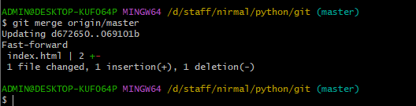
Git Merge

Slide 18
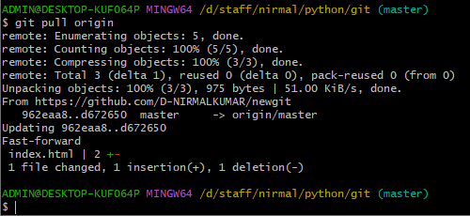
Git Pull

Slide 19
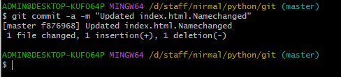
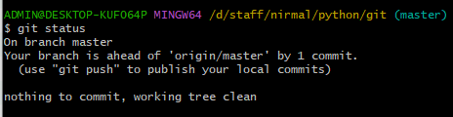
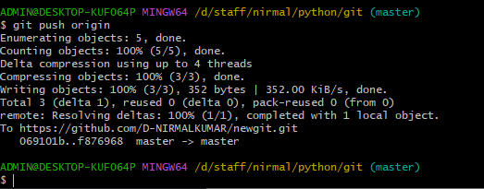
Git Push to GitHub

Slide 21
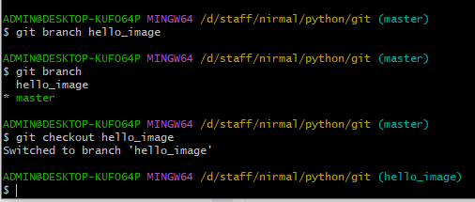
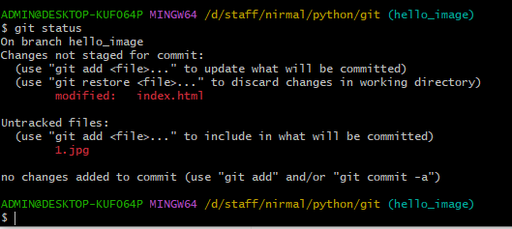
Git Branch

Slide 22
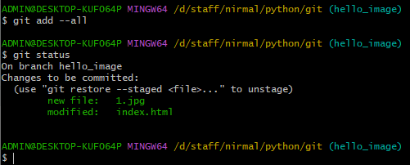
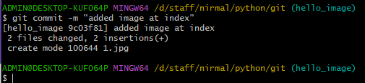

Slide 23
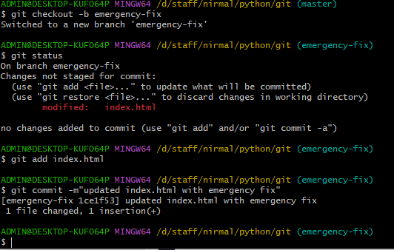
Emergency Branch

Slide 24
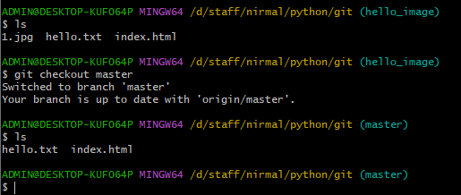
Check image present in branch and master

Slide 25
Emergency Branch

