Slide 1

SLK Software

Slide 2
Objective
To be confident in all the concepts and become a successful product engineer.
To become a Full Stack Developer by gaining all the skills required to work with front end and back end web technologies.

Slide 3
Where Do We Stand ?...
Earlier:
Basic Theoretical and less practical knowledge.
OOPs basics.
Training:
Practical knowledge in Java .
Angular7
Spring Boot
DBMS
HTML, CSS, Bootstrap
J2EE,JSP
Agile Methodology, JUnit, GitHub, Maven, Tomcat, Jenkins

Slide 4
Framework for 8 weeks
8th week
2nd week
Agile Methodology
JUnit
GitHub
Maven
Tomcat
Jenkins
Project Completion
4th week
6th week
Object oriented programming concepts
Data structures.
Java programming
HTML
CSS
Bootstrap
AJAX
Architecture and framework of angular
JEE Architecture
1st week
3rd week
5th week
7th week
Database concepts and SQL
Project banking application.
JDBC and WEB design fundamentals
Java script
ES5,ES6
Angular7
UML diagrams.
JSP Servlet
Spring REST( Core & MVC)
myBatis

Slide 5
Overview
SQL
Introduction to SQL, Database concepts,Table, Queries, Practical Examples.
Object Oriented Programming Concepts
Introduction, objects, class, constructor,static keyword, this keyword, java inheritance.
Core Java
Introduction, Inheritance,Abstraction, Polymorphism, Encapsulation, Exception handling, Multithreading Concepts, Java I/O, Java Collection, JDBC.
HTML,CSS
Introduction to HTML, HTML tags, Introduction to CSS, Styles, Practical Examples.
Java Script
History, Introduction, Types of Java Script, Components of Java Script,
Introduction to Type Script,ES5,ES6.

Slide 6
Spring REST
Introduction, Spring Framework, Environmental Setup in Eclipse Mars, Architecture, Container, Annotations, Components of Spring Application.
JSP & Servlet
Introduction, Environmental Setup, Architecture, Life Cycle, Container(Apache Tomcat),Inbuilt Services, API.
Angular7
History, Introduction, Environmental Setup, Architecture of Angular, Installation,
Using Angular CLI, Components, Modules, Data Binding, Event Binding,
Directives, Pipes, Routing, Services.
Agile Methodology
Introduction to agile, Scrum, Scrum Artifacts, Scrum Master, Backlogs, Ceremonies.

Slide 7
GitHub
Introduction, Account creation, Creating Repository, Git Commands, import,push and pull operations in GitHub.
Maven
Introduction, Maven lifecycle ,Phases, Plugin, Goals, Maven Commands.
Jenkins​
Introduction to Jenkins, Jenkin Configuration.​

Slide 8
Agenda
Our Journey
Our Trainers
Our Team
Project Banking Application
Project Goals
Project Overview
Scope And Conclusion
Full Stack Architecture

Slide 9
05
Our Journey
Test
Define
02
04
03
Prototype
Ideate
.
01
.
01
Empathize

Slide 10


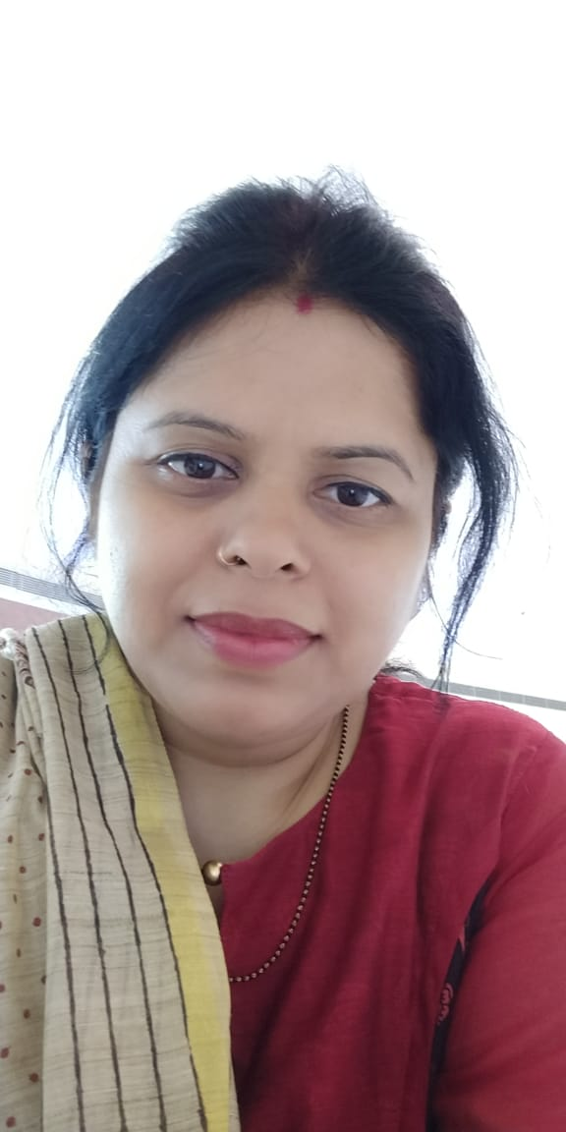
Our Trainers
AMIT KR BALYAN
UPASANA
KAVITA

Slide 11
OUR TEAM
AVENGERS

Slide 12




Meet Our Team
Rachayya Kallimath
Sagar S Banakal
Archana Shetty S
EID:109273
Supriya Tirumale
EID:109276
Team Leader
EID:109263
EID:109281

Slide 13

Project-Banking application
Low Level Diagrams:
Use Case, Class, Application Flow.
Architecture of banking application
Front End :
Angular7(HTML,CSS,JS,BOOTSTRAP)
Back End :
Java ,Spring REST, Database.
Tools :
MySql,Sublime,Eclipse.

Slide 14

This online banking application provides the basic services to manage bank accounts.
Bank has many branches, each of which has an address, IFSC code ,branch id and name.
A customer/client opens accounts at a branch.
Each account is uniquely identified by an account number.
There are three types of accounts, including: Savings, Current and Loan account (loan account is treated as separate entity).​
ABC Bank Application

Slide 15
Project Goals
To build a product with high performance ,reusability
To build a product which meets user needs and requirements.
To build a product which is user friendly

Slide 16
Overview of Bank Application
There are various job positions within bank application. The positions are as follows:
Super User
Admin
Agent
Customer
CUSTOMER:
Customer module has various functionalities:
List of customers
View Profile
Update Profile
Balance Enquiry
View Loan
Transfer
Transaction History

Slide 17
Scope And Conclusion
Scope of the Project:
This project can be implemented in any bank by fulfilling basic requirements.
Conclusion of the Project:
This Bank Management Application will allow the customers to create the account and manage all his transactions.
All information will be updated automatically by using the information stored in the database system.

Slide 18

Tech Stack
Tech Stack

Slide 19












FRONTEND
BACKEND
DevOps
DATA

Slide 20
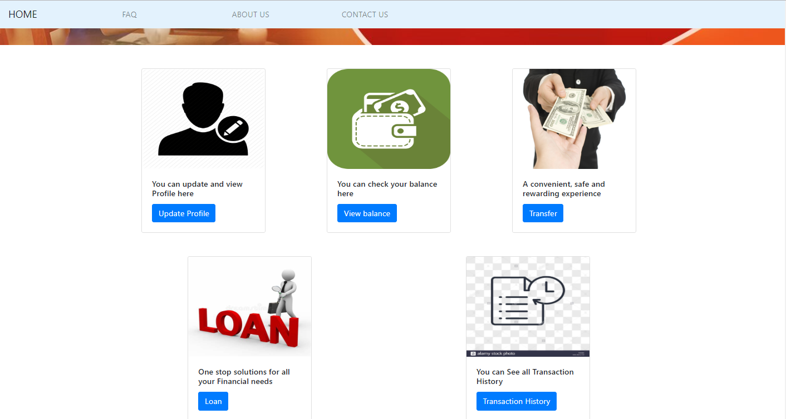
Customer page Screenshot
You can simply impress your audience and add a unique zing and appeal to your Presentations. Easy to change colors, photos and Text. Get a modern PowerPoint Presentation that is beautifully designed. You can simply impress your audience and add a unique zing and appeal to your Presentations. Easy to change colors, photos and Text. Get a modern PowerPoint Presentation that is beautifully designed.
Modern Portfolio Presentation

Slide 21
THANK YOU

