Slide 1

Exploratory Data Analysis of Global Economic Indicators
PYTHON DATA ANALYSIS PROJECT
PRESENTED BY
ARCHANAA D
Student ID
AF05309158
Industry: Economics & Global Development
Course
AIML
Data: World Bank, World Development Indicators | 20 countries | 2016 to 2025
Batch Code
ANP-D7444
Notes:
Introduce the project: an exploratory data analysis of real World Bank data for 20 countries from 2016 to 2025, done in Python with Pandas, NumPy, Matplotlib and Seaborn.

Slide 2


Industry Overview: Economics & Global Development
The industry
Who uses the data
Why data analysis matters
Economics and global development study how countries produce, trade, grow and improve living standards.
Governments, central banks, businesses, investors, researchers and development agencies.
It turns large indicator tables into trends, comparisons and warning signs that support policy and investment decisions.
20
52
10
World Bank
countries
indicators
years (2016 to 2025)
single data source
Notes:
Economic and development data from the World Bank is used by governments, businesses and researchers. Data analysis makes that data usable.

Slide 3

Problem Statement
The problem
Why it is important
Policy, investment and development decisions depend on a clear, accurate picture of economic performance.
Economic data for many countries comes as large, messy indicator tables. Without cleaning and analysis it is hard to see how economies grow, how they react to shocks such as COVID-19, and how income relates to inflation and health.
Who is affected
Policymakers, businesses and investors, researchers, and citizens whose living standards depend on those decisions.
52 x 20 x 10
20.7%
..
indicators x countries x years
of values are missing
text used instead of blanks
Notes:
The raw World Bank extract is hard to use directly: it has footer rows, '..' instead of blanks, and year columns stored as text.

Slide 4
Project Objectives
1
Load, inspect and clean the World Bank WDI extract
2
Reshape the data into long and country-year tables ready for analysis
3
Compare GDP growth, inflation and living standards across 20 countries
4
Measure the impact of COVID-19 and detect outliers
5
Visualize the results and summarize the key insights
Collect
Clean
Transform
Analyze
Visualize
Insights
Notes:
Five objectives, following the workflow shown at the bottom: collect, clean, transform, analyze, visualize, insights.

Slide 5
Proposed Solution & Analysis Questions
Proposed solution
1
2
Clean the World Bank extract and reshape it into a country-year table
Use Pandas and NumPy to group, aggregate, compare and correlate indicators
Use Matplotlib and Seaborn to show trends, categories, distributions and relationships
Python makes the work repeatable: 10,400 values handled in a few lines
How is GDP growth distributed across the 200 country-years?
How did average GDP growth change from 2016 to 2025?
3
4
How badly did COVID-19 hit GDP growth in each country?
Which inflation and GDP growth values are outliers?
5
6
How do Lower, Middle and Upper income tiers compare?
Which indicators move together most strongly?
Notes:
Six questions drive the analysis. Each is answered with Pandas calculations and, where useful, a chart.

Slide 6
Dataset Information
Item | Details
Dataset name | World Development Indicators (WDI) extract
Source | World Bank DataBank (databank.worldbank.org)
File format | CSV (WDI-1.csv)
Rows | 1,045 in file (1,040 data rows + 5 footer rows)
Columns | 14 (4 identifiers + 10 year columns)
Coverage | 20 countries, 52 indicators, 2016 to 2025
After cleaning | 10,400 x 6 (long) and 200 x 19 (country-year)
Important features
Identifiers: Country Name, Country Code, Series Name, Series Code
Years: 2016 to 2025 (one column each)
16 indicators analysed: GDP, GDP growth, GNI per capita, population, population growth, life expectancy, fertility rate, under-5 mortality, exports, imports, inflation, military spending, mobile subscriptions, industry share, agriculture share, capital formation
Each row is one indicator for one country, with a value for every year from 2016 to 2025. The World Bank writes missing values as '..'.
Notes:
The file is in wide format: one row per country and indicator, one column per year.

Slide 7
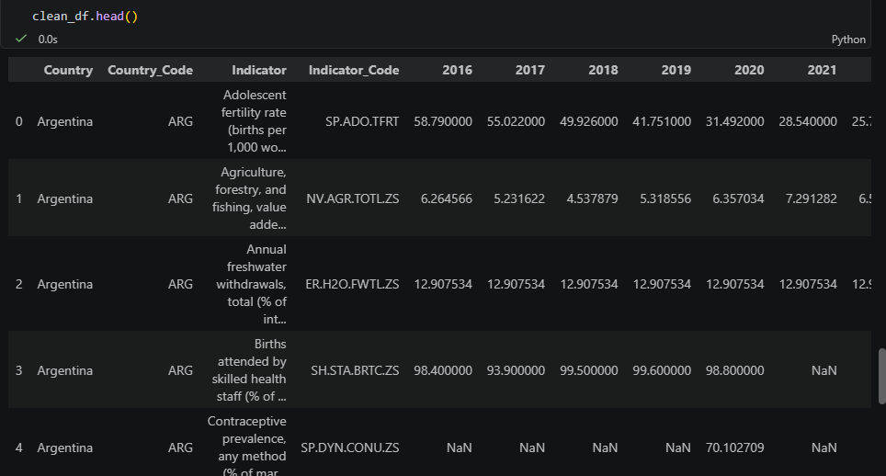
Data Collection & Understanding
Collected from: World Bank DataBank (World Development Indicators), downloaded as a CSV extract for 20 countries, 52 indicators and 2016 to 2025.
Check | Result
Shape | 1,045 rows x 14 columns
Data types | All 14 columns loaded as text (str), including the 10 year columns
Missing values | 5 blank/footer rows, plus 2,156 cells holding '..' (20.7%)
Duplicates | 0 duplicate data records
Notebook output: clean_df.head(). NaN marks a missing value.
Missing values are not random: later years are emptier, because the World Bank publishes some indicators with a delay.
Notes:
raw.info() showed every column as text. The '..' placeholder is why: pandas could not read the year columns as numbers until it was replaced.

Slide 8
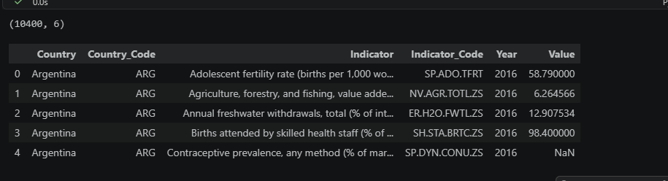
Data Cleaning & Transformation
Cleaning
Kept an untouched copy (raw_df) and cleaned a second copy
Removed 5 footer/blank rows (1,045 to 1,040 rows)
Replaced '..' with real missing values (NaN)
Converted the 10 year columns from text to float64
Renamed columns (2016 [YR2016] became 2016)
Checked duplicates: 0
Notebook output: long_df after melt(). Shape is (10400, 6).
1,045 to 1,040
10,400 x 6
rows after removing footers
long table
Transformation
Melted wide to long format (10,400 x 6)
Filtered to 16 key indicators and pivoted to one row per country-year (200 x 19)
Created GDP growth categories (pd.cut) and income tiers (pd.qcut)
Saved cleaned_dataset.csv
200 x 19
0
country-year table
duplicate records
Notes:
Every number here was printed in the notebook: 1,045 rows before, 1,040 after, 10,400 rows in long format, 200 rows in the country-year table.

Slide 9
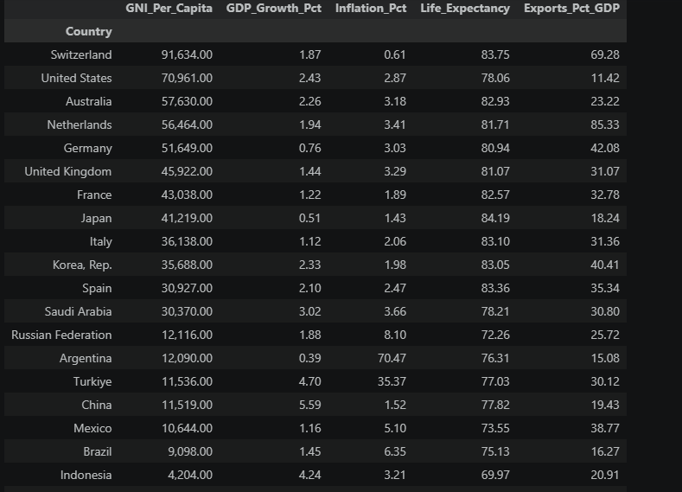
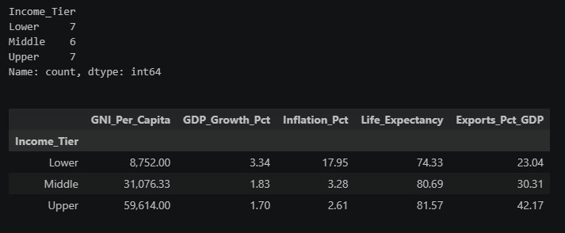
Exploratory Data Analysis
Pandas: groupby, agg, pivot, cut, qcut, corr
NumPy: nan, inf, triu
Distribution
31 of 200 country-years (15.5%) were contractions; 85% grew
Country profile
Highest GNI per capita: Switzerland ($91,634). Lowest: India ($2,173)
Trend
Average growth: 1.79% (2019), -4.32% (2020), +6.56% (2021)
Outliers
25 inflation outliers, mostly Argentina and Turkiye
Income tiers
Lower tier grew 3.34% a year; Upper tier 1.70%
Correlation
Exports and imports (% of GDP): 0.98
Notebook output: country profiles and income-tier averages.
Notes:
Each row on the left is one analysis question from the notebook. The screenshots are the actual notebook outputs for the country profile and the income-tier comparison.

Slide 10
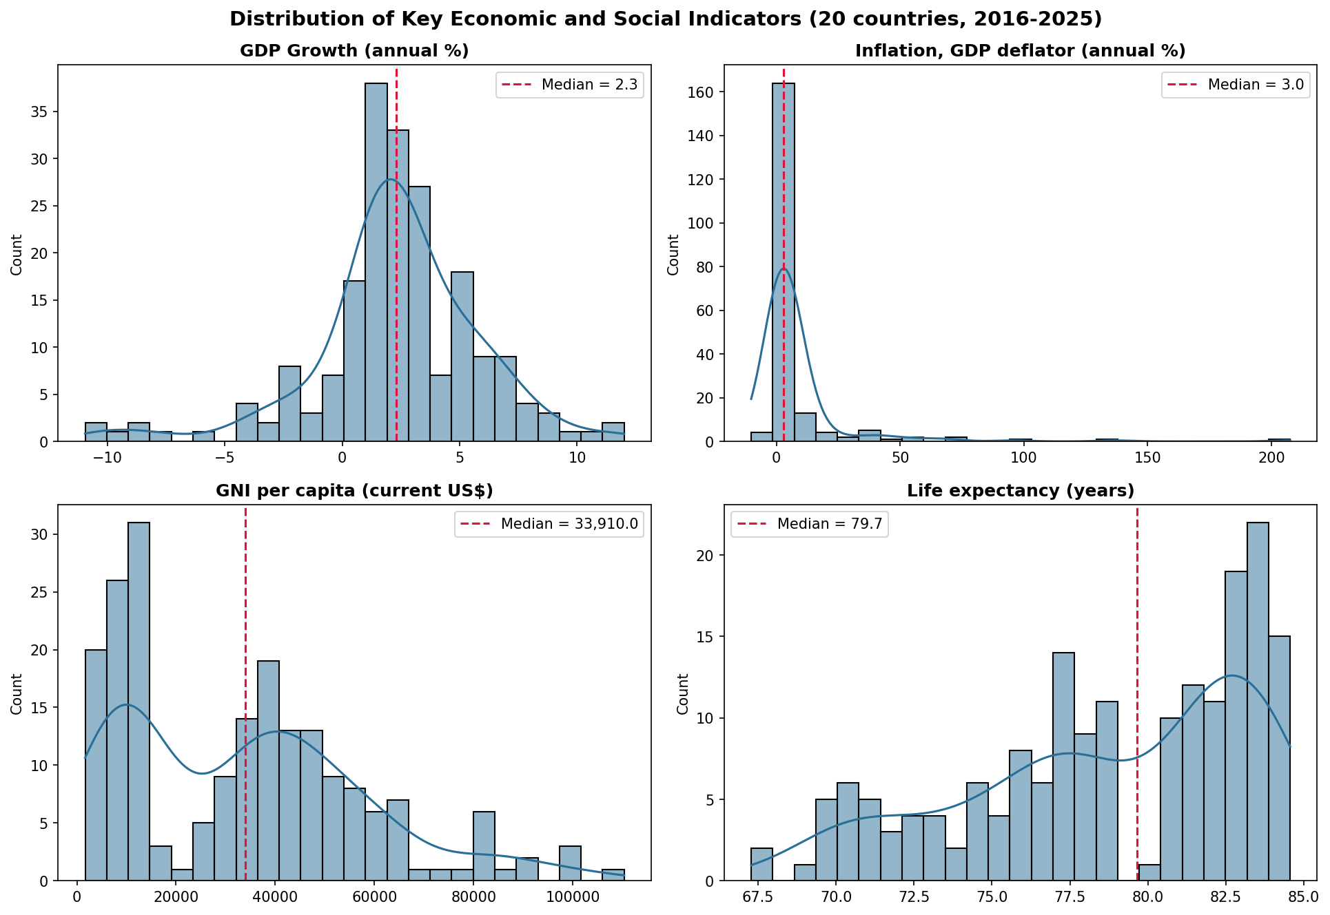
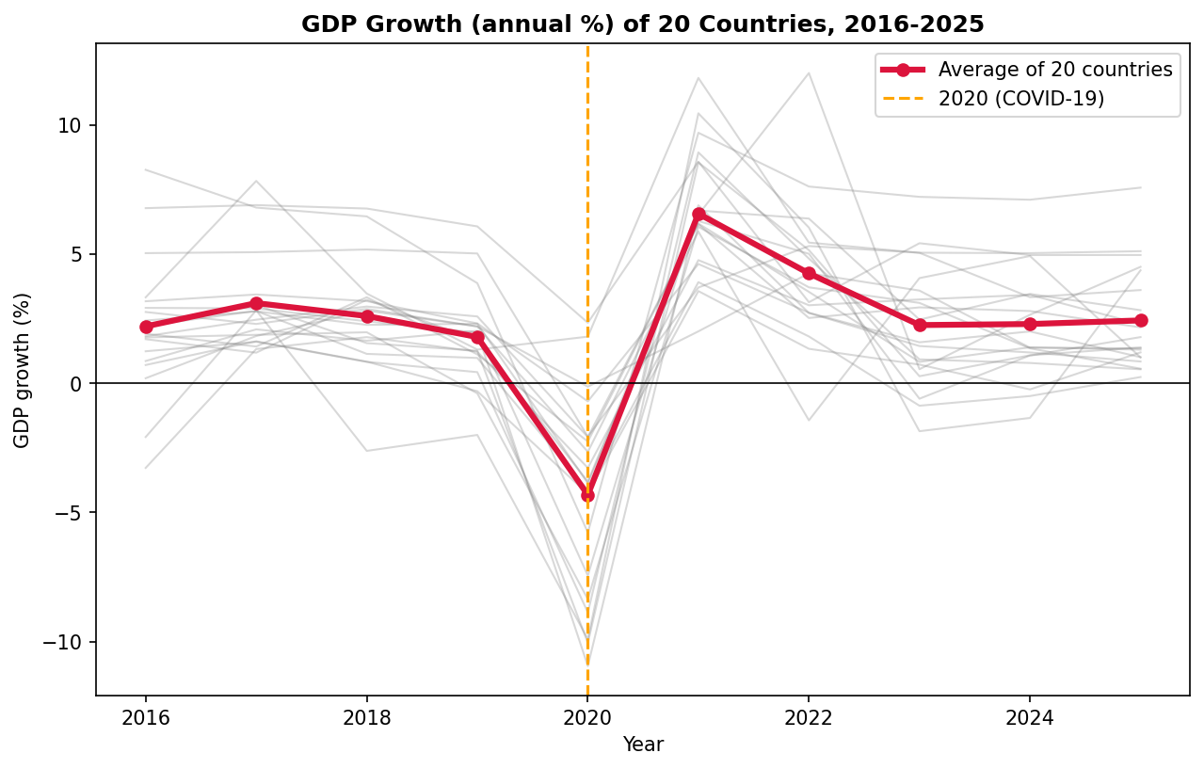
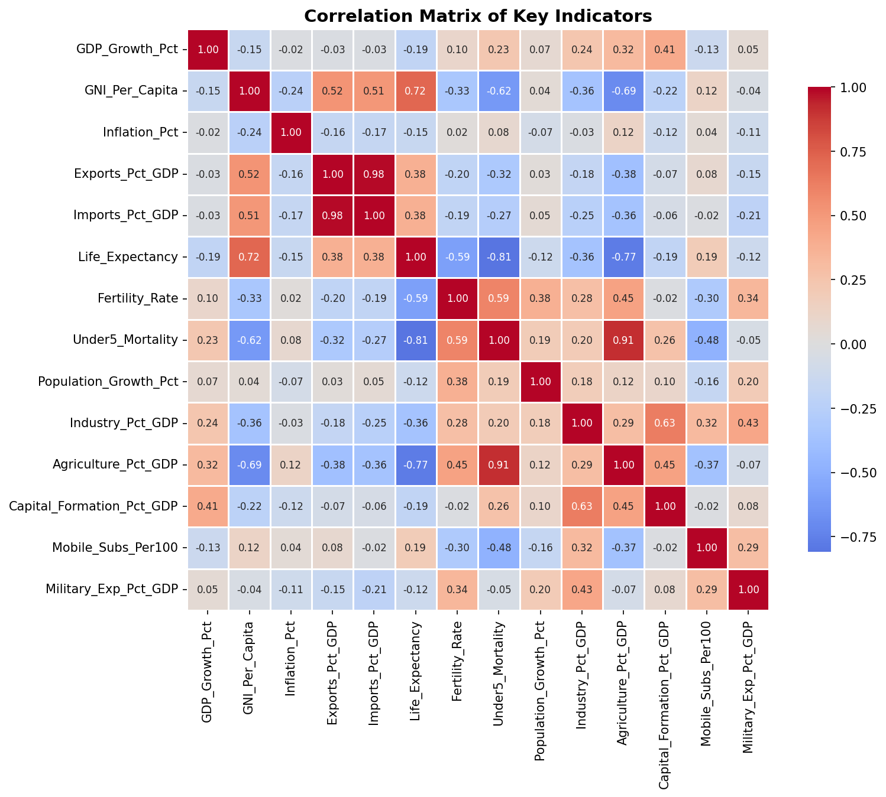
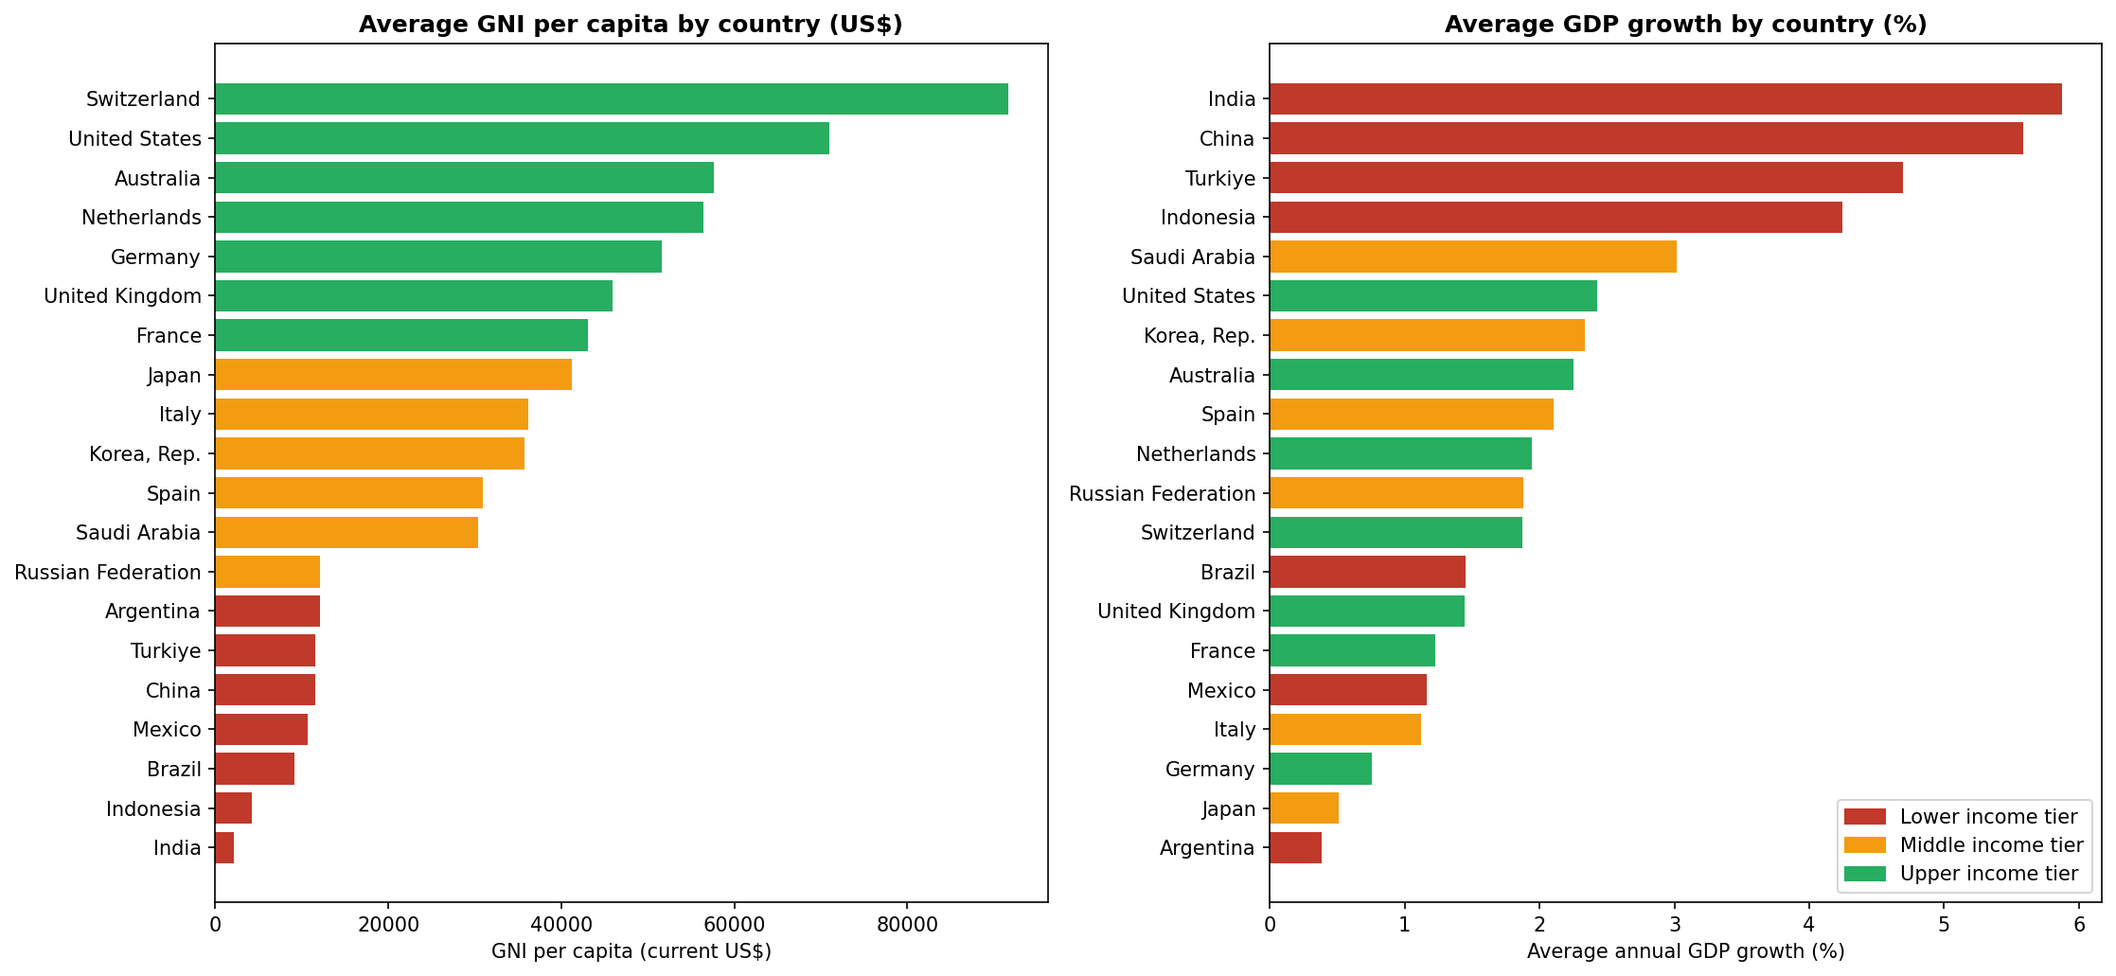
Data Visualization
Distribution Analysis
Trend Analysis
Purpose: see how values are spread
Shows: histograms of GDP growth, inflation, GNI per capita and life expectancy
Insight: inflation is skewed, median 2.99 with a few extreme values
Purpose: track growth over time
Shows: GDP growth of all 20 countries, with the average in red
Insight: average fell to -4.32% in 2020, then rose to +6.56%
Category Analysis
Correlation Analysis
Purpose: compare countries by income tier
Shows: average GNI per capita and GDP growth by country, coloured by tier
Insight: lower-income countries grow faster, India 5.88% and China 5.59%
Purpose: find indicators that move together
Shows: heatmap of 14 indicators
Insight: exports and imports 0.98; GNI and life expectancy 0.72
Notes:
Chart name, purpose, what the chart shows, and the key insight for each of the four charts saved in the Visualizations folder.

Slide 11

Key Insights & Recommendations
Key insights
Recommendations
1
COVID-19 was the shock: average growth went from 1.79% (2019) to -4.32% (2020) to +6.56% (2021)
Treat 2020 as an exceptional year: compare trends with and without it
Analyse Argentina and Turkiye separately and use medians for inflation
Compare countries within income tiers, not all 20 together
Treat correlations as leads, not causes
2
Only China (+2.34%) and Turkiye (+1.80%) still grew in 2020; Spain fell most (-10.94%)
3
Richer is not faster: India (5.88%) and China (5.59%) grew fastest, Japan (0.51%) and Argentina (0.39%) slowest
4
Inflation is uneven: Argentina averaged 70.47% (peak 207.61% in 2024), Turkiye 35.37%, all others under 9%
5
Exports and imports (% of GDP) are almost perfectly correlated (0.98)
6
Higher income goes with longer life: GNI vs life expectancy 0.72; Upper tier 81.57 years, Lower 74.33
Notes:
Every insight on this slide comes from an output in the notebook. Recommendations follow directly from those findings.

Slide 12




Conclusion
What was achieved
Major findings
How it addresses the problem
Future scope
Cleaned a 1,045 x 14 World Bank file into a 10,400-row dataset and a 200-row country-year table, answered 7 analysis questions and produced 4 charts.
COVID-19 cut average growth to -4.32% in 2020, followed by +6.56% in 2021. Lower-income economies grew faster (3.34% vs 1.70%). Inflation is extreme in Argentina and Turkiye.
Turns a messy indicator table into clear trends and comparisons that support policy and investment decisions.
Add more countries and years, include the latest social indicators when published, and add forecasting or an interactive dashboard.
Notes:
Wrap up: what was done, what was found, how it helps, and what could come next.

