Slide 1
DATA ANALYTICS PROJECT
E-Commerce Sales and Customer Insights
SQL and Power BI analysis of 96,478 delivered orders from a Brazilian online marketplace
Archana H | Data Analytics | MySQL · Power BI
Notes:
Introduce the project: a full analytics workflow from raw e-commerce data to business insights.

Slide 2
Where does revenue come from, and where does it leak?
Which products and categories drive revenue?
Who buys, and do they come back?
How does delivery affect satisfaction?
Top sellers, revenue share and customer ratings by category
New vs repeat buyers, order value and payment habits
Delivery time, review scores and regional sales
1
2
3
Built for store owners, marketing teams and operations teams
Notes:
Three questions guide the whole project.

Slide 3
What this project is about
The data
What I did
What it answers
Olist, a Brazilian online marketplace. 9 related tables: orders, items, payments, reviews, customers, products, sellers. 99,441 orders, Sep 2016 to Oct 2018.
Loaded the CSV files into MySQL, cleaned dates and blank values, wrote 8 SQL queries, and built a 2-page Power BI dashboard.
Where revenue comes from, how many customers buy again, and how delivery speed affects review ratings.
How the tables connect
customers
→
orders
→
order_items
→
products
Payments, reviews and sellers connect to orders and order_items in the same way. Analysis uses delivered orders only.
Notes:
Explain the data, the steps and the questions.

Slide 4
Key terms explained
Delivered orders
Revenue
AOV (average order value)
Orders with status delivered (96,478). Cancelled and unavailable orders are left out.
Sum of product prices. Shipping cost, discounts and profit are not included.
Total revenue ÷ number of orders = R$137.04.
Repeat customer
Boleto
Review score
A customer (customer_unique_id) with 2 or more delivered orders.
A Brazilian bank-slip payment, similar to paying in cash.
Customer rating from 1 (worst) to 5 (best).
Notes:
Define each term in simple words before showing numbers.

Slide 5
How I built it, step by step
1
2
3
4
5
Load
Clean
Analyse
Model
Visualise
9 CSV files loaded into MySQL (database olist_ecommerce).
Dates converted to DATETIME, blanks set to NULL, duplicates checked.
8 SQL queries using joins, GROUP BY, CASE WHEN and CTEs.
Power BI: 7 table relationships and DAX measures (Total Orders, Total Revenue, AOV, Repeat %).
2-page dashboard with KPI cards, charts and a year slicer.
Tools: MySQL, MySQL Workbench, Power BI Desktop
Notes:
Walk through the five steps from raw files to dashboard.

Slide 6
Eight business questions answered with SQL
# | Business question | Key result
1 | What is the monthly revenue trend? | Peak in Nov 2017: R$987,765
2 | Which categories bring the most revenue? | health_beauty leads with R$1.23M
3 | How many customers buy again? | 3.00% (2,801 of 93,358)
4 | Which states have the highest sales? | SP: R$5.07M (about 38% of revenue)
5 | How does delivery time relate to reviews? | 4.41 (0-7 days) down to 3.06 (22+ days)
6 | Which payment methods are used most? | Credit card: 78.34% of payment value
7 | What are the overall KPIs? | 96,478 orders, R$13.22M, AOV R$137.04
8 | Which categories have the lowest ratings? | office_furniture: 3.52
Notes:
Each row is one SQL file in the GitHub repository.

Slide 7
The business at a glance
96,478
R$13.22M
R$137.04
93,358
delivered orders
total revenue
average order value
unique customers
What the data tells us
Revenue peaks in November
A few categories lead
Few customers return
Slow delivery hurts ratings
Nov 2017 is the peak month at R$987,765.
Top 3 categories bring about 26% of revenue.
Only 3.00% (2,801 of 93,358) order again.
22+ day orders average 3.06 vs 4.41 for 0-7 days.
Notes:
Give the headline numbers first, then the four findings.

Slide 8
Revenue peaks in November 2017, led by three categories
R$987,765
peak month: Nov 2017
R$838K
revenue in Aug 2018
So what: Plan stock, delivery and campaigns before November. Revenue per order differs: health_beauty about R$143, watches_gifts about R$212, bed_bath_table about R$110 (calculated).
Notes:
Black Friday may explain the peak, but the data does not prove the reason.

Slide 9
Only 3% of customers order again, and most pay by credit card
So what: 97% buy only once, so loyalty offers can add revenue. Credit card carries 78% of payment value; boleto is a Brazilian bank-slip payment.
Notes:
Repeat rate uses customer_unique_id, because customer_id changes with every order.

Slide 10
Ratings drop sharply after 21 days of delivery
3.06
average rating for 22+ day deliveries (11,519 orders)
4.41
average rating for 0-7 day deliveries (30,679 orders)
So what: Ratings fall by about 1.35 points for the slowest deliveries. Late delivery may not be the only cause, but faster delivery is a clear lever to test.
Notes:
Delivery time is linked to ratings. This shows association, not proof of cause.

Slide 11
SP dominates sales, and office furniture rates lowest
Lowest-rated categories (100+ orders)
Category | Orders | Avg review
office_furniture | 1,244 | 3.52
fixed_telephony | 209 | 3.76
fashion_male_clothing | 105 | 3.76
audio | 345 | 3.83
home_confort | 390 | 3.85
So what: About 38% of revenue comes from SP, so delivery there matters most. office_furniture has the lowest rating (3.52) with 1,244 orders, so check why customers are unhappy.
Notes:
SP alone brings about 38% of revenue (R$5.07M of R$13.22M, calculated).

Slide 12
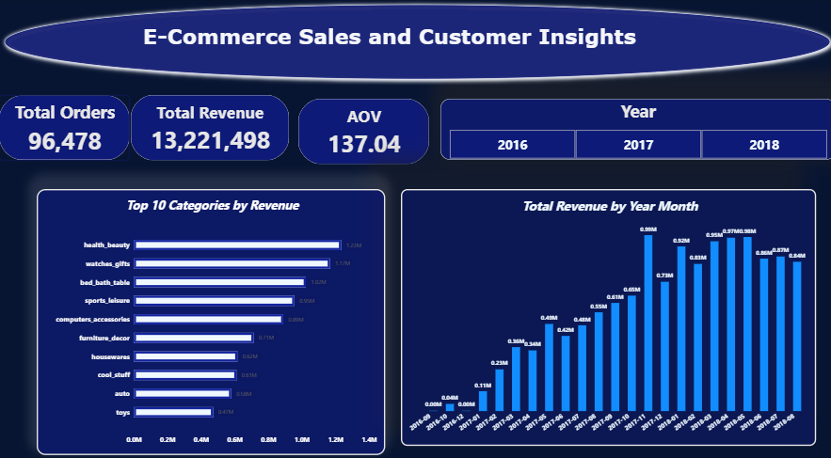
Dashboard page 1: Sales Overview
What it shows
KPI cards: 96,478 orders, R$13,221,498 revenue, AOV 137.04
Year slicer filters every chart
Top 10 categories by revenue
Monthly revenue trend
Insight: Revenue grew through 2017 and peaked in Nov 2017.
Notes:
Point to each chart and say which question it answers.

Slide 13
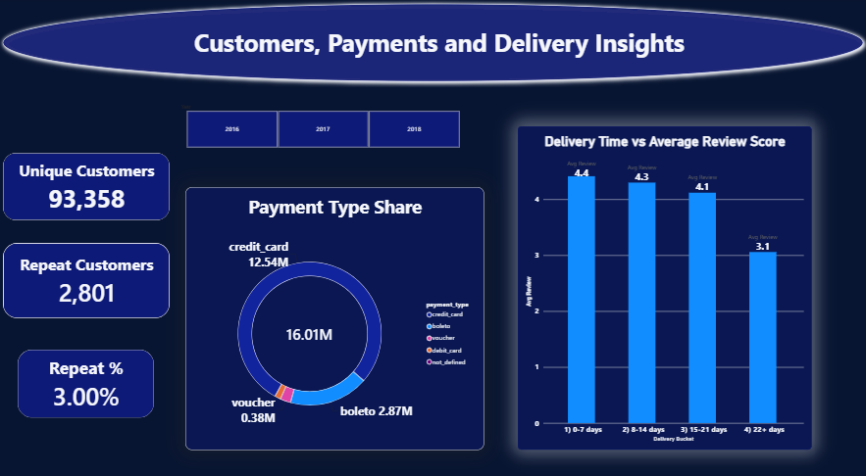
Dashboard page 2: Customers and Delivery
What it shows
Unique customers 93,358 and repeat customers 2,801 (3.00%)
Payment type share: credit card leads
Delivery time vs average review score
Insight: Ratings fall to about 3.1 for deliveries that take 22+ days.
Notes:
Show how delivery time connects to customer ratings.

Slide 14
What the business should do
Nov 2017 is the peak month
→
Plan stock, delivery and campaigns before November
Top 3 categories bring about 26% of revenue
→
Stock and promote best sellers; review weak ones like office_furniture
Only 3.00% of customers reorder
→
Run loyalty offers and win-back campaigns
SP brings about 38% of revenue
→
Protect SP delivery; grow RJ and MG with campaigns
Orders over 21 days rate 3.06 vs 4.41
→
Cut slow deliveries and set realistic delivery promises
Notes:
Each row links a finding to a decision a real business would make.

Slide 15
Limitations and next steps
Limitations
Next steps
Data covers Sep 2016 to Oct 2018 and one marketplace
Revenue is product price only: no profit or discount data
Findings show association, not cause
Analyse delivery delay by state
Segment customers with RFM analysis
Repeat the analysis on an Indian e-commerce dataset
Notes:
Be upfront about limits; it builds credibility.

Slide 16
Thank you
Archana H | Data Analytics | MySQL · Power BI
github.com/archanaarchanah0812-lgtm
Notes:
Invite questions.

