Slide 1
Credit Card Fraud Detection
Submitted by,
Seema Archana
Archana Bhattarahalli Suryanarayana

Slide 2
Problem
The Credit Card Fraud Detection Problem includes modeling past credit card transactions with the knowledge of the ones that turned out to be fraud.
To build a regression model and evaluate its performance based on various metrics.

Slide 3
Datasets
Data Source : https://www.kaggle.com/dalpozz/creditcardfraud/data
In the dataset there are 31 attributes.
Attribute V1,V2,V3.. V28 are obtained from the PCA transformation and therefore are numeric.
‘Time’ contains second elapsed between each transaction and the first transaction in the dataset.
Attribute 'Amount' is the transaction Amount.
Attribute ‘Class’ determines whether the transaction is fraudulent or not. Fraud = 1 , Non Fraud = 0
Total Observations = 284,807.
Fraudulent Observations = 492.
Non Fraudulent Observations = 284,315.
Event Rate= 0.172%.

Slide 4
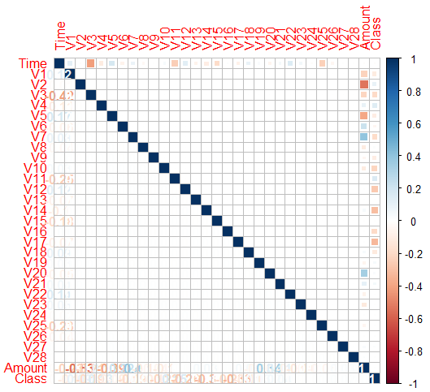
Preprocessing Task
Pearson Correlation coefficient.
Finding the correlation coefficient between 31 attributes in the data set.
Correlation coefficient value is almost zero between attributes, which specify all the attributes are independent.
Since all the attributes are independent, No dimensionality reduction.

Slide 5
Data Mining Task
Data Level approach: Resampling Techniques
Random Under-Sampling
Random Over-Sampling
Cluster-Based Over Sampling
Synthetic Minority Over-sampling Technique
Algorithmic Ensemble Techniques
Bagging Based
Boosting-Based
Random Forest

Slide 6
Random Forest [RF]
Random Forest is an ensemble algorithm which makes use of decision trees.
It is one of the most accurate learning algorithms available. For many data sets, it produces a highly accurate model.
It runs efficiently on large databases and without overfitting problem.
The random forest algorithm can be used for feature engineering. (Which means identifying the most important features out of the available features from the training dataset)
In random forests, there is no need for cross-validation or a separate test set to get an unbiased estimate of the test set error. It is estimated internally, during the run.

Slide 7
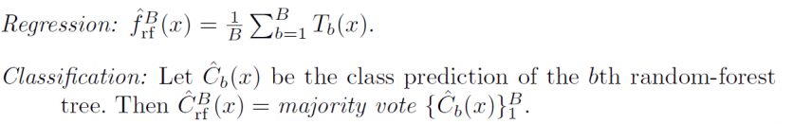
RF Algorithm
Step 1: For b=1 to B:
Draw a bootstrap sample Z* of size N from the training data.
Grow a random forest tree Tb to the bootstrapped data, by recursively repeating the following steps for each terminal node of tree, until minimum node of size n_{min} is reached.
Select m variables at random from the p variables.
Pick the best variable/Split-point among the m.
Split the node into two daughter nodes.
Step 2: Output the ensemble of trees . { T_{b} }₁^{B}
To make Prediction at new point x:
Notes:
Call:
randomForest(formula = RFForm, data = dtTraining, ntree = 100, importance = T)
Type of random forest: regression
Number of trees: 100
No. of variables tried at each split: 10
Mean of squared residuals: 0.0004462246
% Var explained: 75.65

Slide 8
Building Regression Model
Dividing 2/3rd dataset for training set and 1/3rd dataset for test set to build the regression model.
Build random forest on the training dataset with 100 decision trees.
Plot graphs to visualize the Variable importance based on two methods, i.e., Node purity and Mean Square error(MSE).
Here the 100 random decision trees are predicting 2 unique classes fraud, non-fraud.
The votes of fraud are nothing but out of 100 random decision trees how many trees prediction is fraud. This concept of voting is known as majority voting.
Each tuple in the test set is verified the same way to produce predicted class (fraud/non-fraud).
Comparing the predicted and actual classes, we will build the confusion matrix

Slide 9
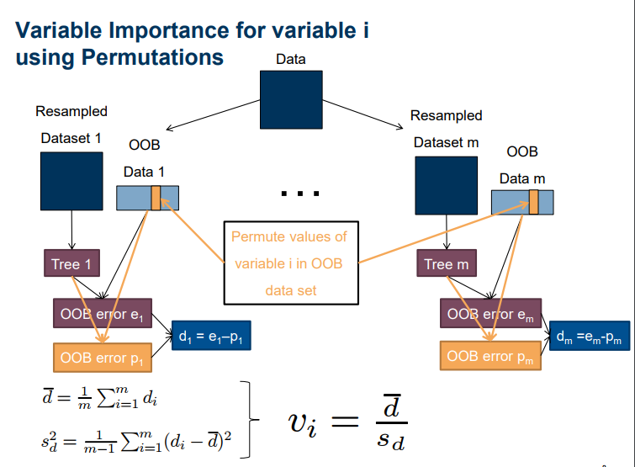

Slide 10
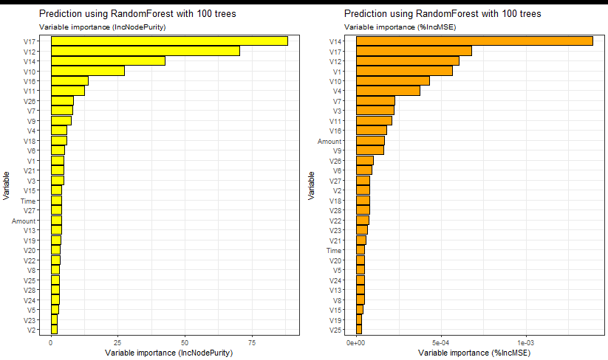
RF - Variable Importance

Slide 11
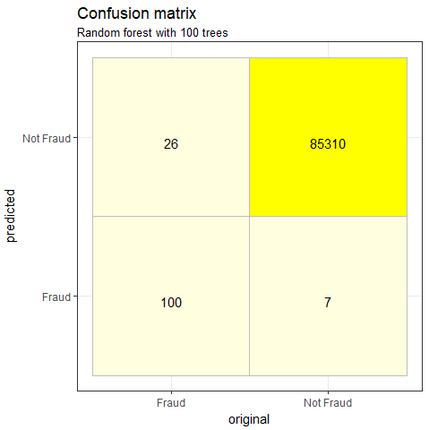
Confusion matrix
Confusion Matrix: Merely tabulating the confusion matrix will not provide a clear understanding of the performance of the data. This is because the total number of fraud cases is much less, and variation in the confusion matrix will be so small.
it is important to use a metric that include evaluation of FP and FN as well.
We are interested in minimizing FN as much as possible. (Predicted: Not Fraud and True: Fraud)

Slide 12
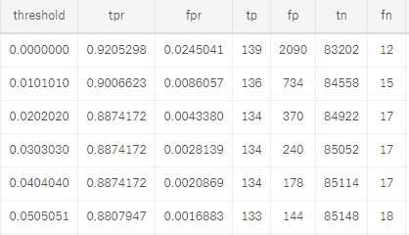
ROC (Receiver Operating Characteristic) Curve
ROC Curves are used to see how well your classifier can separate fraud and non-fraud classes and to identify the best threshold for separating them.
Set a threshold and define everything above as positive(fraud) and the others as negative (non fraud)
Then match those decisions with actual test set to calculate TP,FP,TN,FN,TPR (sensitivity) and FPR (1-specificity) for the associated threshold
Here we set threshold with values between 0 and 1 (100 values equally distributed)

Slide 13
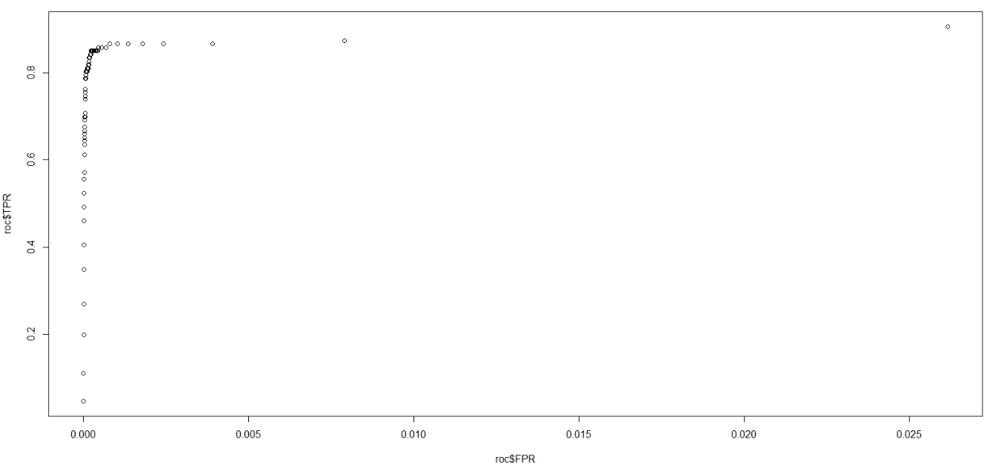
ROC Curve

Slide 14
Deliverables
Describe the deliverables :
R-code and Output
Describe what you have finished so far
Random Forest Modelling And Evaluation
Show the completed task is at least 50% of the overall activity:
Our next work is to reduce the dimension based on the variable importance we got in our first model and remodel accordingly.

Slide 15
Learning
Linear Regression
Classification
Bagging
Boosting
Random Forest
Performance Metrics

Slide 16
Conclusion
From the ROC curve, we infer that our model is good as we initially are more likely to encounter TP's as we move up the table (threshold high to low).

