Slide 1
Enhancing Bank Marketing Model Performance
Through Feature Engineering and Selection

Slide 2
Problem Statement
Using too many irrelevant or redundant features can lead to poor model accuracy and overfitting.
Our dataset includes categorical and numerical variables, many of which require transformation or elimination.

Slide 3
Objective
Enhance model performance using:
- Feature Engineering (e.g., One-Hot Encoding, Scaling)
- Feature Selection (e.g., RFE, L1)
Result: Improve accuracy and interpretability.

Slide 4
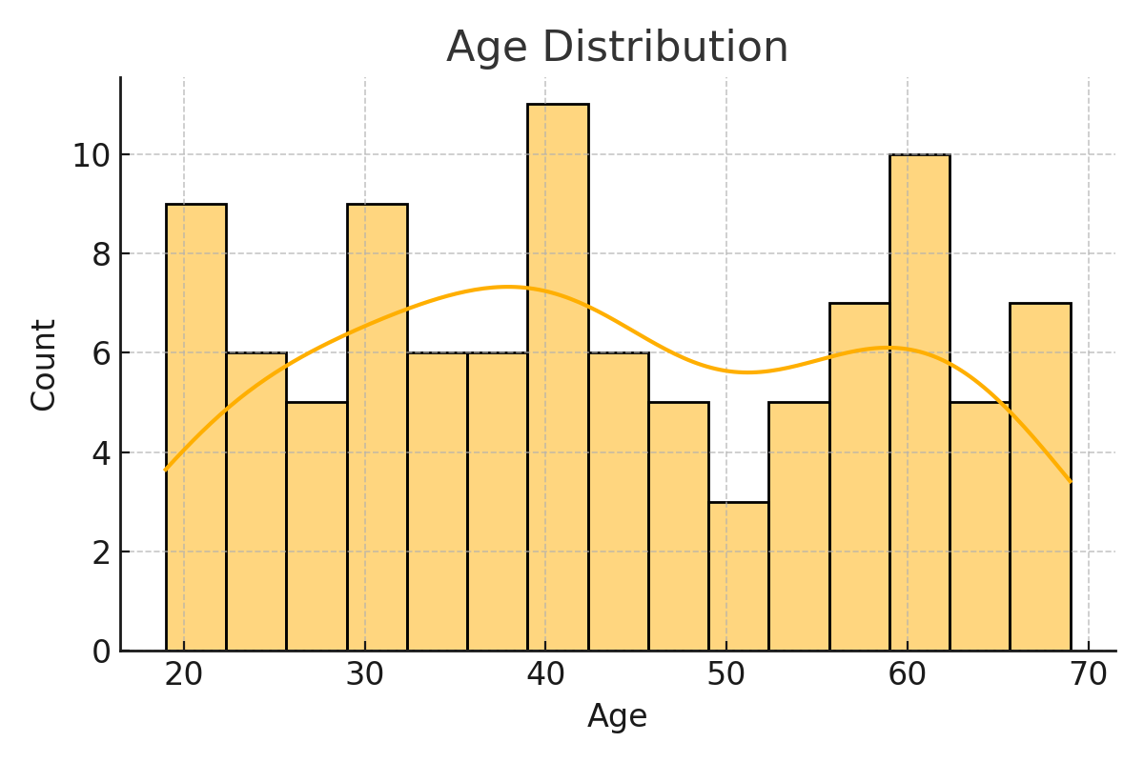
EDA: Age Distribution

Slide 5
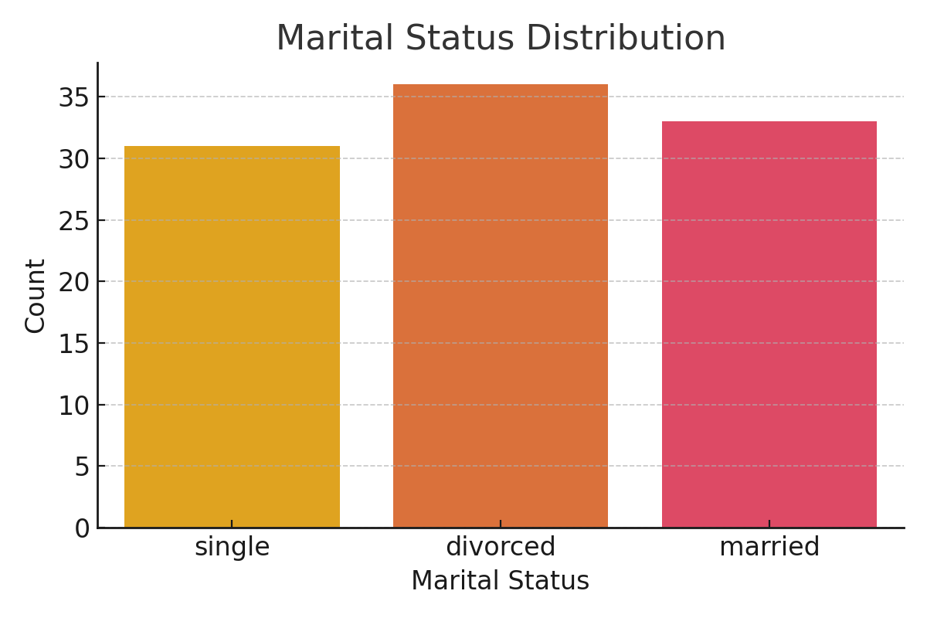
EDA: Marital Status

Slide 6
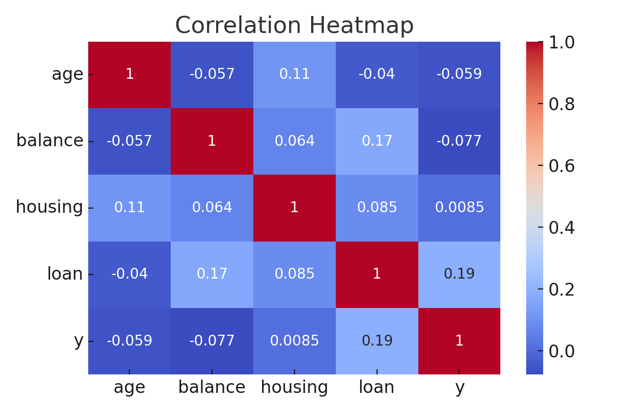
Feature Correlation

Slide 7
Feature Engineering
- One-Hot Encoding for categorical variables
- StandardScaler applied to numerical features
- Removed highly correlated features

Slide 8
Feature Selection Techniques
- SelectKBest
- Random Forest Importance
- L1 Regularization (Lasso)
- Recursive Feature Elimination (RFE)

Slide 9
Model & Results
- Gradient Boosting Classifier performed best
- Accuracy improved after feature selection
- Model interpretable and efficient

Slide 10
Conclusion
Effective feature engineering and selection significantly improved model performance.
This structured approach ensures better predictions and model transparency.

