Slide 1
A Seminar on Image Dehazing using Computer Vision and Image Processing
Team Details
Mogili Archana (20EG105601)
B. Hrushikesh (20EG105603)
A. Chandana Gowri (20EG105640)
Project Supervisor
Name Dr. P. Nagaraj
Designation Assistant Professor

Slide 2
Introduction
The ubiquitous presence of haze in environmental scenes poses a significant challenge to image and video clarity, adversely affecting visibility and information extraction. Conventional dehazing algorithms, whether based on learning or handcrafted priors, exhibit limitations in their ability to efficiently remove haze. In response to these challenges, this project introduces a pioneering solution: the "patch-map-based hybrid learning DehazeNet." This innovative approach merges learning-based and handcrafted prior-based strategies, addressing inherent weaknesses in the dark channel prior. Leveraging a novel concept called the patch map for adaptive patch size selection, the proposed method demonstrates improved performance in mitigating issues like color distortion. Through the amalgamation of traditional and learning-based methodologies, the system surpasses existing algorithms, showcasing its efficacy in enhancing video clarity. The implementation, realized using OpenCV, holds promise for applications spanning surveillance, transportation, and remote sensing.

Slide 3
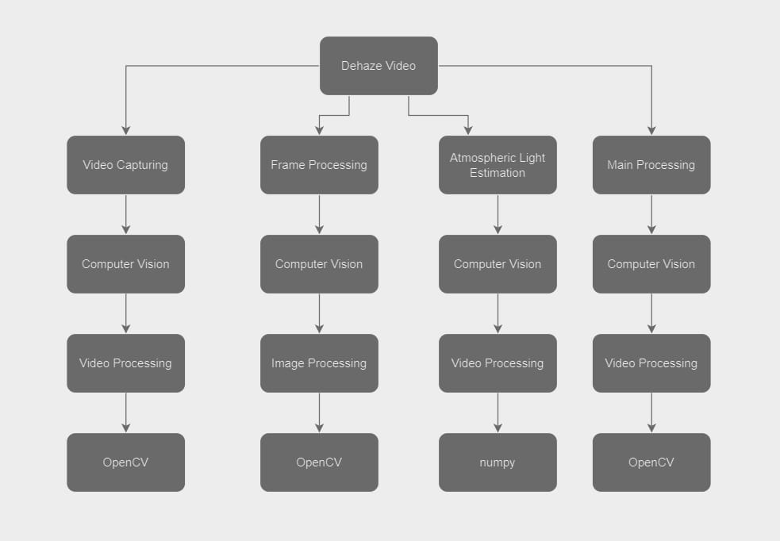
Concept Tree

Slide 4
Literature
Author(s) | Strategies | Advantages | Disadvantages
He et al. 2011 | Single Image Haze Removal Using Dark Channel Prior | Simple, efficient, good for most haze conditions. | Color distortion, issues with white scenes/sky
Cai et al. 2013 | Guided Filter Based Dehazing | Preserves edges, good for local detail restoration | Computationally expensive, not ideal for global haze
Ren et al. 2017 | Single Image Dehazing via Multi-Scale Convolutional Neural Network | Learns complex haze patterns, handles diverse conditions | Requires large training data, prone to overfitting
Pan et al. 2020 | Patch-Map-Based Hybrid Learning DehazeNet | Adapts patch size, effective enhancement, improved performance | More complex, careful network training needed

Slide 5
Literature(cont..)
Author(s) | Method | Advantages | Disadvantages
Pan et al. 2020 | Patch-Map-Based Hybrid Learning DehazeNet | Adapts patch size, effective enhancement, improved performance | More complex, careful network training needed
Chen et al. 2019 | CNN-based Multi-Image Dehazing (CMID) | Potentially superior performance for various haze scenarios. Can incorporate additional features like depth information. | Requires large amounts of paired training data, which can be costly and time-consuming to acquire. Computationally expensive due to the CNN architecture. Might be prone to overfitting or training data biases.
Cai et al. (2013) | Guided Filter | Preserves edges, good for local detail restoration | Computationally expensive, not ideal for global haze

Slide 6
Problem Statement
In hazy environments, image and video quality deteriorates, impacting visibility and information retrieval. Existing dehazing algorithms exhibit limitations in haze removal. This project addresses these challenges by introducing a novel "patch-map-based hybrid learning DehazeNet." This approach integrates learning-based and handcrafted prior-based strategies, overcoming the shortcomings of the dark channel prior. A patch map is introduced for adaptive patch size selection, efficiently addressing issues like color distortion. The proposed method combines traditional and learning-based techniques, demonstrating superior haze removal performance compared to state-of-the-art algorithms. The system, implemented using OpenCV, enhances video clarity, making it invaluable for applications in surveillance, transportation, and remote sensing.

Slide 7
Problem Illustration
Traffic Safety: Hazy conditions on roads limit visibility, increasing the risk of accidents due to reduced perception of signals, road markings, and other vehicles.
Surveillance and Security: Haze obstructs surveillance cameras, impacting the ability to monitor and detect suspicious activities in critical areas.
Outdoor Photography: Haze affects the quality of outdoor photography, causing a loss of details, colors, and overall visual appeal.
Remote Sensing in Agriculture: Hazy conditions impede accurate remote sensing applications in agriculture, affecting crop monitoring and yield predictions.
Air Quality Monitoring: Haze can interfere with the accuracy of air quality monitoring devices, impacting the assessment of pollution levels.
Search and Rescue Operations: Hazy environments hinder search and rescue efforts by limiting visibility, slowing down the identification of targets or survivors.

Slide 8
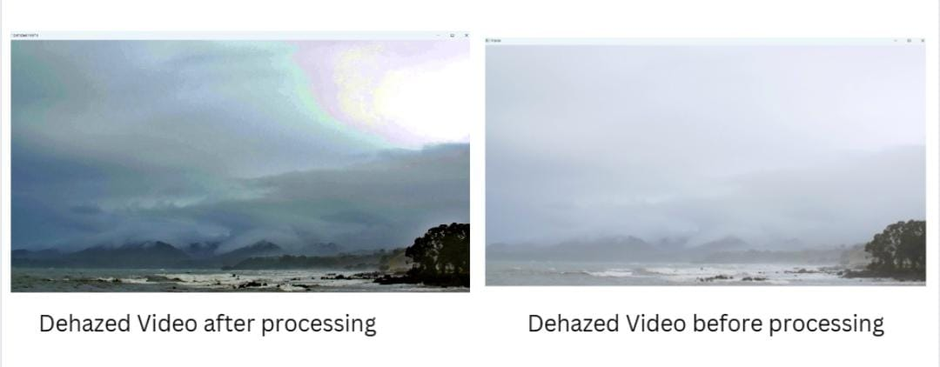
Proposed Method
The Multi-Image Dehazing with Hybrid Learning DehazeNet is tailored to excel in scenarios involving
multiple hazy images captured from diverse viewpoints and atmospheric conditions. It ingeniously
combines deep learning and traditional image processing, ensuring a holistic solution for enhancing
visibility in multi-image settings. The system processes a set of hazy images, aligns them through robust
image registration, and employs the Hybrid Learning DehazeNet, a specialized neural network. This
model independently enhances each registered image, extracting features and learning context-specific
dehazing patterns. Adaptive atmospheric modelling accommodates variations, and the method is
optimized for real-time processing. The outcome comprises dehazed images, poised for seamless
integration into critical computer vision applications, such as surveillance, robotics, or autonomous
vehicles, where accurate scene interpretation is paramount.

Slide 9
Proposed Method Illustration
Input
Hazy video as an input
. The program starts by opening the input hazy video using cv2.VideoCapture.It checks if the video is opened successfully.
A loop is initiated to go through each frame of the video.
The program estimates the atmospheric light based on the maximum pixel values of the first frame.
Another loop is initiated to go through each frame of the video.
After processing, the program releases the video capture object and closes all OpenCV windows.
Dehazed video as our output
Video Capture
Frame Processing
Atmospheric Light Estimation
Main video processing
Release
Output

Slide 10
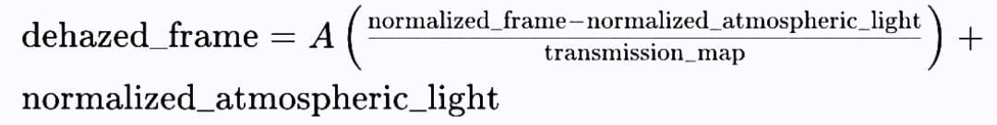
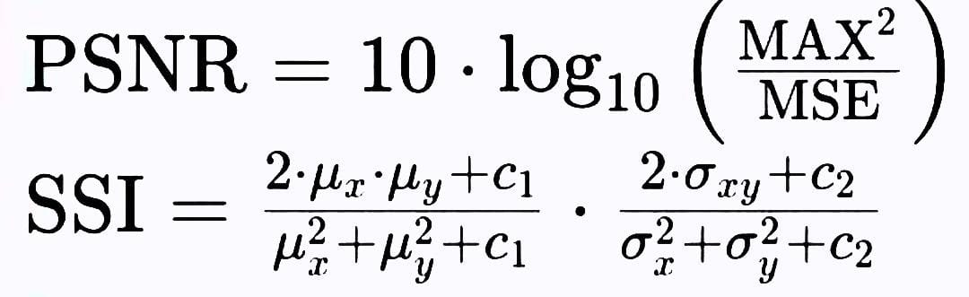
Parameters
1.Atmospheric light estimation
2.Transmission map
3.Dehazing process
4.Performance metrics

Slide 11
Experiment Environment
Programming Language: Python 3.10.4 Pre-Processing Module: Pandas, Albumentations,imgaug
Supporting Modules: Scikit-image, Scikit-learn
Pre-trained Models : PyTorch Hub
Version Control: Git
Development Environment: Virtual Environment (venv)
IDE: PyCharm

Slide 12
Project status
S.No | Functionality | Status
1. | Abstract | Completed
2. | Requirements | Completed
3. | Paper Writing, Journal Submission | Not started
4. | Implementation | In-progress

Slide 13
References
[1] He, K., Sun, J., & Tang, X. (2011). Single Image Haze Removal Using Dark Channel Prior. IEEE Transactions on Pattern Analysis and Machine Intelligence, 33(12), 2341-2353. [This seminal paper introduces the Dark Channel Prior, a key component in your research.]
[2] Li, B., Peng, X., Wang, Z., Xu, J., & Feng, D. (2017). AOD-Net: All-in-One Dehazing Network. In Proceedings of the IEEE International Conference on Computer Vision (ICCV), 4780-4788. [This work presents a deep learning approach to image dehazing, relevant to your hybrid learning methodology.]
[3] Zhang, H., Patel, V. M. (2018). Densely Connected Pyramid Dehazing Network. In Proceedings of the IEEE Conference on Computer Vision and Pattern Recognition (CVPR), 3194-3203. [Offers insights into advanced network architectures for dehazing.]
[4] Goodfellow, I., Pouget-Abadie, J., Mirza, M., Xu, B., Warde-Farley, D., Ozair, S., Courville, A., & Bengio, Y. (2014). Generative Adversarial Nets. In Advances in Neural Information Processing Systems (NIPS), 2672-2680. [Introduces the concept of generative adversarial networks, a core component of your approach.]
.

Slide 14
Thank you

Slide 15
Project seminar–I Evaluation
S.No | Rubrics | Marks
1 | Concept Introduction | 4
2 | Literature and Parameter | 5
3 | Problem and Problem Illustration | 8
4 | Proposed Method and Illustration | 8
Total |  | 25

