Slide 1
💼 HireFlow Recruitment Management System 👩‍💻 Archana Padamata

Slide 2
HireFlow is a full-stack web application designed to automate and streamline the recruitment process.
It provides role-based access for Admin, Recruiter, and Candidate to manage hiring efficiently.
Candidates can search jobs, upload resumes, and apply, while recruiters manage applications and workflows.
The system supports end-to-end recruitment including shortlisting, selection, and interview scheduling.
It integrates email notifications and match scoring to improve decision-making and user experience.
Abstract

Slide 3
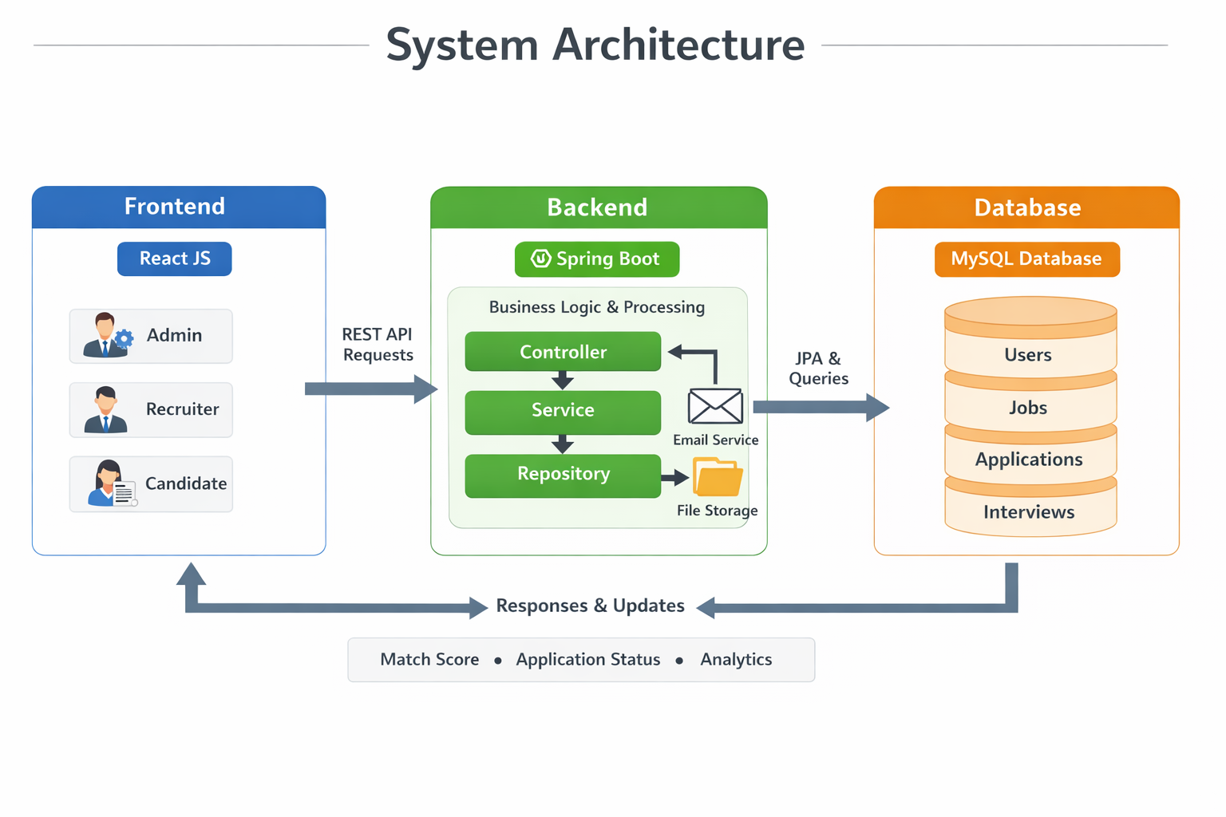
System Architecture

Slide 4
Functionalities
🔐 Authentication
• User Registration & Login
• BCrypt Password Encryption
• JWT Token Generation
• Role-based Access
👤 Profile Management
• View & Update Profile
• Store User Details
• Resume Upload
• Resume Linked to User
📊 Dashboard
• Total Jobs
• Total Applications
• Analytics Data
🧑‍💻 Admin
• Manage Users
• Manage Jobs
• System Monitoring

Slide 5
📄 Application System
• Apply with Resume Upload
• Prevent Duplicate Applications
• Store Application Data
🤖 Match Scoring
• Score (0–100)
• Based on Skills & Resume
• Helps Recruiters
💼 Job Management
• Create, Update, Delete Jobs
• View Job Listings
• Job Details Management
🔍 Job Search
• Search by Role, Location
• Filter by Company & Experience
• Dynamic API Filtering

Slide 6
📊 Application Tracking
• Track Status
• View Applied Jobs
• Display Match Score
🧑‍💼 Recruiter Features
• View Applications
• Shortlist / Select / Reject
• Access Resume
📅 Interview Management
• Schedule Interview
• Date, Time, Message
• Update Status
📩 Notifications
• Email Alerts
• Application Updates
• Interview Notifications

Slide 7
Action by role:
🧑 Candidate (Job Seeker)
Register and login to the system
Search and filter jobs
Apply for jobs with resume upload
Track application status (Applied, Shortlisted, Rejected, Selected)
View interview details and updates
Manage personal profile
🧑 Candidate (Job Seeker)
Register and login to the system
Search and filter jobs
Apply for jobs with resume upload
Track application status (Applied, Shortlisted, Rejected, Selected)
View interview details and updates
Manage personal profile
🧑‍💻 Admin
Manage all users (view/delete)
Manage all job listings
Monitor system activities
Access overall recruitment data
Maintain system control

Slide 8
TECHNOLOGY
FRONTEND (React)
React.js (UI Development)
HTML5, CSS3, JavaScript (ES6)
Fetch API (REST communication)
LocalStorage (User session handling)
Component-based architecture
⚙️ BACKEND (Spring Boot)
Java (JDK 17+)
Spring Boot (REST APIs)
Spring Data JPA (Hibernate)
MySQL (Database)
JWT Authentication & BCrypt Security

Slide 9
Process to run:
🎨 Frontend Setup (React)
Install Node.js & npm
Navigate to frontend folder:
cd frontend
Install dependencies:
npm install
Start React app:
npm start
Runs on: 👉 http://localhost:3000
⚙️ Backend Setup (Spring Boot)
Install Java (JDK 17+) and MySQL
Create database (e.g., hireflow_db)
Update application.properties (DB username & password)
Run the backend using:
mvn spring-boot:run
Server runs on: 👉 http://localhost:9095

Slide 10
Backend Working:
🧠 2. Service Layer (Business Logic)
Contains core application logic
Processes data and applies rules
Handles workflows like:
Job application
Match scoring
Interview scheduling
Communicates with Repository layer
👉 Heart of the application
🧩 1. Controller Layer (API Layer)
Handles incoming HTTP requests from frontend
Defines REST endpoints (/api/users, /api/jobs, etc.)
Receives input and sends response
Calls Service layer for processing
👉 Example: Login, Apply Job APIs
🗄️ 3. Repository Layer (Data Access Layer)
Interacts with database using JPA
Performs CRUD operations
Uses interfaces like:
UserRepository
JobRepository
No business logic here
👉 Direct DB communication

Slide 11
🧱 4. Entity Layer (Model Layer)
Represents database tables
Defines fields and relationships
Example:
User
Job
Application
Interview
👉 Maps Java objects ↔ Database tables
⚠️ 6. Exception Handling Layer
Global error handling
Returns structured error responses
Handles:
Not found
Invalid login
Server errors
👉 Improves reliability
🔐 5. Security Layer
Handles authentication & authorization
JWT token generation
Password encryption (BCrypt)
Controls access to APIs
👉 Protects the system

Slide 12
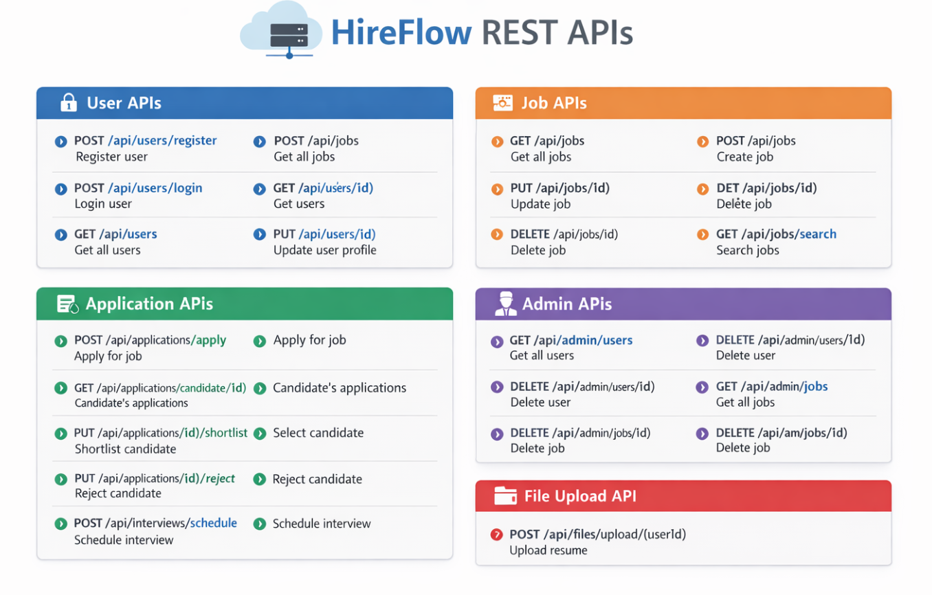
Rest APIs

Slide 13
Advantages:
Automates the complete recruitment process
Reduces manual work and saves time
Centralized system for managing data
Easy job search and application process
Real-time application tracking
Resume management and quick access
Automated email notifications
Improves hiring efficiency and decision-making
Role-based secure access
Scalable and user-friendly system

Slide 14
Conclusion:
HireFlow successfully automates the complete recruitment process
Simplifies job posting, application tracking, and hiring workflow
Improves efficiency and reduces manual effort
Provides a centralized and user-friendly platform
Enhances decision-making with match scoring and analytics
Can be further improved with advanced features in future

