Slide 1
SmartMeet AI
Intelligent Video Conferencing Platform with Real-Time Transcription, Subtitle Generation and Multilingual PDF Export
PRESENTED BY
GUIDE
ARCHANA SATHEESH
REG NO: MLM25MCA-2022
Mangalam College of Engineering Kottayam
2025–2027
Ashwani Vijayachandran
Assistant Professor
Mangalam College Of Engineering Kottayam

Slide 2

INTRODUCTION
SmartMeet AI is an AI-based video conferencing system.
Users can hold online meetings with audio and video.
It uses WebRTC for real-time communication.
AI converts speech into text automatically.
It provides subtitles/captions for recorded meetings.
Meeting content can be translated into different languages.
Translation
Users can download the meeting transcript as a PDF.
It helps make online meetings easy, accessible and organized.
PDF

Slide 3
ABSTRACT – SMARTMEET AI
SmartMeet AI is an AI-powered web-based online meeting platform.
It provides real-time audio and video communication using WebRTC.
Users can create and join online meetings easily.
Meetings can be recorded for post-meeting processing.
Recorded audio is converted into text using Whisper speech recognition.
The system generates automatic meeting summaries from the transcript.
It provides automatic subtitle generation for recorded meetings.
The transcript and summary can be translated into multiple languages.
A PDF report containing meeting information and processed content can be generated.
The system reduces manual effort in meeting documentation.
SmartMeet AI provides a single platform for communication, recording, transcription, summarization, translation, and reporting.

Slide 4
PROBLEM STATEMENT
Limited subtitle support: Difficulty generating synchronized subtitles for meeting recordings.
Language barriers: Limited access to meeting content in users’ preferred languages.
Manual documentation: Reviewing long recordings and preparing meeting notes takes time.
Lack of report generation: No integrated option to generate downloadable PDF reports containing transcripts and summaries.
Why It Matters
Students, educators, and professionals spend significant time reviewing meeting recordings and preparing notes manually. SmartMeet AI addresses these challenges through automatic transcription, AI-based summarization, subtitle generation, translation, and PDF report generation in one platform.

Slide 5


Objectives
Real-Time Communication
Session Recording
AI Transcription
Enable seamless peer-to-peer video meetings using WebRTC technology.
Allow hosts to record meetings for later reference and review.
Convert recorded audio into accurate text using OpenAI Whisper.
Subtitle Generation
Multilingual Export
Accessible Design
Auto-generate subtitles synced with the recorded video timeline.
Translate transcripts and export them as formatted PDF documents.
Improve usability for students, educators and professionals alike.

Slide 6
EXISTING SYSTEM
Google Meet
Zoom
Microsoft Teams
Real-time video and screen share
Stable video conferencing
Enterprise-grade meetings
Basic cloud recording
Cloud recording available
Recording with transcript
No transcript export
Auto-captions in limited plans
Transcript tied to MS ecosystem
No subtitle sync for recordings
No multilingual PDF export
No translated document export

Slide 7
PROPOSED SYSTEM
SmartMeet AI unifies real-time video conferencing with an AI-driven post-meeting pipeline recording, transcription, subtitle sync, translation and PDF export in a single platform.
Live Meeting
Recording
Whisper Transcription
Subtitle Generation
Translation
PDF Export
WebRTC video call
Session captured
Google Translate API
Downloadable document
Whisper ASR
Synced to video
Built with Python Django (backend) and HTML, CSS, JavaScript (frontend), combining communication, accessibility and intelligent data processing in one workflow.

Slide 8


PROJECT SCOPE
IN SCOPE
FUTURE WORK
Browser-based video meetings via WebRTC (audio, video, screen share)
Native mobile applications (iOS / Android)
Host-controlled session recording
Support for more than a limited set of concurrent participants
Speech-to-text transcription of recorded audio (Whisper)
Offline / on-device transcription without internet access
Automatic subtitle generation synced to recorded video
Real-time (live) subtitle overlay during an ongoing meeting
Language selection and transcript translation (Google Translate API)
Enterprise-grade SSO and admin governance features
Export of translated transcript as a formatted PDF

Slide 9
LITERATURE REVIEW
Paper / Year | Authors / Publication | Algorithm / Method | Features / Methodology | Performance Metric | Results / Findings
Whisper-Based Speech Transcription from Videos (2026) | Michael Picheny, arXiv | OpenAI Whisper & WhisperX ASR Pipelines | Multilingual speech processing, YouTube data pipelines, and out-of-the-box acoustic transcription. | Word Error Rate (WER), Language Error Breakdown | Achieved high accuracy speech-to-text conversion across various noise levels.
Subtitle-Aligned Fine-Tuning of Whisper for ASR (2026) | Felix Akeret, arXiv | Whisper Large-V3 Transformer | Subtitle-aligned audio processing, sequence decoding, and timestamp matching. | Character WER (cWER), Processing Latency | Improved precision for timestamp segmentation and subtitle track alignment.
AI-Powered Meeting Assistant for Transcription & Summarization (2026) | IRJET | OpenAI Whisper + NLP Processing | Automated audio transcription, text segmentation, and structured document formatting. | WER, Transcription Accuracy | Demonstrated high transcription accuracy and automated meeting documentation.
Speech Translation and Metrics: Findings of IWSLT (2026) | David I. Adelani et al., ACL / IWSLT | Neural Machine Translation (NMT) | Offline and simultaneous speech translation across multilingual contexts. | Translation Quality, BLEU Scores | Established benchmark accuracy for cross-lingual automated text translation.
Scalable Subtitle-Aligned Pipelines for Archival Systems (2026) | Independent Research, arXiv | Subtitle Generation & Formatted PDF Export | Automated subtitle track creation, segmentation, and structured document export. | Processing Throughput, Formatting Precision | Proved effective for generating structured, printable transcripts and exported files.

Slide 10
TECHNOLOGY STACK
FRONTEND
BACKEND
REAL-TIME COMMUNICATION
HTML, CSS, JavaScript
Python, Django
WebRTC
Responsive meeting UI and controls
Server logic, session and user management
Peer-to-peer audio/video streaming
SPEECH-TO-TEXT
TRANSLATION
DOCUMENT EXPORT
OpenAI Whisper
Google Translate API
PDF Generation Library
AI-based transcription of recordings
Multilingual transcript translation
Formatted, downloadable transcripts

Slide 11
SYSTEM ARCHITECTURE
Frontend( UI)
HTML,CSS,JAVASCRIPT
Users
AI Processing
module
Meeting
Dashboard
Video
Room
Transcripts
Reports
OPEN AI
Whisper
Django Backend Server
User Authentication
Meeting Management
NLP
Workflow
Transcription & NLP Services
1.Join meeting
Translation
services
Recording
Management
Report/PDF Generation
Translation API
2. Record Session
3. Transcript Audio
Subtitle
Generation
4. Generate subtitles
Database (SQLite)
5.Translate Text
6.Export PDF
User details
Meeting details
Recordings
Transcripts
Reports
Generated Output
Meeting Transcript
Multilingual
Translation
AI Meeting summary
Subtitle File
PDF Report/Download

Slide 12
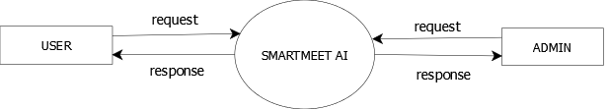
LEVEL 0
Data Flow Diagram

Slide 13
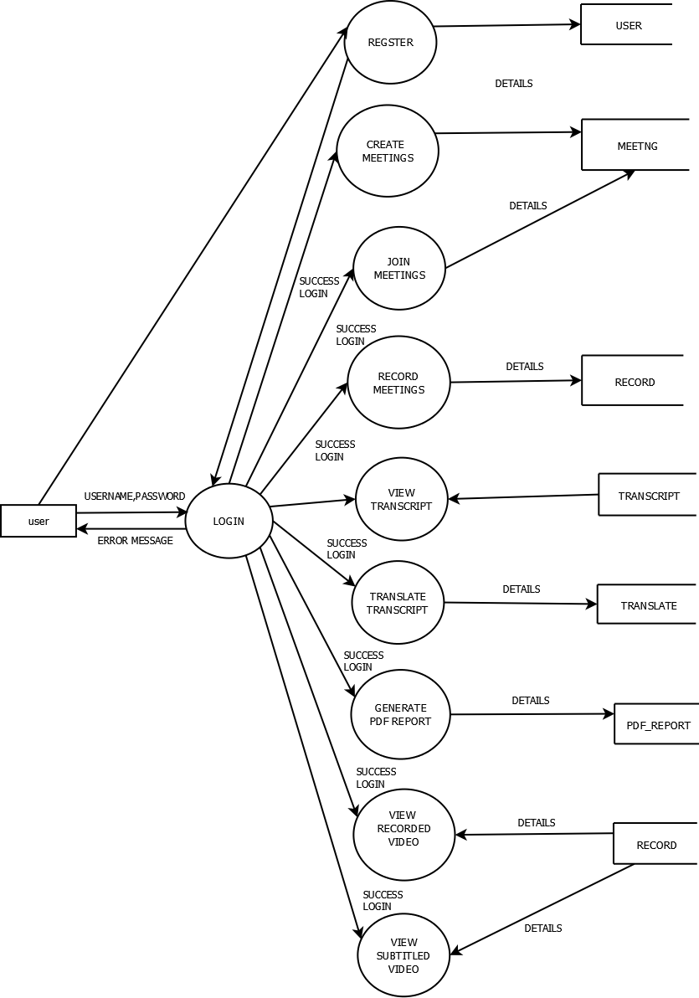
LEVEL 1 USER

Slide 14
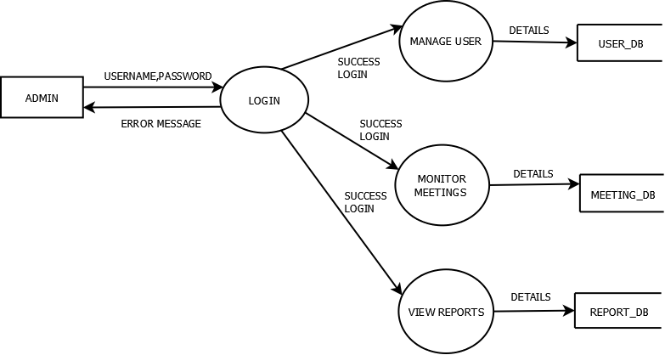
LEVEL 1 ADMIN

Slide 15
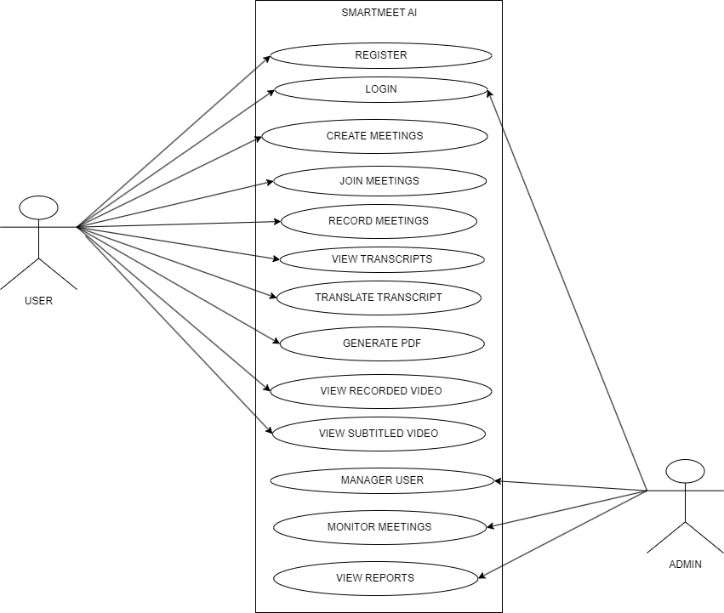
USECASE DIAGRAM

Slide 16
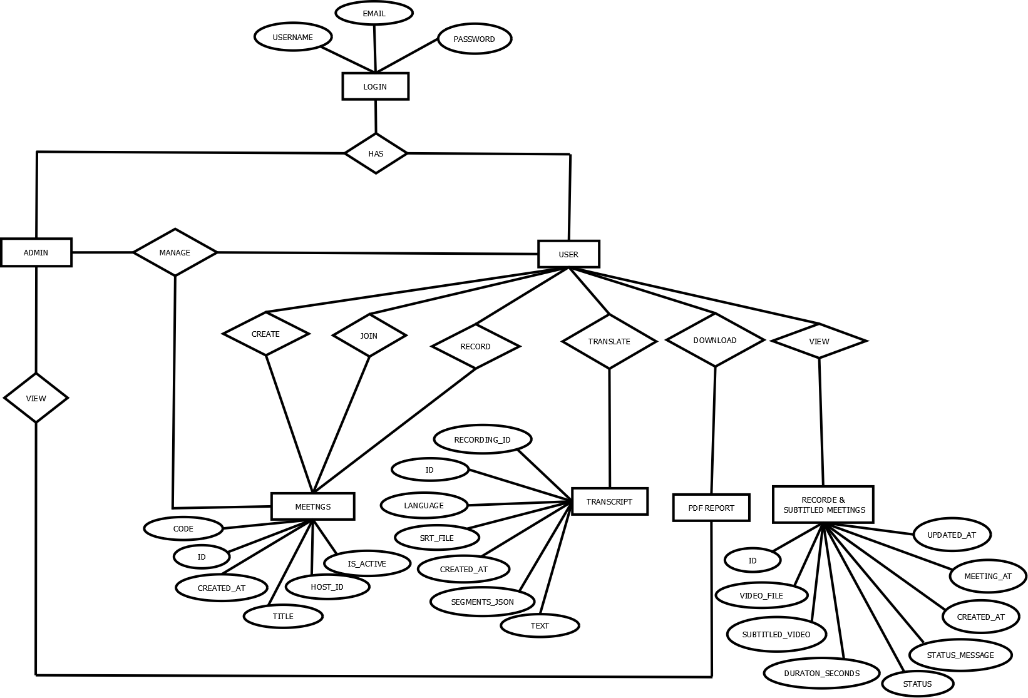
ER DIAGRAM

Slide 17
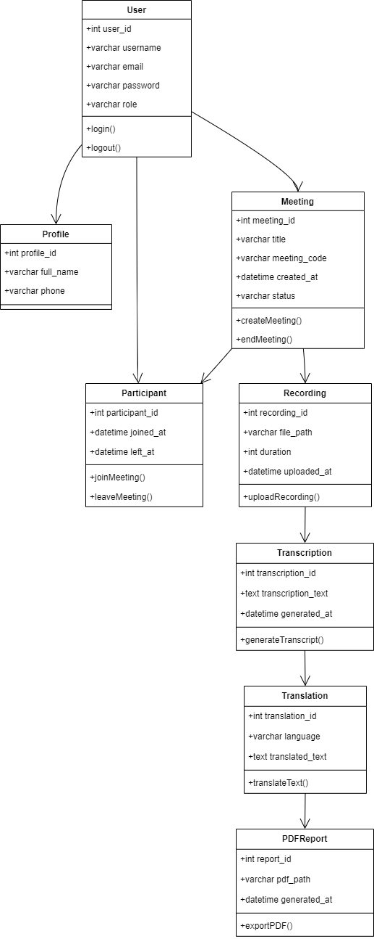
Class Diagram
CLASS DIAGRAM

Slide 18
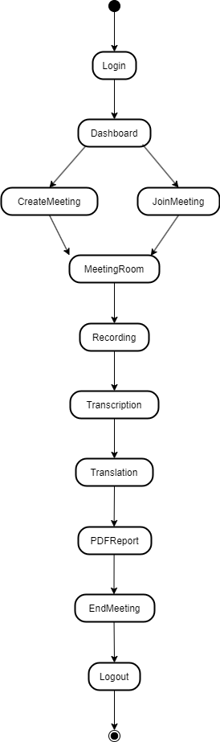
STATE DIAGRAM
STATE DIAGRAM

Slide 19
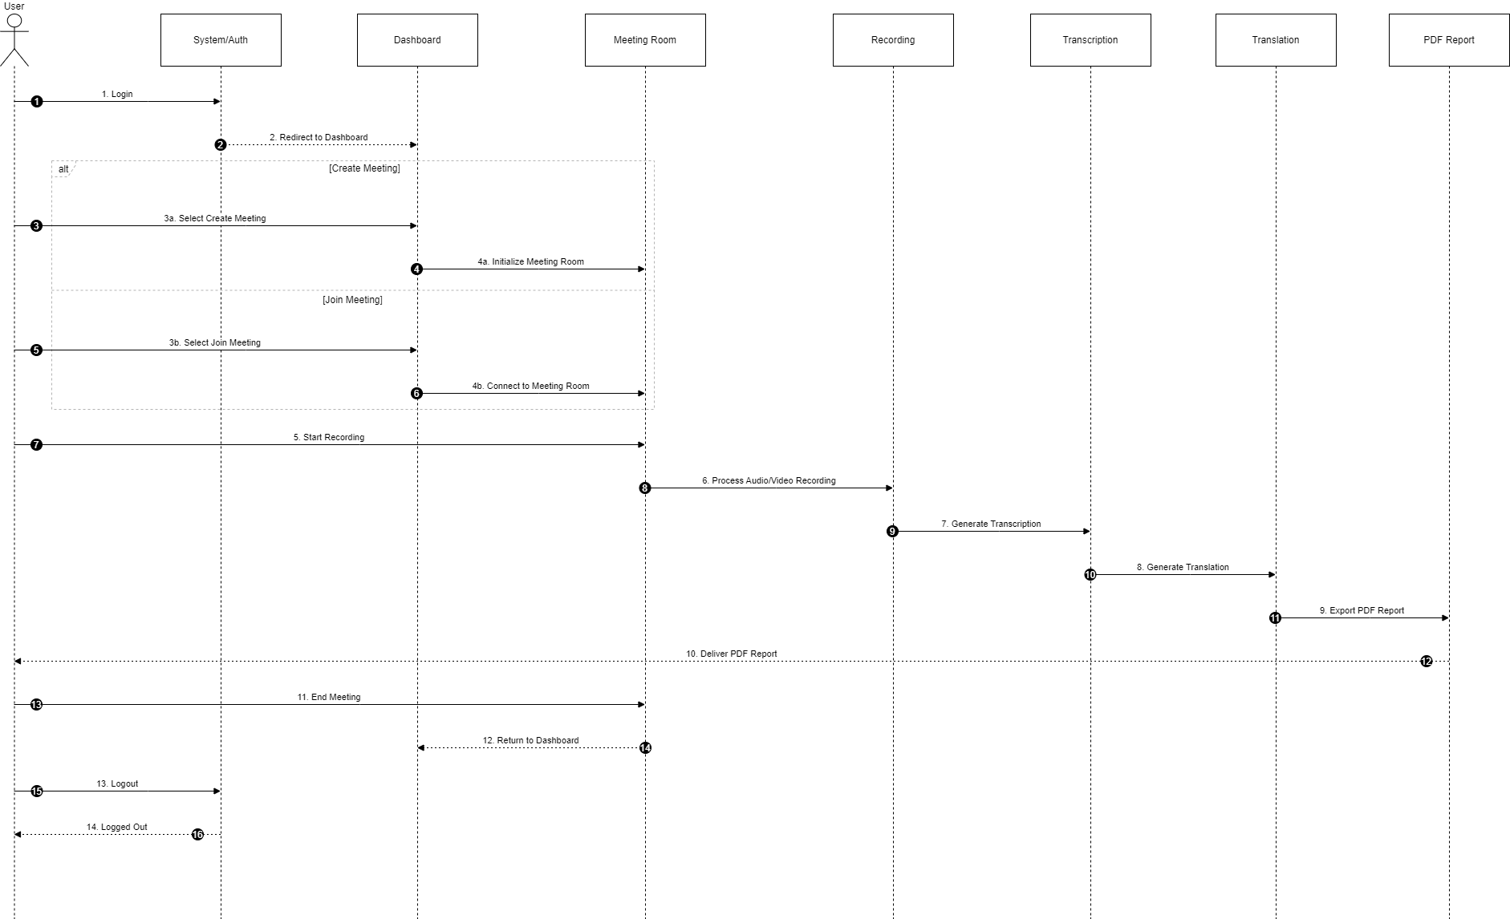
SEQUENECE DIAGRAM
SEQUENCE DIAGRAM

Slide 20


SYSTEM MODULES
Meeting Module
Session Recording
Real-time WebRTC audio/video meetings with screen sharing
Host-controlled recording of meeting audio and video
Speech-to-Text Transcript
Subtitle Generator
Whisper-based transcription of recorded sessions
Synchronizes transcript text with the recorded video timeline
Translation Module
PDF Export
Converts transcripts into the user's preferred language
Formats and generates downloadable translated documents

Slide 21
Methodology
1
2
3
4
5
6
Requirement Analysis
System Design
Front-end Setup
Backend & WebRTC
AI Pipeline Integration
Testing & Deployment
Define functional and non-functional requirements
Modeling, architecture, wireframes
Build meeting UI with HTML/CSS/JS
Django server, real-time media handling
Whisper ASR, subtitle sync, translation
Validate, refine and deploy the platform

Slide 22
RESULTS
Function | Observation | Status
Login/Register | User authentication successful | ✔ Pass
Create Meeting | Meeting created successfully | ✔ Pass
Join Meeting | Participants able to join | ✔ Pass
Audio/Video | Real-time communication works | ✔ Pass
Recording | Meeting content recorded | ✔ Pass
Transcription | Audio converted to text | ✔ Pass
Summarization | Meeting summary generated | ✔ Pass
Translation | Selected language output generated | ✔ Pass
PDF Report | Report generated and downloaded | ✔ Pass
9 / 9

Slide 23
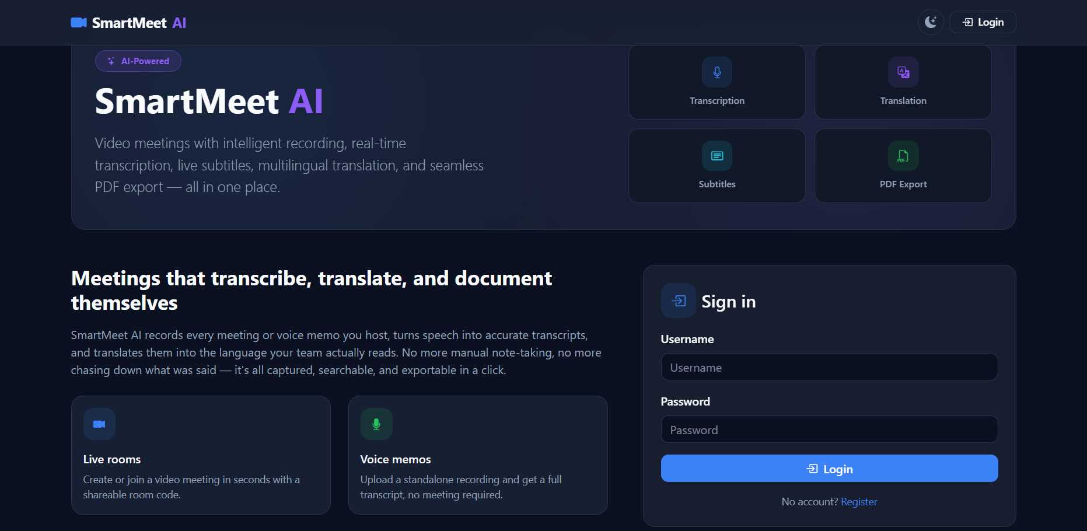
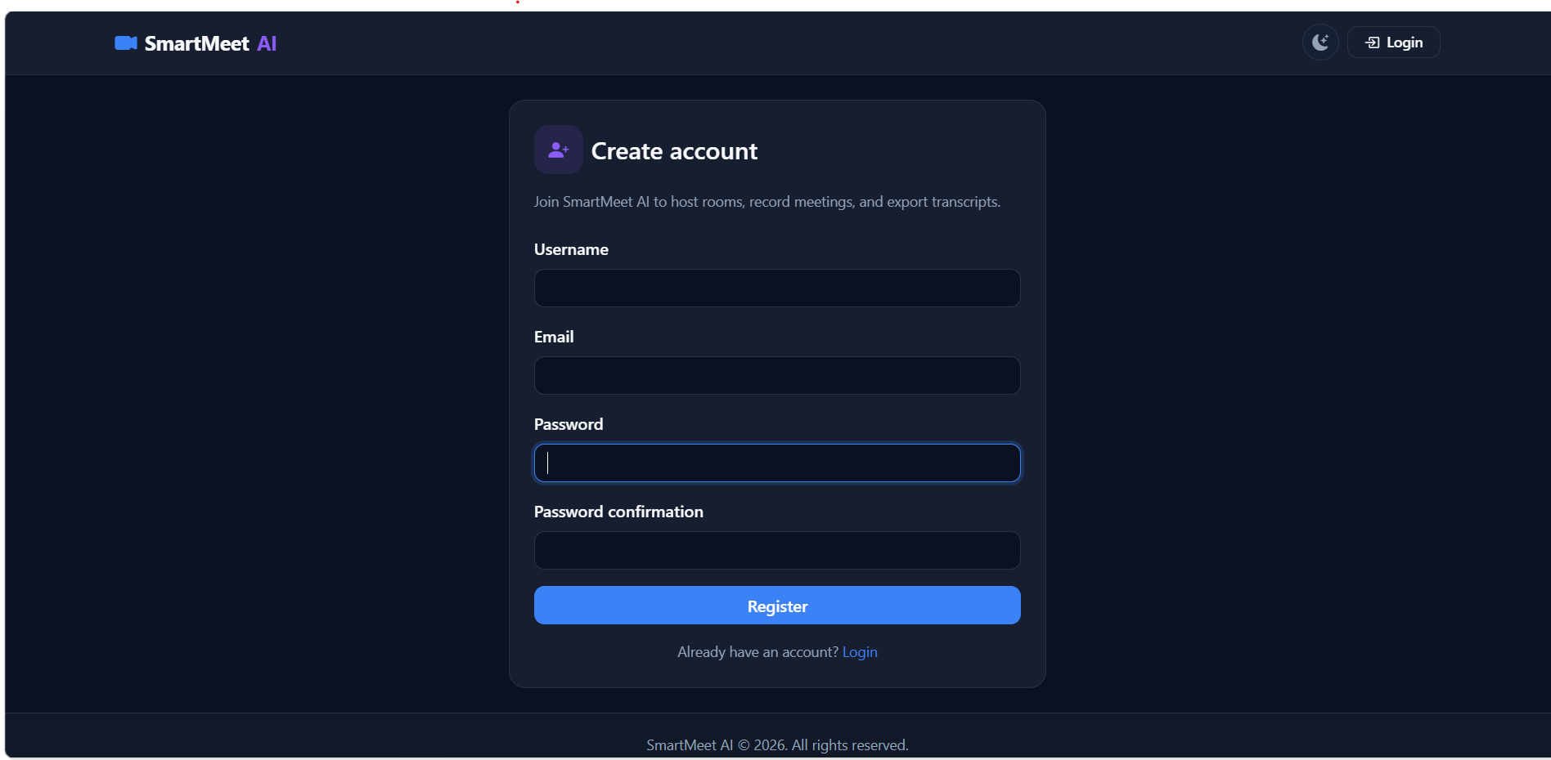
SCREENSHOTS
Landing page and sign-in
Create account (registration)

Slide 24
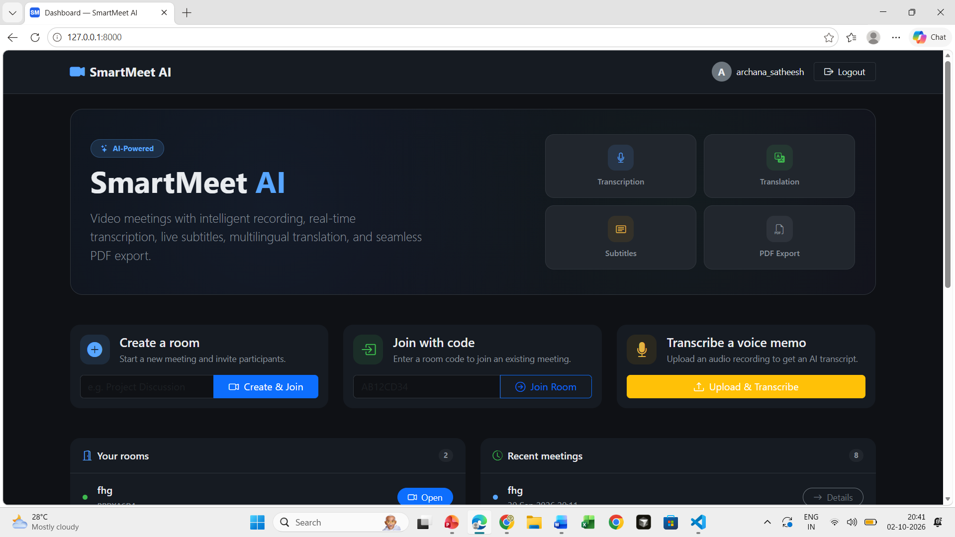
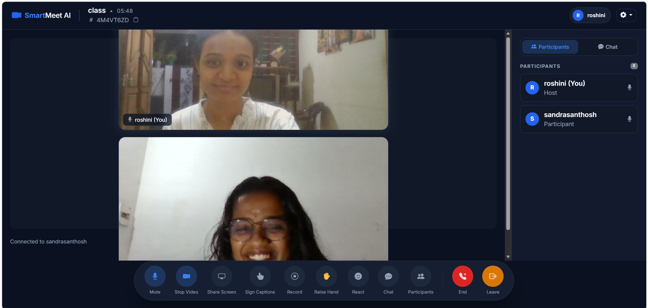
SCREENSHOTS
Dashboard
Meeting room with participants and controls

Slide 25
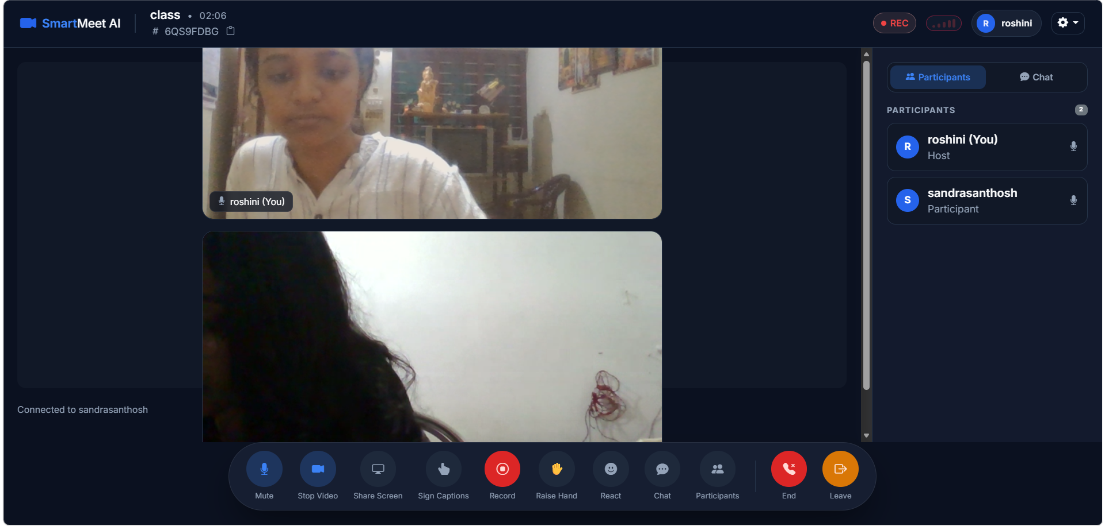
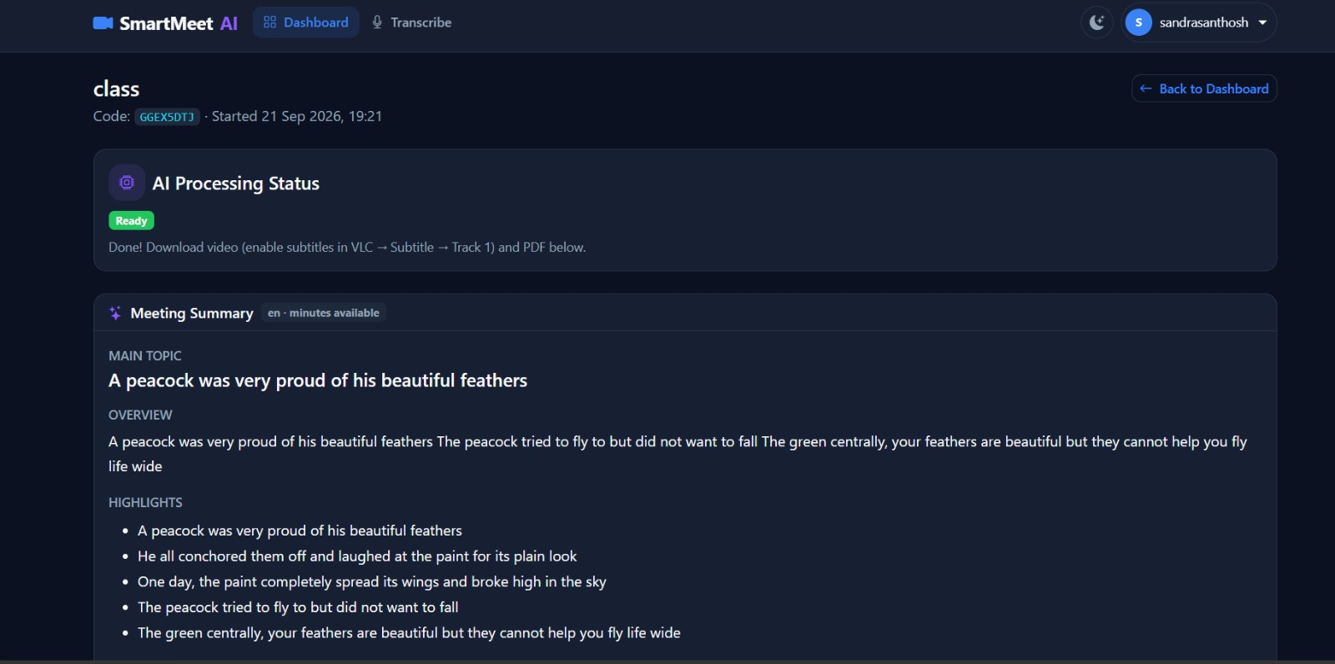
SCREENSHOTS
Meeting room with recording active
AI processing status and meeting summary

Slide 26
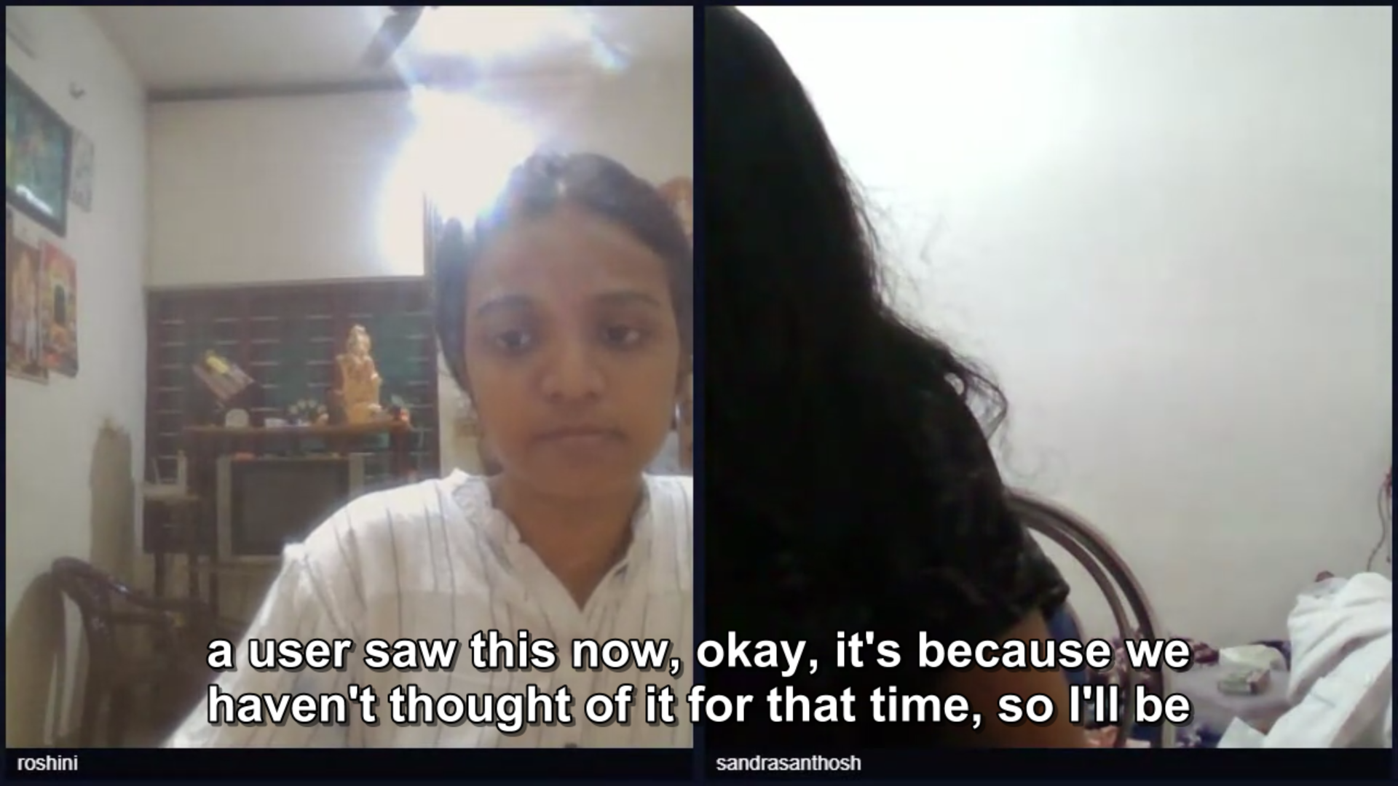
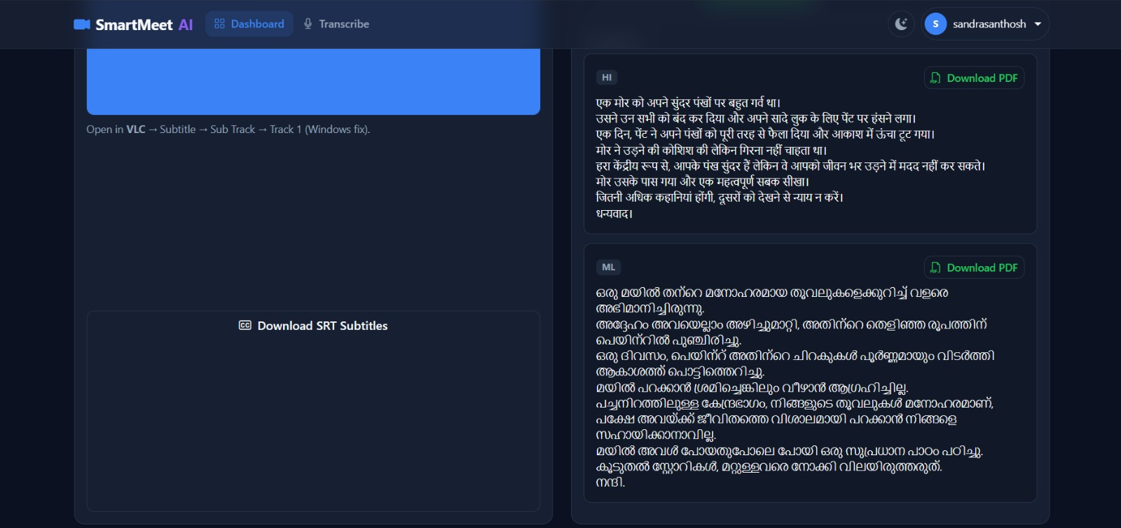
SCREENSHOTS
Transcript with translated PDF download options
Recorded video playback with subtitles

Slide 27
Comparison with Existing System
Feature | Existing System | SmartMeet AI
Meeting Communication | Basic/Separate tools | Integrated WebRTC communication
Processing | Mostly manual | Automated post-meeting processing
Transcription | May require separate tool | Whisper-based transcription
Summarization | Usually manual/separate tool | AI-based summary generation
Subtitles | Not always available | Automatic subtitle generation
Translation | May require separate service | Integrated translation
Reporting | Manual documentation | Downloadable PDF report
Accessibility | Depends on external tools | Transcript, subtitles and translation
Meeting Records | Recording may be separate | Recording with post-meeting processing

Slide 28
Testing
Test Case | Expected Result | Actual Result | Status
Valid Login | Login successful | Successful | ✔ Pass
Invalid Login | Error message displayed | Error displayed | ✔ Pass
User Registration | Account created | Account created | ✔ Pass
Create Meeting | Meeting created | Successfully created | ✔ Pass
Join Meeting | User joins meeting | Successfully joined | ✔ Pass
Audio/Video | Communication established | Successful | ✔ Pass
Start Recording | Recording starts | Recording started | ✔ Pass
Transcription | Transcript generated | Generated | ✔ Pass
Summary | Summary generated | Generated | ✔ Pass
Translation | Translated output generated | Generated | ✔ Pass
PDF Report | PDF generated | Generated | ✔ Pass

Slide 29
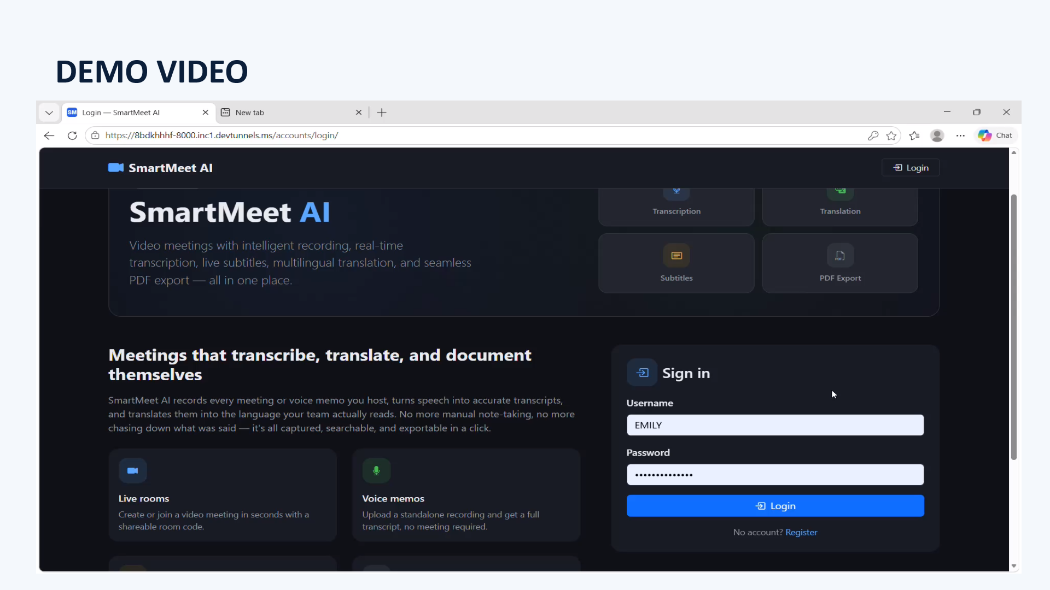

Slide 30
ADVANTAGES
Real-time audio and video communication
Easy meeting creation and joining
Meeting recording facility
Automatic speech-to-text transcription
AI-based meeting summarization
Automatic subtitle generation
Multilingual translation support
Downloadable PDF meeting reports
Reduces manual meeting documentation
Integrated meeting and post-meeting processing

Slide 31
LIMITATIONS
Connectivity and audio
Processing and storage
Quality and scope
Requires stable internet connectivity for WebRTC communication
Long recordings require more processing time
Translation quality may vary between languages
Audio quality affects transcription accuracy
Large recordings require additional storage
Advanced speaker identification is limited
Background noise can affect speech recognition
AI summary depends on transcript quality
AI processing is mainly performed after the meeting
Overlapping speech may reduce transcription quality

Slide 32
CONCLUSON
SmartMeet AI provides an intelligent platform for conducting online meetings.
1
Overall, SmartMeet AI helps make meetings more efficient, accessible and organized.
It supports real-time video conferencing and communication using WebRTC.
2
Meeting audio can be converted into text using AI-based speech recognition.
3
It provides multilingual subtitles and translation for better accessibility.
4
Meeting transcripts can be summarized and exported for future reference.
5

Slide 33
Future Scope
1
2
3
4
Speech and Language
Meeting Intelligence
Meeting Experience
Platform and Scale
Real-time speech transcription
Automatic action-item extraction
Calendar and meeting reminder integration
Cloud-based meeting storage
Advanced speaker diarization
Automatic identification of decisions and key points
Advanced participant controls
Improved scalability for large meetings
Improved multilingual speech recognition
Real-time AI meeting assistant
Mobile application support
Enhanced AI-based meeting analytics

Slide 34
REFERENCES
[1] M. Picheny and R. Zhang, “Robust multilingual speech recognition and transcription using OpenAI Whisper in modern web applications,” IEEE Transactions on Audio, Speech, and Language Processing, vol. 34, pp. 1120–1132, 2026.
[2] S. Wang, L. Chen, and H. Zhao, “Real-time peer-to-peer audio and video streaming architectures using WebRTC for interactive meeting platforms,” Journal of Systems and Software, Elsevier, vol. 222, pp. 112150, 2025.
[3] R. Patel, K. Gupta, and T. Baker, “AI-driven conversational summarization and action-item extraction frameworks for collaborative meetings,” IEEE Access, vol. 14, pp. 15200–15215, 2026.
[4] D. Martinez, A. Al-Mansoor, and E. Rossi, “Cross-lingual neural machine translation and subtitle alignment pipelines in cloud-based communication tools,” Computers & Security, Elsevier, vol. 148, pp. 104120, 2025.
[5] K. Thorne, J. Davis, and M. Taylor, “Automated document structuring and secure PDF generation for multimedia meeting archival systems,” IEEE/ACM Transactions on Audio, Speech, and Language Processing, vol. 33, pp. 910–922, 2025.

Slide 35
THANK YOU
SmartMeet AI

