Slide 1
HOUSE PRICES ANALYSIS AND PREDICTION(REGRESSION TECHNIQUES)
Archana Vemula(700688319)
Srinivas Yadav Caveri(700671933)

Slide 2
OBJECTIVE
To design a machine learning algorithm which can predict sale prices for data in AMES housing data test set based on the train set sales prices.

Slide 3
SOFTWARE PRE-REQUISITES
R for data analysis and prediction
R Studio

Slide 4
TASKS DONE
Data Preprocessing
Data Cleaning
Data Reduction
Data Transformation
Data Mining Techniques
Linear Regression
Lasso Model

Slide 5
AMES HOUSING DATA
Common factors in consideration while buying a house
Built-in-year and the locality of the house
Lot Size
Square feet of living space in the dwelling
Is basement finished?
Number of bathrooms

Slide 6
ABOUT THE DATA
Dataset from Ames, Iowa for the sales between 2006 to 2010
2919 Rows divided as training set and testing set equally.
There are total of 80 attributes to predict the Sale price which is the target variable.
There are 48 Quantitative and 33 Qualitative variables in the data set and 35 columns with missing values are identified.

Slide 7
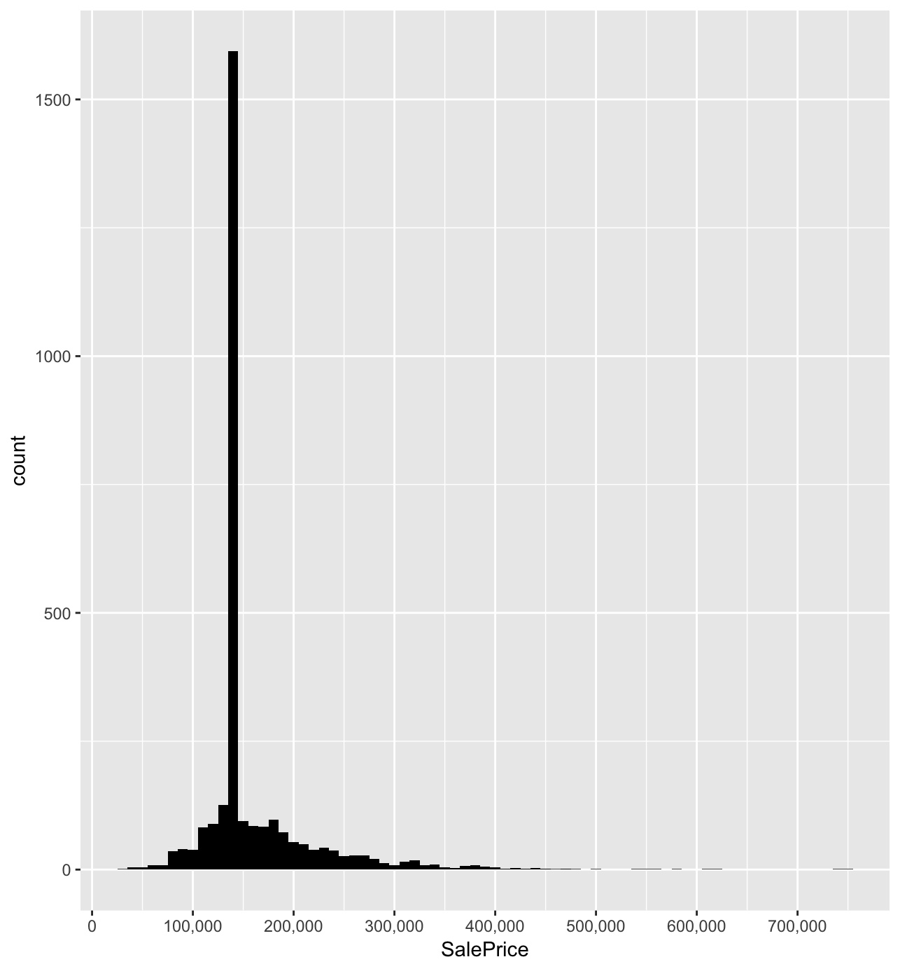
DESCRIPTIVE STATISTICS OF TARGET VARIABLE(SALE PRICE)
Min – 34,900, Mean – 1,60,468, Max -7,55,000

Slide 8
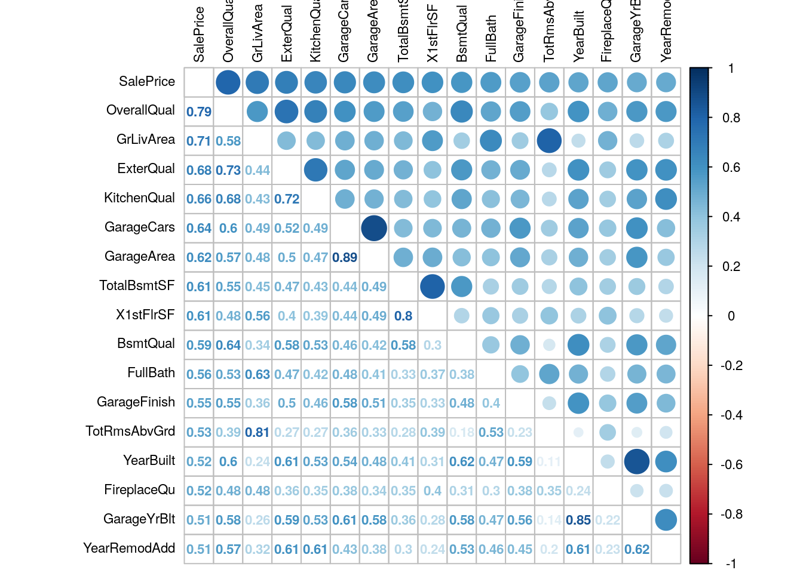
CORRELATION BETWEEN VARIABLES
Visualization of correlation shows the different grades(highest, medium, least) of correlation between variables.

Slide 9
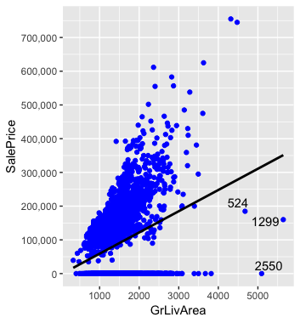
STRONG CORRELATION
Plot depicts that correlation
between GrLivArea and
saleprice is positive and higher.

Slide 10
DATA CLEANING
As part of data cleaning, data refining will be done as below.
Missing Data : Check for missing or incomplete data, impute/fill NA with appropriate data.
Ignore the tuple
Replace the value with mean
Replace the value with mode.
Replace the value with NA
Quality : Check for duplicates, accuracy, unusual data.

Slide 11
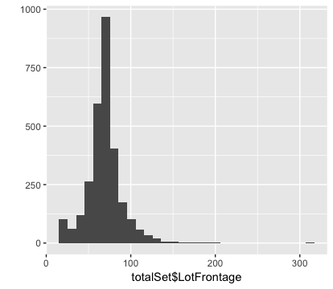
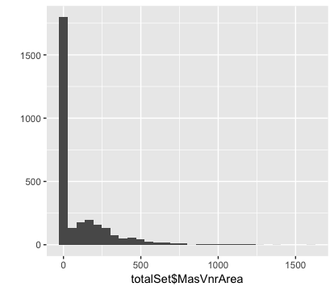
DATA VISUALIZATION &CLEAN-UP
If the data is normally distributed , then imputation can be done through
Mean as below for LotFrontage variable.
Histogram plotted for MasVnrArea variable
depicts that most of the data is at zero, which
implies that it is appropriate to fill the null values
with zero.
o/

Slide 12
DATA IMPUTATION
Similarly if the data is not normally distributed, then there is possibility of outliers in the data, then imputation can be done through median/mode or with NONE.
MSZoning ,Functional, SaleType,KitchenQual, Electrical, Exterior1st ,Exterior2nd , Electrical - MODE
Sale Price, LotFrontage - MEAN
Alley, Utilities, FireplaceQu, PoolQC ,Fence, MiscFeature - NONE
GarageType ,GarageYrBlt ,GarageFinish , GarageCars ,GarageArea ,GarageQual ,GarageCond - NONE
MasVnrType ,MasVnrArea - NONE.
TotalBsmtSF, BsmtFullBath ,BsmtHalfBath ,BsmtQual ,BsmtCond ,BsmtExposure ,BsmtFinType1 ,BsmtFinSF1 ,BsmtFinType2 ,BsmtFinSF2 ,BsmtUnfSF – NONE

Slide 13
DATA REDUCTION
Feature Creation and dropping unnecessary features.
totalSet$TotalSF = totalSet$TotalBsmtSF + totalSet$X1stFlrSF + totalSet$X2ndFlrSF
totalSet$TotBathrooms <- totalSet$FullBath + (totalSet$HalfBath*0.5) + totalSet$BsmtFullBath + (totalSet$BsmtHalfBath*0.5)
totalSet$TotalPorchSF <- totalSet$OpenPorchSF + totalSet$EnclosedPorch + totalSet$X3SsnPorch + totalSet$ScreenPorch

Slide 14
DUMMIES LIBRARY FOR ENCODING
Machine learning algorithms need numerical input variables and categorical variables must be transformed into numerical features.
Categorical variables must be encoded which would help in enhancing the prediction while designing a machine learning algorithm.
Argument Dummy.classes = “character” will create dummy variables for all columns with character type.
totalSet_Corr <-dummy.data.frame(totalSet, dummy.classes = "character")

Slide 15
DATA TRANSFORMATION
Skewed data distribution wouldn't’t be normal and it will be either left symmetric or right symmetric.
Box Cox transformation will be used to adjust the data and remove the skewness and it will try to convert non-normal explanatory variables to normal shape.
Used Boxcoxtrans for columns with value greater than 0.75 will be considered and lambda value will be applied for transformation of the data.
skewed_feats <- skewed_cols[abs(skewed_cols) > 0.75]
for (x in names(skewed_feats)) {
bc = BoxCoxTrans(totalSet_Corr[[x]], lambda = 0.15)
totalSet_Corr[[x]] = predict(bc, totalSet_Corr[[x]])}

Slide 16
DATA MINING TECHNIQUES
Multiple Linear Regression
Linear regression is used to predict the value of an outcome variable Y based on one or more input predictor variables X.
Here our model is Y = β 0 + β 1 X 1 + β 2 X 2 + · · · + β p X p + ,
where X1 , X2, X3 …etc are OverallQual, GrLivArea,TotalSF..etc

Slide 17
ASSESSMENT OF MODEL ACCURACY
The lm() function takes in two main arguments, namely: 1. Formula 2. Data. The data is typically a data.frame and the formula is a object of class formula.
mlr <-lm(formula = SalePrice ~., data = new_train)
On Train Set:
Residual standard error: 25040
Multiple R-squared: 0.9225, Adjusted R-squared: 0.9044
F-statistic: 50.88 on 198 and 825 DF, p-value: < 2.2e-16(=0.000000000000022)
On Test Set:
Root mean square error: 30974.18
Multiple R-squared: 0.8412093

Slide 18
REGULARISED LINEAR MODEL
LASSO REGRESSION:
For a linear model, regularization is achieved by constraining the weights of the model.
Lasso regression is called the Penalized regression method, often used in machine learning to select the subset of variables. LASSO, is actually an acronym for Least Absolute Selection and Shrinkage Operator. It adds a regularization term to the cost function.
Lasso regression tends to completely eliminate the weights of the least important features/Columns.
RMSE value Parameters obtained after applying lasso regression are as below:
Root mean square error: 25206.68
Multiple R-squared: 0.8948432

Slide 19
Demo
Executing the code.

Slide 20
THANK YOU

