Slide 1
Flip that Switch! Implications of a rogue switch in SDN security
Bonnie Eisenman
Michael Kranch
Anna Kornfield Simpson

Slide 2
Overview
ANNA
Background
Implementing a Rogue Switch
Results of our Attacks
Additional Attacks
Countermeasures
Way Ahead

Slide 3
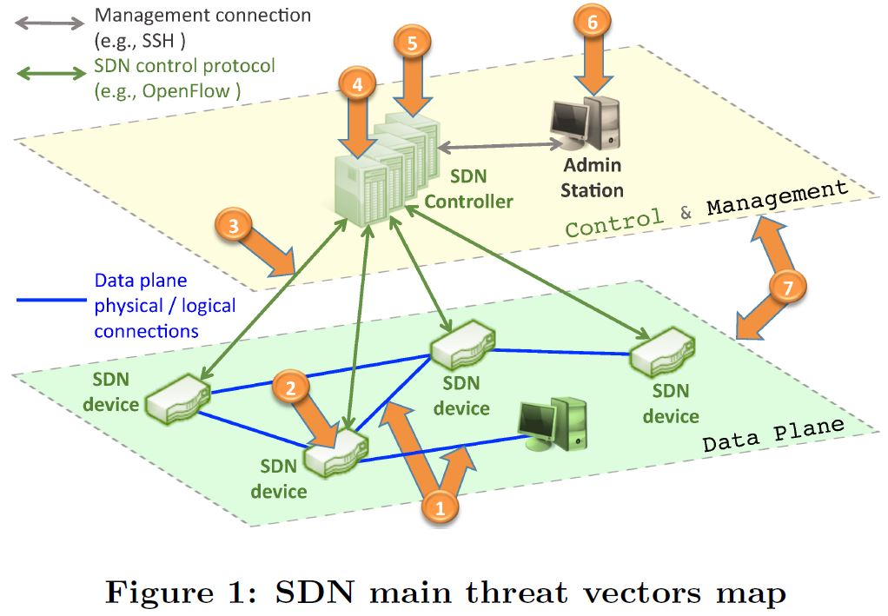
Background
ANNA
Security prominent in Ethane (2007)
Little work on security of SDN
Threat model == compromised switch
Kreutz et. al. “Towards Secure and Dependable Software Defined Networks” HotSDN, 2013.

Slide 4
Implementing a Rogue Switch
MICHAEL
OpenFlow Protocol
Header
Bootstrapping a Controller

Slide 5
Our Rogue Switch Utility
MICHAEL
Connecting
Parser
Test Setup

Slide 6
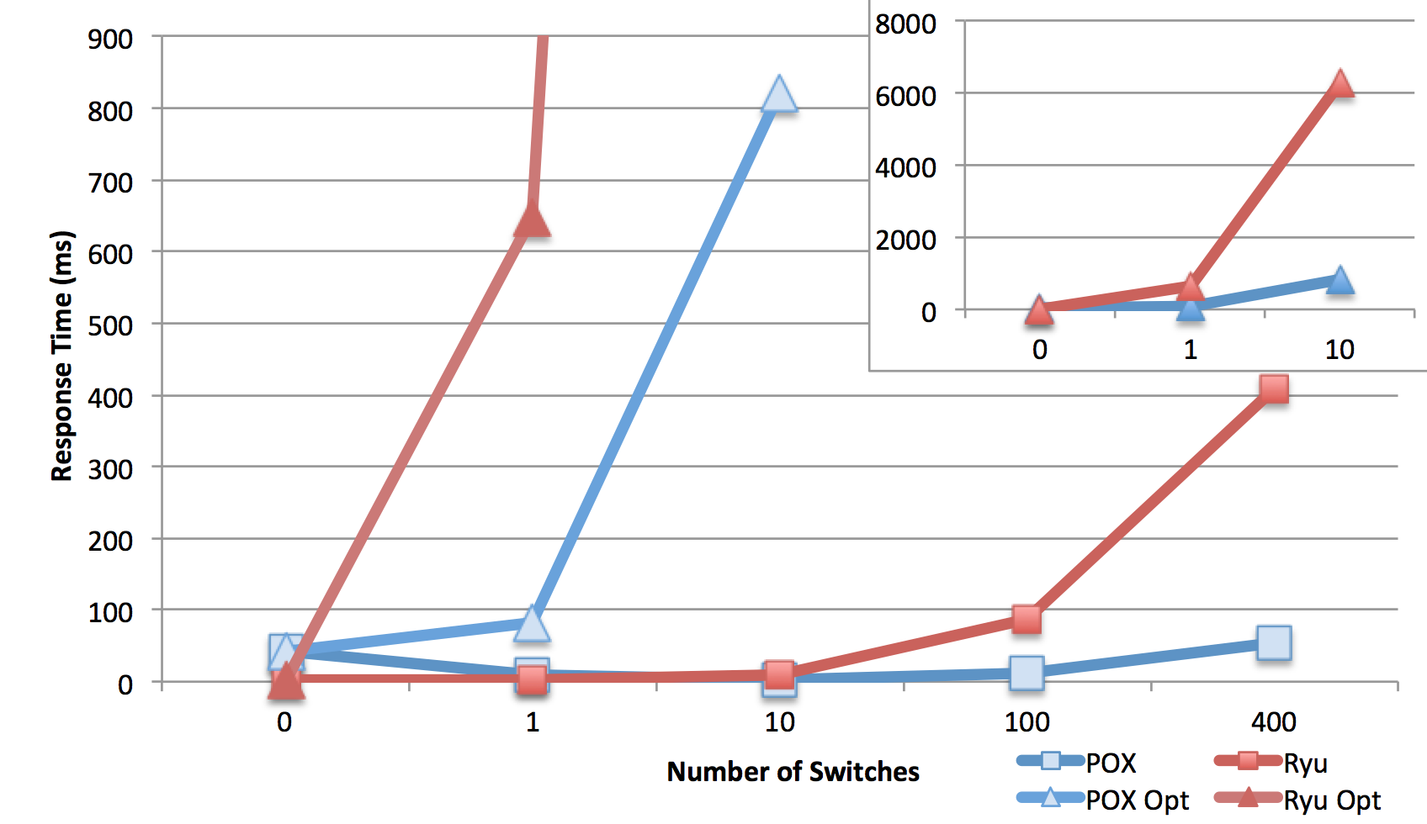
Results
MICHAEL
No Demo (probably some screen shots)

Slide 7
Other Attacks
BONNIE
SDN

Slide 8
Possibly More
BONNIE
SDN

Slide 9
Countermeasures
BONNIE
SDN

Slide 10
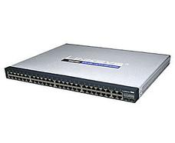
Way Ahead
ANNA
Many other attack vectors
Switch-to-switch attacks
MITM switch/controller connection
Boundary between SDN and legacy network
FLIP!
CC image

