Slide 1
Flip that Switch! Implications of a rogue switch in SDN security
Bonnie Eisenman
Michael Kranch
Anna Kornfield Simpson

Slide 2
Overview
ANNA
Background
Implementing a Rogue Switch
Results of our Attacks
Additional Attacks
Countermeasures
Way Ahead

Slide 3
Background
ANNA
SDN
Security Work in SDN
Threat Model

Slide 4
Implementing a Rogue Switch
MICHAEL
OpenFlow Protocol
Header
Bootstrapping a Controller

Slide 5
Our Rogue Switch Utility
MICHAEL
Connecting
Parser
Test Setup

Slide 6
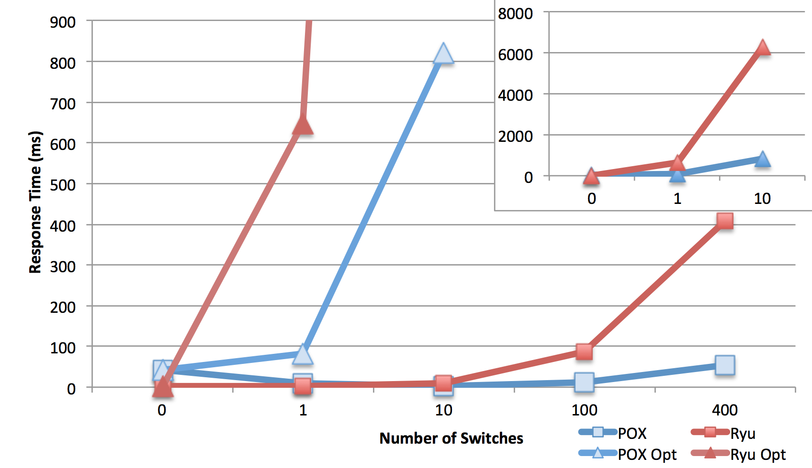
Results
MICHAEL
No Demo (probably some screen shots)

Slide 7
Other Attacks
BONNIE
SDN

Slide 8
Possibly More
BONNIE
SDN

Slide 9
Countermeasures
BONNIE
SDN

Slide 10
Way Ahead
ANNA
Walk about other attacks ( we focused Switch to Controller)
Implement Switch to Switch Attacks
MITM switch/controller connection
Other random stuff

