Slide 1
🤖 SYNTAXIS - AI Chat Assistant

Slide 2
👤 Team Member(s)
Name: Aayansh Vashisht
Roll No: 2401730247
Branch: B.Tech AIML
Semester: 2nd
Section: B

Slide 3
📘 Project Description
Syntaxis is a self-hosted, customizable AI-powered chatbot UI that supports multiple AI models like OpenAI GPT, Claude, Gemini, and more. It provides an intuitive chat interface with support for plugins, prompt customization, and data privacy.

Slide 4
🚀 Features
Multi-model support (GPT, Claude, Gemini, etc.)
Chat with Markdown and Code rendering
Plugin and RAG API support
Easy deployment with Docker
Secure and self-hosted

Slide 5
🛠️ Technologies Used
Node.js, React.js, Express.js
MongoDB, Meilisearch
Docker & Docker Compose
OpenAI / Claude / Gemini APIs

Slide 6
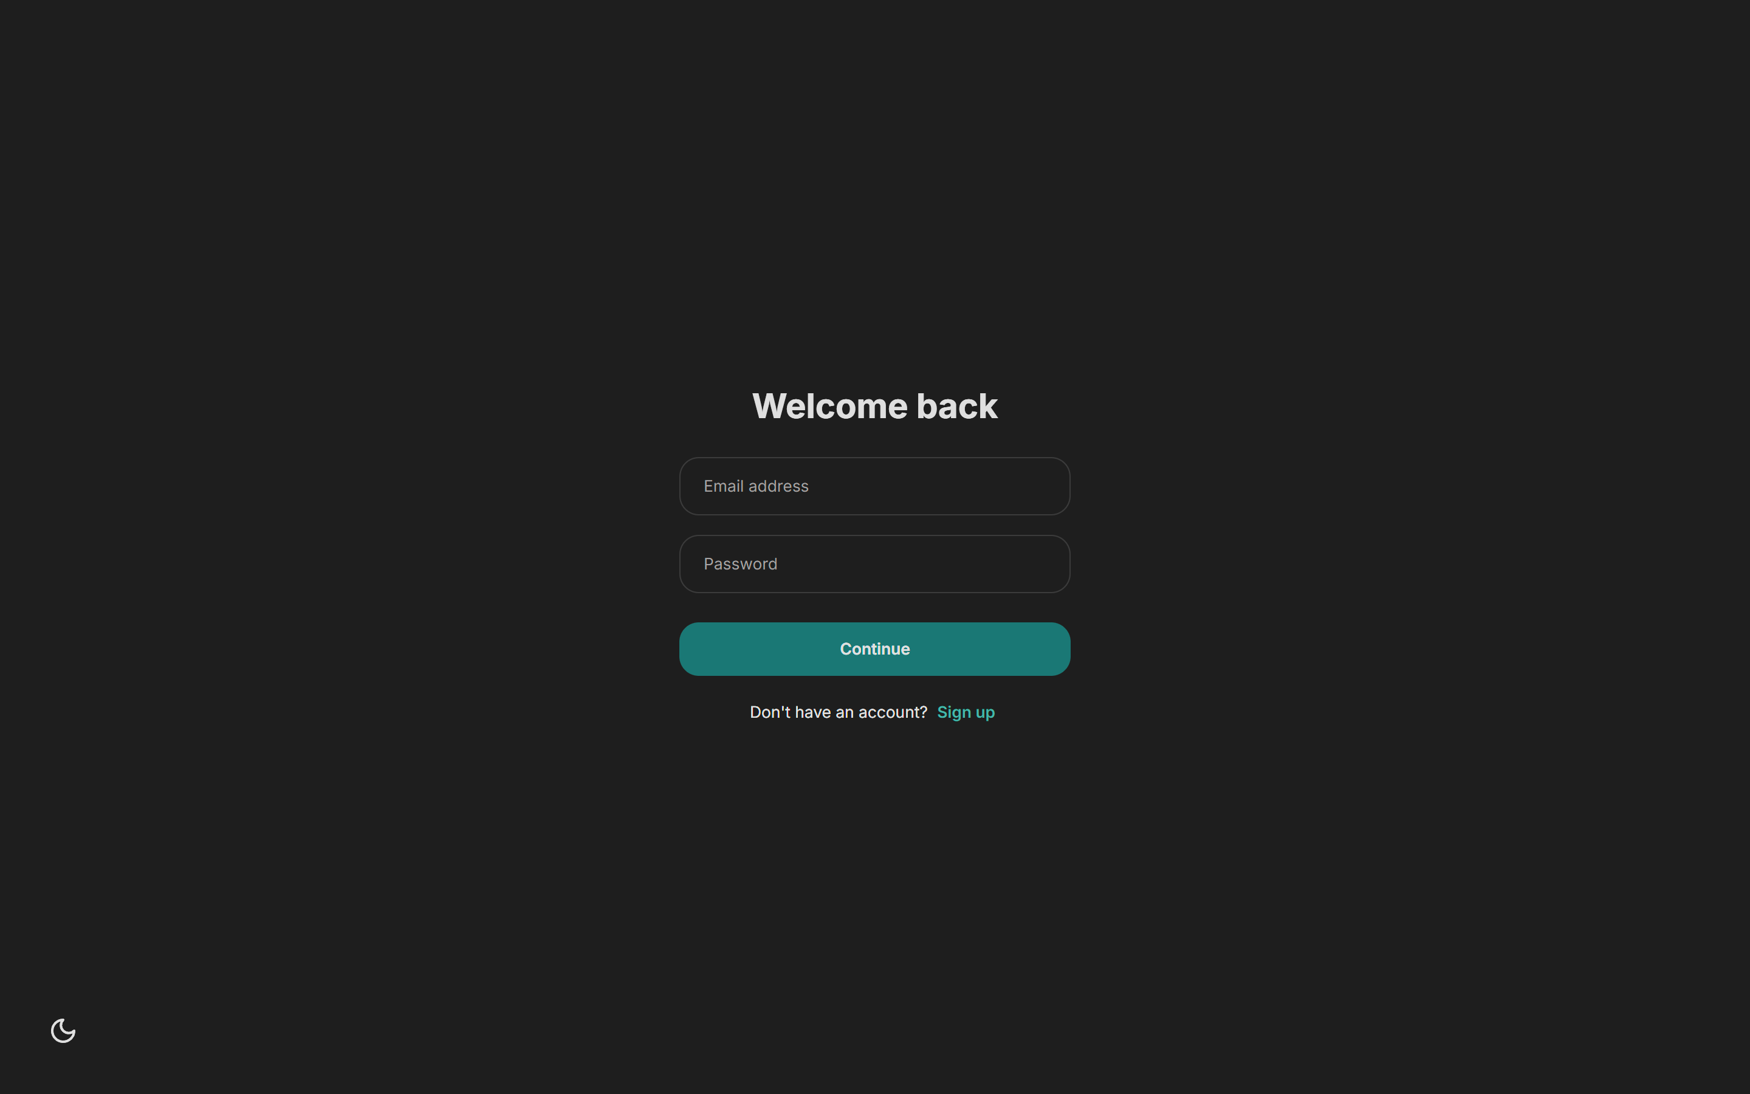
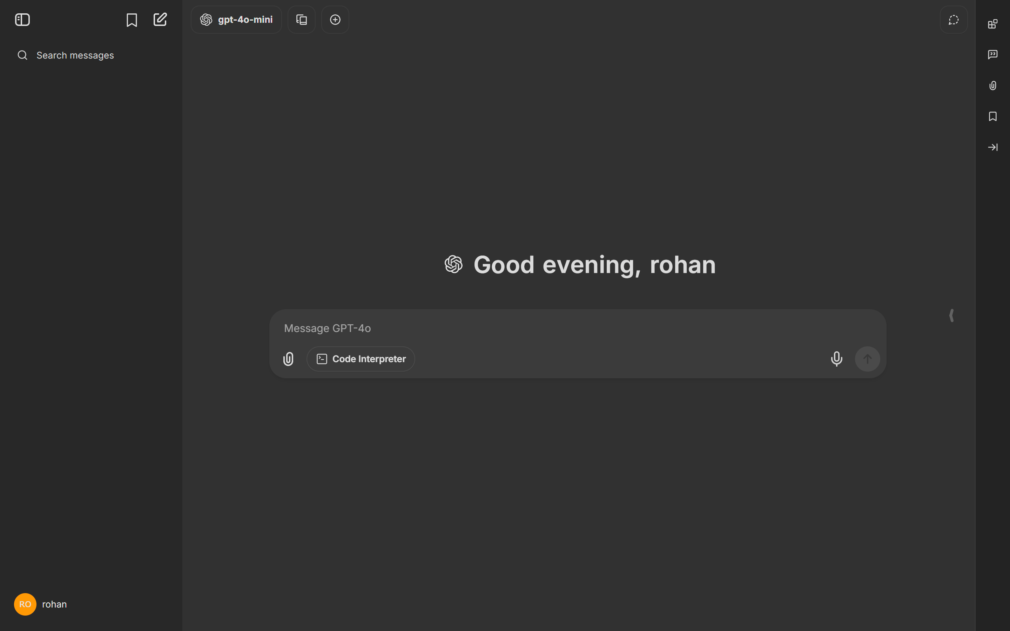
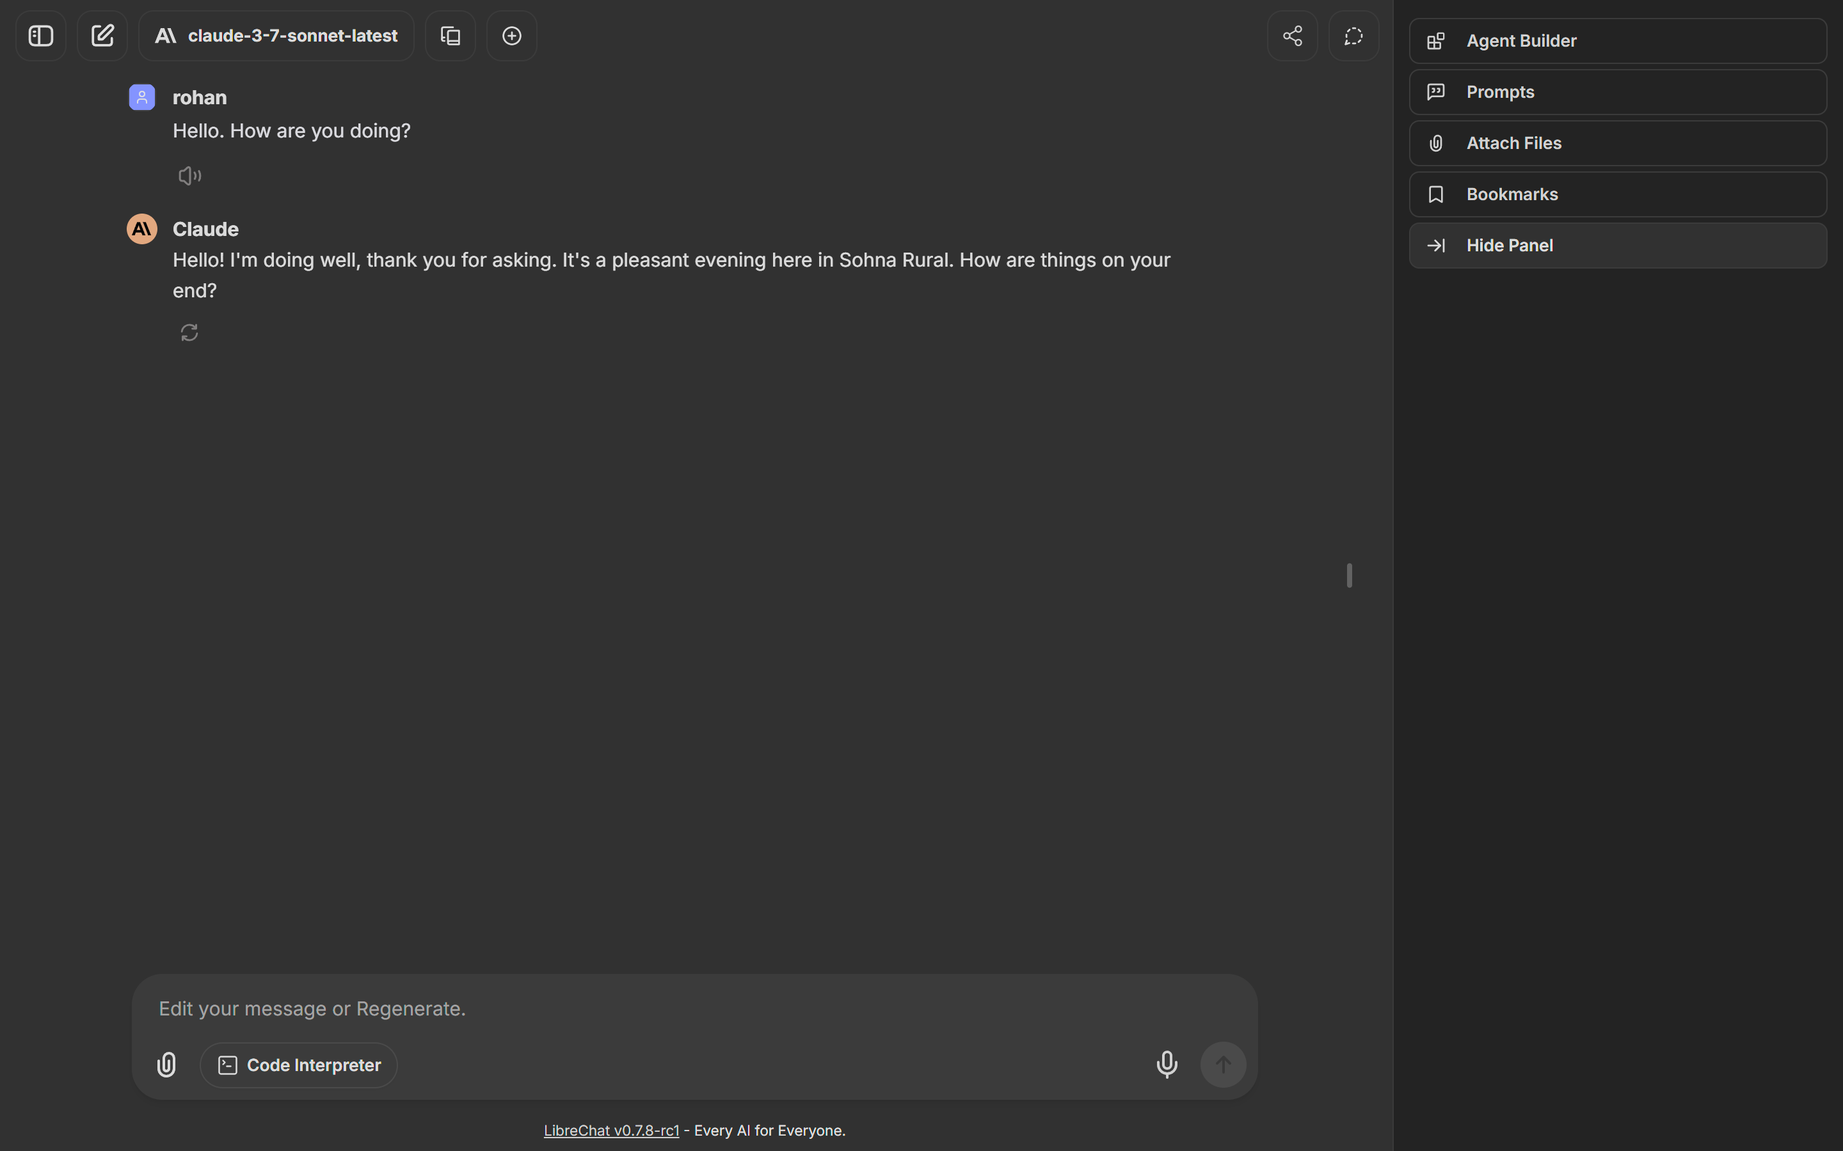
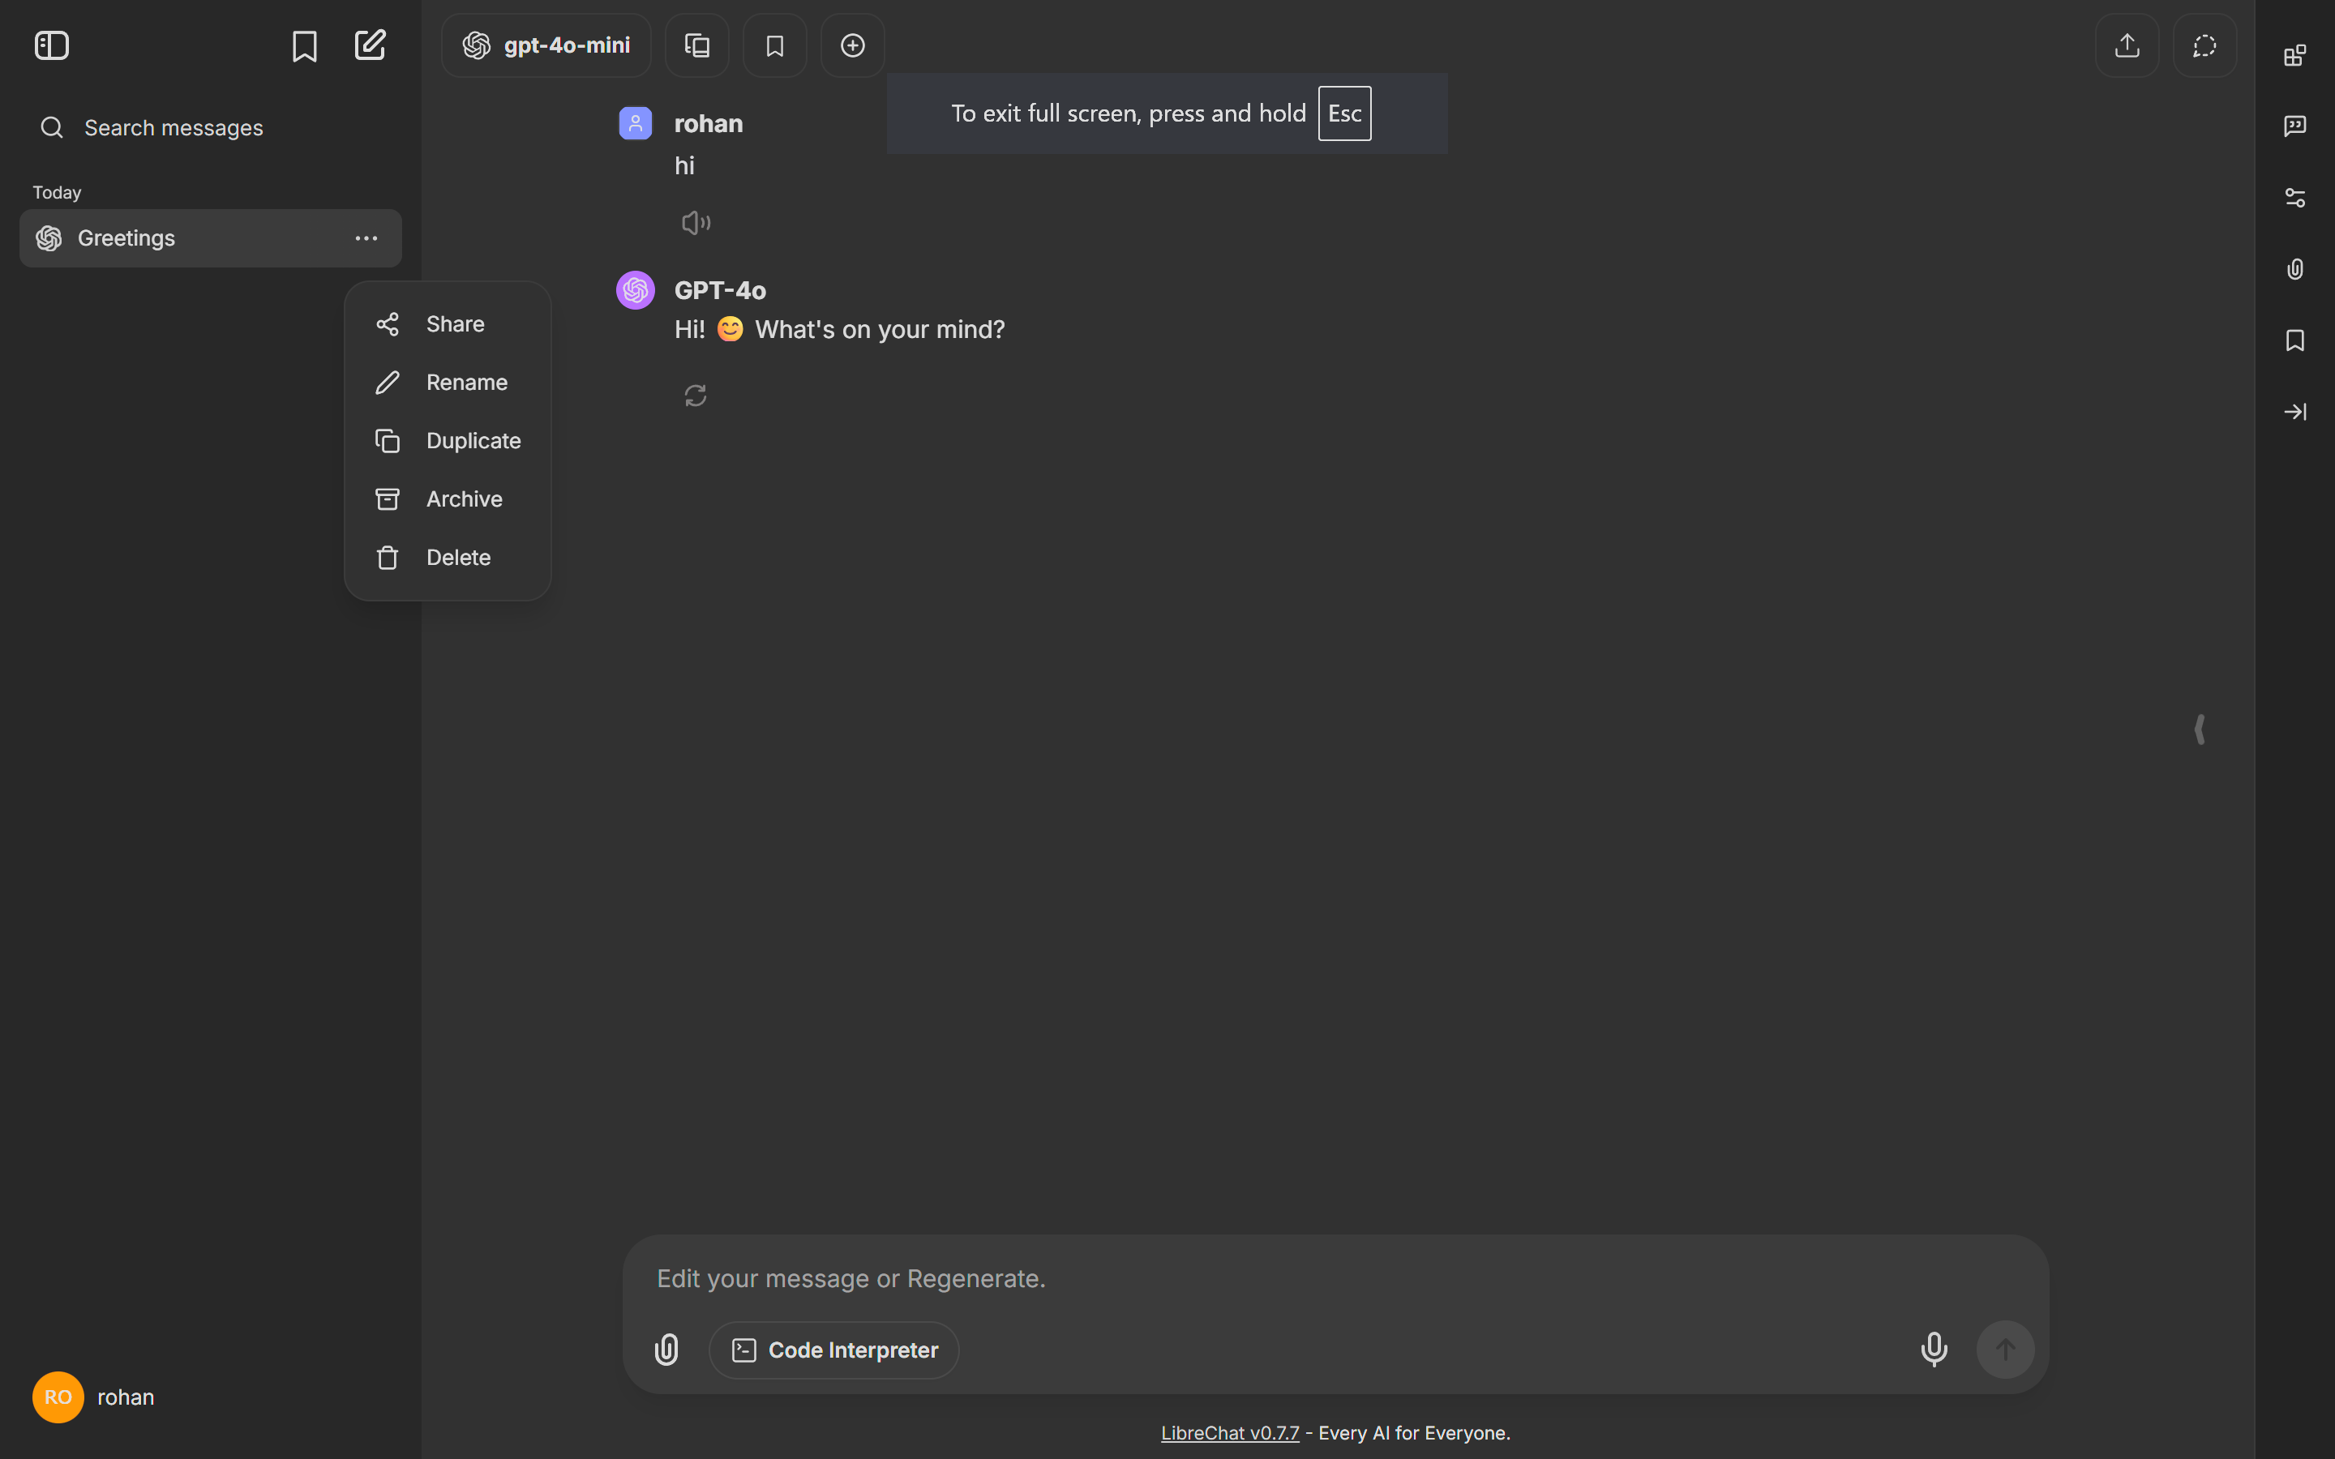
📸 Project Snapshots

Slide 7
📦 Steps to Run
1. Clone the repo
2. Rename `.env.example` to `.env` and fill in keys
3. Run using Docker:
`docker-compose up --build`
4. Access via `http://localhost:3080`

