Slide 1

🌪️ ResQTweet
Real-Time Crisis Detection from Tweets
Github: archangel2006 | Global AI Buildathon 2025

Slide 2

PROBLEM ?
🕑 Time-critical challenge – In times of natural disasters, conflict, or humanitarian crises, timely information can save lives.
Social media, particularly Twitter, has become a critical source of real-time updates.
🔊 Social media is noisy – disaster keywords like fire, crash, flood are often used metaphorically.
🚨 High risk of false alarms – casual chatter can get mixed with real emergencies.
❓ Key question – How can we automatically detect real disaster tweets in real-time to support faster response?

Slide 3

SOLUTION ?
🤖 Disaster Alert Tweet Classifier – AI-powered pipeline to detect real disaster events from tweets.
🔗 Hybrid approach – combines NLP & Machine Learning
🧹 Preprocessing – clean tweets (remove links, hashtags, noise).
📊 Keyword + Context – captures both disaster terms (earthquake, flood, casualties) and semantic meaning of tweets.
✂️ Summarization – generate short, human-readable alerts (via DistilBART).

Slide 4

Sustainable Development Goals
🌆 SDG 11 – Sustainable Cities & Communities: Strengthens urban safety & disaster preparedness with real-time social media alerts.
🌍 SDG 13 – Climate Action: Enables faster early warning systems & response to climate-related disasters.
🤝 Global Impact – scalable solution that supports communities, NGOs, and authorities worldwide.

Slide 5

FEATURES
🧹 Data Cleaning – remove URLs, mentions, hashtags & special characters; convert text to lowercase.
✍️ TF-IDF Vectorization – applied on tweet text & keywords, using unigrams + bigrams.
🚩 Keyword Flag – binary feature marks presence of disaster-related keyword.
📊 High-Dimensional Sparse Vectors – each tweet represented in numeric form for ML models.

Slide 6
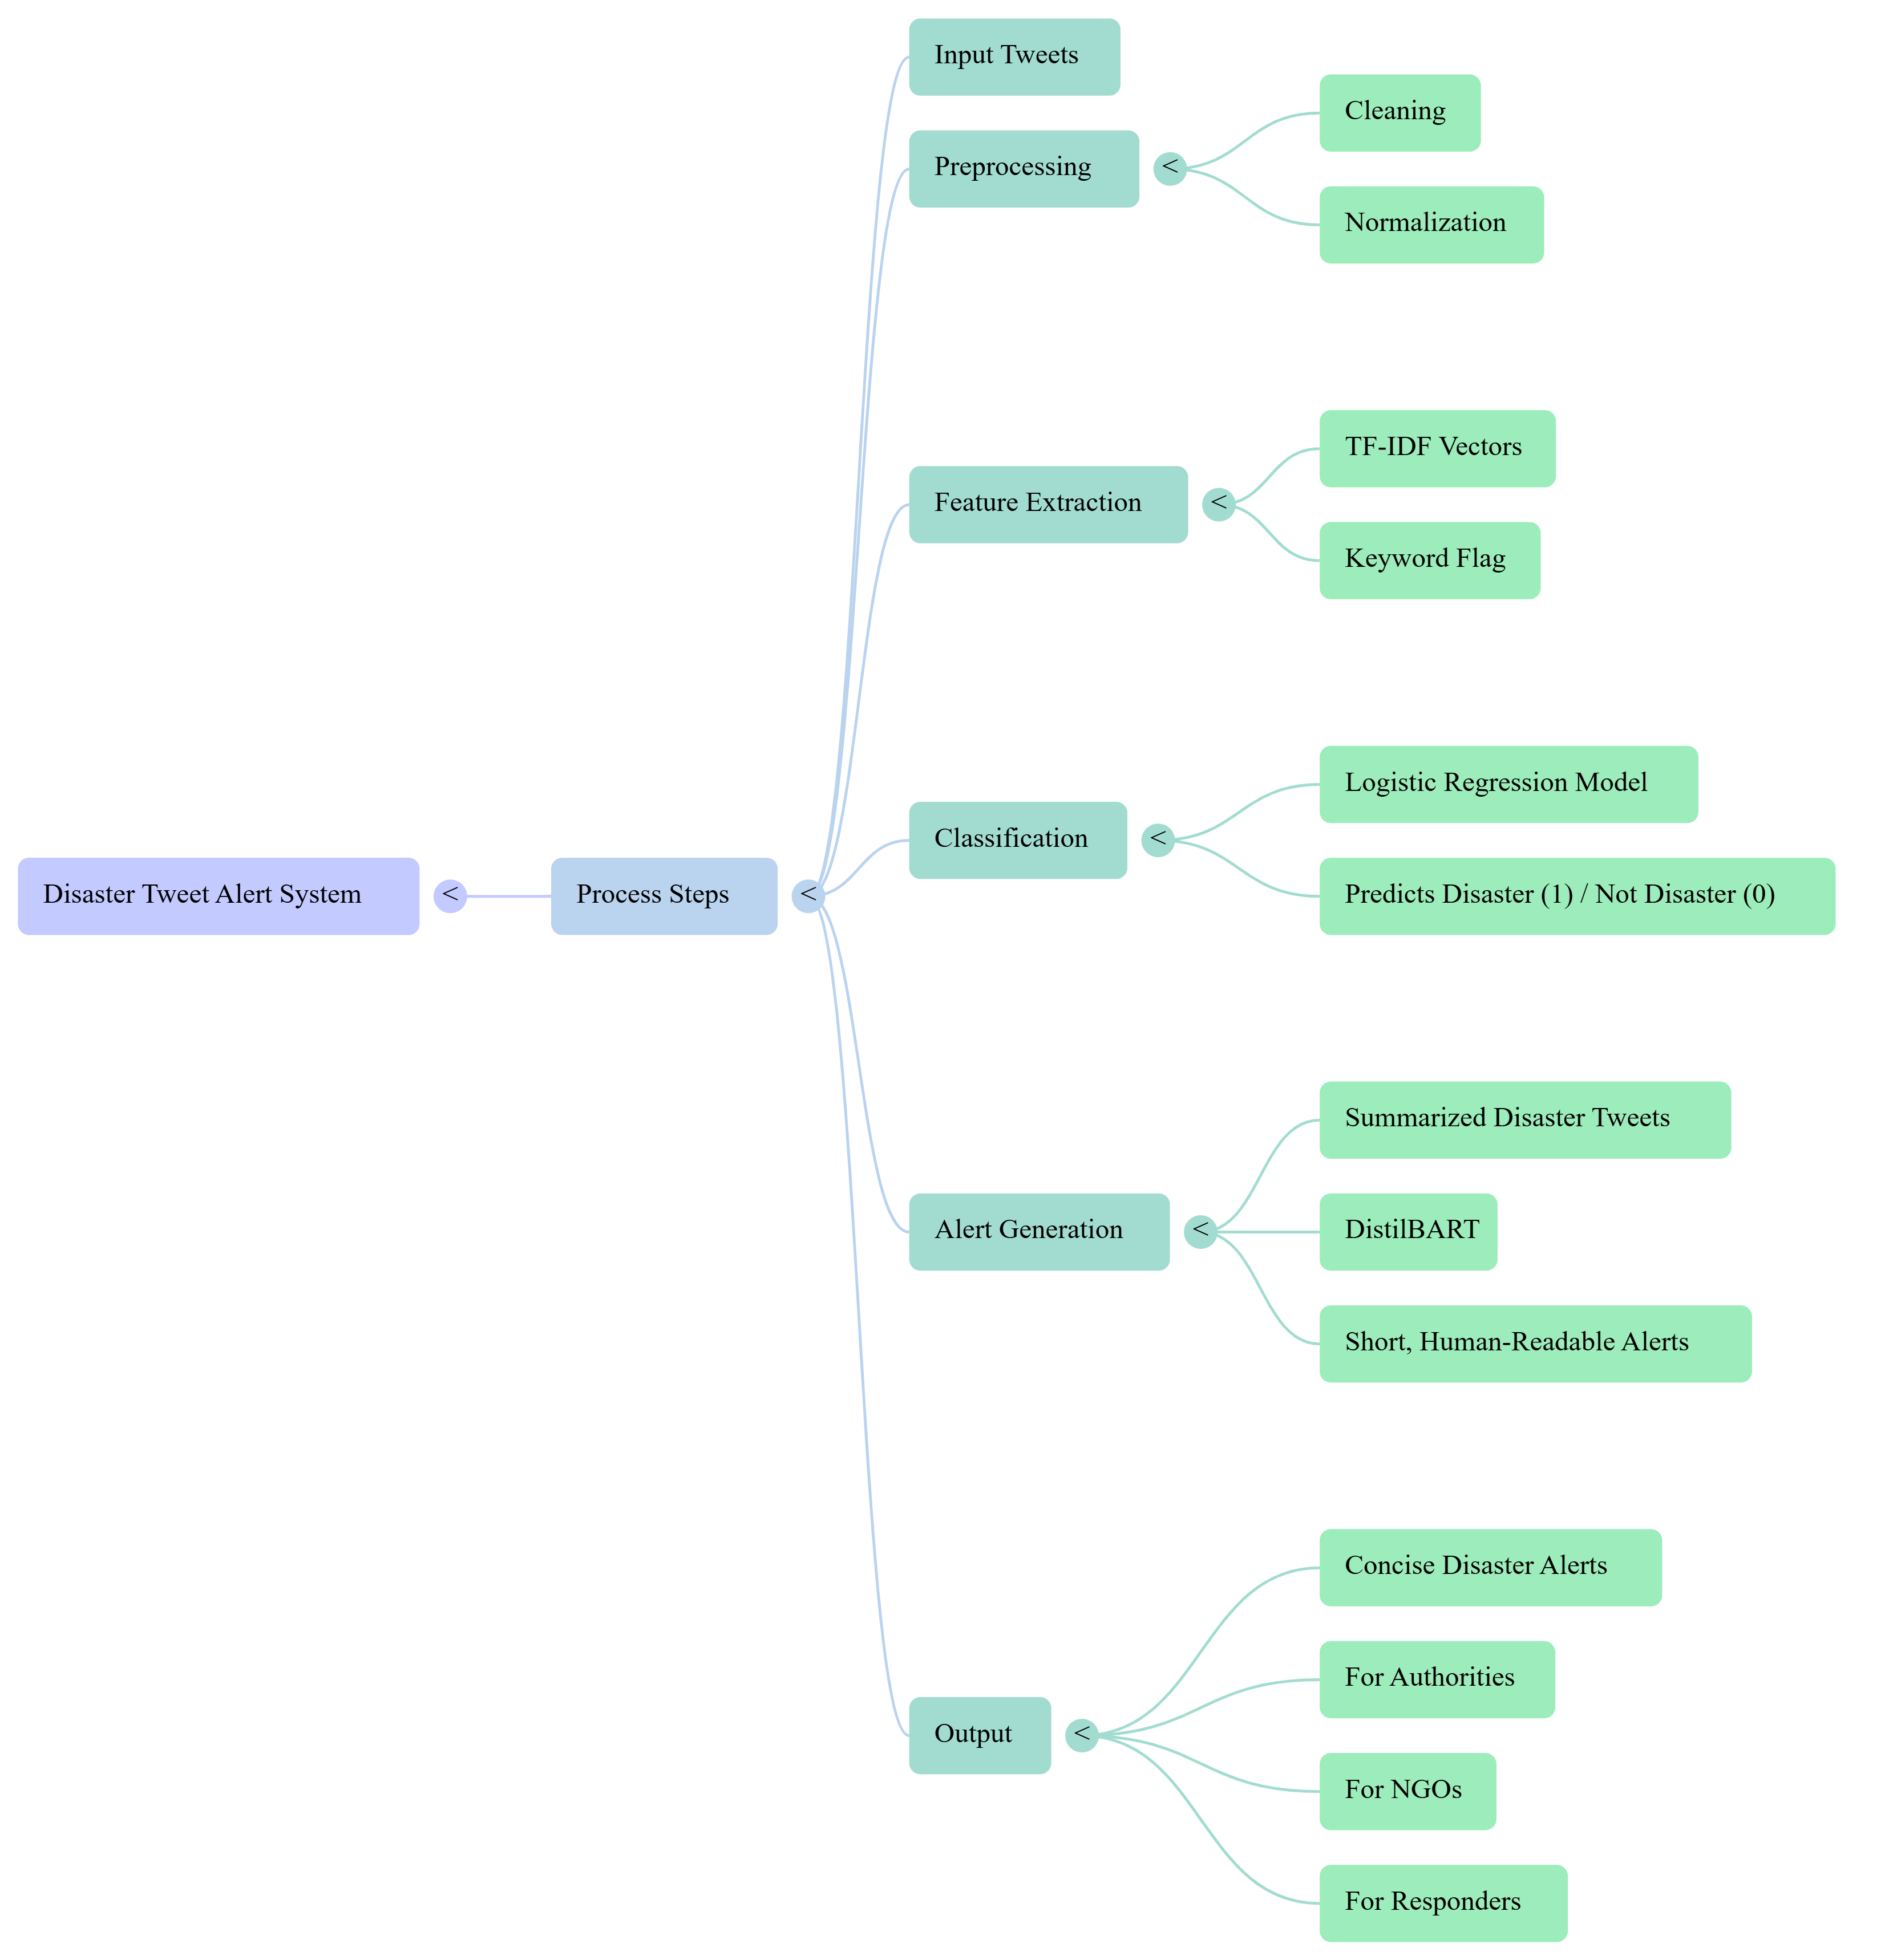
ML PIPELINE
1️⃣ Input Tweets → stream of raw tweets.
2️⃣ Preprocessing → cleaning + normalization.
3️⃣ Feature Extraction → TF-IDF vectors + keyword flag.
4️⃣ Classification → Logistic Regression model predicts Disaster (1) / Not Disaster (0).
5️⃣ Alert Generation → disaster tweets summarized with DistilBART into short, human-readable alerts.
6️⃣ Output → concise disaster alerts for authorities, NGOs, and responders.

Slide 7

MODEL
🧪 Models Tested – Multinomial NB, Complement NB, Logistic Regression.
🏆 Best Model – Logistic Regression (Accuracy: 81.48%, F1-score: 0.777).
📉 Confusion Matrix – shows strong disaster detection & reduced false positives.
⚡ Real-Time Ready – lightweight, scalable, and effective for streaming tweets.
📝 Alerting – summarization ensures short & clear alerts for rapid response.

Slide 8
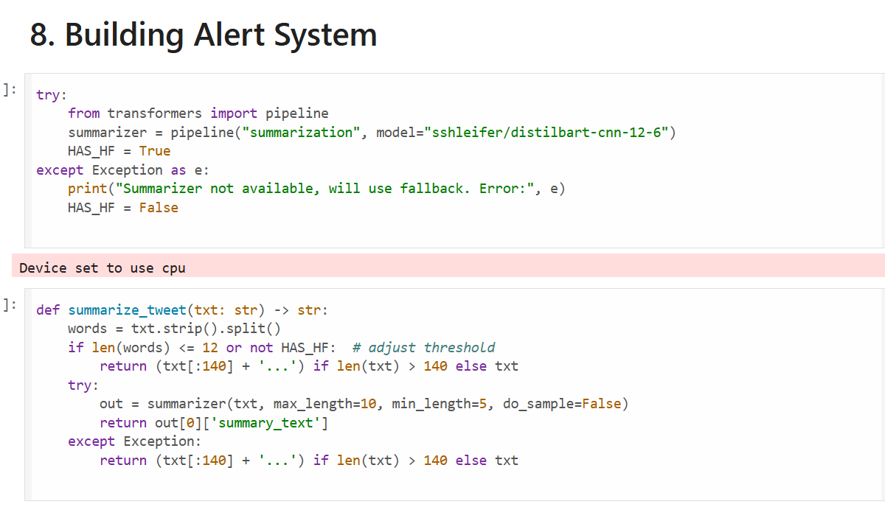

Slide 9
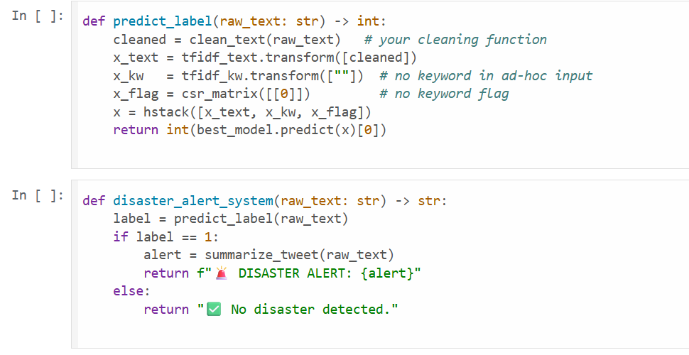

Slide 10
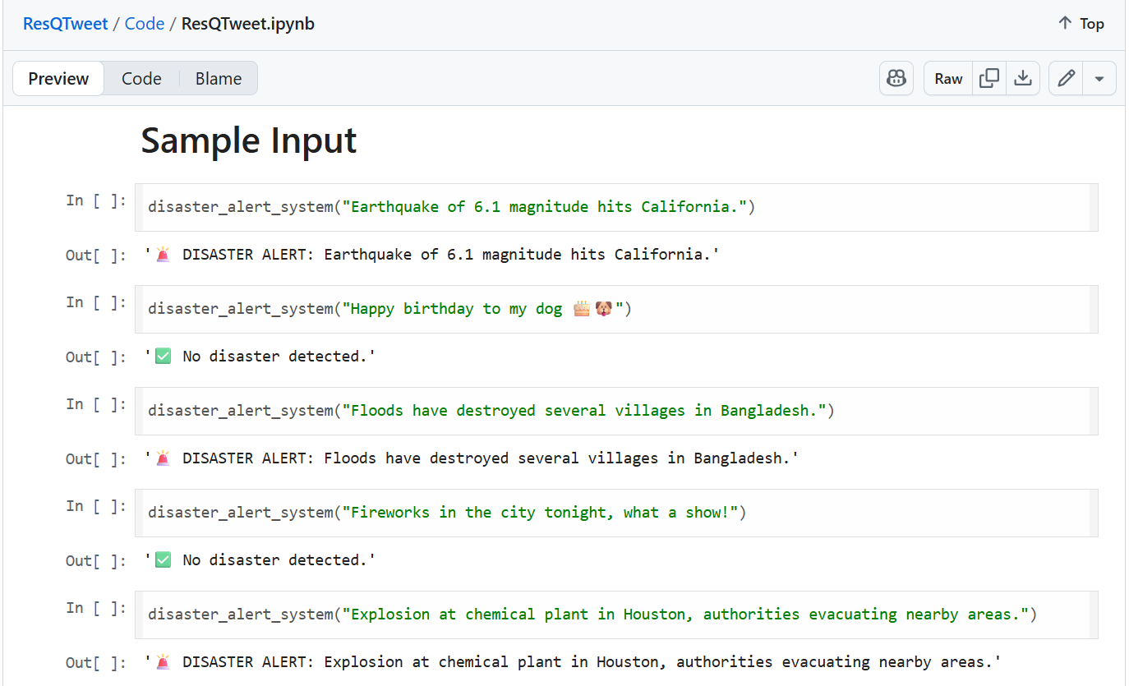

Slide 11

IMPACT
🚨 Faster Disaster Response – helps authorities quickly detect real events from noisy social media.
📰 Support for NGOs & Media – early signals improve resource allocation and news coverage.
🌍 Global Extensibility – adaptable to multiple regions & languages for worldwide impact.
📈 Scalable & Lightweight – works in real-time, even with high-volume tweet streams.
🤝 Ethical & Inclusive – focuses on saving lives, reducing misinformation, and ensuring accessibility.

Slide 12
THANK YOU
Github: archangel2006 | Global AI Buildathon 2025

