Slide 1
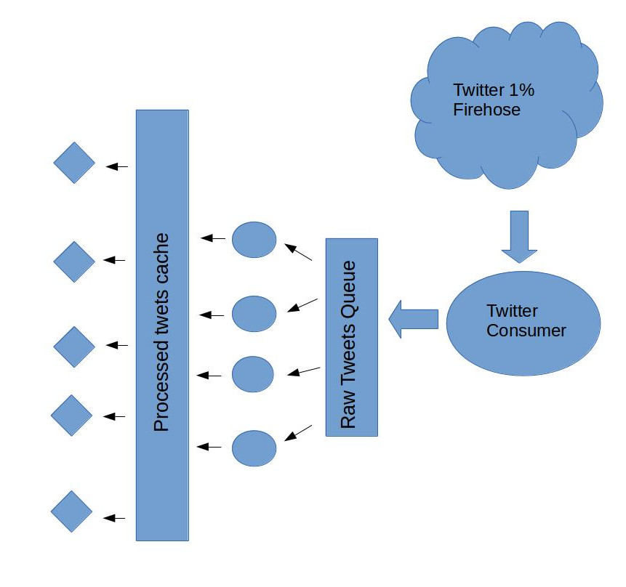
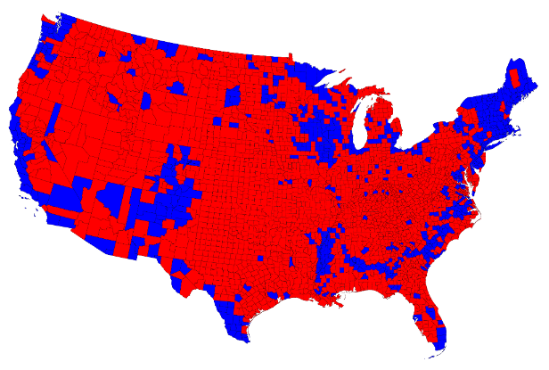

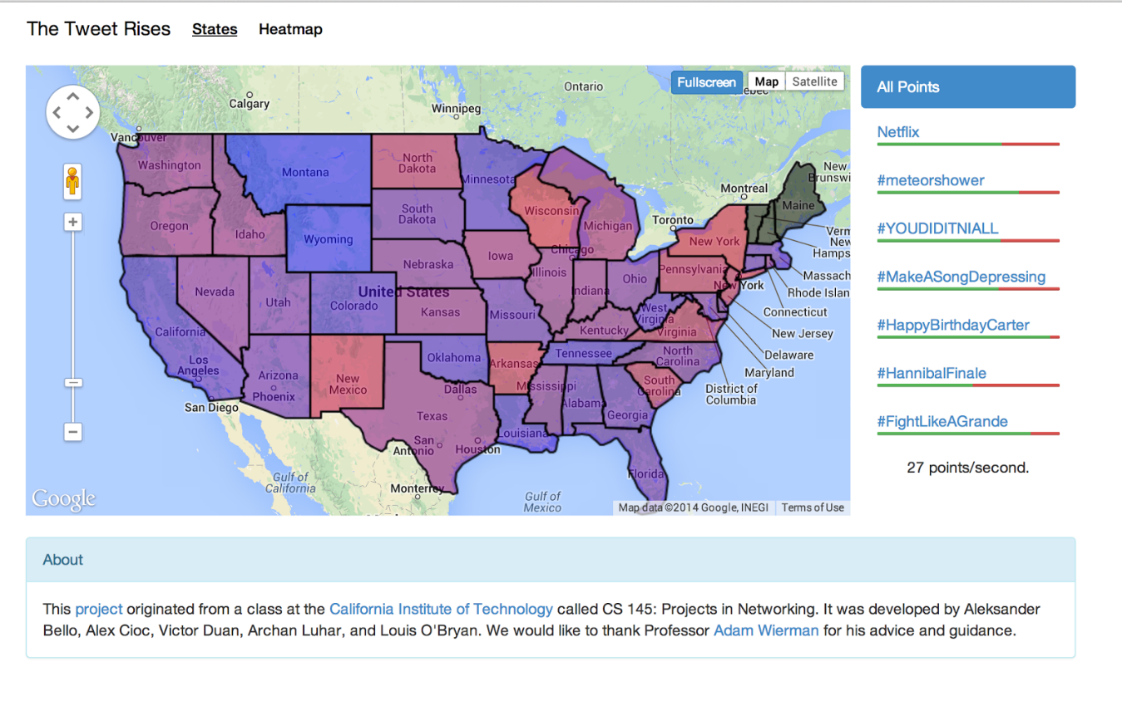

CALIFORNIA INSTITUTE OF TECHNOLOGY
The Tweet Rises
Aleksander Bello, Alexandru Cioc, Victor Duan, Archan Luhar, and Louis O’Bryan
INTRODUCTION
How are people feeling right now?
Interesting question for sociological research and corporate gauging of reactions
How do discussions on a product spread
How do people react to specific events
How quickly does sentiment change?
MACHINE LEARNING
Idea was to develop classifiers to determine tweet sentiment.
Classification Methods
Naïve Bayes
Maximum Entropy
Support Vector Machines
BACK END
+
Machine Learning Results
Support Vector Machines best for <10,000 training tweets
Naïve Bayes fastest; trained on 1.6 million tweets
Most accurate classifier when trained on full data set
Two data streams
“General” and “Trending”
Raw tweets saved in cache
Natural Language Processing categorizers perform sentiment analysis on raw Tweets
Middleware serves processed Tweets to clients
Structure
Using Redis as a cache
Python/Node.js
Goals
Categorize Tweets based on emotional content
Visualize sentiments in an accessible manner
Allow for interactive filtering of Tweets based on topic
Challenges
Correctly analyze sentiments
Obtain live Tweets (Twitter Firehose API)
Visualization
FINAL PRODUCT
Online visualization tool for Twitter sentiments
“State” Map
Heat Map
Trending topic analysis
Interactivity
“State” Map
Average sentiments of last n tweets
Google Maps API
DEPARTMENT OF COMPUTING AND MATHEMATICAL SCIENCES
Special Thanks to Professor Adam Wierman and Lingwen Gan for Advice and Guidance

