Slide 1
Fuzzification

Slide 2
Fuzzification
Fuzzification is the process of changing a real scalar value into a fuzzy value.
This is achieved with the different types of fuzzifiers (membership functions).

Slide 3
Fuzzification
Fuzzy Linguistic Variables are used to represent qualities spanning a particular spectrum
Temp: {Freezing, Cool, Warm, Hot}
Question: What is the temperature?
Answer: It is warm.
Question: How warm is it?

Slide 4
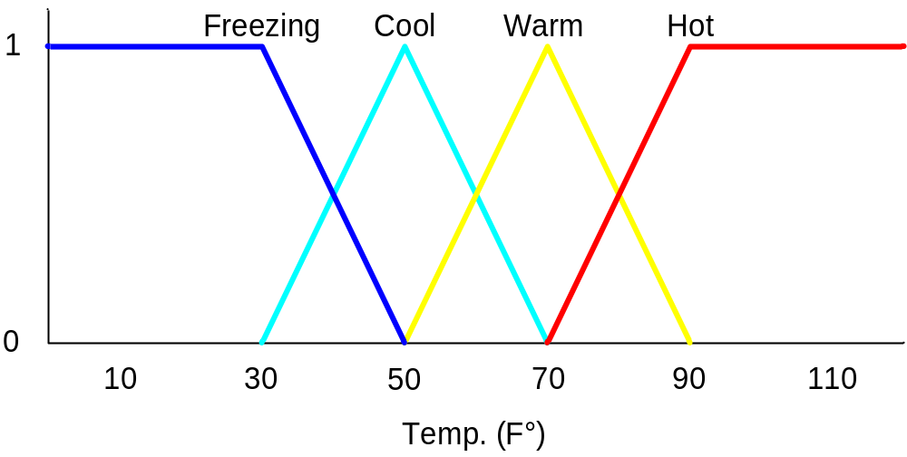
Fuzzification
Temp: {Freezing, Cool, Warm, Hot}
Degree of Truth or "Membership"
Membership Functions

Slide 5
Fuzzification
How cool is 36 F° ?
It is 30% Cool and 70% Freezing
0.7
0.3

Slide 6
Fuzzification
Membership Functions
The MATLAB toolbox includes 11 built-in membership function types. These 11 functions are, in turn, built from several basic functions:
piecewise linear functions
the Gaussian distribution function
the sigmoid curve
quadratic and cubic polynomial curves

Slide 7
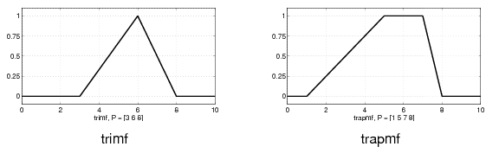
Fuzzification
Membership Functions
The simplest membership functions are formed using straight lines. The simplest is the triangular membership function, and it has the function name trimf.
The trapezoidal membership function, trapmf, has a flat top and really is just a truncated triangle curve. These straight line membership functions have the advantage of simplicity.

Slide 8
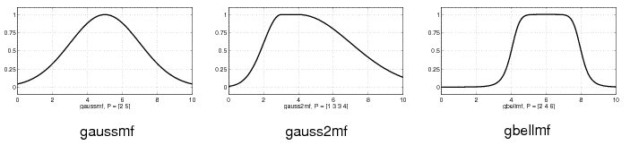
Fuzzification
Membership Functions
Two membership functions are built on the Gaussian distribution curve: a simple Gaussian curve and a two-sided composite of two different Gaussian curves. The two functions are gaussmf and gauss2mf. The generalized bell membership has the function name gbellmf.
Because of their smoothness and concise notation, Gaussian and bell membership functions are popular methods for specifying fuzzy sets. Both of these curves have the advantage of being smooth and nonzero at all points.

Slide 9
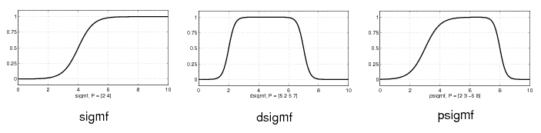
Fuzzification
Membership Functions
Although the Gaussian membership functions and bell membership functions achieve smoothness, they are unable to specify asymmetric membership functions, which are important in certain applications.
the sigmoidal membership function is defined, which is either open left or right. Asymmetric and closed (i.e. not open to the left or right) membership functions can be synthesized using two sigmoidal functions, so in addition to the basic sigmf, you also have the difference between two sigmoidal functions, dsigmf, and the product of two sigmoidal functions psigmf.

Slide 10
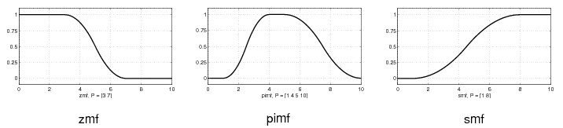
Fuzzification
Membership Functions
Polynomial based curves account for several of the membership functions in the toolbox.
Three related membership functions are the Z, S, and Pi curves, all named because of their shape. The function zmf is the asymmetrical polynomial curve open to the left, smf is the mirror-image function that opens to the right, and pimf is zero on both extremes with a rise in the middle.

