Slide 1
SRE Watchdog
AI-Powered Intelligent Observability & Event Watchdog
MVP Presentation — May 2026

Slide 2
The Problem
SRE teams drown in log noise — thousands of entries per minute
Manual threshold monitoring misses subtle degradation patterns
Alert fatigue from duplicate/noisy notifications
No intelligent context in alerts — just raw numbers
Need: AI-powered anomaly detection with actionable summaries

Slide 3
The Solution: SRE Watchdog
Python FastAPI application with AI-powered log analysis
Two-gate detection: statistical pre-filter + AWS Bedrock AI
Automatic webhook alerts with severity classification
Real-time dashboard with Chart.js visualizations
Full audit trail — every detection, analysis, and alert recorded
12-factor app methodology — all config via environment variables

Slide 4
Architecture Overview
Gate 1: APScheduler tick → per-service error rate computation
Gate 2: FastAPI BackgroundTask → Bedrock Converse API (Claude Sonnet 4.6)
Alert Service: Severity mapping + webhook dispatch with retry
Cooldown: Prevents alert fatigue (15-min suppression window)
Dashboard: Jinja2 SSR + Chart.js + auto-refresh every 60s
Storage: SQLite WAL mode for concurrent read/write

Slide 5
Tech Stack
Language: Python 3.11+
Framework: FastAPI + Uvicorn
AI: AWS Bedrock (Claude Sonnet 4.6 via Converse API)
Database: SQLite with WAL mode (SQLAlchemy ORM)
Scheduling: APScheduler (BackgroundScheduler)
Dashboard: Jinja2 + Chart.js
Testing: pytest + hypothesis + freezegun + respx

Slide 6
Development Timeline
Phase 1: Requirements & Design (spec-driven development)
Phase 2: Project scaffold, config, database foundation
Phase 3: Core services (ingestion, Bedrock client, alert service)
Phase 4: Anomaly detector (two-gate pipeline) + scheduler
Phase 5: API routers (8 endpoints) + app wiring
Phase 6: Dashboard, synthetic log generator, documentation
Phase 7: Test infrastructure, verification, git setup

Slide 7
Key Features Delivered
10,000 synthetic logs across 5 services (24-hour simulation)
3 seeded anomaly windows: sharp spike, sustained degradation, cascade
AI-generated anomaly summaries with severity scoring (0.0–1.0)
Webhook alerts with 4-band severity (LOW/MEDIUM/HIGH/CRITICAL)
Cooldown suppression to prevent alert fatigue
On-demand analysis via POST /analyze + job polling
11 API endpoints + HTML dashboard

Slide 8
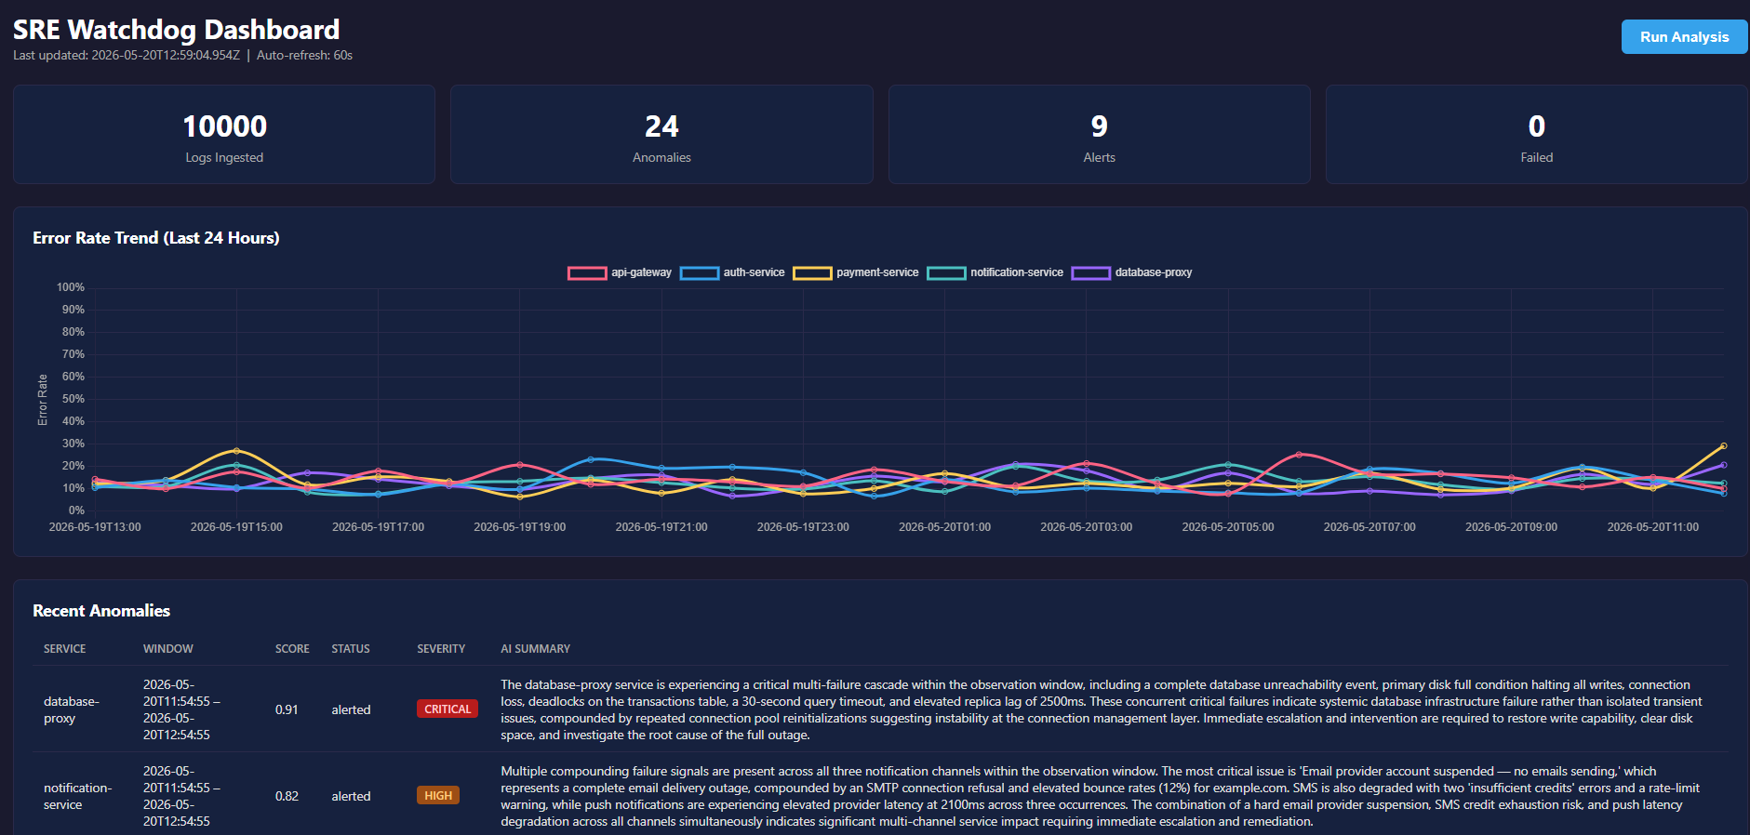
Dashboard: Metrics & Error Rate Chart
Metrics bar showing logs ingested, anomalies, alerts, and failures. Chart.js line chart with error rate per service over 24 hours.

Slide 9
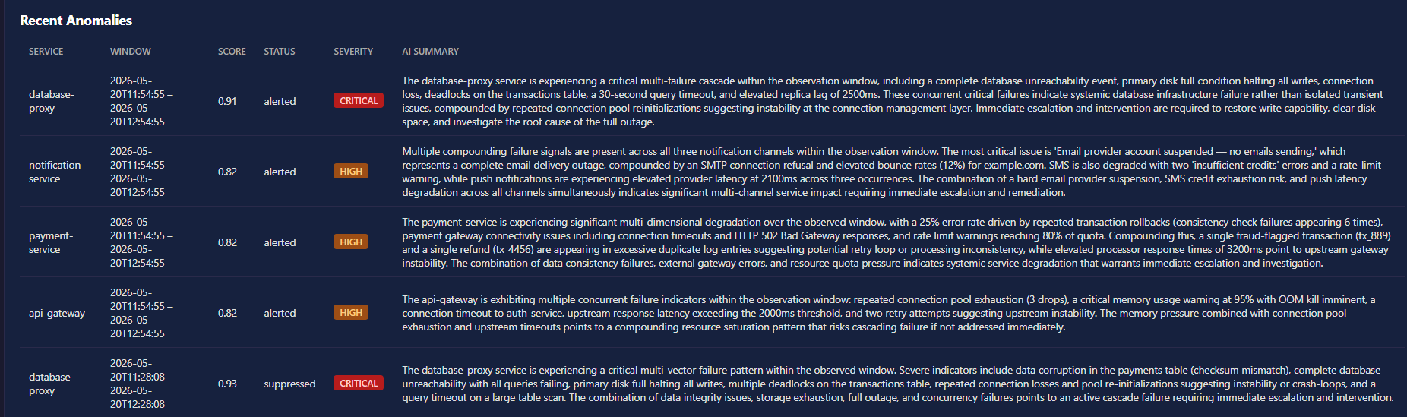
Dashboard: Anomaly Detection Results
Recent anomalies table showing service, time window, AI score, lifecycle status, severity badge, and AI-generated summary.

Slide 10
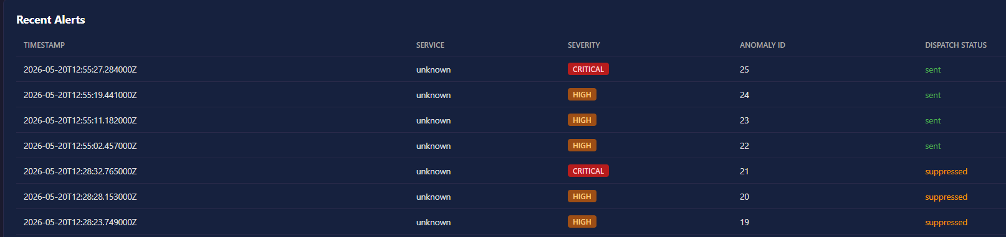
Dashboard: Alert Dispatch Log
Recent alerts table showing timestamp, service, severity, anomaly ID, and dispatch status (sent/suppressed/failed).

Slide 11
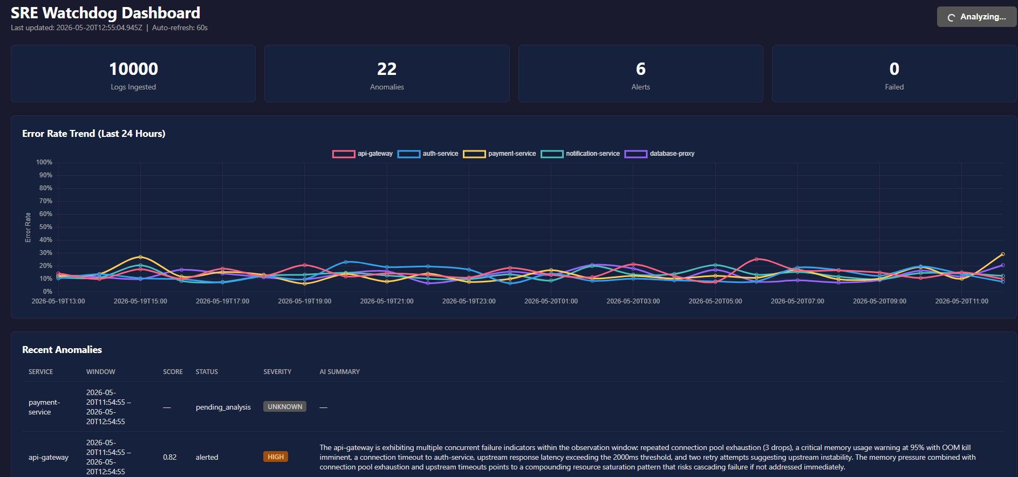
Dashboard: On-Demand Analysis
Run Analysis button triggering Bedrock AI analysis across all services. Shows loading state and refreshes results on completion.

Slide 12
Detection Pipeline in Action
1. APScheduler tick fires every 60 seconds
2. Gate 1: Compute error rate per service (sliding 5-min window)
3. If error_rate > 10%: create AnomalyWindow (pending_analysis)
4. Gate 2: BackgroundTask invokes Bedrock with log context
5. Bedrock returns anomaly_score (0.0–1.0) + AI summary
6. If score ≥ 0.5 and no cooldown: dispatch webhook alert
7. Full lifecycle persisted for audit trail

Slide 13
AWS Bedrock AI Integration
Model: Claude Sonnet 4.6 (us.anthropic.claude-sonnet-4-6)
Prompt: Service context + error rate + log messages (capped at 50)
Response: JSON with anomaly_score (0.0–1.0) + plain-text summary
Retry: Exponential backoff (1s, 2s, 4s) for transient errors
Health caching: /health reports last-known Bedrock status
Cost control: Gate 1 pre-filter reduces unnecessary API calls

Slide 14
Challenges & Solutions
Model ID changes: Iterated through 4 model IDs to find active one
Response parsing: Model wraps JSON in markdown — added fence stripping
Cooldown noise: Suppressed records cluttered dashboard — by design for audit
Concurrent writes: SQLite WAL mode enables BackgroundTask parallelism
Session credentials: Temporary tokens expire — documented in workflow

Slide 15
Code Quality & Standards
48 source files, 7,322 lines of code
flake8 linting: zero errors (max-line-length=120)
Google-style docstrings on all public functions
Module-level docstrings in every Python file
Structured JSON logging throughout
Type hints on all function signatures
Comprehensive .env.example with all 14 configuration variables

Slide 16
Production Roadmap
Authentication: OAuth2/OIDC for dashboard access
Deployment: Docker + AWS App Runner or ECS/Fargate
Semantic analysis: S3 Vectors for log embeddings
Cursor-based pagination for high-volume log stores
Test coverage: Complete the optional test suite (target 80%+)
Monitoring: CloudWatch integration for self-observability

Slide 17
Live Demo
1. Start server: uvicorn app.main:app --reload
2. Generate logs: python generate_logs.py
3. Open dashboard: http://localhost:8000/dashboard
4. Click 'Run Analysis' — watch Bedrock AI in action
5. Observe: anomaly scores, AI summaries, alert dispatch
6. Check /health, /metrics, /anomalies endpoints

Slide 18
Thank You
SRE Watchdog — AI-Powered Observability
Questions?

