Slide 1
IEEE TRANSACTIONS ON BIOMEDICAL CIRCUITS AND SYSTEMS · VOL. 18, NO. 2 · APRIL 2024
Population-Specific Glucose Prediction in Diabetes Care With Transformer-Based Deep Learning on the Edge
EPS-TFT — a population-specific temporal fusion Transformer for multi-horizon blood-glucose forecasting (software scope)
Taiyu Zhu · Lei Kuang · Chengzhe Piao · Junming Zeng · Kezhi Li · Pantelis Georgiou
Imperial College London · University College London · University of Oxford
124
2
30 & 60
7
6
T1D / T2D participants
clinical CGM datasets
min horizons, one model
quantile outputs
baselines outperformed

Slide 2
Agenda
From clinical need to a validated forecasting model
01
Clinical problem
Diabetes burden, CGM lag, why prediction matters
02
Research gaps
Patient-specific models, single horizon, little T2D work
03
Method: EPS-TFT
Temporal fusion Transformer with gating + quantile forecasts
04
Experiments
OhioT1DM & ShanghaiDM, 7 methods, 4 metrics, 2 horizons
05
Results & validation
Accuracy, trajectories, ablation, in-silico trial
06
Discussion
Limitations, generalization, deployment path
Zhu et al., IEEE Trans. Biomedical Circuits and Systems, 18(2), 2024 — DOI 10.1109/TBCAS.2023.3348844
2

Slide 3
PART 01
Clinical Problem & Motivation
Why real-time blood-glucose forecasting is load-bearing in diabetes care

Slide 4
Diabetes: scale of the problem
IDF Diabetes Atlas + CGM physiology
> 500 M
~10 %
> 90 %
~30 %
people living with diabetes worldwide
of cases are Type 1 (autoimmune β-cell loss)
of cases are Type 2 (secretion + resistance)
of time spent outside euglycemic range
▪ CGM measures interstitial fluid glucose, not blood — the conversion introduces an intrinsic lag between reading and true BG.
▪ Hypo-/hyperglycemia detected only after the fact leaves no window for proactive action.
– Prediction converts a monitoring device into a decision-support device.
▪ Unmanaged excursions drive cardiovascular disease, nephropathy, retinopathy and diabetic ketoacidosis.
▪ CGM produces high-resolution time series — ideal substrate for deep sequence models.
Zhu et al., IEEE Trans. Biomedical Circuits and Systems, 18(2), 2024 — DOI 10.1109/TBCAS.2023.3348844
4

Slide 5
Research gaps and contributions
What the literature misses, and what this paper delivers
GAPS IN PRIOR WORK
THIS PAPER
▪ Patient-specific models: one network per subject — does not scale to a cohort
▪ Single prediction horizon: separate models for 30 and 60 min
▪ T2D (>90 % of cases) is largely unexplored in BG prediction
▪ Most models need manual inputs (meals, insulin) that are inconsistent across a population
▪ Little use of static demographics to personalise a shared model
▪ One population-specific TFT serving a whole cohort, conditioned on demographics
▪ Multi-horizon direct forecast: 30 and 60 min from a single forward pass
▪ Validated on both T1D (24 subjects) and T2D (100 subjects)
▪ Feature selection via VSN weights: CGM + timestamp alone suffice (93.9 % importance)
▪ Quantile loss → prediction intervals for tunable hypo/hyper alarms
▪ In-silico decision-support trial with the UVA/Padova simulator
Zhu et al., IEEE Trans. Biomedical Circuits and Systems, 18(2), 2024 — DOI 10.1109/TBCAS.2023.3348844
5

Slide 6
PART 02
Method: EPS-TFT
Problem formulation, gated Transformer architecture, quantile forecasting

Slide 7
Problem formulation
Multi-horizon forecasting with heterogeneous inputs
Given timestep t and target BG series y, forecast y(t : t+τ) for horizon τ ∈ {30, 60} min
Observed inputs
Known inputs
Static covariates
Output
Past CGM readings
(24 samples = 120 min look-back)
Timestamps, known for past
and future (12 steps ahead)
Gender, age, BMI,
diabetes type
12-step BG trajectory
× 7 quantiles
▪ Direct (non-recursive) multi-horizon output: all future values in one forward step — faster and no error accumulation.
▪ A single set of weights serves the whole population; personalization comes from the static covariate path, not retraining.
▪ Feature set deliberately reduced to CGM + timestamp → no manual user input, enabling fully automatic operation.
Zhu et al., IEEE Trans. Biomedical Circuits and Systems, 18(2), 2024 — DOI 10.1109/TBCAS.2023.3348844
7

Slide 8
End-to-end system architecture
Software pipeline — cohort CGM streams → TFT inference → predictive decision support
CGM data
Preprocessing
Feature window
EPS-TFT
Risk engine
Decision support
5 / 15-min readings
per patient
›
causal imputation
clip 40–400 · normalize
›
24 past steps +
12 known future steps
›
VSN · GRN · LSTM ·
attention · quantile head
›
hypo / hyper flags
from quantile bounds
›
alerts · forecast view
PLGM insulin rule
↑
Static demographics
age · gender · BMI · diabetes type → covariate encoder context
One population model serves the whole cohort; demographics personalise predictions, and quantile outputs drive tunable alarms.
Zhu et al., IEEE Trans. Biomedical Circuits and Systems, 18(2), 2024 — DOI 10.1109/TBCAS.2023.3348844
8

Slide 9
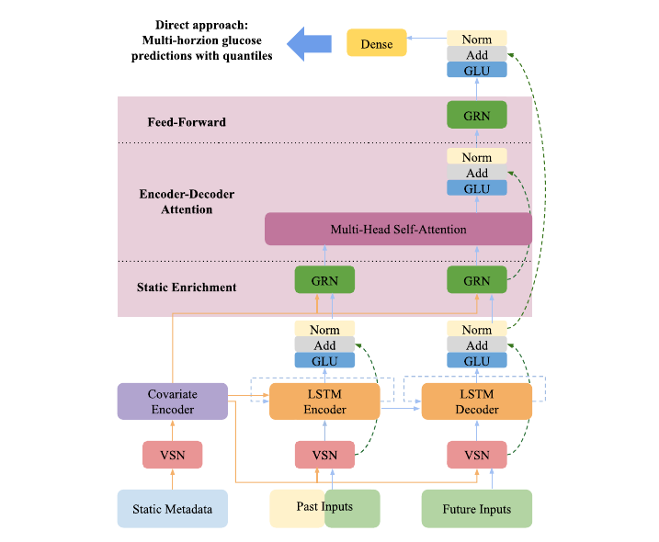
Temporal fusion Transformer architecture
Fig. 2 — gated, multi-modal encoder–decoder
VSN — Variable Selection Network
GRN + Softmax weights per feature per timestep; also used post-hoc for feature importance
Covariate encoder
Turns static demographics into context vectors for VSN, LSTM initial states and static enrichment
LSTM encoder / decoder
Encoder: observed + past known features. Decoder: future known inputs, initialized by encoder state
Multi-head self-attention
Long-range temporal dependencies + interpretability by head aggregation
GLU + residual paths
Allow the model to skip LSTM, MHSA or the whole Transformer block when a simpler mapping suffices
Zhu et al., IEEE Trans. Biomedical Circuits and Systems, 18(2), 2024 — DOI 10.1109/TBCAS.2023.3348844
9

Slide 10
Gating mechanisms and loss
The machinery that makes multi-modal fusion and interval forecasts work
Gated linear unit (1)
GLU(z) = σ(W_g·z + b_g) ⊙ (W_l·z + b_l)
Sigmoid gate modulates how much non-linear contribution passes.
Gated residual network (2–3)
GRN(p,e) = LN(p + GLU(W_g·a + b_g)), a = ELU(W_p·p + W_e·e + b_a)
Residual + layer norm; ELU damps outliers and CGM noise.
Multi-head self-attention (4–6)
MHSA = [ (1/N) Σ H_i ] W_O , A = Softmax(Q K^T / √D_k) V
Q, K, V come from the GRN static-enrichment layer: static and temporal features fused.
Quantile loss (7)
L = (1/τ) Σ_i Σ_q (1−q)(ŷ_i − y_i)⁺ + q(y_i − ŷ_i)⁺, q ∈ {0.02, 0.1, 0.25, 0.5, 0.75, 0.9, 0.98}
Lower/upper bounds make alarm sensitivity a tunable knob — a feature patients requested in earlier focus groups.
Zhu et al., IEEE Trans. Biomedical Circuits and Systems, 18(2), 2024 — DOI 10.1109/TBCAS.2023.3348844
10

Slide 11
PART 03
Experimental Design
Datasets, preprocessing, baselines and clinical metrics

Slide 12
Clinical datasets
Two public CGM cohorts — 124 participants in total
 | OhioT1DM | ShanghaiDM
Participants | 12 T1D | 12 T1D + 100 T2D
CGM device | Medtronic Enlite (real-time) | Abbott FreeStyle Libre (flash)
Sampling interval | 5 minutes | 15 minutes
Trial duration | 8 weeks | 14 days
Auxiliary data | Pump insulin, self-reported meals & exercise | Self-reported diet & insulin, physical exam, questionnaire, labs
Split | Provided train (~6 wk) / test (~2 wk) | 80 / 20 chronological per subject
Static features used | Gender, age | Gender, age, BMI, diabetes type
▪ Final 25 % of every training set held out for validation; individual sets aggregated into population-level splits.
▪ Missing CGM (mainly OhioT1DM: calibration, artifacts) filled by causal linear extrapolation, clipped to the 40–400 mg/dL sensor range.
▪ Timestamps normalized over the 24 h cycle to [0, 1]; all other features standard-normalized.
Zhu et al., IEEE Trans. Biomedical Circuits and Systems, 18(2), 2024 — DOI 10.1109/TBCAS.2023.3348844
12

Slide 13
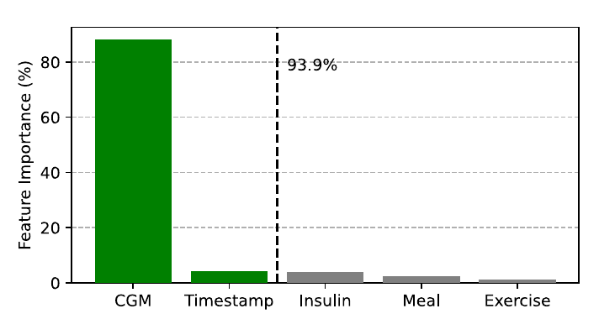
Feature selection from variable selection weights
Fig. 4 — VSN weights act as post-hoc interpretation
▪ CGM + timestamp account for 93.9 % of encoder VSN selection weight.
▪ Insulin, meal and exercise contribute little at population level — inter-individual variability in daily behaviour makes these features inconsistent.
▪ Model retrained with only CGM + timestamp; the same setup carried over to ShanghaiDM.
– No manual logging → closed-loop-ready, fewer human errors.
– Smaller input set → less computation per prediction.
Zhu et al., IEEE Trans. Biomedical Circuits and Systems, 18(2), 2024 — DOI 10.1109/TBCAS.2023.3348844
13

Slide 14
Baselines, training and evaluation metrics
Seven methods, four metrics, two horizons
BASELINES
TRAINING SETUP
▪ Classical, single-horizon (two models each): SVR, XGBoost, Linear Regression
▪ Deep, reconfigured as multi-horizon: LSTM, N-BEATS, N-HiTS
▪ PyTorch 1.11 / Python 3.9, trained on an NVIDIA GTX 1080 Ti
▪ 120 min look-back window → 60 min forecast (12 steps)
▪ Adam optimizer on quantile loss; 200 epochs, early stopping patience 20
▪ Hyperparameters tuned per dataset with the HyperBand tuner
RMSE
MAE
MAPE
gRMSE
Root mean square error — penalizes large deviations
Mean absolute error — average magnitude
Relative error; comparable across BG scales in a diverse population
Glucose-specific RMSE (Clarke-error weighted) — penalizes clinically harmful mistakes
Zhu et al., IEEE Trans. Biomedical Circuits and Systems, 18(2), 2024 — DOI 10.1109/TBCAS.2023.3348844
14

Slide 15
PART 04
Results
Accuracy, trajectories, ablation and in-silico validation

Slide 16
Prediction accuracy — OhioT1DM (12 T1D)
Table I — mean ± STD; EPS-TFT best on every metric and horizon
PH = 30 minutes (mg/dL)
PH = 60 minutes (mg/dL)
Method | RMSE | MAE | MAPE (%) | gRMSE
EPS-TFT | 19.1 ± 2.5 | 13.1 ± 1.6 | 8.5 ± 1.6 | 23.3 ± 3.1
N-BEATS | 19.4 ± 2.3 | 13.4 ± 1.6 | 8.9 ± 1.6 | 23.8 ± 2.7
N-HiTS | 19.6 ± 2.3 | 13.9 ± 1.6 | 9.5 ± 1.7 | 24.5 ± 2.8
LSTM | 20.2 ± 2.6 | 14.3 ± 1.7 | 9.7 ± 1.7 | 24.6 ± 3.3
XGBoost | 22.1 ± 2.9 | 15.7 ± 1.9 | 10.6 ± 2.0 | 28.2 ± 3.9
LR | 22.2 ± 2.8 | 15.9 ± 2.0 | 10.9 ± 2.1 | 27.7 ± 3.7
SVR | 23.5 ± 4.7 | 16.1 ± 2.3 | 10.6 ± 2.0 | 29.9 ± 6.7
Method | RMSE | MAE | MAPE (%) | gRMSE
EPS-TFT | 32.3 ± 3.8 | 23.2 ± 2.8 | 15.5 ± 2.8 | 40.1 ± 4.9
N-HiTS | 33.0 ± 3.7 | 24.5 ± 2.9 | 17.3 ± 3.1 | 42.5 ± 4.6
N-BEATS | 33.8 ± 3.9 | 24.4 ± 3.0 | 16.3 ± 3.0 | 43.0 ± 4.9
LSTM | 34.4 ± 4.2 | 25.4 ± 3.1 | 17.6 ± 3.3 | 42.7 ± 5.4
XGBoost | 35.6 ± 4.7 | 26.4 ± 3.4 | 18.1 ± 3.7 | 46.6 ± 6.6
LR | 36.0 ± 4.6 | 27.0 ± 3.7 | 18.7 ± 3.9 | 46.5 ± 6.6
SVR | 37.0 ± 5.6 | 27.0 ± 3.9 | 18.0 ± 3.7 | 48.5 ± 8.0
▪ Multi-horizon deep models (EPS-TFT, N-BEATS, N-HiTS, LSTM) clearly beat single-horizon SVR / XGBoost / LR.
▪ Gains over the next-best method are small at 30 min but statistically significant (paired t-test, p < 0.05, normality by Shapiro-Wilk).
Zhu et al., IEEE Trans. Biomedical Circuits and Systems, 18(2), 2024 — DOI 10.1109/TBCAS.2023.3348844
16

Slide 17
Prediction accuracy — ShanghaiDM (12 T1D + 100 T2D)
Table II — the first large-cohort T2D forecasting benchmark of its kind
PH = 30 minutes (mg/dL)
PH = 60 minutes (mg/dL)
Method | RMSE | MAE | MAPE (%) | gRMSE
EPS-TFT | 12.7 ± 3.8 | 8.8 ± 2.8 | 6.7 ± 2.3 | 14.8 ± 4.9
N-BEATS | 12.9 ± 4.0 | 9.0 ± 3.0 | 6.9 ± 2.2 | 15.1 ± 5.2
LSTM | 13.1 ± 3.7 | 9.2 ± 2.7 | 7.1 ± 2.2 | 15.4 ± 5.0
N-HiTS | 13.4 ± 4.1 | 9.3 ± 3.1 | 7.1 ± 2.3 | 15.6 ± 5.3
XGBoost | 17.2 ± 7.0 | 13.1 ± 6.2 | 11.5 ± 8.3 | 20.8 ± 9.3
LR | 17.7 ± 14.3 | 12.4 ± 5.6 | 9.5 ± 4.5 | 20.3 ± 17.4
SVR | 18.3 ± 9.4 | 13.8 ± 8.3 | 11.9 ± 10.3 | 22.2 ± 12.5
Method | RMSE | MAE | MAPE (%) | gRMSE
EPS-TFT | 21.7 ± 6.9 | 15.1 ± 5.1 | 11.2 ± 4.1 | 26.2 ± 9.5
N-BEATS | 22.1 ± 7.0 | 15.4 ± 5.2 | 11.6 ± 3.7 | 26.9 ± 9.6
N-HiTS | 22.5 ± 7.0 | 15.7 ± 5.3 | 11.8 ± 3.9 | 27.2 ± 9.5
LSTM | 22.5 ± 6.8 | 15.9 ± 5.0 | 12.0 ± 3.9 | 27.4 ± 9.4
SVR | 26.3 ± 10.7 | 20.1 ± 9.6 | 16.9 ± 11.5 | 32.4 ± 14.4
XGBoost | 27.1 ± 10.8 | 21.0 ± 9.9 | 18.0 ± 11.7 | 32.6 ± 13.6
LR | 28.8 ± 16.4 | 21.0 ± 10.6 | 16.7 ± 7.6 | 34.1 ± 19.8
▪ A single population model covers both diabetes types; static covariates (incl. diabetes type, BMI) supply the personalization.
▪ Five-fold cross-individual validation on unseen ShanghaiDM cohorts: mean RMSE 14.7 mg/dL (30 min) and 23.5 mg/dL (60 min).
Zhu et al., IEEE Trans. Biomedical Circuits and Systems, 18(2), 2024 — DOI 10.1109/TBCAS.2023.3348844
17

Slide 18
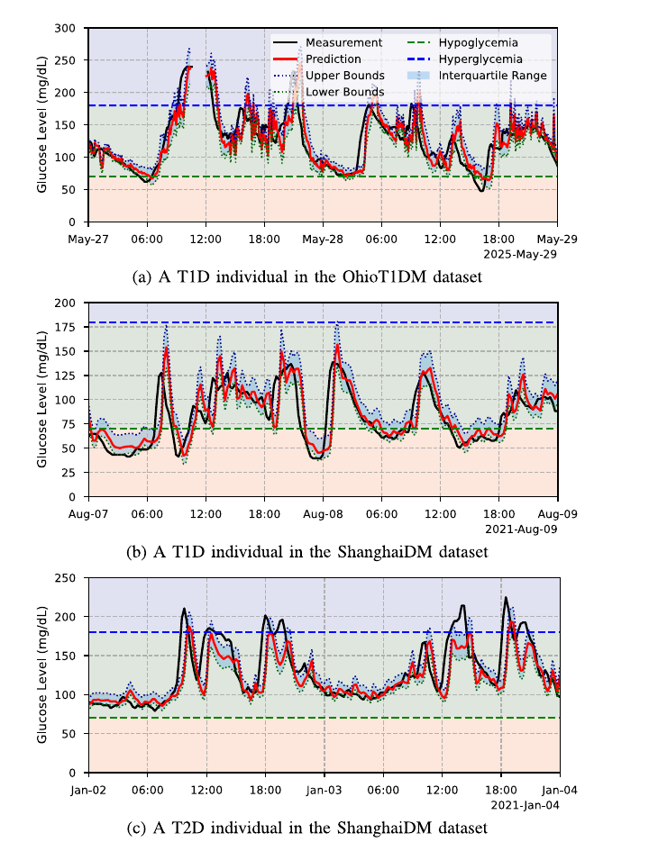
Qualitative behaviour across patient phenotypes
Fig. 5 — two-day traces, 60-min EPS-TFT predictions
▪ (a) OhioT1DM T1D: both hypo- and hyperglycemia, high variability, missing CGM segments.
▪ (b) ShanghaiDM T1D: hypoglycemia-dominated profile.
▪ (c) ShanghaiDM T2D: hyperglycemia-dominated profile.
▪ Predictions track measured CGM closely across all three phenotypes — evidence of population-level generalization.
▪ Quantile bounds (25th / 75th percentile band) capture severe hypo- and hyperglycemia events that the point forecast alone misses.
▪ Alarm thresholds can be moved along the quantile range to trade sensitivity against false alarms.
Zhu et al., IEEE Trans. Biomedical Circuits and Systems, 18(2), 2024 — DOI 10.1109/TBCAS.2023.3348844
18

Slide 19
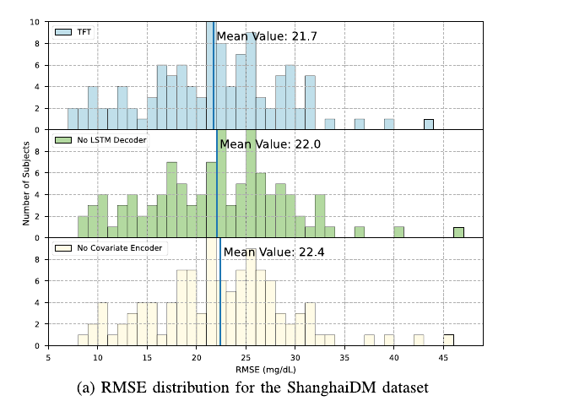
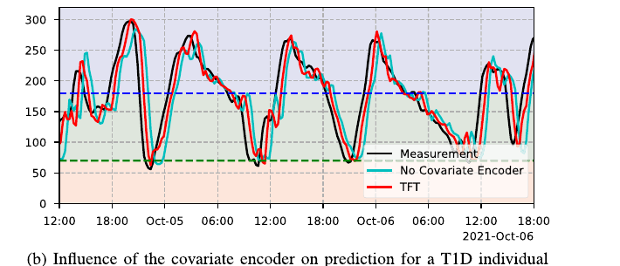
Ablation study
Fig. 7 (Appendix A) — contribution of TFT submodules, ShanghaiDM, 60-min PH
21.7
Full EPS-TFT — mean RMSE (mg/dL)
22.0
No LSTM decoder
22.4
No covariate encoder
▪ Removing the covariate encoder costs the most accuracy: static demographics are what make one population model work for a heterogeneous cohort.
▪ Degradation concentrates exactly where it matters clinically — hypo- and hyperglycemic excursions (Fig. 7b).
Zhu et al., IEEE Trans. Biomedical Circuits and Systems, 18(2), 2024 — DOI 10.1109/TBCAS.2023.3348844
19

Slide 20
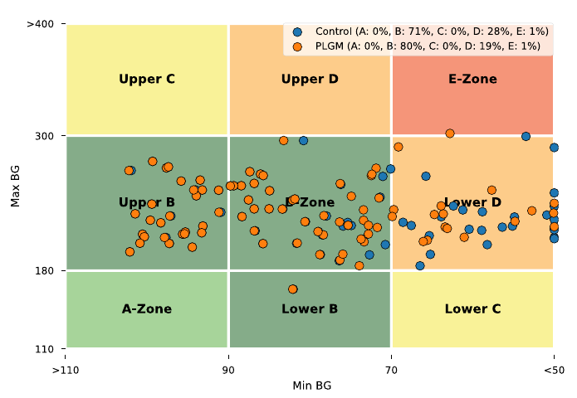
In-silico decision-support trial
Appendix B — 3-month UVA/Padova T1D simulation, 10 virtual adults, PLGM decision support
Predictive low-glucose management: pump suspends basal insulin when the 60-min prediction ≤ 70 mg/dL.
Outcome | Open loop | With EPS-TFT
Time below 70 mg/dL | 5.3 % | 1.9 %
Time in range 70–180 mg/dL | 74.6 % | 75.2 %
CVGA A+B zone | 71 % | 80 %
CVGA D+E zone | — | −9 %
▪ Hypoglycemia exposure cut by ~64 % relative — the clinically dominant benefit.
▪ Simulator streamed CGM to the model, which returned 60-min predictions that drove the insulin-suspend rule.
▪ Time-in-range improvement is modest; the mechanism targets lows, not overall glycemia.
Fig. 8 — Control-variability grid analysis; each dot is one day's min/max BG.
Zhu et al., IEEE Trans. Biomedical Circuits and Systems, 18(2), 2024 — DOI 10.1109/TBCAS.2023.3348844
20

Slide 21
PART 05
Discussion & Conclusion
What it means, what it does not yet solve

Slide 22
Discussion — strengths, caveats, limitations
STRENGTHS
CAVEATS
LIMITS & FUTURE WORK
▪ One model, one cohort, two horizons, two diabetes types
▪ Only CGM + timestamp needed: no manual input
▪ Prediction intervals give clinicians a tunable alarm policy
▪ Hospital-scale use case: cohort monitoring on inpatient wards (post-COVID CGM uptake)
▪ RMSE margin over N-BEATS is small at 30 min — significant (p < 0.05) but modest; it matters mainly for precision dosing / artificial pancreas loops
▪ Population-specific multi-horizon setting is not directly comparable with classic patient-specific results
▪ Simple models (LR in a phone app) remain preferable when latency is irrelevant or data cannot leave the device for training
▪ No cross-population transfer (5 vs 15 min CGM resolution, cohort variability) → meta-learning / domain generalization planned
▪ Missing-data protocol: alerts + linear imputation < 1 h, prediction suspended beyond
▪ Next: integration with CGM systems and insulin-pump decision logic
▪ Real-world clinical trials, expert review, user studies still required
Zhu et al., IEEE Trans. Biomedical Circuits and Systems, 18(2), 2024 — DOI 10.1109/TBCAS.2023.3348844
22

Slide 23
Conclusion
EPS-TFT delivers population-specific, multi-horizon glucose forecasting for T1D and T2D from a single model conditioned on patient demographics.
Accuracy
Simplicity
Lowest RMSE, MAE, MAPE and gRMSE against six baselines on both datasets, at 30 and 60 min (p < 0.05).
One model, two horizons, two diabetes types; only CGM + timestamp as dynamic inputs.
Clinical value
Contribution
Quantile bounds flag severe events; PLGM loop cut time below 70 mg/dL from 5.3 % to 1.9 % in silico.
A reusable framework for population-level, uncertainty-aware glucose forecasting.
T. Zhu, L. Kuang, C. Piao, J. Zeng, K. Li, P. Georgiou, "Population-Specific Glucose Prediction in Diabetes Care With Transformer-Based Deep Learning on the Edge," IEEE Trans. Biomed. Circuits Syst., vol. 18, no. 2, pp. 236–246, Apr. 2024.

