Slide 1
Smart India Hackathon 2026 · Problem Statement 26015
PRAMAAN
FIELD PHOTOGRAPH
SATELLITE @ 30 m
“Check dam, completed,
20-Nov-2023, 19.87°N 77.42°E”
MNDWI −0.08 → +0.31
Water 4 → 7 months / year
प्रमाण · proof
RECONCILE
Turning geo-tagged watershed photographs
from paperwork into proof.
CORROBORATED · L4 control-differenced · confidence 0.84
…and the evidence against it, shown alongside.
Ministry of Rural Development · Department of Land Resources
Category: Software · Theme: Agriculture, FoodTech & Rural Development
Notes:
Pramaan means proof. In Indian philosophy, pramana is literally the theory of how a claim becomes valid knowledge. That is exactly what we built: a system that takes the photograph a field officer sends in, and asks the satellite record whether it is true.

Slide 2
02
THE PROBLEM
India solved collection. It has not solved interpretation.
1 crore+
1,24,830
₹8,134 cr
MGNREGA assets geo-tagged
PIB, 2018
water harvesting structures created
or rejuvenated under WDC-PMKSY 2.0
central outlay · 49.5 lakh ha target
2021–2026
Today the photograph is moderated by eye.
ACCEPTED
REJECTED
NRSC’s SRISHTI portal colour-codes each geotag blue → green (accepted) or red (rejected)
An officer opens one photograph and clicks one of two buttons
That verifies a photograph exists. It does not verify that the structure works.
…and nothing in between.
No outcome. No confidence. No evidence.
No trend. No record of why.
1,24,830 structures is far past the point
where an officer can eyeball an outcome.
Notes:
Every figure on this slide comes from a government source: PIB for the crore of MGNREGA assets, and the live DoLR WDC-PMKSY national dashboard for the rest. The blue-green-red moderation scheme is taken directly from NRSC's own DRISHTI v2.3 user manual. Do not paraphrase these as estimates - they are published numbers.

Slide 3
03
THE ECOSYSTEM WE INTEGRATE INTO
DoLR already has DRISHTI, SRISHTI and Bhuvan.
We add the one missing layer.
PLAN
IMPLEMENT
GEO-TAG
MODERATE
EVALUATE
DPR at 1:5,000
GIS + remote sensing
›
works executed
unique ID assigned
›
DRISHTI 2.0 — GPS,
orientation, 2 photos
›
SRISHTI 2.0 —
accept / reject by eye
›
mid & end-term,
manual, retrospective
▲
PRAMAAN
one arrow inserted — nothing replaced
The WDC-PMKSY 2.0 Guidelines already mandate this analysis:
“change detection technique should be used to understand changes in vegetation cover by NDVI and changes in
water availability through NDWI” · “cross verification of satellite-based images with ground-based
interventions can facilitate multiple levels of authentication, monitoring”
Nobody has built the system that does those two sentences at scale. That is PRAMAAN.
Notes:
This is the trust slide, aimed squarely at the DoLR mentor. Say it plainly: one arrow. We integrate, we do not displace. Mention the DoLR-NRSC MoU of 18 October 2023, which named SRISHTI 2.0 and DRISHTI 2.0 explicitly and commits NRSC to land-cover change analysis for watersheds. We are building what the department has already written down that it wants.

Slide 4
04
THE SOLUTION
Every photograph becomes a testable claim.
CLAIM
›
EVIDENCE
›
VERDICT
›
ACTION
›
SIGNED RECORD
0.15
PHOTO
VERDICT
What the field says. Weighted lowest — it is the claim’s own source.
L4 · CONTROL-DIFFERENCED
0.25
TERRAIN
confidence 0.84 coverage 0.92
Flow accumulation, Strahler order, slope. Deterministic. No AI.
DISSENT — ALWAYS SHOWN
0.25
SATELLITE
Cloud gap Jul–Aug 2024: 2 of 6 scenes lost
Only one fully observed post-monsoon season
Correlational — this is not a causal claim
NDVI · MNDWI · bare soil · water persistence, at 30 m.
0.25
TEMPORAL
Same season, year on year, against 5–12 matched controls.
The officer decides.
AI never becomes government
evidence on its own.
0.10
CONTEXT
Rainfall anomaly, land cover, neighbouring interventions.
Illustrative verdict card. Five independent evidence families; the weights are published in the interface and adjustable per deployment.
Notes:
The line that lands with technical mentors: the photograph is weighted lowest of the five, because the photograph is the claim's own source. Independent evidence must outrank self-report. Also point at the dissent panel - it is always shown, and a verdict that has no dissent list fails validation and cannot be saved.

Slide 5
05
THE KILLER WORKFLOW
One workflow, built completely — not ten built partially.
01
SELECT
02
INGEST
03
INTERPRET
Open a real micro-watershed. 142 geo-tagged works, 6 already flagged.
EXIF → sidecar → CSV → manual pin. Every coordinate carries its provenance rank.
Photo attributes with calibrated confidence — and permission to abstain.
04
RECONCILE
05
ADJUDICATE
06
REPORT
Terrain, satellite, temporal and matched controls resolve to one verdict.
Accept, edit or reject. Signed into an append-only, hash-chained ledger.
Evidence Pack PDF: every scene id, model version and weight used.
Everything else in the product exists to serve these six steps. Anything that does not, we did not build.
Notes:
Say this out loud: we deliberately built one workflow completely rather than ten workflows partially. Judges reward closure. The loop ends in a signed government artefact, not in a dashboard view.

Slide 6
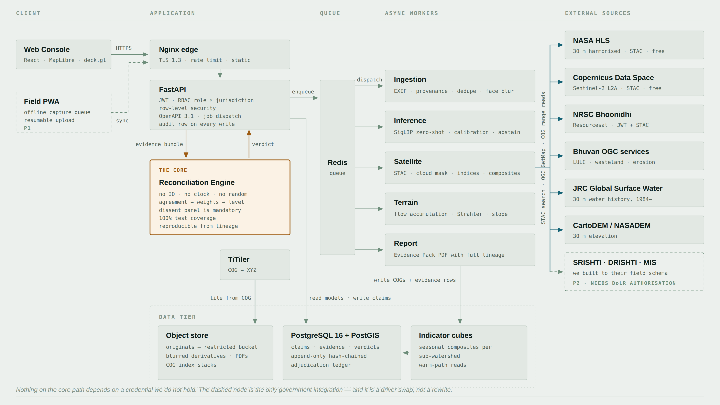
06
SYSTEM ARCHITECTURE
Boring where it should be. Careful where it matters.
The amber core has exactly two connections — a bundle in, a verdict out.
Notes:
Three separable concerns. The application tier owns identity and jurisdiction. The workers own everything slow, and each is a retryable job with an id you can inspect. The engine owns judgement and has no database handle, no clock and no network call - which is why the same evidence bundle always yields the same verdict, and why a stored lineage record is enough to recompute it under audit years later. Every teal source is free and open today. The dashed node is the only government integration, and it is a driver swap.

Slide 7
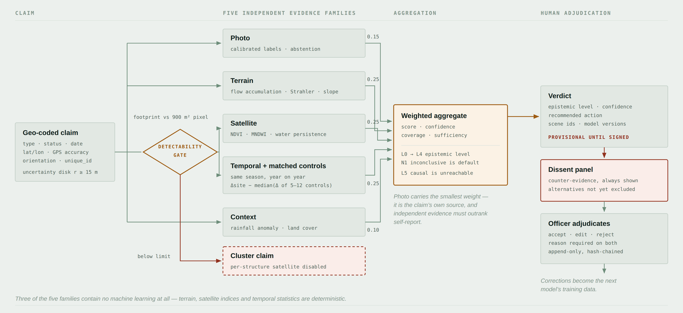
07
THE RECONCILIATION MECHANISM
Inside the engine — and the one branch that removes an arrow.
A 25 × 25 m farm pond is 625 m². One 30 m pixel is 900 m². The gate fails, and per-structure satellite evidence is switched off — visibly, in the UI and in the PDF.
Notes:
This is the diagram a GIS or remote-sensing mentor will interrogate, so know it cold. Walk left to right: claim, five families, weighted aggregate, verdict, dissent, human. Then point at the amber diamond. Most systems in this space would quietly return a confident 'no water detected' for a structure smaller than a pixel. Ours refuses, escalates to a cluster assessment, and says why. That refusal is what makes a negative verdict from the surviving families trustworthy.

Slide 8
08
WHY IT HOLDS UP SCIENTIFICALLY
Three ideas do the work. None of them is deep learning.
01
02
03
MATCHED CONTROLS
TERRAIN PLAUSIBILITY
THE DETECTABILITY GATE
Every structure is scored against 5–12 automatically matched sites in the same sub-watershed — same slope, land cover, elevation and stream order, with no intervention.
A check dam claimed on a ridge with 12 cells of flow accumulation is flagged before any model runs, from DEM-derived flow accumulation, Strahler order and slope.
Footprint is compared to sensor resolution first. Below one pixel, per-structure satellite evidence is disabled and the claim escalates to a cluster.
Same rainfall, same season. We measure the intervention, not the monsoon.
Deterministic. Zero training data. Explainable to an auditor in one line.
A system that refuses to answer is one you can trust when it does.
AI appears in exactly one of the five evidence families — a zero-shot vision-language model, chosen because no labelled Indian watershed photo corpus exists.
Notes:
If a mentor asks 'where is the AI?', this is the honest answer: we used the least AI that solves the problem, and we can defend every place we used it. The photo family uses a zero-shot vision-language model with calibrated thresholds and an abstention band, because there is no labelled Indian watershed photograph dataset to train on. The other four families are hydrology, spectral indices and statistics.

Slide 9
09
DEMO & RESULTS
One real claim, run end to end on real data.
INCONCLUSIVE · N1
confidence 0.0615
REQUIRES VERIFICATION · N3
confidence 0.3371
Check dam · claimed complete 20-Nov-2023 · Marathwada · REAL DATA
Farm pond · golden case 21 · SYNTHETIC INPUTS, ENGINE-COMPUTED
Satellite: 40 cloud-screened NASA HLS granules · 10 seasonal composites over 5 years · rabi NDVI +0.1157 across the claim date
Controls: 12 sites matched on real NASADEM terrain rose a median +0.0901. The site sits at the 75th percentile — inside the band. Differenced +0.026
Terrain: Strahler order 0, 277 m from any drainage line — implausible siting for a check dam. The engine names the conflict instead of averaging it
Terrain: 12 cells of flow accumulation, 340 m from any channel — no runoff reaches it. A deterministic rule, not a model, drives this verdict
Detectability gate FAILED: a 625 m² footprint against a 900 m² pixel. Per-structure satellite evidence is disabled, and the verdict is reached via the named N3_TERRAIN_PATH
MEASURED, NOT CLAIMED — every figure below was measured on this build and is re-runnable from the repository. NOT MEASURED YET: adjudication-time A/B test · photo-model precision/recall · calibration error (ECE) · terrain-screen precision. Where a number does not exist, this deck says so.
Engine throughput
~13 µs / verdict
1,24,830 structures in under 2 s · one district of 1,200 works in 16 ms
Test suite
458 tests · 100 %
branch coverage on the deterministic core · 23 golden cases, all 8 levels
Matched controls
12 of 342
on real DEM covariates; 276 rejected for stream distance, 11 for slope
Imagery volume
1.8 GB
five years, windowed COG reads — against 78 GB for naive granule download
Photo inference
29 img/s on CPU
zero GPU · ~6 img/s on a demo VM assumed 5× slower · 1,200 images in minutes
Notes:
Never invent a number on this slide - it is the fastest way to lose a technical mentor. The A/B adjudication-time test is the single most persuasive measurement available to us in a hackathon, and it costs one afternoon: take twenty claims, show ten to a tester as photo-plus-map only, ten in the full PRAMAAN view, and time them. Run it in week three, not week four.

Slide 10
10
NOVELTY
What is genuinely new — and what is not.
NOT NEW — AND WE DON’T PRETEND OTHERWISE
NEW IN THIS COMBINATION
NDVI / NDWI change detection
Mapping geo-tagged points on satellite imagery
GIS dashboards for government programmes
Computer vision applied to field photographs
Treated-versus-control watershed impact studies
Claim-level satellite–field reconciliation on a published epistemic ladder
Matched-control differencing per individual structure, not per programme
Terrain plausibility screening of geotags before any model runs
An explicit refusal-to-answer gate tied to sensor resolution
An append-only adjudication ledger that becomes the next training set
We are not claiming a first. We are claiming these five have not been assembled into one government-workflow-native system — and we checked.
Notes:
Mentors have sat through a great many decks that claim world firsts. Honesty is the differentiator here, and it also protects you: you cannot be caught out on a claim you did not make.

Slide 11
11
IMPACT
Redirecting scarce human attention.
Watershed development already works.
B:C ≈ 2 · IRR 27.4 % · cropping intensity +35.5 %
runoff −45 % · soil loss −1.1 t / ha / yr
ICRISAT meta-analysis, 636 Indian micro-watersheds
The constraint is not whether it works. It is knowing which structures are working.
₹0
in data and licence costs. Every source on the core
path is free, open and verified — so the marginal cost
of monitoring one more structure is CPU seconds.
Illustrative funnel from the demo corpus. The ratio is measured and reported — never assumed.
Every officer correction becomes a labelled training sample — the dataset is produced by the system’s own use, by domain experts, for free, forever.
Notes:
The ICRISAT figures are real and citable - 636 micro-watersheds, benefit-cost ratio around two, internal rate of return 27.4 per cent. Do not extrapolate them into a rupee savings claim we cannot support. The argument is about attention, not about money saved.

Slide 12
12
FEASIBILITY & HONESTY
Free data. No GPU. One driver class to production.
What production needs
What we use for the hackathon
Swap effort
DRISHTI geo-tag feed
A corpus faithful to NRSC’s published DRISHTI field schema — lat, lon, GPS accuracy, orientation, timestamp, activity, survey no., status
one driver class
“SRISHTI-DRISHTI 30 m imagery”
NASA HLS 30 m + Landsat 30 m + Resourcesat through the NRSC Bhoonidhi STAC API
one driver class
WDC-PMKSY MIS records
CSV import matching the MIS columns, keyed on the government’s own unique_id
configuration only
SRISHTI project boundaries
SLUSI micro-watershed polygons — already the same geometry family
none
VERIFIED, OPEN, PROGRAMMATIC
WE COULD NOT FIND A PUBLIC SRISHTI-DRISHTI API
NASA HLS 30 m (STAC) · Copernicus Sentinel-2 (STAC) · NRSC Bhoonidhi
API (JWT + STAC; open above 5 m under Indian Space Policy 2023)
Bhuvan OGC WMS · JRC Global Surface Water · CartoDEM
So we are not going to pretend we did. We built to NRSC’s published field
schema instead — which makes integration a configuration change on the day
the Department grants access, not a rewrite.
Notes:
This is the anti-BS slide, and it is the strongest credibility moment in the deck. It converts our biggest apparent weakness - no access to the platform named in the problem statement - into evidence that we did the research and refused to fabricate. If a mentor asks about the 30 m claim in the problem statement, this is the slide to return to.

Slide 13
13
CLOSING
The officer decides. The system shows its work.
ADJUDICATION
PRAMAAN is the intelligence layer
DoLR’s own guidelines already asked for.
ACCEPT
EDIT
REJECT
SIGNED · R. Kumar, WCDC Project Manager, Nanded
27-Aug-2026 09:14 IST · ledger hash 7f3a…9c1
Append-only · hash-chained · non-repudiable
Every correction becomes a labelled sample for the next model.
Integrates — never replaces SRISHTI, DRISHTI or Bhuvan
Implements two written mandates from WDC-PMKSY 2.0
Adopts the government’s own IDs, roles and statuses
Caps itself below causal claims — enforced in code
Runs on free, verified data with zero licence cost
Nothing here becomes government evidence
until a named human being says it does.
प्रमाण · PRAMAAN · proof
1,24,830 structures. Free satellite data. The officer still decides.
Notes:
Close on the ledger, not on the AI. The last thing you want in the room is the image of a machine that argued against its own conclusion and then handed the decision to a person. If there is time for one more sentence: the system's training data is produced by its own use, by domain experts, for free, forever.

