Slide 1


SMART INDIA HACKATHON 2026
TITLE PAGE
Problem Statement ID – 26015
Problem Statement Title – Application of Geospatial Techniques for visualization and analysis to interpret Geo-Coded Images to enhance watershed Development Outcomes
Theme – Agriculture, FoodTech & Rural Development
PS Category – Software
Team ID – <your team ID>
Team Name (Registered on portal) – <your team name>
PRAMAAN • प्रमाण
Turning geo-tagged watershed photographs into verifiable evidence.

Slide 2
IDEA TITLE
Team Name
Proposed Solution (Describe your Idea/Solution/Prototype)
PRAMAAN — an evidence-reconciliation layer over DoLR’s existing SRISHTI / DRISHTI geotag pipeline. Every field photograph becomes a claim the satellite record can test.
CLAIM
›
EVIDENCE
›
VERDICT
›
OFFICER DECIDES
›
SIGNED RECORD
PHOTO 0.12
TERRAIN 0.25
SATELLITE 30 m 0.20
TEMPORAL 0.20 · CONTROL 0.15
RAINFALL CONTEXT 0.08
Detailed explanation of the proposed solution
How it addresses the problem
Innovation and uniqueness of the solution
Each DRISHTI geotag — lat/lon, GPS accuracy, orientation, timestamp, activity, status — becomes a structured, testable claim
Reconciled against six evidence families — terrain, satellite, temporal, matched controls, rainfall context and the photograph. Five are independent of the claim; the photograph is not, which is why it is weighted lowest
Output: a verdict on a published L0–L4 evidence ladder, with calibrated confidence and a mandatory dissent panel
Officer accepts / edits / rejects; signed into an append-only, hash-chained ledger
Deliverable: an Evidence Pack PDF carrying every scene ID, model version and weight used
Today a geotag is moderated by eye — accept or reject. That verifies a photograph, not an outcome
1,24,830 water-harvesting structures under WDC-PMKSY 2.0 cannot be eyeballed at scale
Implements the WDC-PMKSY 2.0 written mandate: NDVI/NDWI change detection, and cross-verification of satellite images with ground interventions
Converts ~1,200 works per district into ~40 that need a human decision, each with a documented reason
Adds one step to the existing workflow — replaces no government system
Matched-control differencing per structure — 5–12 similar un-treated sites in the same sub-watershed, so we measure the intervention, not the monsoon
Terrain plausibility screen — a check dam claimed off any drainage line is flagged deterministically, before any AI runs
Detectability gate — the system refuses to judge structures smaller than one 30 m pixel and escalates to a cluster claim
Causal claims are unreachable in code; “requires physical verification” is the strongest language it can emit
Every officer correction becomes labelled training data

Slide 3
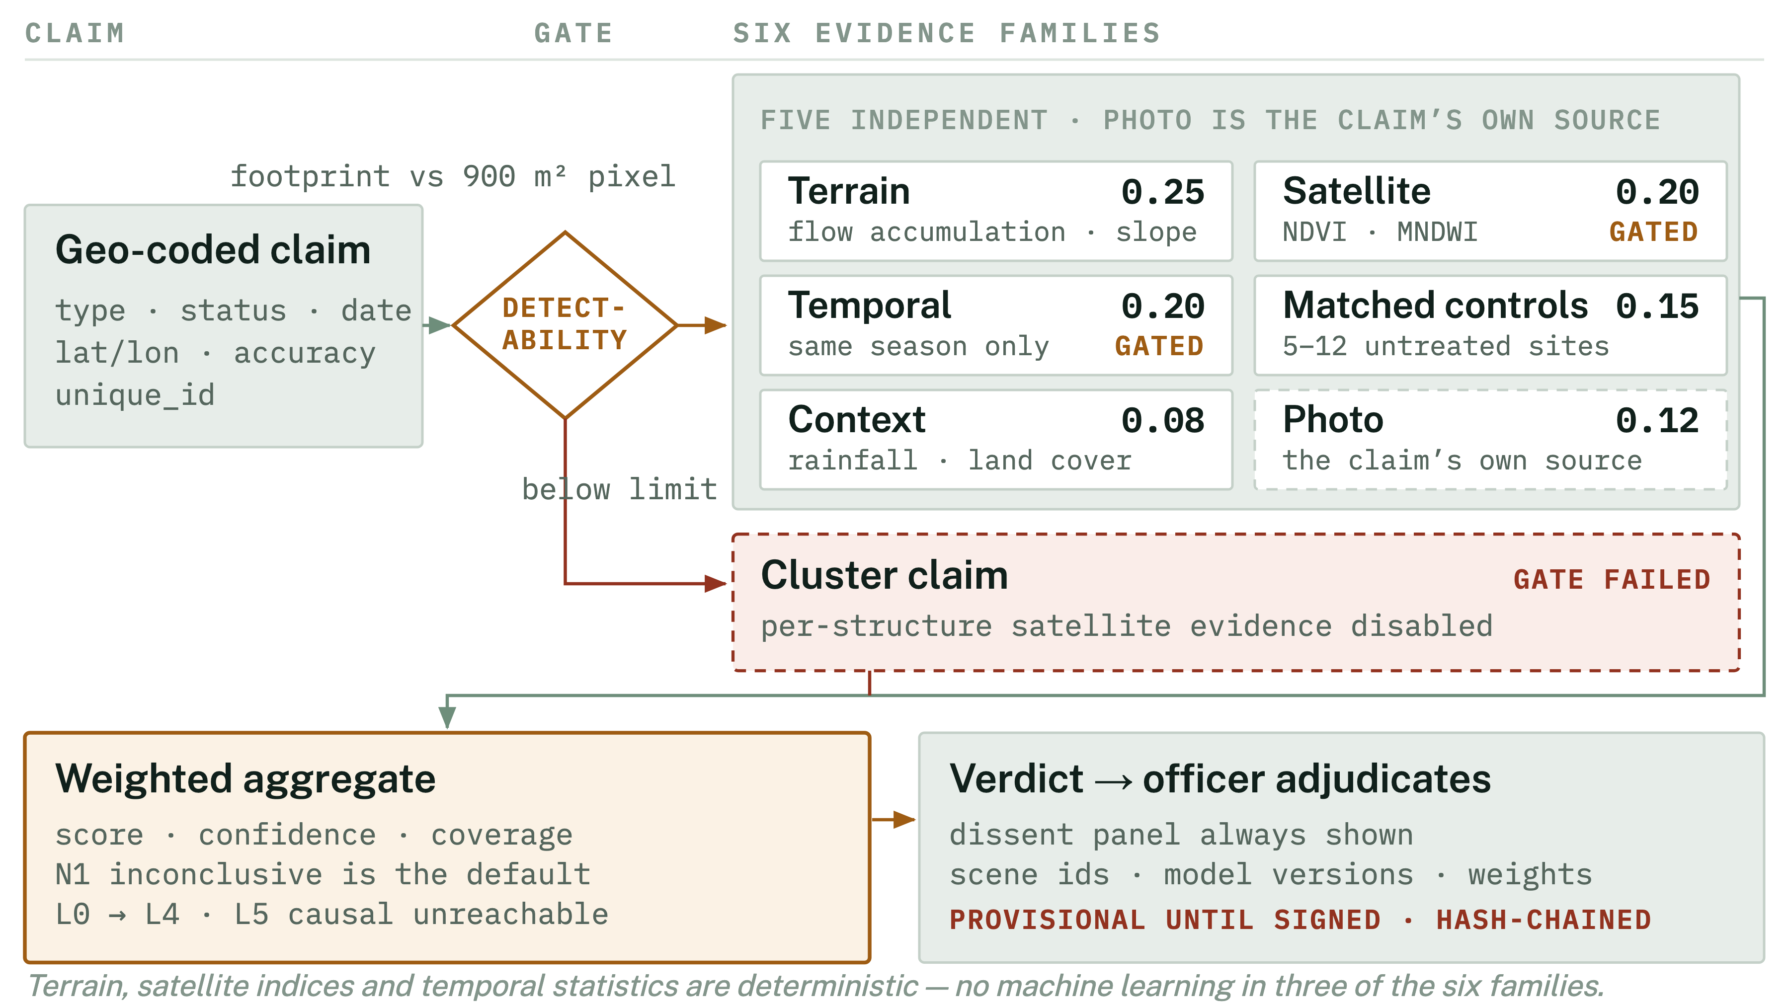
TECHNICAL APPROACH
Team Name
Technologies to be used (e.g. programming languages, frameworks, hardware)
Methodology and process for implementation (Flow Charts / Images / working prototype)
BACKEND
Python 3.11 · FastAPI · Celery · Redis · Docker Compose
INGEST
›
VALIDATE
›
INTERPRET
›
RECONCILE
›
ADJUDICATE
›
REPORT
GEOSPATIAL
PostgreSQL + PostGIS · GDAL · rasterio · GeoPandas · Shapely · PyProj · WhiteboxTools
AI / CV
PyTorch · SigLIP-2 zero-shot (no labelled corpus exists) · OpenCV · Prithvi-EO-2.0 30 m foundation model as the research path
FRONTEND
React · TypeScript · MapLibre GL · TiTiler for COG tiles
DATA SOURCES
NASA HLS 30 m (STAC) · Copernicus Sentinel-2 (STAC) · NRSC Bhoonidhi API (JWT + STAC) · Bhuvan OGC WMS · JRC Global Surface Water · CartoDEM · SLUSI watershed atlas
HARDWARE
One 8-core VM. No GPU required on the core path. ₹0 in data and licence cost.
The reconciliation mechanism. Six evidence families weighted into one verdict — five independent of the photograph, which is the claim’s own source and weighted lowest. The detectability gate disables per-structure satellite evidence below one 30 m pixel; the engine is a pure function — same bundle, same verdict.

Slide 4
FEASIBILITY AND VIABILITY
Team Name
Analysis of the feasibility of the idea
Potential challenges and risks
Strategies for overcoming these challenges
Every core data source is free, open and programmatic — endpoints verified, not assumed
NRSC Bhoonidhi exposes a documented JWT + STAC API; data coarser than 5 m is open under Indian Space Policy 2023
₹0 in data and licence cost; entire stack is open-source
Runs on a single 8-core VM with no GPU on the core path
Built to NRSC’s published DRISHTI field schema, so production integration is a driver swap, not a rewrite
Complete workflow demonstrable offline from a local cache
Many structures are smaller than one 30 m pixel — farm ponds, gully plugs, individual trenches
Monsoon cloud cover can destroy an entire kharif observation window
EXIF GPS is often stripped by messaging apps; coordinates may be typed manually
Seasonality and rainfall can be mistaken for genuine intervention impact
A false negative could unfairly implicate a beneficiary
No public SRISHTI / DRISHTI API could be found during research
Detectability gate compares footprint to sensor resolution first, then escalates to a cluster claim — never a false negative
Rabi and summer windows carry the analysis; cloud is scored per area of interest, not per scene
Ranked provenance chain (EXIF → sidecar → CSV → manual pin) plus a deterministic terrain plausibility screen
Matched controls in the same sub-watershed, same-season comparison, construction window excluded
Verdicts stay provisional until a named officer signs; wording is locked to “requires physical verification”
Imagery and geotag sources sit behind driver interfaces — one class to swap

Slide 5
IMPACT AND BENEFITS
Team Name
Potential impact on the target audience
Benefits of the solution (social, economic, environmental, etc.)
WCDC Project Manager — ~1,200 works per district reduce to ~40 needing a decision each month, each with a documented reason for the field visit
SLNA monitoring & evaluation — a standing, reproducible evidence pipeline replaces hand-built one-off GIS analyses
DoLR — every aggregate number traces to a signed adjudication, making progress reporting audit-defensible
Field WDT — fewer wasted verification journeys; feedback on capture quality
ECONOMIC
Targets a scarce verification budget inside a ₹8,134 crore programme covering 49.5 lakh hectares
₹0 data and licence cost — marginal cost per extra structure is CPU seconds
SOCIAL
Accountability without accusation — the system never says fraud or false
Strongest wording it can emit is “requires physical verification”; a named officer makes the finding
TARGETING SCARCE VERIFICATION EFFORT — ONE DISTRICT, ONE MONTH
ENVIRONMENTAL
Works in one district
1,200
Earlier detection of non-performing soil and water conservation works
Faster remedial action on degraded land, water retention and vegetation cover
Assessable at 30 m
890
INSTITUTIONAL
Need a human decision
400
An expert-labelled dataset of Indian watershed field evidence grows from routine use
Owned by the department, at no additional cost
Field visits ordered
60
Watershed development is already proven: mean benefit–cost ≈ 2, IRR 27.4%, cropping intensity +35.5% (ICRISAT, 636 Indian micro-watersheds). The gap is knowing which structures work.

Slide 6
RESEARCH AND REFERENCES
Team Name
Details / Links of the reference and research work
GOVERNMENT OF INDIA — PROGRAMME & PLATFORM
DATA SOURCES & SCIENTIFIC LITERATURE
WDC-PMKSY 2.0 portal and national dashboard — wdcpmksy.dolr.gov.in
Guidelines for New Generation Watershed Development Projects (WDC-PMKSY 2.0), DoLR — mandates NDVI/NDWI change detection and cross-verification of satellite images with ground interventions
National Technical Guidelines for Improved Watershed Management, NRAA, Aug 2025
NRSC SRISHTI–DRISHTI User Manual and DRISHTI v2.3 Manual — bhuvan-app1.nrsc.gov.in/iwmp
Bhuvan Watershed Development Component 2.0 — bhuvan-app1.nrsc.gov.in/wdc2.0
MoRD press release, DoLR–NRSC MoU, 18 Oct 2023 — SRISHTI 2.0 and DRISHTI 2.0
PIB: one crore MGNREGA assets geotagged (PRID 1488368)
Bhoonidhi API Specification, NRSC — bhoonidhi.nrsc.gov.in/bhoonidhi-api (JWT + STAC)
NASA Harmonized Landsat Sentinel-2 (HLS) 30 m v2.0 — LP DAAC
Copernicus Data Space Ecosystem STAC catalogue
JRC Global Surface Water v1.4 (Pekel et al.) — 30 m water history, 1984–
SLUSI Digital Watershed Atlas of India
Prithvi-EO-2.0: A Versatile Multi-Temporal Foundation Model for Earth Observation — arXiv:2412.02732 (pretrained on 4.2 M HLS samples at 30 m)
Assessing impacts of watershed interventions using ground data and remote sensing, Ethiopia — Springer, doi 10.1007/s13762-021-03192-7
Impact of Watershed Program and Conditions for Success: A Meta-Analysis — ICRISAT, 636 micro-watersheds
Small water bodies mapped from Sentinel-2 MSI — Int. J. Remote Sensing 41(20)

