Slide 1


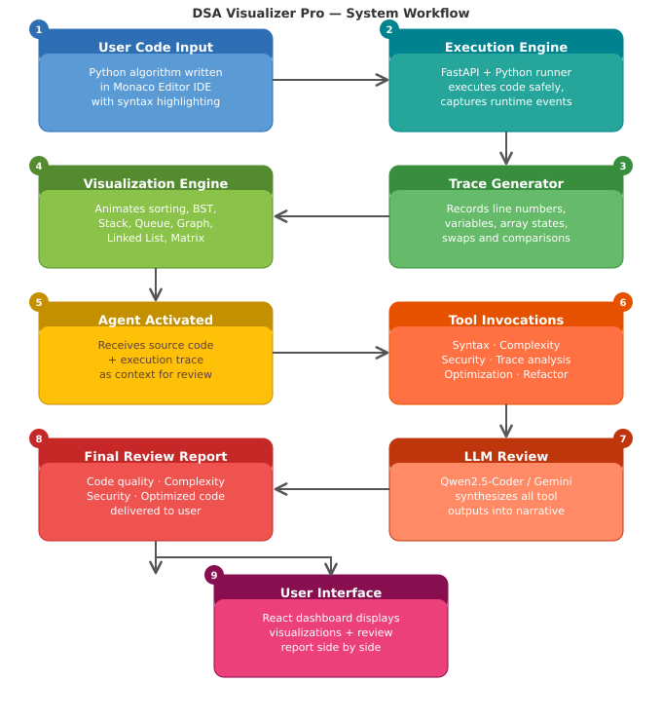
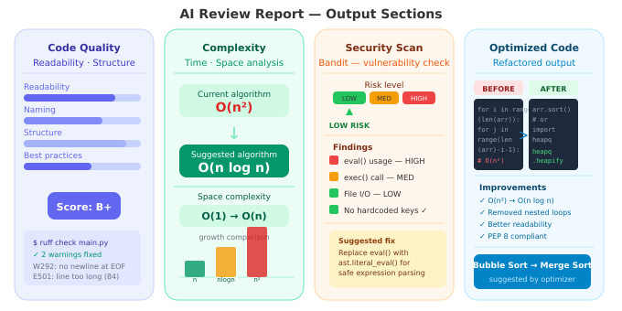
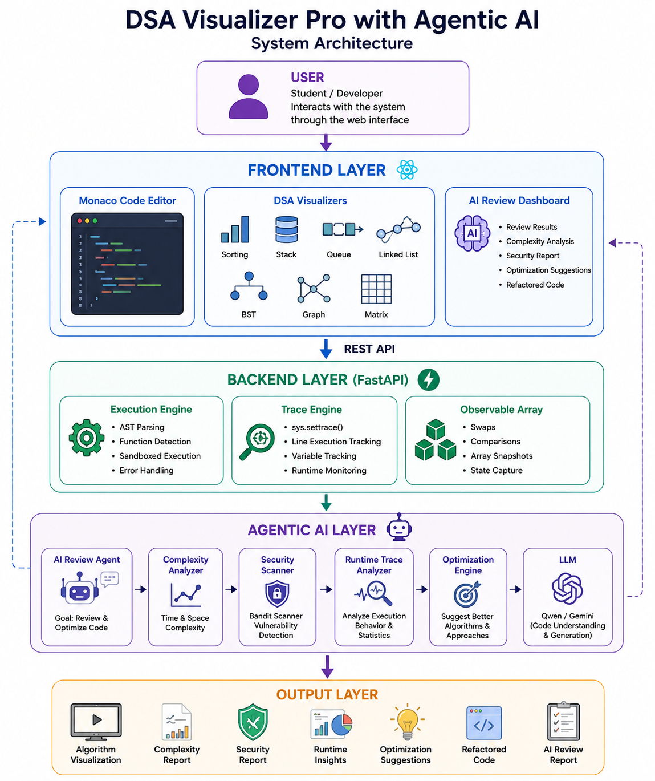
DSA Visualizer Pro with Agentic AI Code Review System
Abhinav Patidar (0827IT231006), Aditya Trivedi(0827IT231014), Akshat Yadav (0827IT231020), Archesh Shrivas (0827IT231029), Aryan Singh (0827IT231033)
Department Of Information Technology
Acropolis Institute of Technology & Research, Indore
Session: Jan. – Jun. 2026
Abstract
Methodology
Results
DSA Visualizer Pro is a full-stack educational platform combining an online Python IDE, interactive Data Structure and Algorithm visualizations, execution tracing, and an Agentic AI-powered code review system. The platform allows users to write, execute, visualize, and intelligently analyze algorithms within a single unified environment. Unlike traditional DSA visualizers, the system animates algorithm execution and performs intelligent code analysis using an AI agent capable of reviewing source code, evaluating complexity, detecting vulnerabilities, interpreting runtime traces, and generating optimized implementations. Built with React, FastAPI, Monaco Editor, and LLM integration, the project demonstrates practical Agentic AI in software engineering education.
Visualizers: 7 fully animated visualizers (Sorting, Stack, Queue, Linked List, BST, Graph, Matrix).
Agent Tools: 6 specialized tools — Syntax Analyzer, Complexity Estimator, Security Scanner (Bandit), Runtime Trace Analyzer, Optimization Engine, Code Refactoring Tool.
Complexity Detection: Accurate Time and Space complexity estimation (e.g., O(n²) → O(n log n)).
Security Scanning: Detects unsafe eval(), hardcoded credentials, and insecure file handling.
The platform successfully combines online coding, live visualization, execution tracing, and AI review in a single environment.
Introduction
Traditional DSA learning tools suffer from a critical gap: they animate pre-defined algorithm steps but cannot analyze the code a student actually writes. Learners receive no feedback on complexity, security, or correctness—only a visual representation disconnected from their own logic.
This project addresses these challenges by building a platform where users write Python algorithms in a Monaco Editor IDE, execute them through a FastAPI backend, and receive live step-by-step visualizations driven by real runtime execution traces—not pre-baked animations.
Version 2.0 extends this with an Agentic AI Review Engine that autonomously invokes specialized tools—syntax analysis, complexity estimation, security scanning, runtime trace analysis, and code refactoring—before producing a structured review report. This transforms the platform from a visualization tool into an intelligent algorithm development and learning environment.
Conclusion
DSA Visualizer Pro successfully combines algorithm visualization, execution tracing, online code execution, and intelligent software analysis within a unified platform. The integration of Agentic AI enables the system to move beyond visualization and become an intelligent programming assistant capable of analyzing, evaluating, improving, and explaining algorithms using both static source code and runtime execution data. The project establishes a strong foundation for future intelligent development environments and demonstrates practical application of modern AI systems in software engineering education.
Objectives
Provide an interactive environment for learning Data Structures and Algorithms through live code execution and step-by-step visualization.
Enable runtime execution tracing to capture variable values, array states, swaps, and comparisons and feed them directly into the visualization engine.
Implement an Agentic AI Review System that autonomously invokes multiple specialized analysis tools before generating a structured review report.
Detect security vulnerabilities in user-submitted code using Bandit and provide actionable security recommendations.
Generate optimization recommendations and produce refactored implementations with improved readability, performance, and maintainability.
Demonstrate practical Agentic AI integration showing how an agent can pursue a goal by orchestrating tools rather than responding to a single prompt.
Acknowledgement
We express sincere thanks to our Project Guide Prof. Manish Vyas, Project Incharge Prof. Ankita Agrawal, Project Coordinator Prof. Deepak Singh Chouhan, HoD Dr. Prashant Lakkadwala, and the Department of Information Technology for their continuous support, guidance, and resources throughout the project.

