Slide 1
E N D E A V O R
Image Manipulation Software

Slide 2
Description
Endeavor is an image manipulation program with two builtin tools, and image opening/saving capabilities. It is also written so that additional tools can be added without difficulty in very few lines of code.

Slide 3
How to use
Endeavor will prompt the user to select an image on startup. Then, effects can be applied using the Tools menu, or the user can save the image/open a new image using the File menu.
For a more detailed explanation of each function that would not fit in a presentation, please see README.pdf.

Slide 4
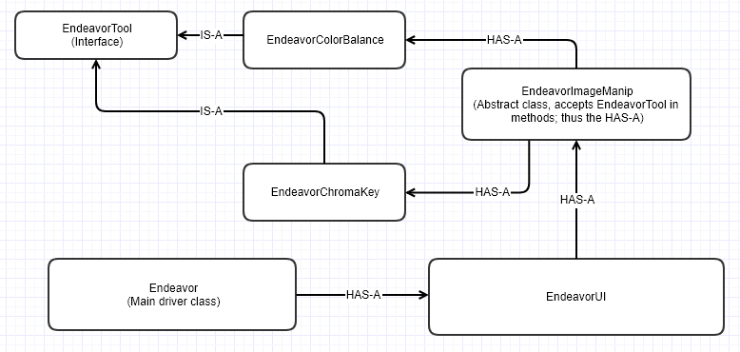
UML Diagram

Slide 5
EndeavorTool
`EndeavorTool` is an interface that ensures certain methods, namely `getName`, `act`, and `configure`, are implemented. `getName` gets the name of the tool, `act` modifies a single pixel provided by EndeavorImageManip, and `configure` is run immediately after the user presses the button associated with the tool in the window toolbar.

Slide 6
EndeavorColorBalance
`EndeavorColorBalance` IS-A `EndeavorTool`. It implements all three methods. Its `configure` displays a color picking dialogue; the picked colors are then multiplied by a constant (default 0.1) and added to each pixel in `act`, to create a tinting effect.

Slide 7
EndeavorChromaKey
`EndeavorChromaKey` IS-A `EndeavorTool`, and also implements all three methods. `configure` accepts a color and chroma key allowance as input, and then colors all pixels within that allowance of the selected color black in `act`.

Slide 8
EndeavorImageManip
`EndeavorImageManip` has one job: to interface between `EndeavorUI` and the `EndeavorTool`s. It has one static method: `apply_effect`. This requires multiple parameters and applies the selected `EndeavorTool`’s effect to the image.

Slide 9
EndeavorUI
`EndeavorUI` is the largest and most complex class in the project, and impossible to describe on this slide. Suffice to say it creates the toolbar, handles loading of images and interfacing with `EndeavorImageManip`, and loads all `EndeavorTool`s for ready use in the Tool menu.

Slide 10
Endeavor (main class)
`Endeavor` is likewise the simplest class, as it contains a single static method: `main`. This method creates an `EndeavorUI` object which handles the rest of the setup, and then directs that object to ask the user for an initial image to edit.

Slide 11
Interesting features
- Warnings will pop up during IOExceptions or if the user fails to select an image.
- The Tint tool operates on an “Add” algorithm, in that a small amount of the tint color is “added” to the existing color. Therefore excessive tinting will noticeably brighten the image.

Slide 12
This work is licensed under a Creative Commons Attribution-ShareAlike 3.0 Unported License. It makes use of the works of Mateus Machado Luna.

