Slide 1
SMART WASTE SEGREGATION
By,
Aswin Subramanian
Akhil Bommireddypalli
Karan Rajashekar

Slide 2
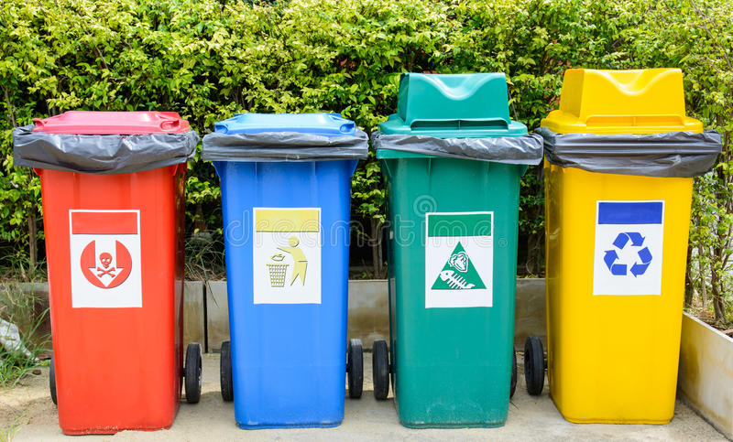
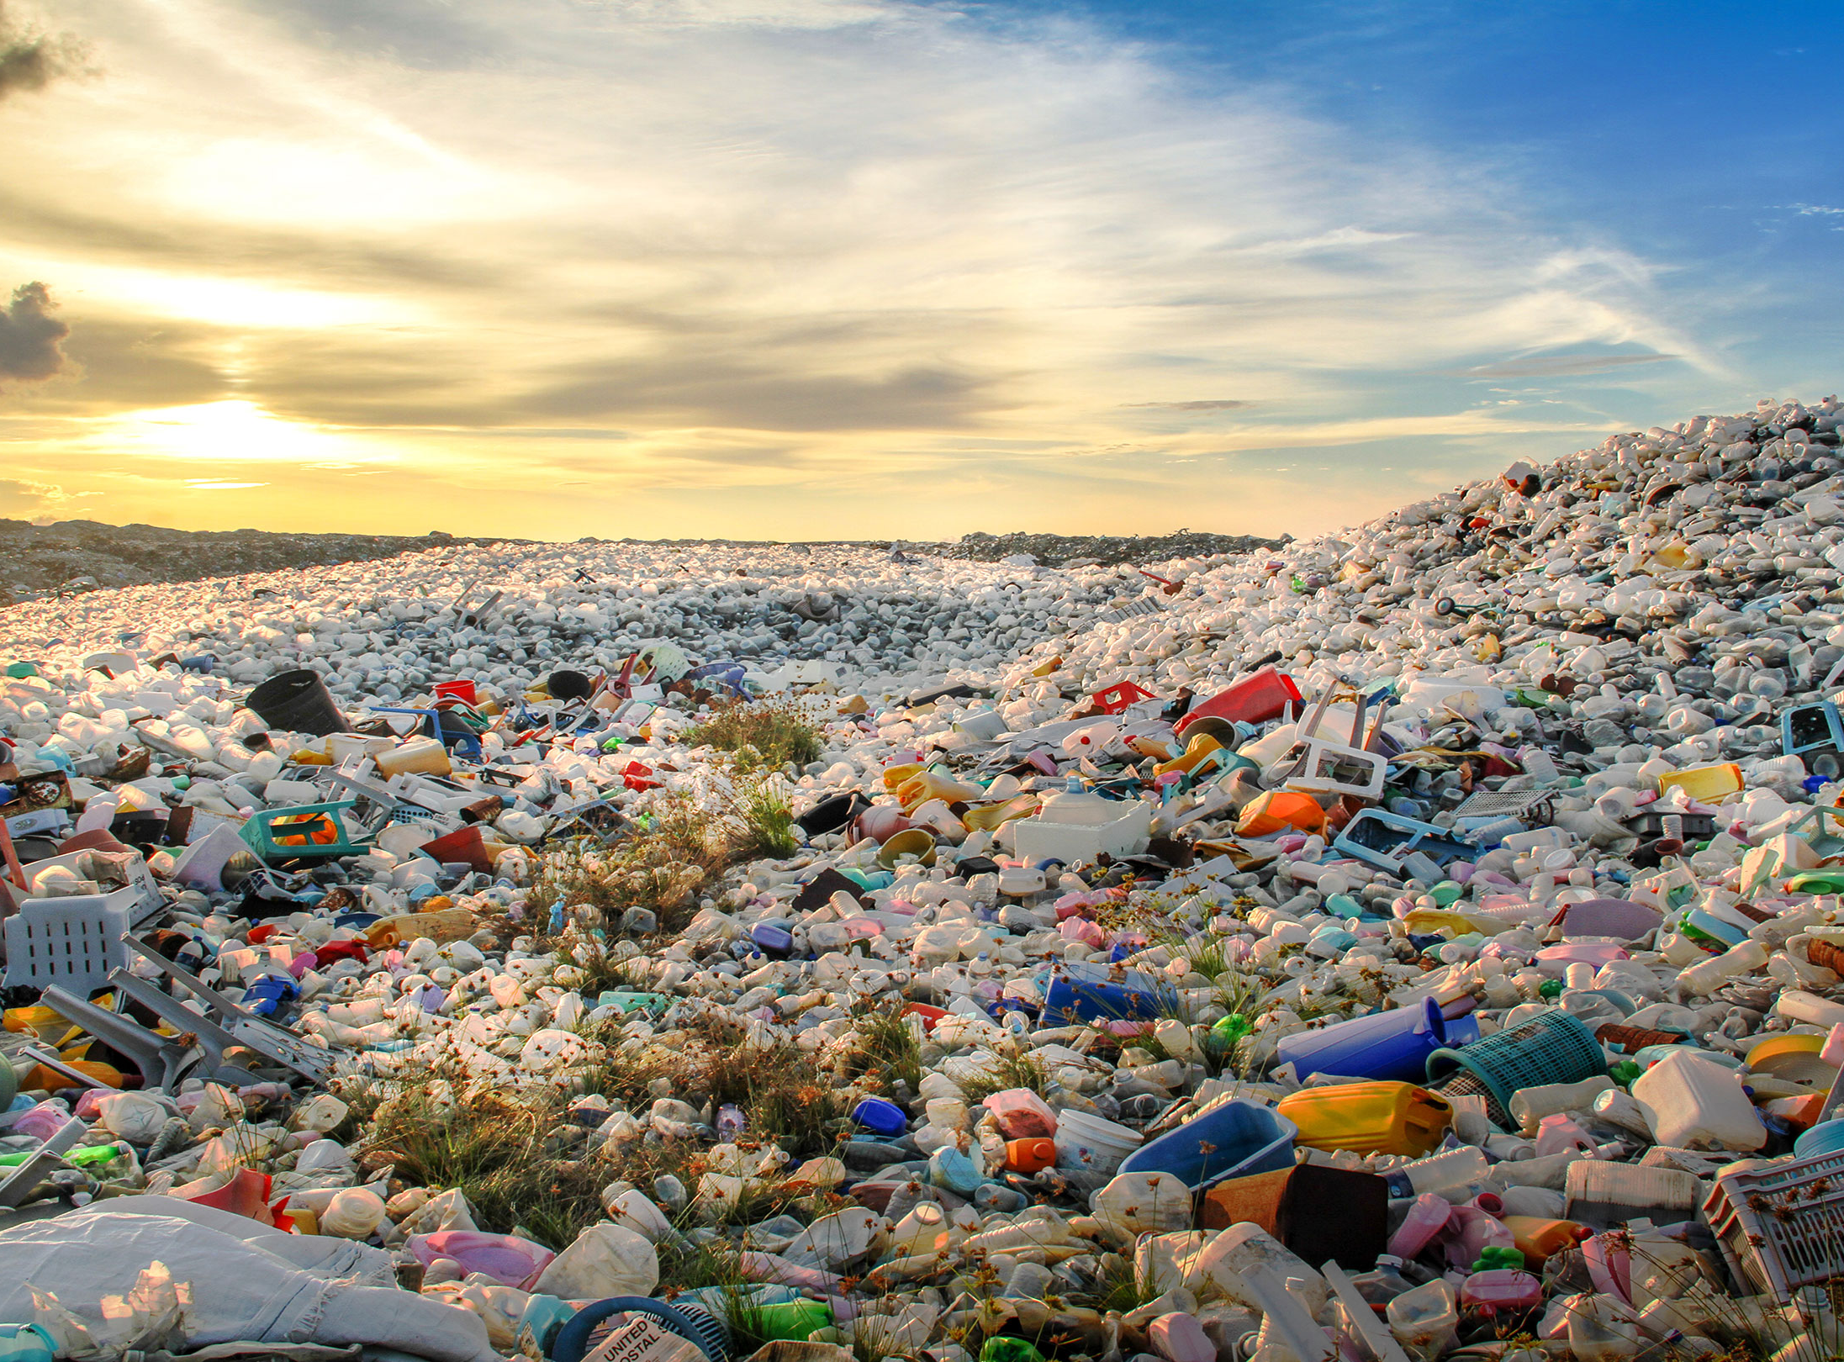
PROBLEM!!
In this fast-growing world, we have seen substantial growth in the amount of waste generated daily. From recent data, two billion Tonnes of municipal waste is generated every year in this world.
Recycling this waste is the only way to tackle this and make our planet cleaner and healthier, but recycling is possible only when the garbage segregation is proper. So, people need to understand the importance of garbage segregation.
For this purpose, we design a garbage disposal system where multiple dustbins are associated with a voice-based system that alerts the user every time he/she comes in front of the dustbin.

Slide 3
SOLUTION
We are designing a system that uses a raspberry-pi controller interfaced with a camera to detect human presence in front of the dustbin.
The controller is associated with a speaker to guide the user in disposing of the garbage in the right bin if it is not full and asking the user to find the nearest bin if it is.
These lids have an electromagnet which seals the bins until an associated personal arrives to empty it.
The bin levels are recorded by ultrasonic level sensors associated with LED indicators.
The pi-controller is also interfaced with a wi-fi module to regularly feed the bin levels to the thingspeak API to display it on the internet. This indication will be useful in alerting the respective authorities for emptying the bin.
This project is our small contribution in countering the garbage crisis and making this planet cleaner and healthier.

Slide 4
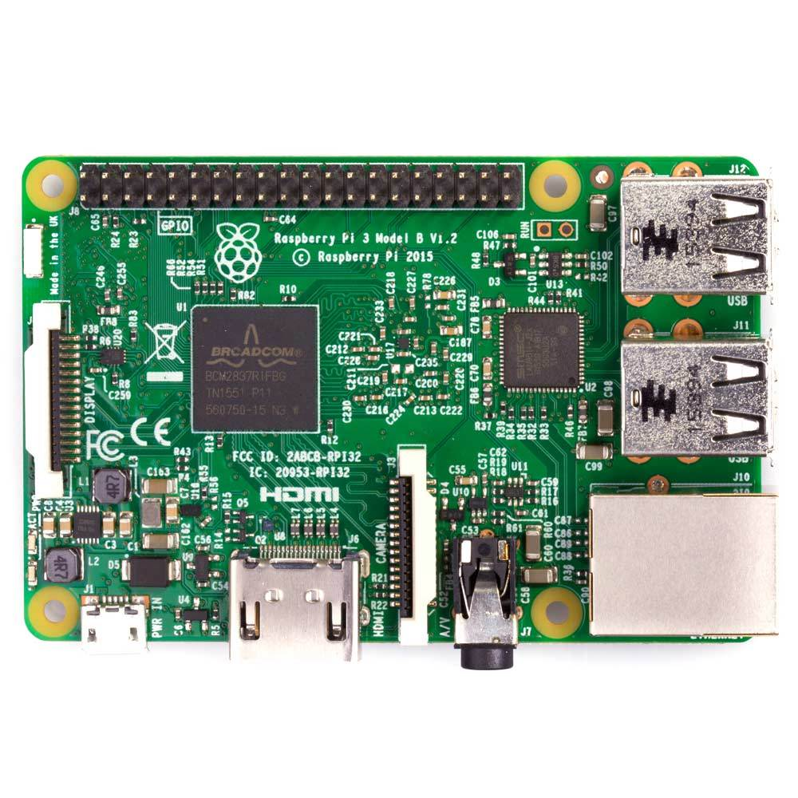
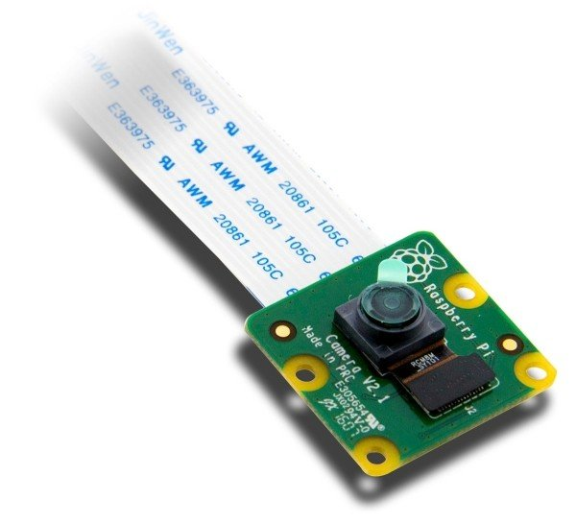

Components used:
Wifi module
Ultrasonic Level Sensors
LED Indicators
Camera
Speaker
Buttons & Switches
Magnetic sensor
Raspberry Pi
IC’s
Transistors
PCB

