Slide 1

AtliQ
Promotion analysis

Slide 2
Problem statement
AtliQ Mart is a retail giant with over 50 supermarkets in the southern region of India. All their 50 stores ran a massive promotion during the Diwali 2023 and Sankranti 2024 (festive time in India) on their AtliQ branded products. Now the sales director wants to understand which promotions did well and which did not so that they can make informed decisions for their next promotional period.

Slide 3
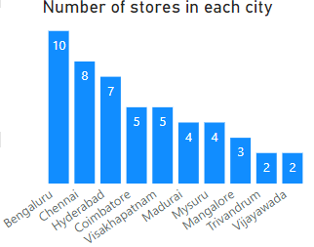
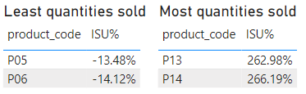


Stores performance
Total number of stores in each cities
Units of products sold most and least
Note:

Slide 4
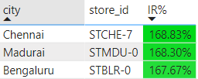
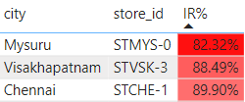
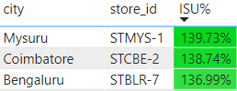
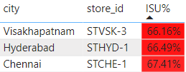
Top 3 stores whose revenue increased with the promotion schemes
Top stores in each city
Hyderabad – STHYD0
Madurai – STMDU0
Bengaluru – STBLR0
Visakhapatnam – STVSK0
Vijayawada – STVJD0
Mangalore – STMLR1
Trivandram – STTVR1
Coimbatore – STCBE2
Mysuru – STMYS3
Chennai – STCHE7
Bottom 3 stores whose revenue increased with the promotion schemes
Top 3 stores whose unit sales increased with the promotion schemes
Bottom 3 stores whose unit sales increased with the promotion schemes

Slide 5
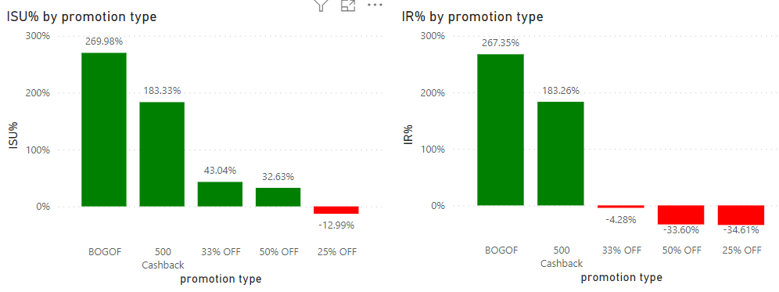
Promotions
But one get one free was most prominent promotion strategy (both in Sankranti and Diwali)
Cashback is also prominent strategy (but only one product, i.e, P15 was under this strategy)
OFFs of 25%, 33% and 50% was not doing good as these promotions reduced the incremental revenue

Slide 6


Diwali | BOGOF | 500 cashback | 25% OFF | 33% OFF | 50% OFF
Combo 1
Grocery and staple
Home appliance
Home care
Personal care
Sankranti | BOGOF | 500 cashback | 25% OFF | 33% OFF | 50% OFF
Combo 1
Grocery and staple
Home appliance
Home care
Personal care
These are the two best promotions in terms of incremental revenue:
BOGOF
500 cashback
Overall | BOGOF | 500 cashback | 25% OFF | 33% OFF | 50% OFF
Combo 1
Grocery and staple
Home appliance
Home care
Personal care

Slide 7
Overall | BOGOF | 500 Cashback | 25% OFF | 33% OFF | 50% OFF
p01
p02
p03
p04
p05
p06
p07
p08
p09
p10
p11
p12
p13
p14
p15
These are the two best promotions in terms of incremental revenue:
BOGOF
500 cashback

Slide 8
Overall | BOGOF | 500 cashback | 25% OFF | 33% OFF | 50% OFF
Below 100
101-200
201-500
Above 500
These are the two best promotions in terms of incremental revenue:
BOGOF
500 cashback

Slide 9
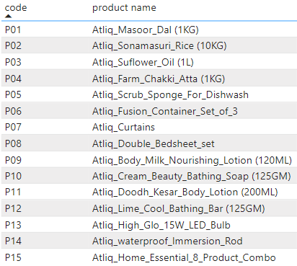
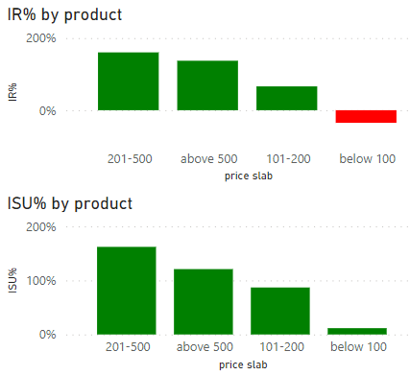
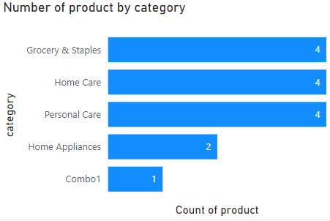
Product and category performance
Total number of products in each category
Combo 1 | Grocery & staple | Home appliance | Home care | Personal care
p15 | p01 | p13 | p05 | p09
 | p02 | p14 | p06 | p10
 | p03 |  | p07 | p11
 | p04 |  | p08 | p12

Slide 10
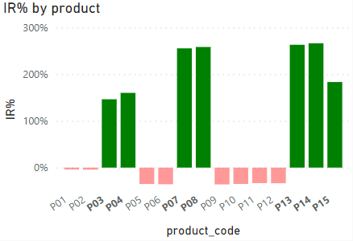
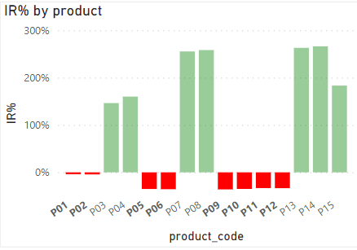
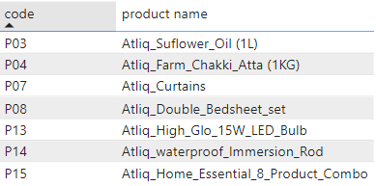
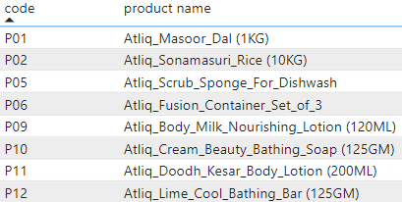
Products whose revenue increased
Products whose revenue decreased

Slide 11
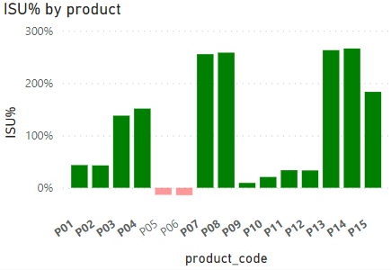
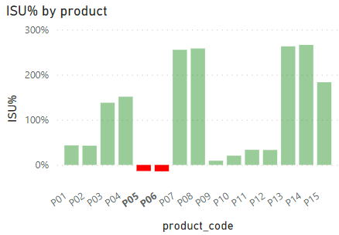
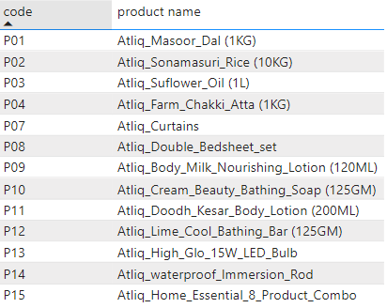

Products whose unit sales increased
Products whose unit sales decreased

Slide 12


