Slide 1
Autoresearch for battery dispatch
A search loop rewrites a grid battery's dispatch rule on real GB prices. A gate promotes the new rule only when it wins on months the search never saw.
Moonfire Ventures Hack · Cambridge Compute Co. · AIDDA · Build Night, 22 October 2026
Notes:
Title. 5 seconds. Say the one line and move on.

Slide 2
A battery's revenue is its dispatch rule
Today the rule is improved by hand
8.5 GW
of grid batteries in GB today. NESO needs 23 to 27 GW by 2030.
1
A quant has a hypothesis
Modo Q3 2026, NESO
2
Edits the rule or its parameters
£99k
per MW per year, September 2026. Wholesale arbitrage a record £68k of it.
Runs an in-house backtest
3
Modo, Sep 2026
4
Keeps it or reverts, by judgement
+42%
earned by the best asset over the index. "Trading smarter, not cycling harder."
Habitat, Entrix, YUSO and Axpo all advertise for this loop. Nobody describes an automated one that is gated out of sample.
One percentage point of capture is worth about £5.5m a year across the GB fleet (our estimate from Modo figures).
Modo, Sep 2026
Notes:
THE PROBLEM, 25 s. Britain has 8.5 gigawatts of grid batteries and needs three times that by 2030. They make money one way: buy power when it's cheap, sell it when it's dear. Every half hour a rule decides charge, discharge or wait. Last month the average battery earned £99,000 per megawatt. The best one earned 42% more, and Modo says the difference isn't cycling harder, it's trading smarter. One point of capture is about five and a half million pounds a year across the fleet. Today that rule is improved by humans: a quant has an idea, edits the rule, runs a backtest, keeps it or not. Every job ad in this industry describes that loop. Nobody has automated it.

Slide 3



"We trade smarter": nobody can prove it
Gridmatic
What a credible number needs
Reported 51% of "theoretical potential" in 2022 while its backtest reached about 75%. Baselines undisclosed. Criticised as a black box.
A fixed evaluator anyone can run
The oracle denominator printed next to every score
A walk-forward split with its dates shown
A test window read exactly once
Baselines in the same table
A confidence interval on every £
Modo on the industry
Optimisers compare themselves to "a theoretical perfect battery, or run a back-test and pick the best result". Modo haircuts perfect foresight by 15 to 25% to match reality.
Percentage of Perfect
The industry metric: revenue over the perfect-foresight maximum. Developers assume 80 to 90%. Observed optimisers land at 60 to 80%, with wide spread.
Notes:
WHY NOBODY CAN BE COMPARED, 20 s. The industry metric is Percentage of Perfect: your revenue over what perfect foresight would earn. Optimisers quote 60 to 80. But Modo says each one picks its own benchmark or its best backtest. Gridmatic reported 51% realised against a 75% backtest, with baselines undisclosed, and got called a black box for it. So the pitch 'we trade smarter' is unfalsifiable. We built the thing that would make it falsifiable: a fixed evaluator with a walk-forward split, a held-out test window, and the oracle denominator in plain sight.

Slide 4

One command scores any rule out of sample
TRAIN
VAL
TEST
2 Oct 2025 to 31 May 2026
1 Jun to 31 Jul 2026
1 Aug to 14 Oct 2026
242 days · the loop's only score
61 days · promotion gate only
75 days · reported once
Half-hourly GB market index price (APX) from Elexon's open BMRS API: 18,192 settlement periods, no key, no forecast feed.
The score
Guards, each tested with a cheating policy
Net £/MW/day with a 95% bootstrap CI over days; revenue minus degradation.
No lookahead: the rule gets prices[:t]. The current price is a settlement price, known after the fact
No peeking: the loop runs train only; gate.py reads val, and test exactly once
No literal dates (regex), no imports but math (AST check)
Crash, NaN or 30 s timeout scores 0 and returns the error
Power and state of charge clipped by the simulator; cycles counted
Percentage of Perfect against an exact perfect-foresight optimum, a 5-state dynamic programme over the window.
Costs live in the simulator 90% round trip, £10/MWh throughput, 1 MW / 2 MWh; the simulator clips and does the accounting.
Under a second per evaluation deterministic, zero dependencies beyond Python.
Notes:
THE EVALUATOR, 35 s. One Python file is the dispatch rule. A sealed simulator replays it against a year of real half-hourly prices from Elexon, with efficiency losses, degradation and power limits inside the simulator so the rule can't misreport. The score is net pounds per megawatt per day with a confidence interval, and Percentage of Perfect against an exact dynamic-programme optimum. The split is by time: the loop only ever scores on train, October to May. Validation, June and July, decides promotion. Test, August to mid-October, is read once. And the rule only ever sees the past: no lookahead, no literal dates, no imports except math, every one enforced by code and tested with a deliberately cheating policy.

Slide 5






Propose, score, keep. Then prove it
›
›
›
›
›
fetch_prices.py
split by time
loop edits policy.py
evaluate.py
gate.py
champion + PR
Elexon API to prices.csv
train / val / test
the only file it may touch
JSON score on train
beats champion on val?
test scored once
249
perfect foresight on train: £64.9/MW/day (chart top)
experiments in one evening, each a one-line hypothesis
39
kept. Every kept change is a commit with its score
£15.4 → £32.4
£/MW/day on train, seed to current champion
This run: a Claude Code agent following program.md. OpenEvolve or LoongFlow drop in via one driver calling the same command.
Notes:
THE LOOP AND THE GATE, 25 s. The agent proposes one change to the rule, scores it on train in a fifth of a second, keeps it if it wins, reverts if not, and commits. It ran 249 experiments this evening [placeholder: confirm final count] and kept 39. The seed earned £15 per megawatt per day on train; the loop took it to £32.4. Then the part that matters: gate.py promotes only if the challenger beats the current champion on validation, two months the loop never saw, and then scores it once on test and publishes that number whether we like it or not.

Slide 6
Results on real GB prices, window by window
Policy | Train Oct 25 to May 26 | Val Jun to Jul 26 | Test Aug to Oct 26 | Test % of perfect | Test cycles/day
Do nothing | 0.0 | 0.0 | 0.0 | 0 | 0.00
Fixed schedule (charge 02 to 04, sell 17 to 19) | 11.1 | 9.1 | 34.1 | 22.3 | 0.95
Seed rolling-percentile rule | 15.4 | 46.9 | 55.1 | 36.1 | 0.67
Champion (loop output) | 32.4 | 61.6 | 70.6 | 46.3 | 0.45
Perfect foresight (oracle) | 64.9 | 115.2 | 152.5 | 100
£/MW/day, net of degradation, for a 1 MW / 2 MWh battery. Windows: train 2025-10-02 to 2026-05-31 (242 d), val 2026-06-01 to 2026-07-31 (61 d), test 2026-08-01 to 2026-10-14 (75 d). Prices: Elexon BMRS APX market index. Test and val numbers for baselines come from evaluate.py; champion val and test come from gate.py.
Seed vs champion, train
Seed vs champion, test
Why £/day leads
£15.4 → £32.4
£55.1 → £70.6
Volatility, not skill
23.7% → 49.9% of perfect
36.1% → 46.3% of perfect, +28%
daily price spread 1.4× and 1.7× train's, ceiling 1.8× and 2.3×; % of perfect tracks that
Notes:
THE RESULT, 30 s. [Show the table.] Do nothing earns zero. A fixed overnight-charge, evening-sell schedule earns £11 a day on train. The seed percentile rule earned £15. The loop took it to £32.4, half of perfect foresight. On the held-out test window the seed earned £55; the champion earned [placeholder: champion test £/MW/day from gate.py] at [placeholder: test % of perfect]. The industry calls that Percentage of Perfect. Optimisers quote 60 to 80, but every vendor picks its own benchmark. Ours is a five-line dynamic programme anyone can run, and the oracle sits in the same table. Note the later windows were two to three times more volatile than train, which is why we lead with pounds per day and show both.

Slide 7
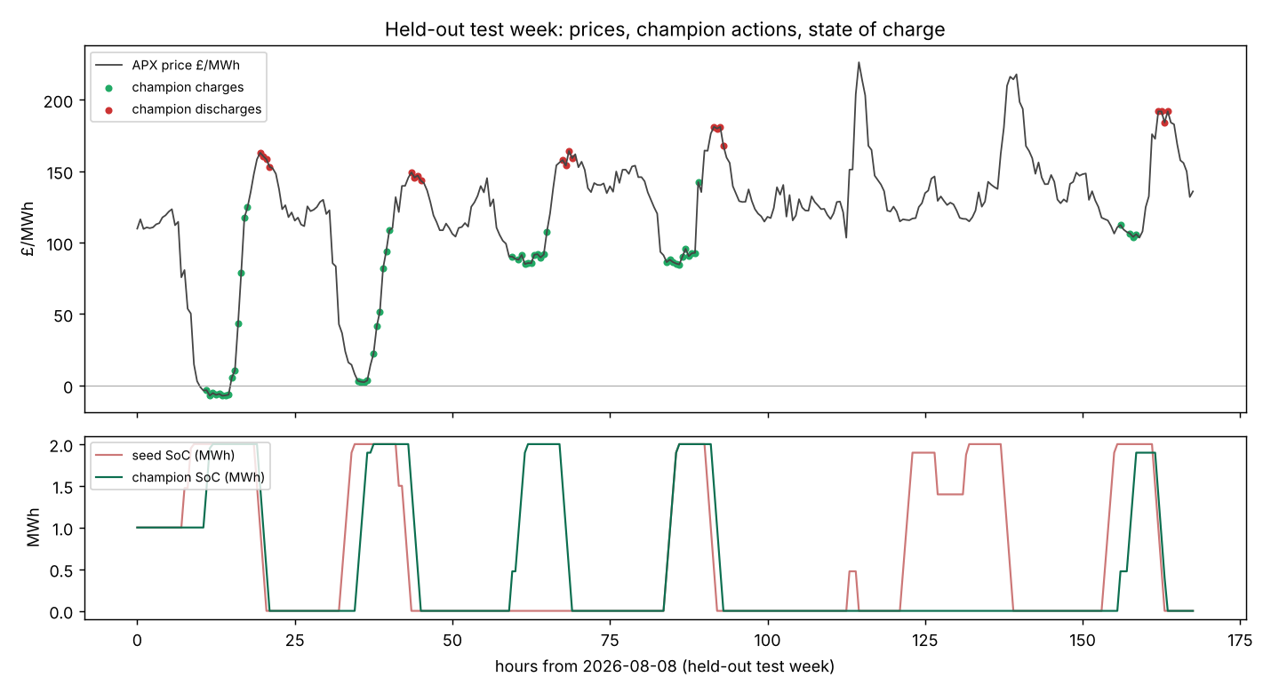
A test week the rule never trained on
charges (buys)
discharges (sells)
Test window only. The rule had the first test week as history and nothing else.
It was never told an overnight trough or an evening peak exists.
Notes:
THE WEEK, 15 s. [Show the plot.] This is a week it never trained on. Green is where it charged, red where it sold. It bought the overnight trough and sold the evening peak without being told either exists. [placeholder: confirm the shape of the plot once results/test_week.png exists and adjust the sentence.]

Slide 8


Runs as a weekly job and opens a pull request
1. Fetch
2. Search
3. Gate
4. Open a PR
the latest prices from Elexon
re-run the loop on a rolling window
on the newest month, never seen by the loop
with the new policy.py and its report
The operator stays in the loop
Swap one file to move it
A quant reviews a diff of about forty lines of plain Python with no dependencies, which is how dispatch rules are written anyway. The challenger shadow-runs beside live dispatch before the switch. Owners already run several optimisers and audit them; this fits that habit.
Different asset: battery.py spec
Different market (ERCOT, NEM, Germany): fetch_prices.py
Different search framework: one driver calling evaluate.py
Cost: under a second per evaluation; the LLM is the only expense, bounded by iteration count
Notes:
DEPLOYMENT, 20 s. This runs as a weekly job. Refetch prices, re-run the search on a rolling window, gate on the newest month, open a pull request with the new rule and its report. The quant reviews a diff of forty lines of plain Python, shadow-runs it, switches. Different battery: change one spec file. Different market, ERCOT or Germany: change the fetcher. Different search framework, OpenEvolve, LoongFlow: call the same evaluate command. We built the contract, not the framework, because the contract is what makes it safe to deploy.

Slide 9





Where it can still mislead
Regime shift
Single market, no forecast
Zero market impact
Train is Oct to May; test is Aug to Oct. Gas, wind and interconnector conditions differ. A train gain that fails on test is reported, not hidden.
Trades the realised market index only. Real desks stack day-ahead, frequency response and the Balancing Mechanism and use forecasts. Absolute £ is a floor.
Assumed at 1 MW. Perfect foresight also assumes the spikes it exploits would survive everyone chasing them.
One year of data
Flat degradation
Search overfits backtests
One price regime. Practitioners re-tune at least quarterly, which is why deployment re-runs the search on a schedule.
£10/MWh of throughput. Ageing costs change the answer a lot (DFKI); a richer model slots into battery.py without touching the loop.
The documented failure of LLM-evolved trading strategies (MadEvolve). Our answer: the val gate and a once-only test read. If the val gain does not hold on test, we say so.
Notes:
FAILURE MODES, 15 s. Six ways this can mislead, all in the README. Regime shift: train is winter, test is late summer. Single market with no forecast feed, so the absolute number is a floor, not what a real desk would earn. Zero market impact at one megawatt. One year of data. A flat degradation cost. And the big one: search overfits backtests. That is the documented failure of LLM-evolved trading strategies, and it is why the loop never touches validation or test. If the validation gain does not hold on test, the table says so.

Slide 10


What we'd do next
OpenEvolve driver
Paired acceptance test
Operator review page
A population search behind the same evaluate.py contract, and a forced structurally different proposal every few iterations, so the loop leaves its plateau.
A change must beat the champion day by day, not just on the mean. The daily series and CI are already in the evaluator's output.
A per-run report committed with each PR: three windows side by side with dates, every CI, the rule as a diff against the seed, the held-out week, and the failure modes as a first-class section.
Every optimiser in this market sells "we trade smarter". None can show a reproducible number. We can, and the loop that produced it is in the repo.
uv sync · uv run python baselines.py · uv run python gate.py policy.py
Notes:
NEXT AND CLOSE, 15 s. Three things next. An OpenEvolve driver behind the same contract, with a forced structurally different proposal every few iterations, because the agent plateaued inside one family of rules. A paired daily acceptance test, so a change has to beat noise, not the mean. And the operator review page: the PR ships a report with the three windows, every confidence interval, the rule as a diff, and the failure modes up front. Close: every optimiser in this market sells 'we trade smarter'. None of them can show you a reproducible number. We can, and the loop that produced it is in the repo.

