Slide 1
Spatiotemporal Analysis of PM2.5 and Meteorological Parameters (2021–2024)
Ground Data Cleaning, Station Selection, and Gap Filling (Week 1 & 2 Update)
- Archie Mittal (2024CS10560) - Yashwardhan Singh Choudhary (2024CS10300)

Slide 2
Project Overview & Data Source
Objective: To analyze PM2.5 trends and their relationship with wind parameters across multiple stations.
Data Source: Central Pollution Control Board (CPCB) Hourly Data available of 39 stations.
Temporal Coverage: January 2021 to December 2024.
Parameters Studied: PM_2.5 (Particulate Matter)
Wind Speed (WS)
Wind Direction (WD)

Slide 3
Task 1 – Robust Data Organization
Goal: Standardize file structures and assess raw availability.
Actions:
Developed a "Robust Mapping" script to identify target columns using keyword matching (Regex).
Organized raw files into a structured hierarchy based on site_id and year.
Key Deliverable: station_availability_summary_robust.csv.
This file tracked the percentage of non-null data for every station-year combination.

Slide 4
Task 2 – Station Selection Criteria
Goal: Filter for high-quality, continuous data.
The 70% Rule: A station was only selected if PM_2.5, Wind Speed, and Wind Direction all had > 70% availability for every single year from 2021 to 2024.
Results:
Original: 39 stations.
Selected: 26 stations met the rigorous quality threshold.
Deliverable: final_selected_stations.csv.

Slide 5
Task 3 – Column Standardization
Process: To ensure seamless analysis across 26 folders, all CSVs were reformatted.
Mapping: timestamp ->Standard Datetime format.
PM 2.5 ->Standardized unit/name.
wind_speed & wind_dir ->Unified labels.
Result: A clean, analysis-ready directory: final_station_data_clean/ which contains all the 26 stations and each of them contains separate datasets for the respective years i.e. 2021 to 2024.

Slide 6
Task 4 – Temporal Gap Filling
Problem: Even high-quality stations have "micro-gaps" (1–3 missing hours) which disrupt time-series modeling.
Strategy: Linear Interpolation.
Threshold: Only gaps <= 3 hours were filled.
Why? To maintain scientific integrity. Large gaps (e.g., 24 hours) cannot be accurately estimated by simple means.
Outcome: Improved data continuity for diurnal cycle analysis.
Deliverable: final_availability_after_fill.csv

Slide 7
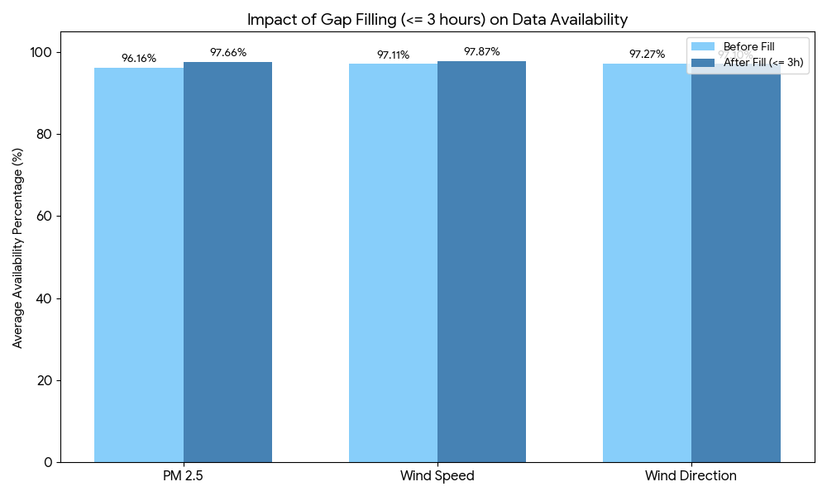
Comparison Analysis (Before vs. After)
Impact: Average PM_2.5 availability: Increased by approximately 1.49%.
Wind Speed Availability: Increased by approximately 0.76%.
Visual Proof:

Slide 8
Conclusion & Next Steps
Summary: We have established a high-quality dataset of 26 stations with standardized metrics and filled temporal gaps.
Future Work: Seasonal Trends & Station Correlations
Seasonal Profiles: Identify PM_2.5 peaks across Winter, Monsoon, and Post-Monsoon periods (2021–2024).
Spatial Heatmaps: Create a correlation matrix to identify which stations share similar pollution patterns.

Slide 9
Week 3: Seasonal and Monthly Analysis of PM₂.₅ (2021–2024)
Objective: Analyze seasonal and monthly variability of PM₂.₅ across selected CPCB stations.
Dataset: 26 stations with hourly PM₂.₅ data (2021–2024).
Focus: Seasonal trends, monthly evolution, and meteorological interpretation.
Diurnal Variations & Behavioral Analysis
Objective: To characterize the "Heartbeat" of Delhi’s air pollution by analyzing hourly PM_2.5 fluctuations across 26 stations over a 4-year period (2021–2024).
Core Question: How do human activity (emissions) and atmospheric physics (meteorology) interact to create daily pollution cycles?
Deliverables:
Processed Dataset: diurnal_pm2.5_seasonwise.csv (Aggregated network-wide hourly averages).
Primary Visualization: diurnal_trends_comparison.png (Comparative seasonal 24-hour profiles).

Slide 10
Seasonal Classification Methodology
We added a season column by mapping calendar months to standard Indian climatological seasons.
Seasonal bins used:
Winter: December–February
Pre-monsoon: March–May
Monsoon: June–September
Post-monsoon: October–November
The cleaned datasets were overwritten to ensure consistent seasonal labeling for all downstream analyses

Slide 11
PM₂.₅ Aggregation Strategy
Seasonal PM₂.₅ statistics were computed independently at each station for each year.
Station-level seasonal means were first averaged across years (2021–2024).
Network-level seasonal PM₂.₅ was then obtained by equally weighting all stations.
This approach prevents dominance by any single station or year.

Slide 12
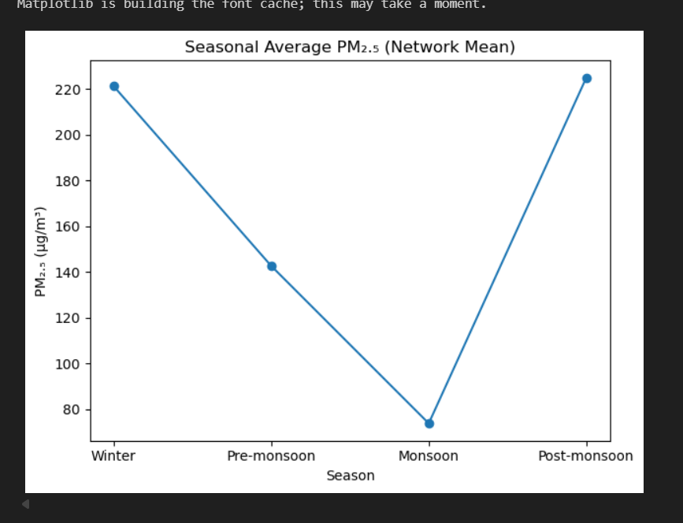
Seasonal Average PM₂.₅ (Network Mean)
Winter and post-monsoon seasons exhibit the highest PM₂.₅ concentrations.
Monsoon shows the lowest PM₂.₅ levels due to wet scavenging and enhanced ventilation.
Pre-monsoon displays transitional PM₂.₅ behavior.
High winter PM₂.₅ is driven by shallow boundary layer heights and frequent temperature inversions.
Post-monsoon enhancement is linked to crop residue burning and reduced atmospheric dispersion.
Monsoon PM₂.₅ reduction is caused by rainfall-driven washout and stronger winds.
Pre-monsoon reflects mixed influence of dust resuspension and improved mixing.

Slide 13
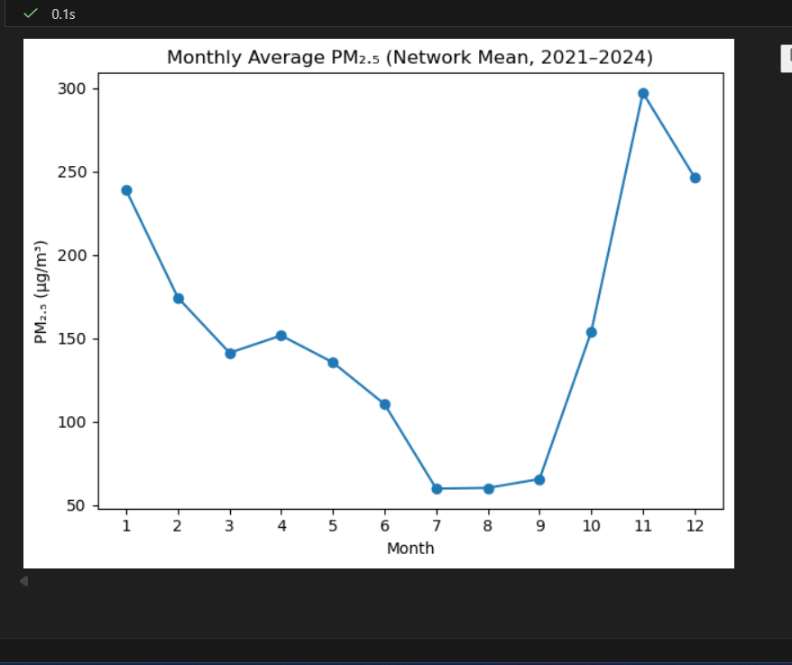
Monthly Average PM₂.₅ (Network Mean, 2021–2024)
Monthly PM₂.₅ peaks during November–January due to post-monsoon biomass burning and wintertime atmospheric stagnation.
Lowest PM₂.₅ levels occur during July–August because of intense rainfall and wet scavenging.
A sharp rise in October marks the transition from monsoon to post-monsoon pollution buildup.
Consistency across years highlights the dominant role of seasonal meteorology.

Slide 14
Month-wise PM₂.₅ Behavior
Jan: Very high PM₂.₅ — peak winter pollution
Feb–Mar: Declining PM₂.₅ — improved ventilation
Apr–May: Moderate PM₂.₅ — dust and enhanced mixing
Jun: Drop in PM₂.₅ — onset of pre-monsoon rainfall
Jul–Aug: Lowest PM₂.₅ — monsoon washout
Sep: Slight increase — monsoon withdrawal
Oct: Sharp rise — post-monsoon onset
Nov: Maximum PM₂.₅ — stubble burning and stagnation
Dec: Very high PM₂.₅ — winter buildup

Slide 15
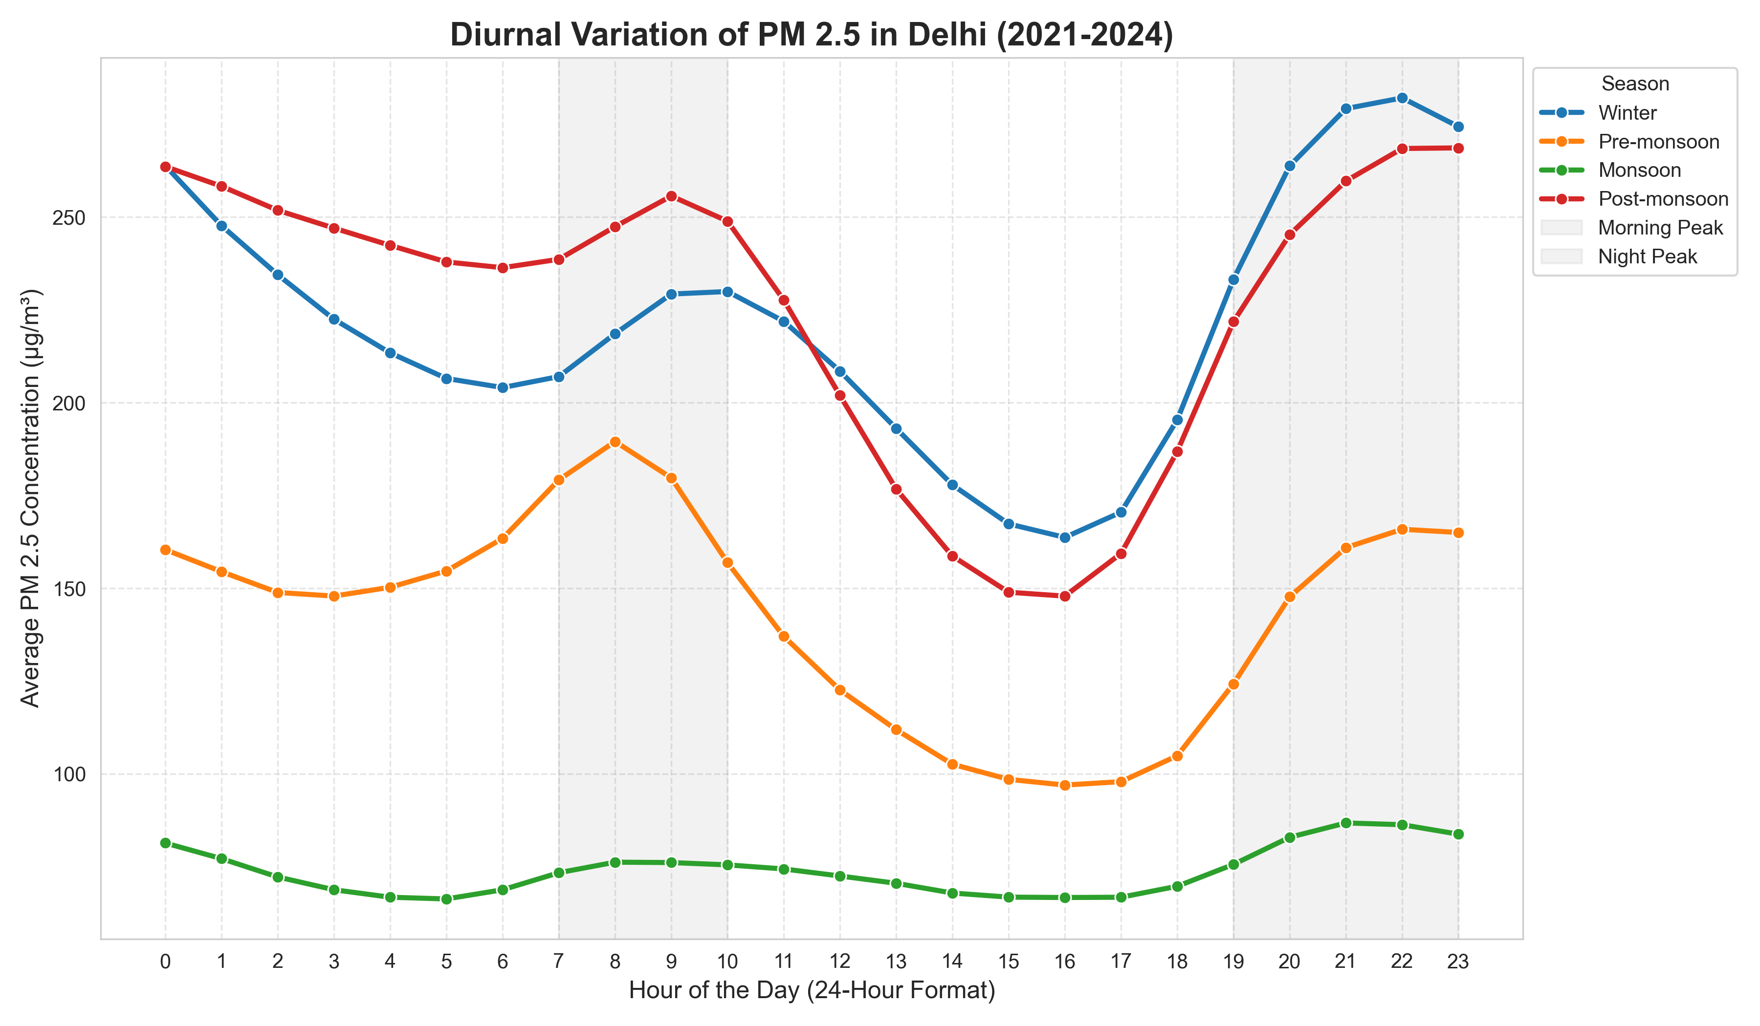
Diurnal Heartbeat of Delhi’s PM₂.₅ Understanding the Daily Cycle: Rush Hours vs. Atmospheric Physics
The Double-Peak Pattern: Across all seasons, the data reveals two distinct peaks:
Morning Peak (08:00 – 10:00): Driven by the resumption of traffic (rush hour) and domestic emissions, coinciding with a still-shallow morning mixing layer.
Evening/Night Peak (20:00 – 22:00): Often higher than the morning peak. This is caused by the "collapse" of the atmospheric boundary layer after sunset, trapping emissions near the ground.
The Afternoon Dip (14:00 – 16:00): PM_2.5 levels are consistently at their lowest during the mid-afternoon.
Why? Solar heating triggers Vertical Mixing. As the ground warms, air rises, increasing the "Mixing Height" and diluting pollutants.

Slide 16
Seasonal Variability & Boundary Layer Severity
Seasonal Contrast: Why Winter and Post-Monsoon Skyrocket
Magnitude Divergence:
Winter & Post-Monsoon: Both hit massive peaks exceeding 260–280 µg/m³.
Monsoon: Shows the most stable profile (66–86 µg/m³). Rain scavenging (washout) and higher humidity prevent major accumulation.
The "Lid" Effect (Thermal Inversion):
In Winter, the nighttime cooling of the ground is so intense that it creates a "Temperature Inversion." This acts as a physical lid, trapping all pollutants within 100-200 meters of the surface, causing the extreme spikes seen in your data.
Post-Monsoon Dynamics:
Captures the unique "tail" of pollution from midnight to 4 AM (~268 µg/m³), reflecting the arrival of transported biomass smoke under stagnant night conditions.

Slide 17
Summary of Findings
Physical Interpretations & Statistical Summary
Conclusion:
PM_2.5 concentration is a function of Emissions ÷ Volume. In the afternoon, the "Volume" (PBL height) is large, leading to lower concentrations. At night, the "Volume" is tiny, leading to toxic air.
Impact: This confirms that policy interventions must account for meteorology; the same emission levels produce much higher health risks at 9 PM than at 3 PM.
Season | Diurnal Range (Peak-Trough) | Atmospheric State
Winter | 118.4 µg/m³ | Highly Stable / Frequent Inversions
Post-Monsoon | 120.8 µg/m³ | Stagnant / Accumulation Phase
Pre-Monsoon | 92.6 µg/m³ | Turbulent / Dust-Heavy
Monsoon | 20.5 µg/m³ | Unstable / High Ventilation

Slide 18
Week 3 Conclusion & Week 4 Outlook
Seasonal Baseline: Analysis confirms Winter and Post-Monsoon pollution levels are 300% higher than Monsoon.
The ABL Driver: Diurnal trends prove PM_2.5 is controlled by the Atmospheric Boundary Layer (ABL). High nighttime levels are caused by the "Lid Effect" (Thermal Inversion) trapping pollutants.
Core Insight: Pollution peaks when emissions meet stagnant atmospheric conditions, regardless of station location.
Next Steps: Week 4 (Meteorological Conditioning)
Wind-Rose Analysis: Transitioning from When it happens to Where it comes from.
Source Tracking: Mapping PM_2.5 against wind speed and direction.
Cluster Analysis: Identifying if specific wind corridors (e.g., North-Westerly) are the primary drivers of the seasonal spikes found in Week 3.

Slide 19
Week 4 – Meteorological Conditioning & Transport Diagnostics
• Objective: Diagnose whether extreme PM₂.₅ events are driven by:
Ventilation suppression (low wind speeds)
Directional transport corridors
Or a combination of both
Methodology:
Regional segmentation (4 zones)
Percentile-based extreme filtering (Top 15%)
Wind speed comparison (Background vs Extreme)
Directional enrichment analysis (next step)

Slide 20
Regional Classification of Stations
North → Haryana/NW transport belt(Rohini, Jahangirpuri, Ashok Vihar, Wazirpur, Narela, Bawana)
East → UP/Trans-Yamuna corridor(IHBAS (Dilshad Garden), Anand Vihar, Patparganj, Vivek Vihar, Sonia Vihar, Pusa)
South/Central → Urban accumulation core(Mandir Marg, Jawaharlal Nehru Stadium, Major Dhyan Chand National Stadium, RK Puram, Okhla Phase II, Nehru Nagar, Sri Aurobindo Marg, Dr. Karni Singh Shooting Range)
West/SW → Rajasthan boundary & industrial influence(hadipur, NSIT Dwarka, Punjabi Bagh, Dwarka Sector 8, Najafgarh, Mundka)

Slide 21
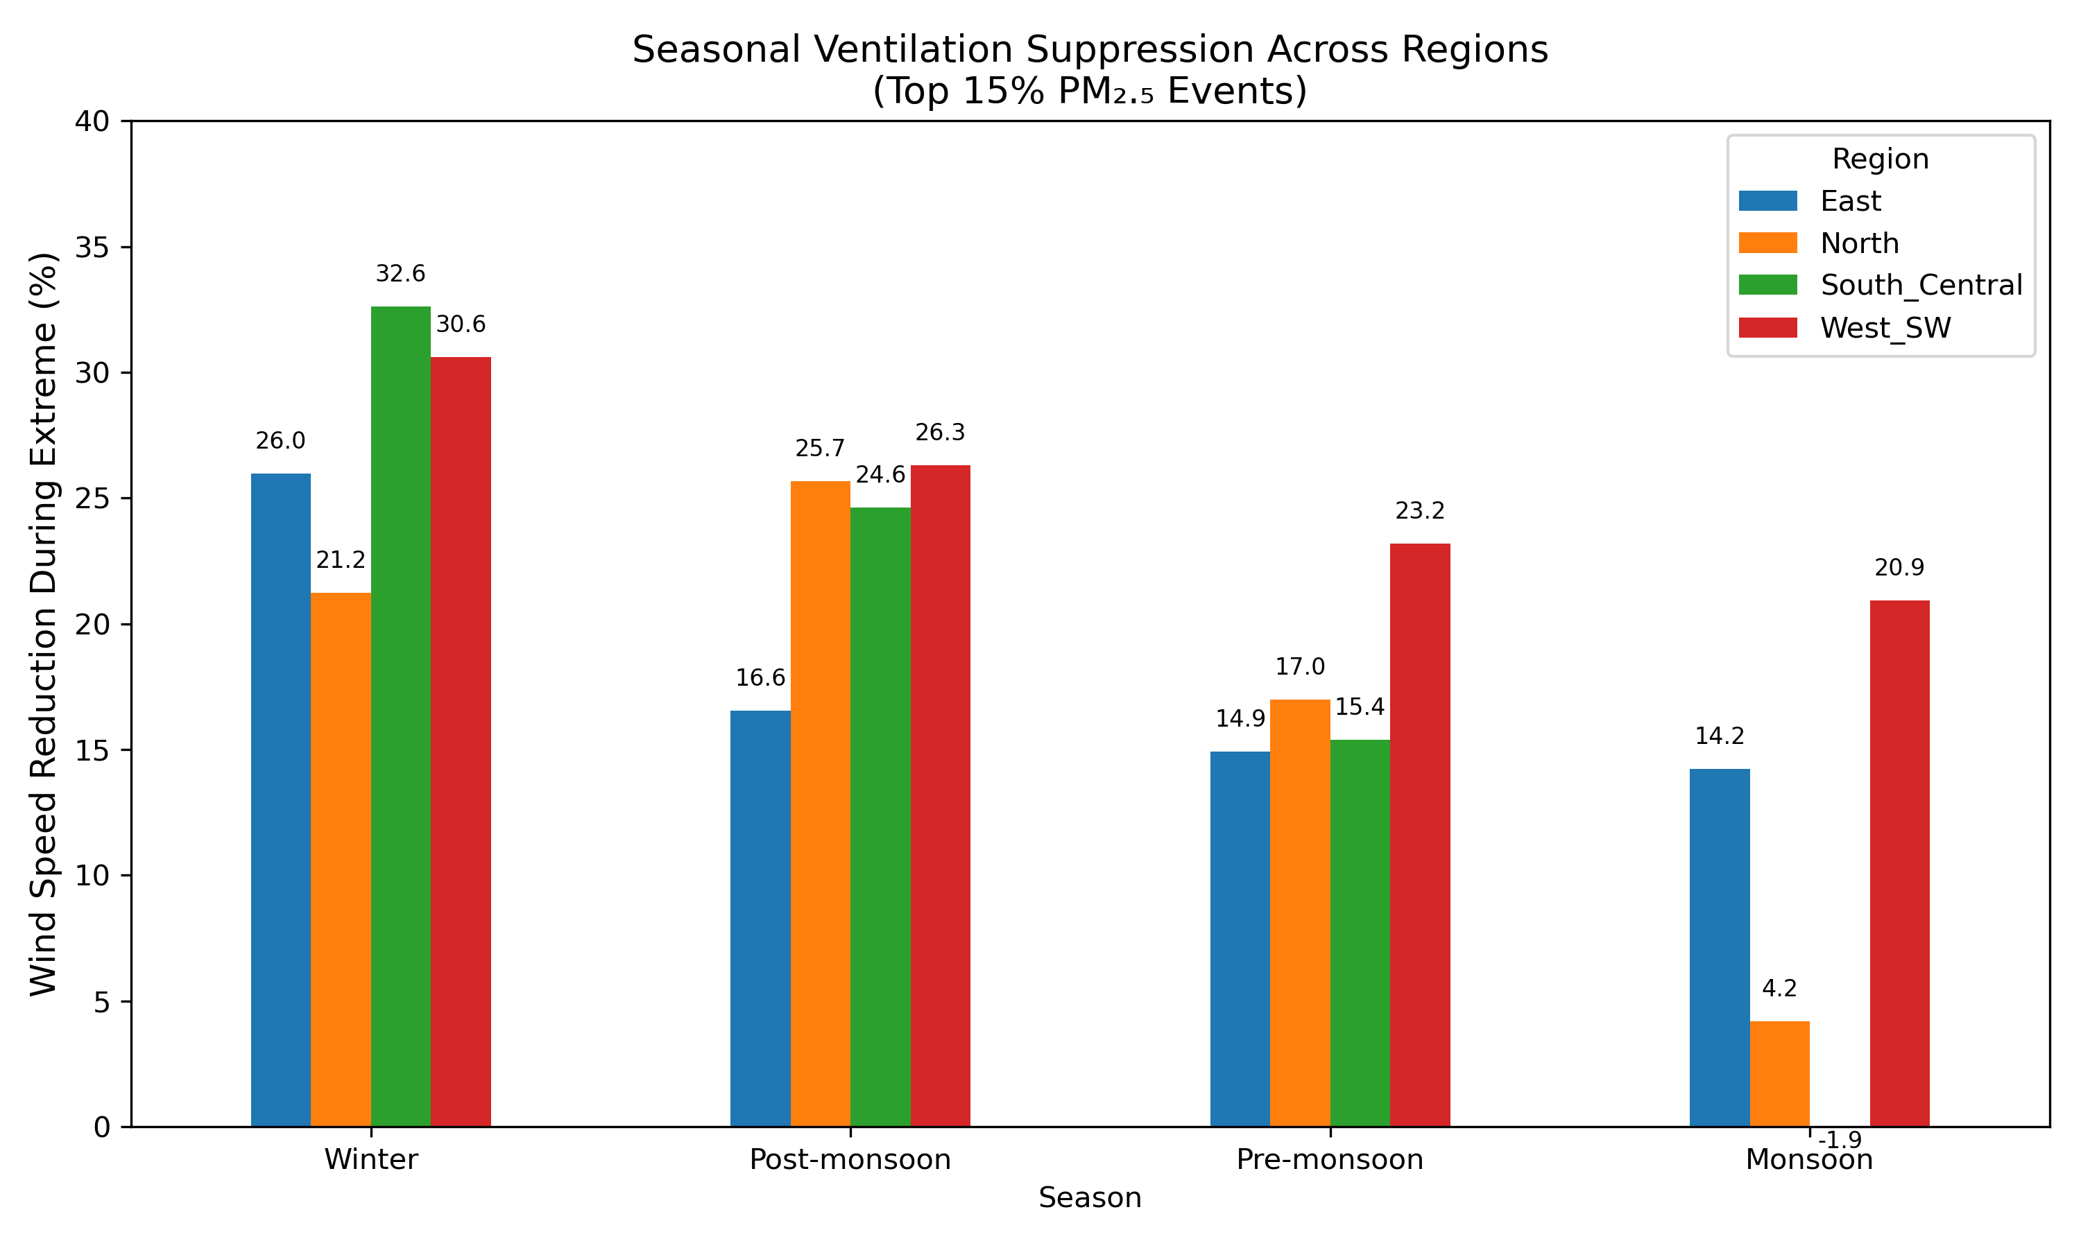
Ventilation Suppression During Extreme Events
Wind speed decreases during extreme PM₂.₅ hours across most regions and seasons
• Strongest suppression observed in Winter (≈21–33%)
• Moderate suppression in Post-monsoon (≈16–26%)
• Weaker but consistent suppression in Pre-monsoon (≈15–23%)
• Minimal or negligible suppression during Monsoon
• Seasonal influence is stronger than regional differences

Slide 22
Week 4 Mechanism Synthesis
• Winter: Strong ventilation suppression across all regions
• Post-Monsoon: Mixed stagnation + directional reinforcement
• Pre-Monsoon: Transitional regime (dust + moderate suppression)
• Monsoon: Weak meteorological control
Conclusion: Seasonal meteorology dominates extreme PM2.5 formation more than spatial location.

Slide 23
PDF-based Transport Diagnostics of Extreme PM₂.₅ (DJF 2021–2024) Regional analysis for Delhi: North, East, South_Central, West_SW
Methods: KDE-based PDFs, top-15% percentile extremes, directional enrichment (extreme/background)
Objective: “Diagnose whether extreme PM₂.₅ events are driven by ventilation suppression or directional transport corridors.”
Hourly PM₂.₅ & wind (dir, speed) from cleaned station dataset (2021–2024).
Regions: North, East, South_Central, West_SW (list stations or refer to appendix).
Months: Dec–Jan–Feb (DJF), 4 years (2021–2024).
Approach:
Build region-level hourly stacks (equal station weighting).
Compute PM₂.₅ PDFs (KDE) for each region per year/month.
Define extremes as top 15% PM₂.₅ hours (85th percentile).
Directional enrichment = (freq during extreme) ÷ (background freq).

Slide 24
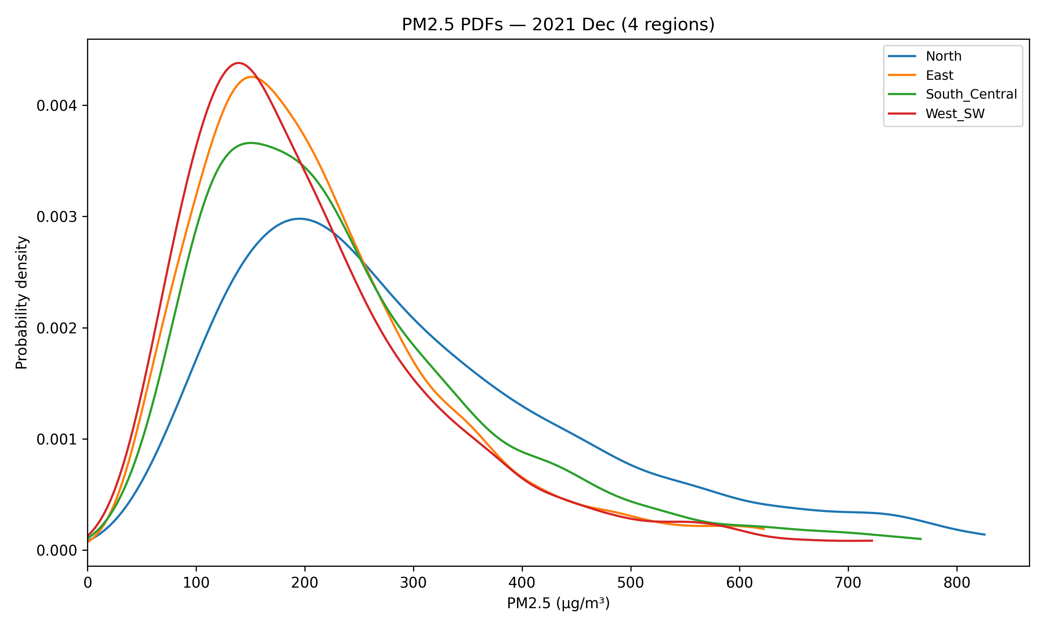
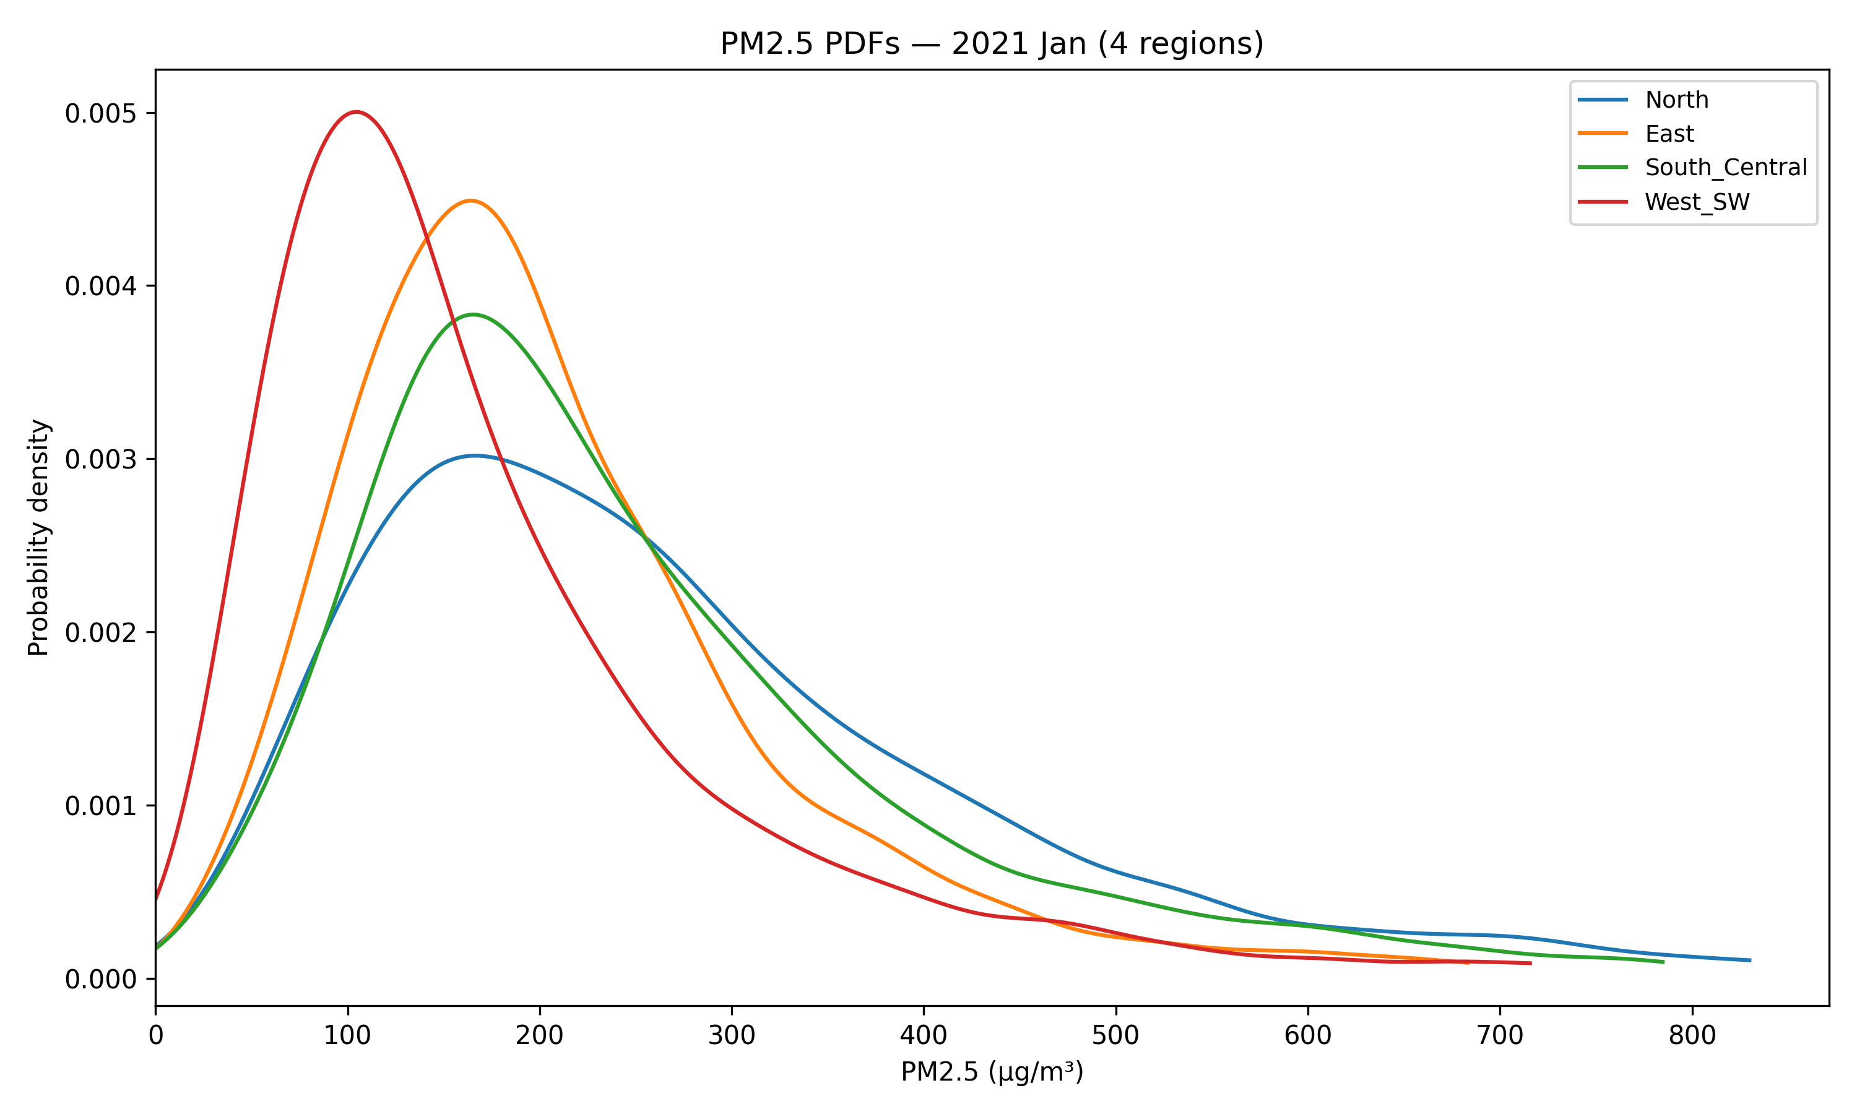
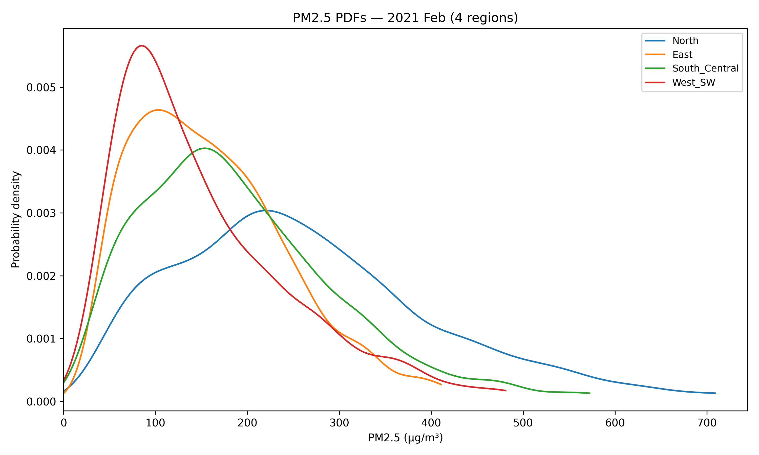
Year 2021
Dec–North region has a higher probability of very high PM₂.₅ in Dec 2021 (more extreme events). Could be weaker ventilation (stagnation) or stronger source + transport into North.
Jan –West/East show concentrated moderate pollution, while North has higher probability of extremes — suggests transport from other regions combined with local stagnation.
Feb – Same pattern: North more extreme-prone; West/East more moderate but frequent pollution.

Slide 25
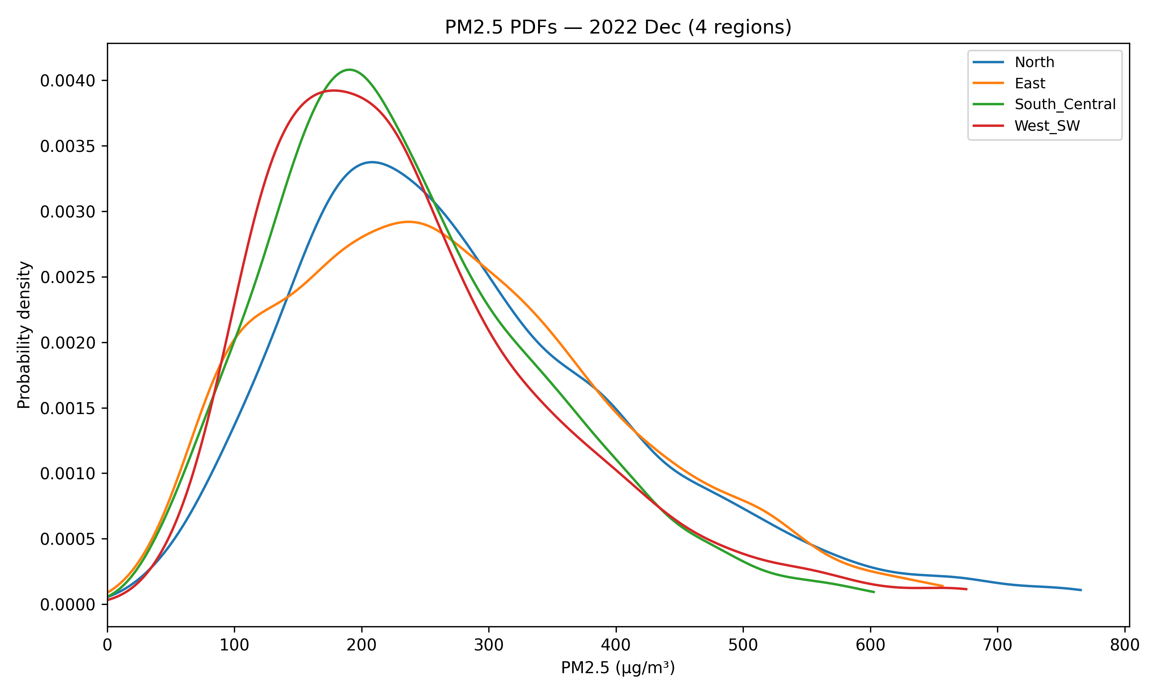
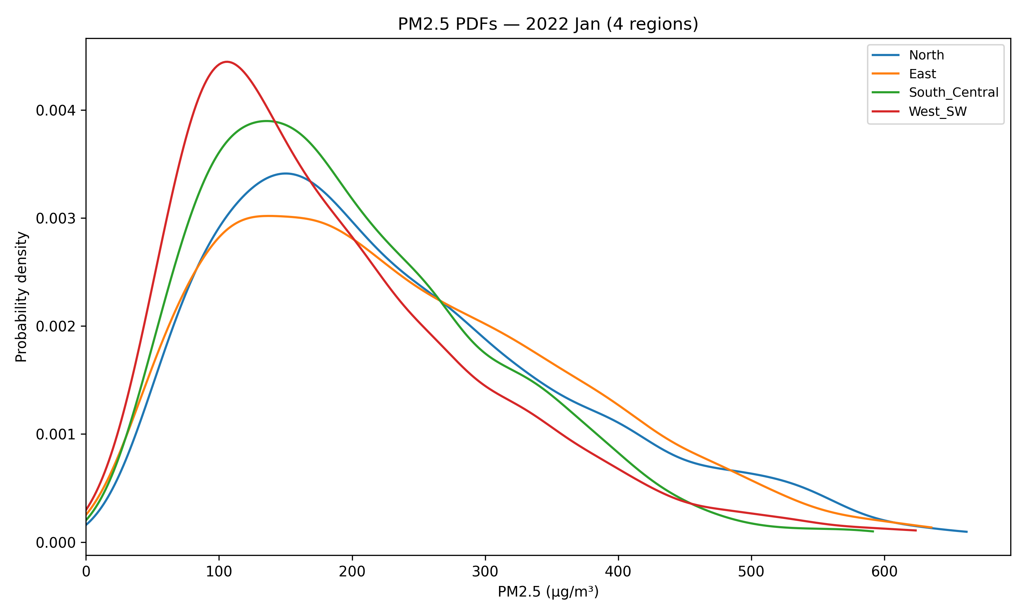
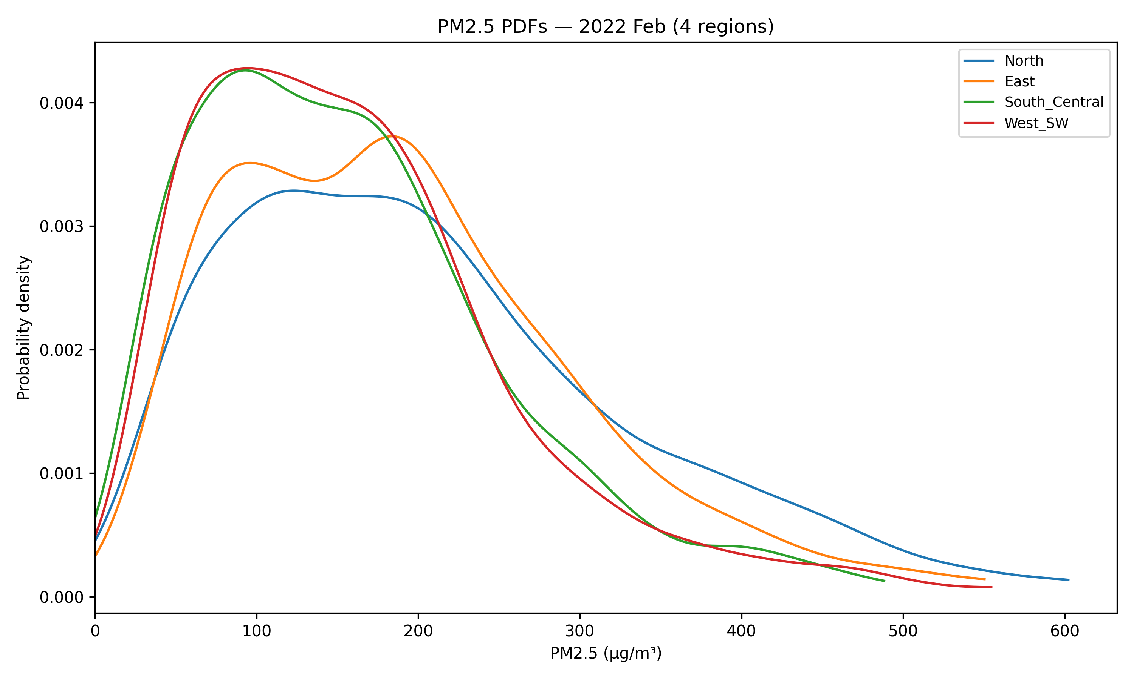
Year 2022
Dec –More homogeneous pollution regimes across regions in Dec 2022 – possibly due to a region-wide meteorological pattern (e.g., synoptic stagnation or uniform emissions/transport).
Jan –January 2022 shows less stark inter-regional contrast than 2021.
Feb –Regional differences are reduced in 2022 (less directional dominance or more similar emissions).

Slide 26
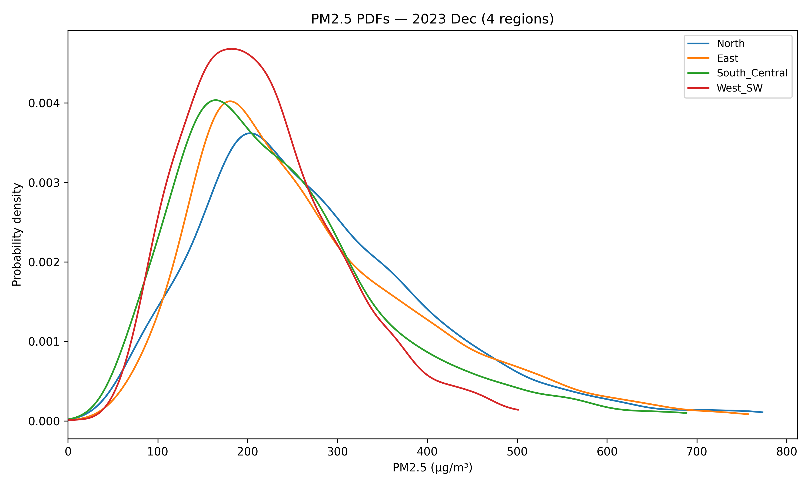
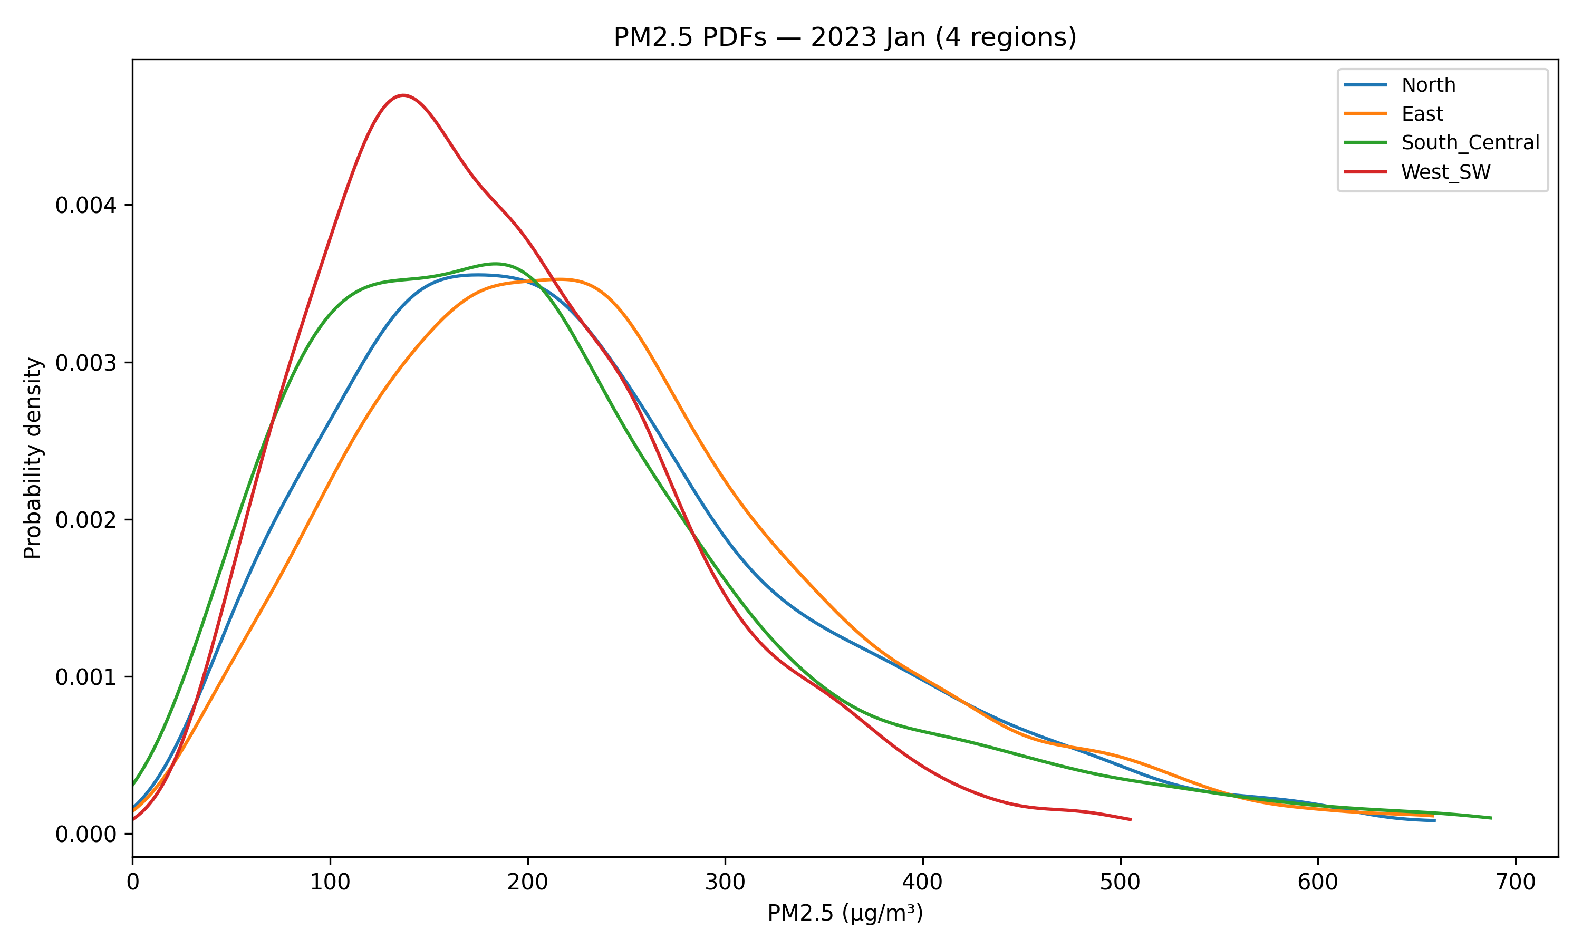
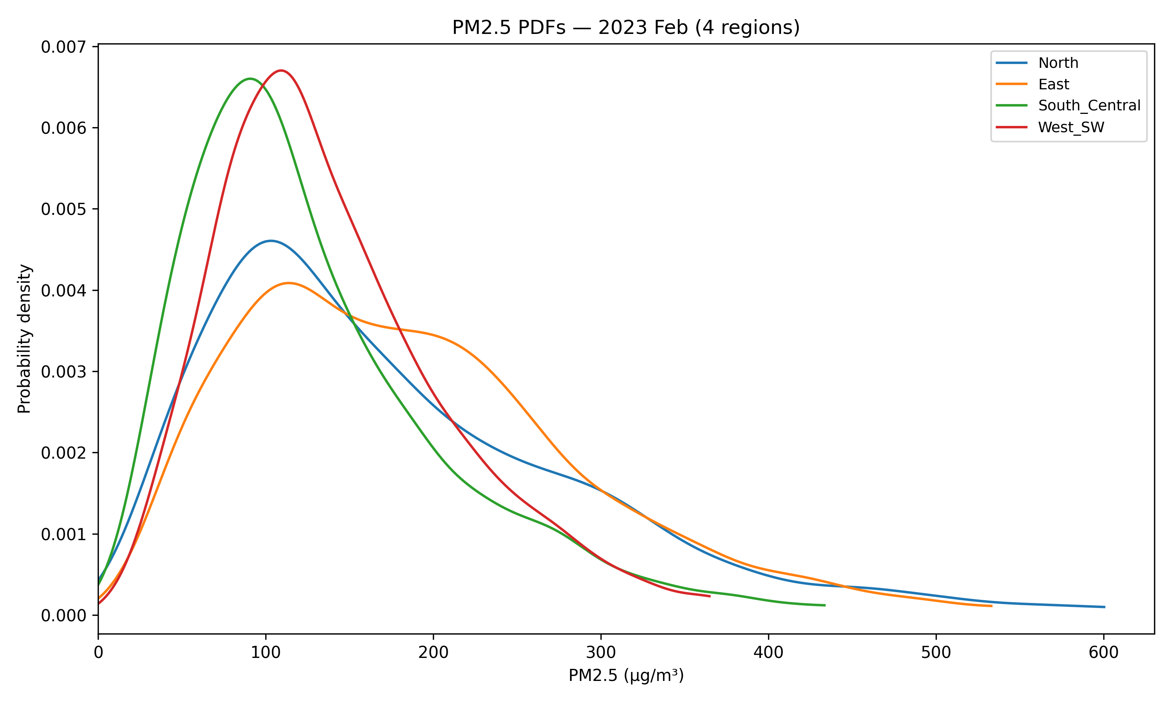
Year 2023
Dec –West_SW shows frequent moderate events; North still has moderate extremes risk.
Jan –Jan 2023 again relatively uniform; suggests common synoptic forcing.
Feb –Feb 2023: East/West often experience frequent moderate pollution but North remains more likely to experience high extremes.

Slide 27
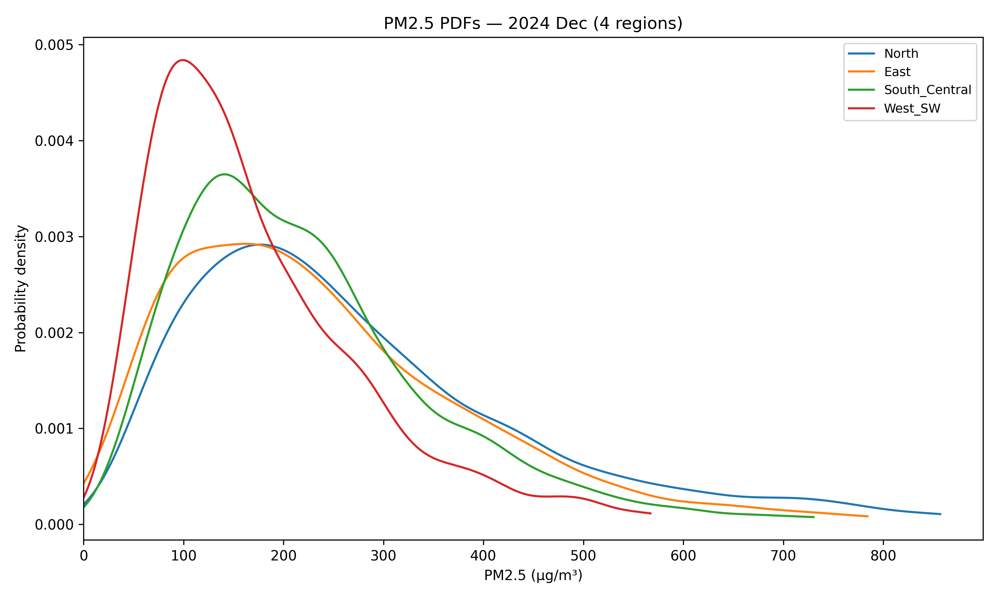
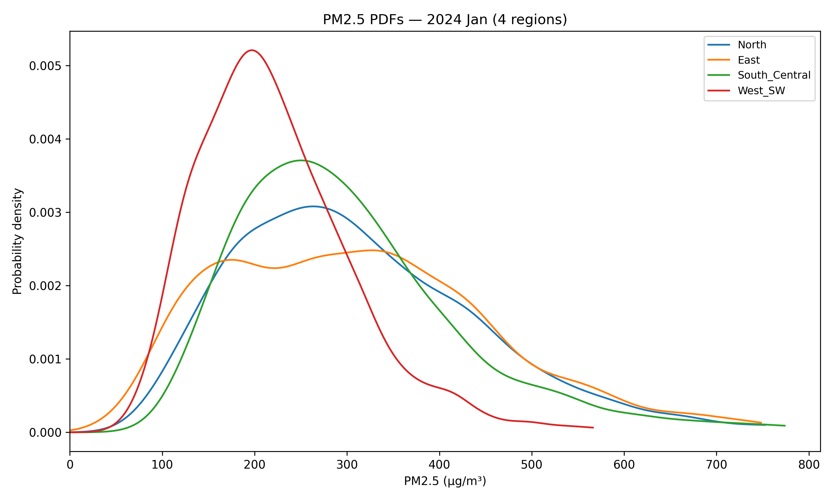
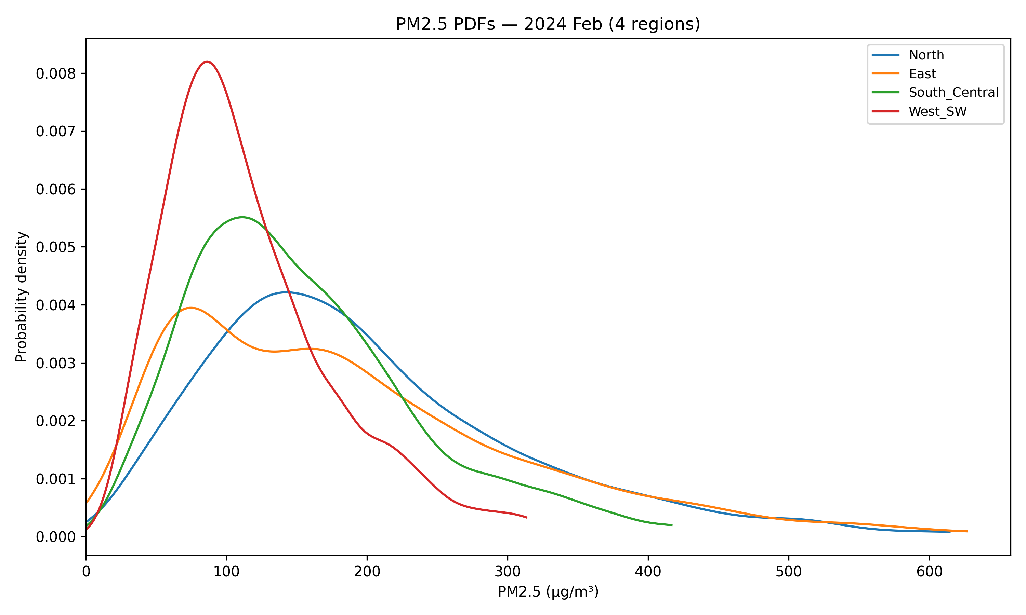
Year 2024
Dec –West_SW frequently experiences moderate events, South_Central sometimes slightly elevated.
Jan –Jan 2024 shows West_SW dominated by many moderate events; extremes less frequent there.
Feb –Again pattern recurs: West_SW/East often concentrated moderate events; North more tail-heavy (extreme probability).

Slide 28
Overall takeaways
Across most years and months North frequently has a broader distribution and heavier right tail → higher probability of extreme PM₂.₅ events.
West_SW often shows sharp, high modal peaks at lower PM (frequent moderate pollution), especially in Jan/Feb (consistent across years).
East and South_Central are usually intermediate — sometimes overlapping closely depending on year/month.
When all four curves cluster closely (e.g., parts of 2022), this suggests widespread synoptic forcing rather than a single transport corridor dominating.

Slide 29
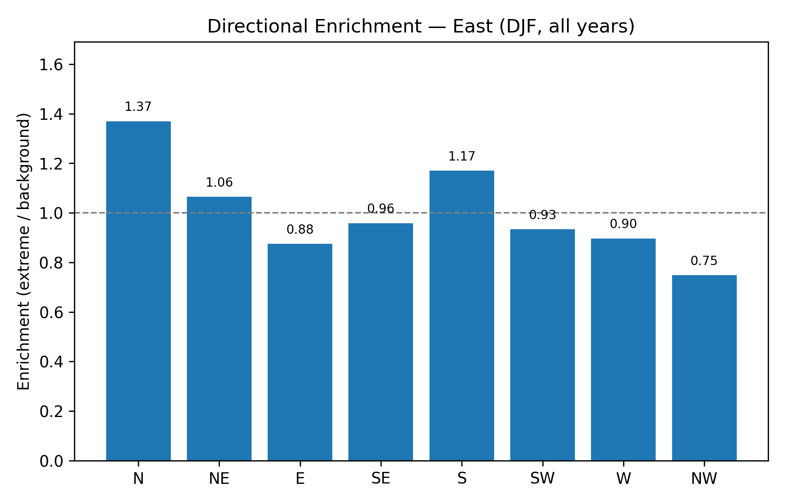
Directional Enrichment plots (Enrichment = fraction of wind directions observed during extreme hours ÷ fraction in the background; values >1 indicate a sector is over-represented during extremes.)
EAST REGION
Interpretation: Northerly winds (N) and southerly (S) are slightly enriched during extreme PM₂.₅ events in East. So episodes there commonly occur when the wind has a northerly component and sometimes southerly inflow — mixed transport influence.

Slide 30
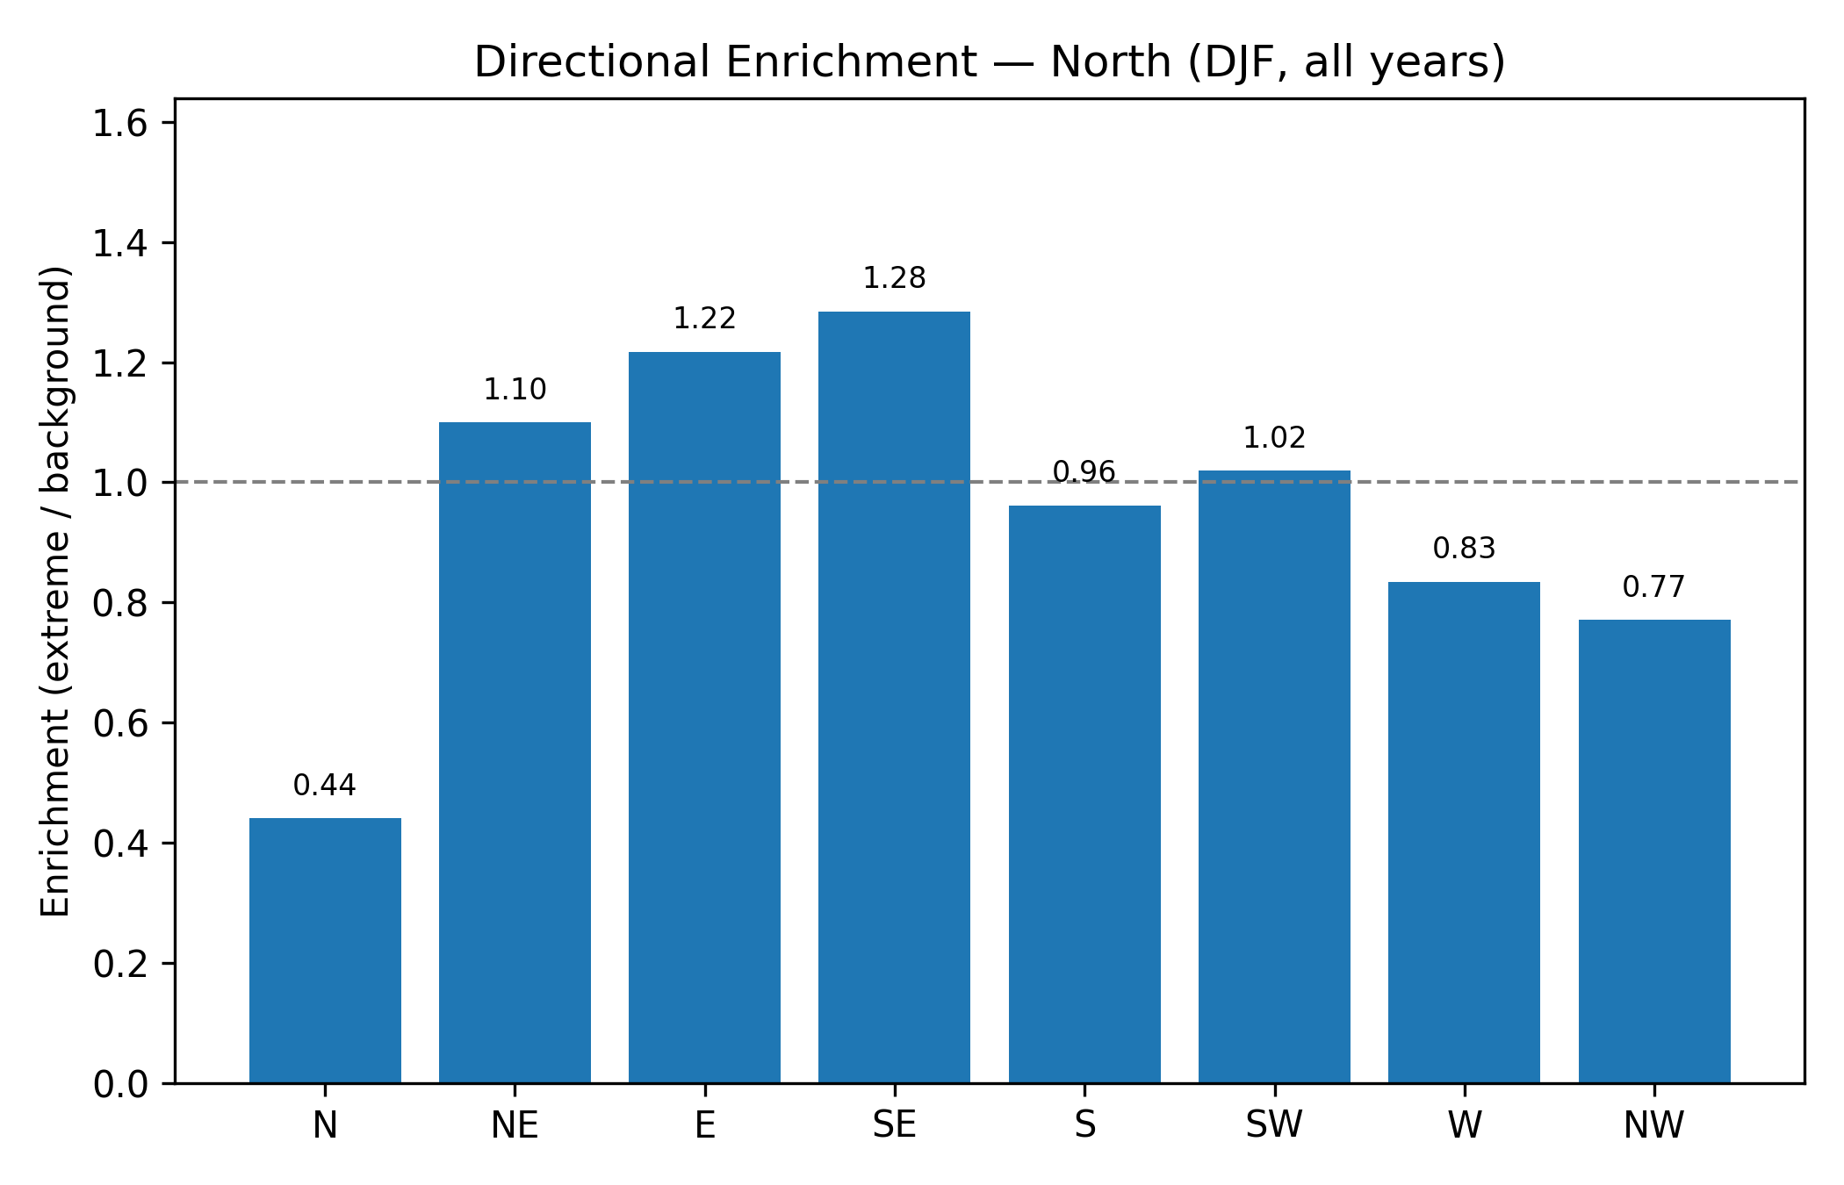
NORTH REGION
Interpretation: Northerly sector is under-represented during extremes (N 0.44), while E and SE and NE are enriched (≈1.1–1.28). This implies extremes in the North region are associated with easterly/SE winds — i.e., pollution being transported into northern stations from east/southeast corridors (possibly from urban core or Trans-Yamuna influences).

Slide 31
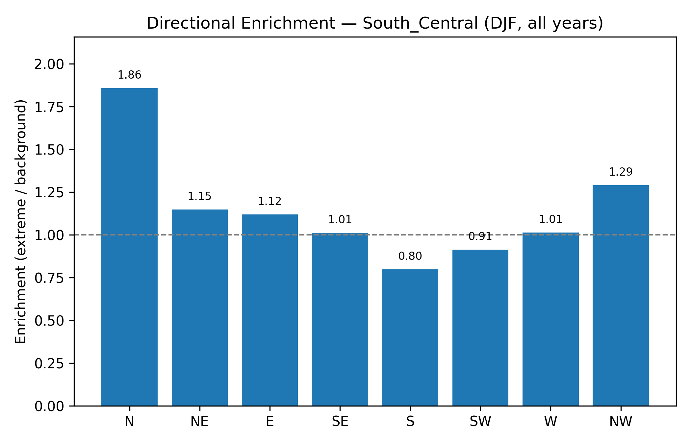
SOUTH_CENTRAL REGION
Interpretation: Strong enrichment from the North (1.86) — very likely that northern transport (Haryana/NW belt) strongly contributes to extremes in South_Central. Also NW is enriched. This is a clear transport-dominated signature from the north.

Slide 32
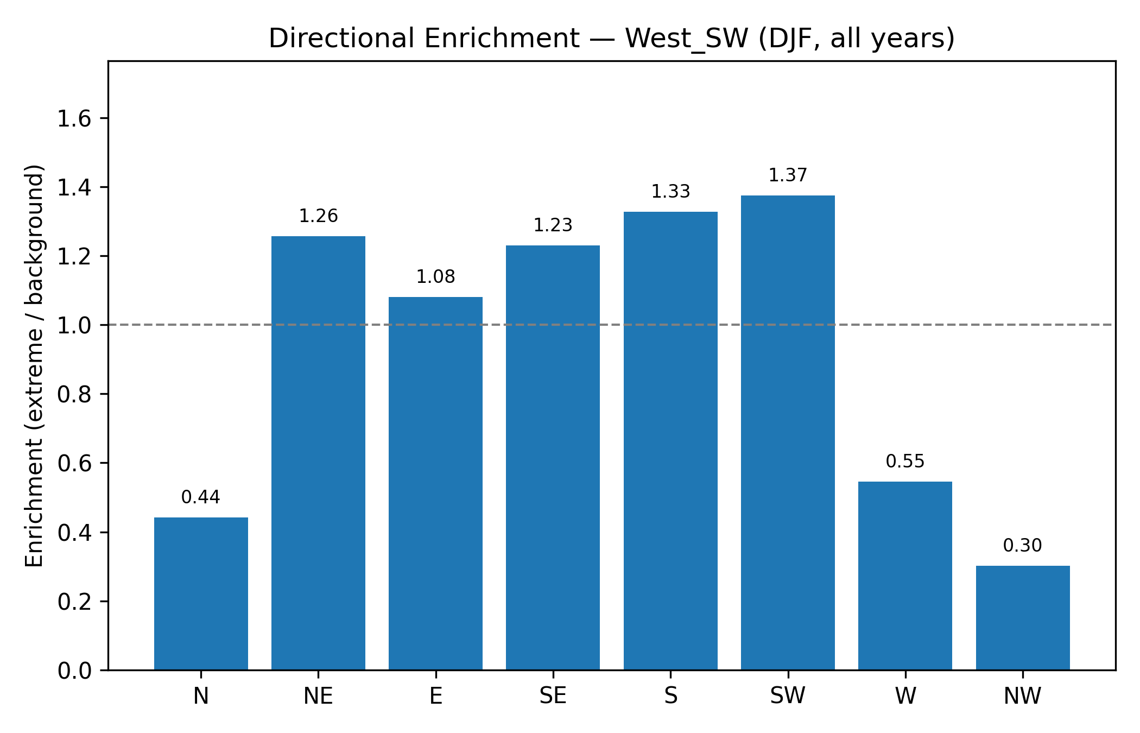
WEST_SW REGION
Interpretation: Strong enrichment from SW, S, SE, NE (SW = 1.37 highest) — this indicates extremes at West_SW are associated with southerly–southwesterly winds (likely bringing in pollution from industrial/aggregated emission sources to the southwest/west). NW & N under-represented.

Slide 33
OVERALL ENRICHMENT TAKEAWAYS
South_Central: most clearly dominated by northerly transport during extremes (N = 1.86).
West_SW: strongly dominated by southwest / southerly transport (SW 1.37, S 1.33).
North: extremes in this region correlate with E/SE winds (transport from east / Trans-Yamuna corridor).
East: mixed signals but N shows enrichment (N = 1.37) — Northern transport matters there, too.
These enrichment numbers directly answer the question: which direction(s) dominate extreme PM₂.₅ events at each region.

Slide 34
Mechanistic interpretation (transport vs ventilation)
Where enrichment ratio for one or more sectors is >1.2–1.3 (e.g., South_Central N = 1.86; West_SW SW = 1.37), the extreme events are strongly associated with directional transport from those sectors — i.e., air mass advection bringing pollution to the region.
Where PDFs show heavy right tails (e.g., North in many months), this suggests either local accumulation (stagnation) or advection of already-polluted air masses; enrichment plots tell which direction these air masses come from. For instance, North’s heavy tail + enrichment for E/SE implies that extremes there are likely driven by directional inflow from the east/southeast combined with meteorological conditions that limit dispersion.
When all region PDFs overlap tightly (e.g., Dec 2022), it likely reflects synoptic-scale conditions (widespread stagnation or uniform pollution) rather than a single transport corridor.

Slide 35
Upgraded Stagnation Index: India-ASI
Inspired by Zhou et al. (2024), Nature Communications, 15, 7448
Condition | Threshold | Physical Meaning | Source
1. Calm Wind | WS10m < 3.2 m/s | Pollution cannot disperse horizontally | NOAA ASI (Wang & Angell 1999)
2. Temperature Inversion | T925hPa - T2m > 0 K | Warm air aloft acts as a lid; pollution cannot escape vertically | India-ASI (Zhou et al. 2024)
3. No Rain | Precip < 1 mm/day | No wet scavenging (washout) of particulate matter | NOAA ASI (Wang & Angell 1999)
A day is classified as stagnant ONLY when ALL THREE conditions are met simultaneously.
Key improvement over old method: The NOAA index uses 500 hPa wind speed for vertical dispersion, but Zhou et al. showed this is poorly correlated with PM₂.₅ over India (R = −0.14). The T925–T2m inversion criterion correlates much better (R ≥ 0.63).
Data: ERA5 reanalysis (0.25°), 2×2 grid cells over Delhi, 2021–2024

Slide 36
India-ASI: Condition Breakdown & Climatology
Month | Calm Wind (ws10m<3.2) | Inversion (T925>T2m) | Dry Day (precip<1mm) | ALL 3 Met (Stagnant)
October | 97.0% | 4.8% | 75.8% | 3.8%
November | 99.0% | 30.0% | 86.2% | 27.7%
December | 90.9% | 58.3% | 79.2% | 47.8%
January | 87.7% | 41.7% | 54.8% | 27.4%
February | 86.1% | 33.2% | 72.8% | 26.5%
Climatology: Mean India-ASI Stagnant Days per Month (2021–2024 average)
Month | Oct | Nov | Dec | Jan | Feb
Domain Avg (days) | 1.19 | 8.31 | 14.81 | 8.50 | 7.50
Key Insights:
October: Nearly zero stagnation — inversions occur only 4.8% of days. Surface is still warm, no lid forms.
December: Peak stagnation (47.8%) — strong inversions (58.3%) + dry conditions (79.2%). Half the month is truly trapped.
January: Drops below December due to Western Disturbance activity bringing rain (only 54.8% dry days).

Slide 37
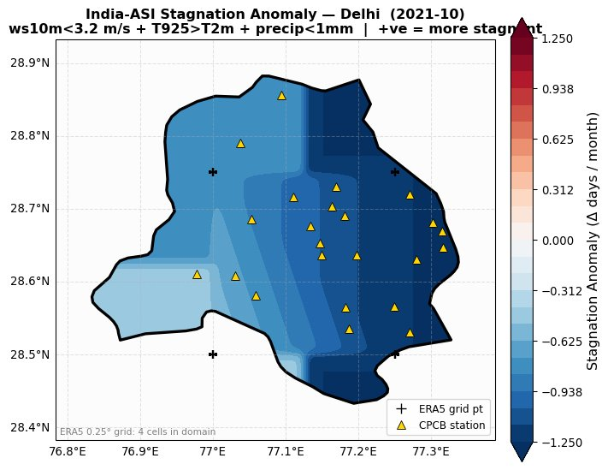
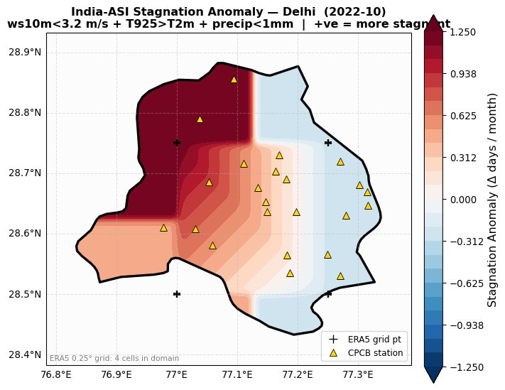
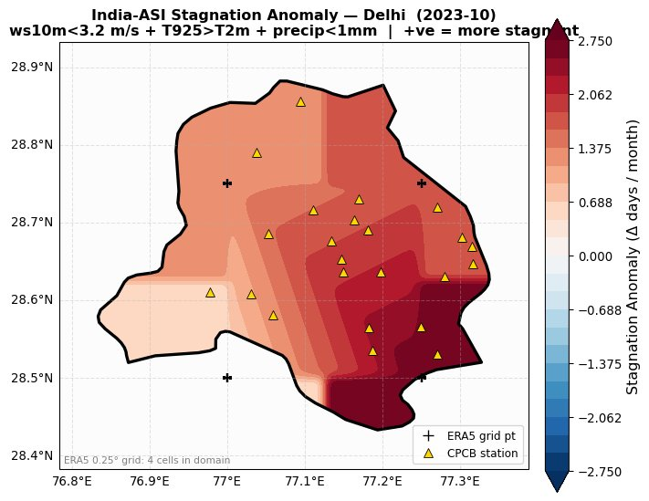
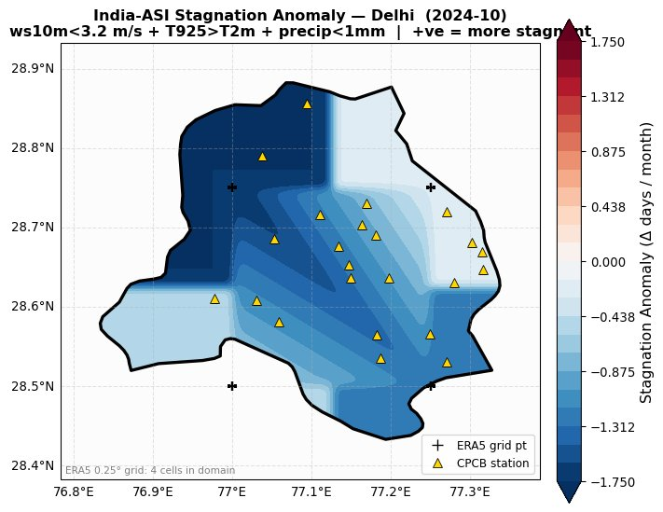
India-ASI Stagnation Anomaly — October
October marks the post-monsoon transition. Inversions are rare (4.8%), so India-ASI stagnation is near zero. Anomalies are small (±1–2 days). Oct 2021 shows a mild negative (better ventilated); Oct 2023 has a slight positive anomaly in south-central Delhi.

Slide 38
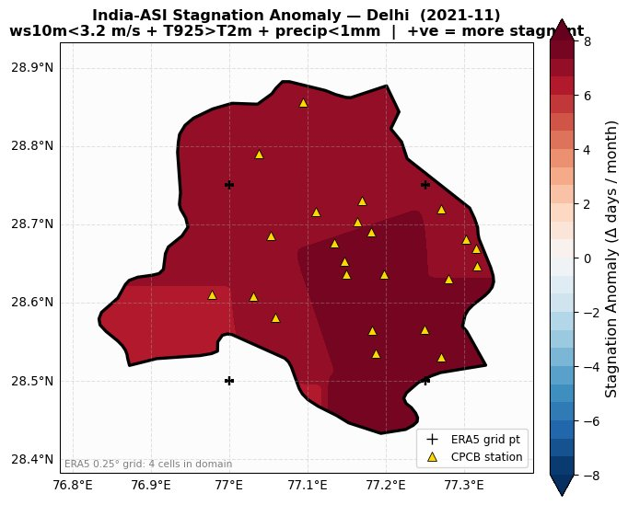
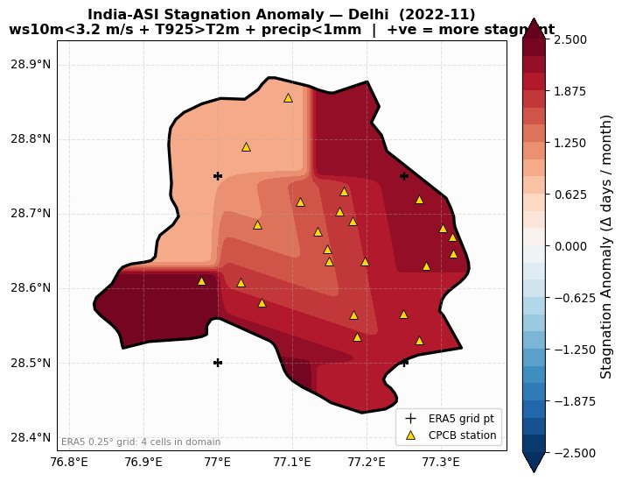
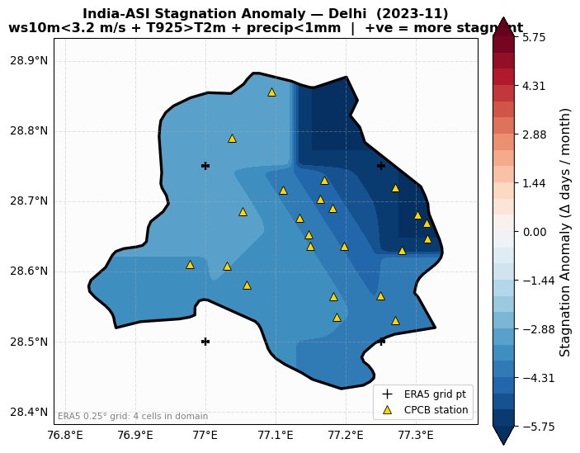
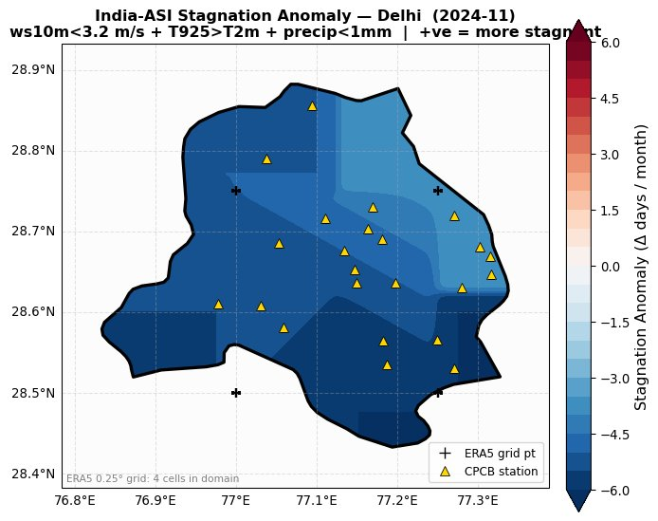
India-ASI Stagnation Anomaly — November
November — peak stubble-burning month. Inversions jump to 30%, driving 8+ stagnant days on average. Nov 2021 shows a strong positive anomaly (+6–8 days above normal) — extreme inversion trapping. Nov 2022 also positive. Nov 2023–24 show negative anomalies, indicating better-than-average ventilation.

Slide 39
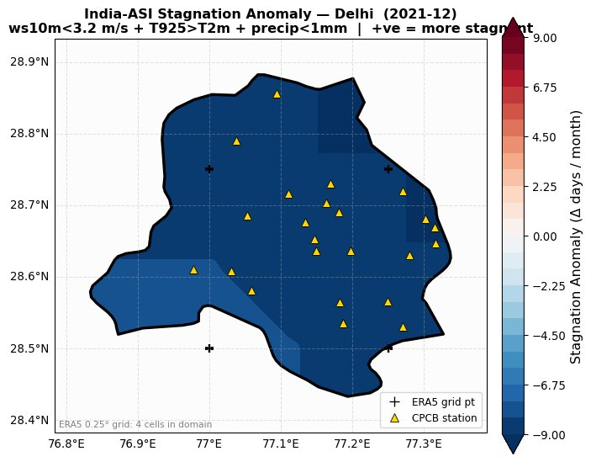
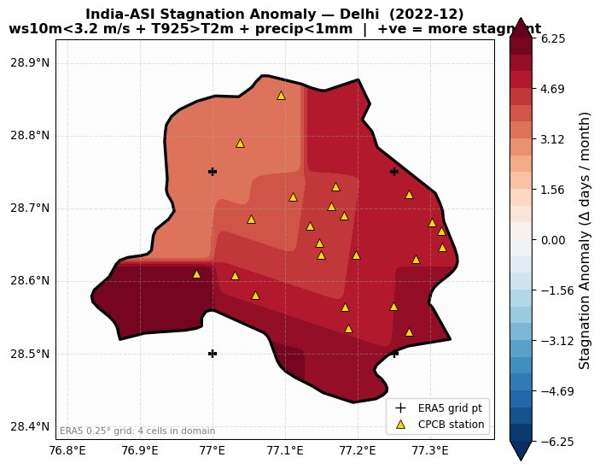
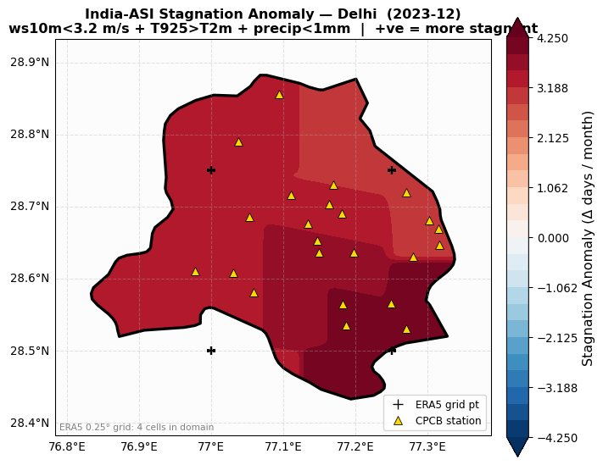
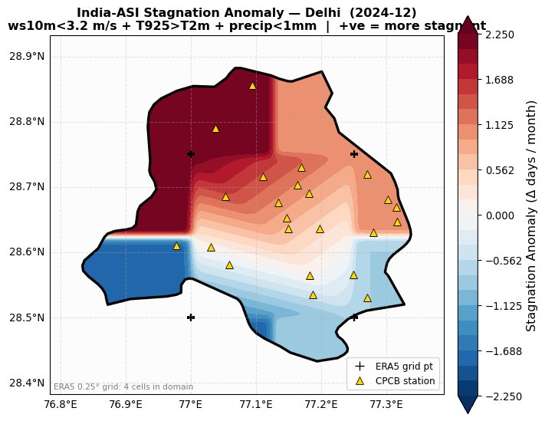
India-ASI Stagnation Anomaly — December
December is peak stagnation: ~15 days/month. Dec 2022 shows a strong positive anomaly (more stagnant than avg), contrasting with the wind-only analysis where Dec 2022 was the most ventilated month. This reversal shows the India-ASI captures inversion-driven trapping that wind speed alone misses. Dec 2023 shows negative anomaly in SE Delhi.

Slide 40
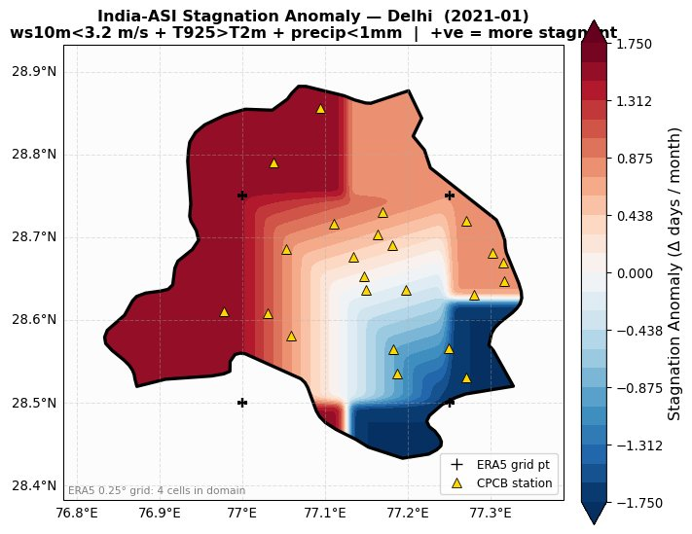
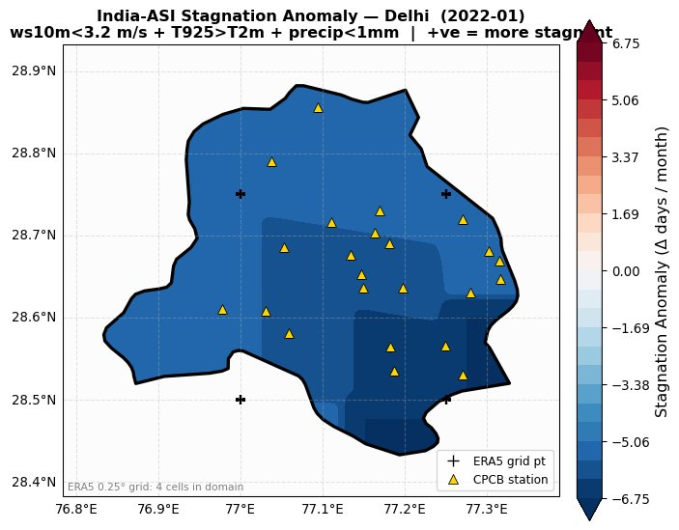
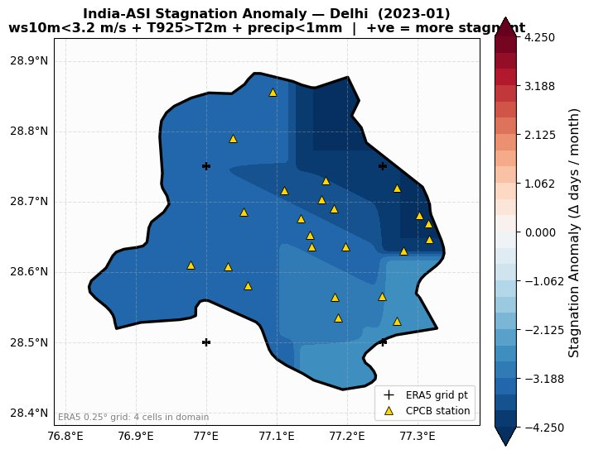
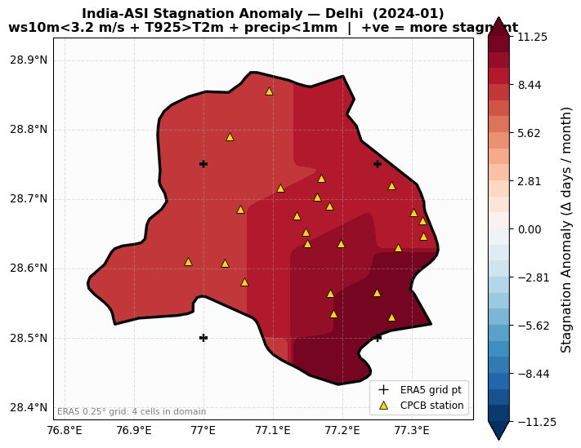
India-ASI Stagnation Anomaly — January
January climatology drops to ~8.5 days due to Western Disturbance rainfall (only 54.8% dry days). Jan 2024 shows a strong positive anomaly in western Delhi (+8–11 days) but negative in east — sharp spatial dipole suggesting localized inversion patterns. Jan 2021–22 both negative (well ventilated).

Slide 41
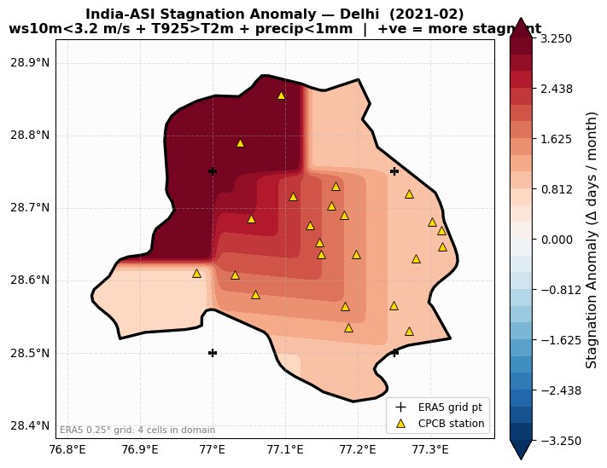
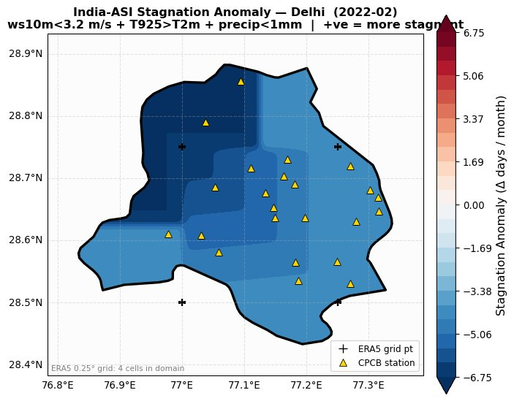
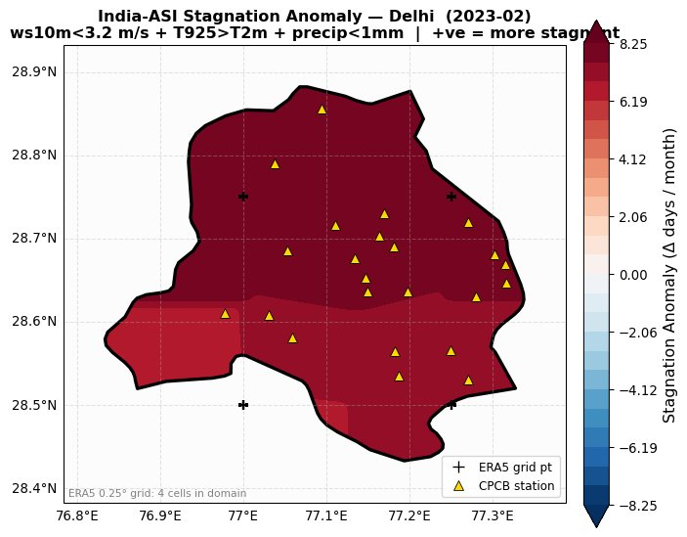
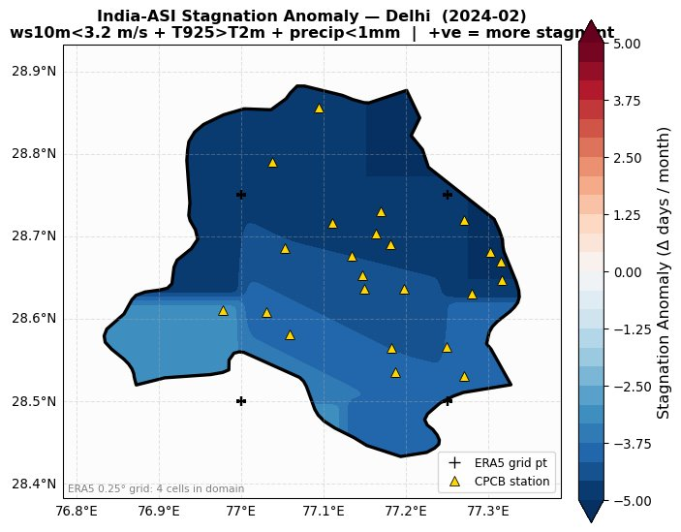
India-ASI Stagnation Anomaly — February
February marks the winter-to-pre-monsoon transition. Inversions weaken (33.2%). Feb 2021 strongly positive in NW Delhi (+3 days); Feb 2023 is the standout with domain-wide positive anomaly (+6–8 days), indicating persistent late-winter stagnation. Feb 2022 and 2024 are negative (better ventilated).

Slide 42
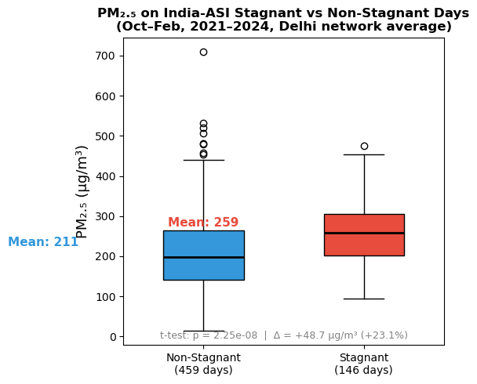
Validation of India-ASI using CPCB PM₂.₅
Step 2: Independent calibration against observed pollution
Box plot summary
Methodology
• Stagnant days = India-ASI TRUE
• Non-stagnant days = India-ASI FALSE
• Compared network-average daily PM₂.₅ (26 stations, Oct–Feb, 2021–2024)
Key Result
• Stagnant: 259 µg/m³
• Non-stagnant: 211 µg/m³
• Difference: +48.7 µg/m³ (~23% higher)
Non-Stagnant
Stagnant
Mean: 211
Mean: 259
t-test: p = 2.25 × 10⁻⁸
The difference in mean PM₂.₅ is highly significant, not random.
Interpretation
• PM₂.₅ shifts upward on stagnant days
• Distribution becomes wider with more extremes
• Strong signal of pollutant trapping under weak dispersion
What the t-test answers:
“Could this PM₂.₅ gap happen by chance?”
Conclusion: India-ASI stagnant days consistently correspond to higher CPCB PM₂.₅.

Slide 43
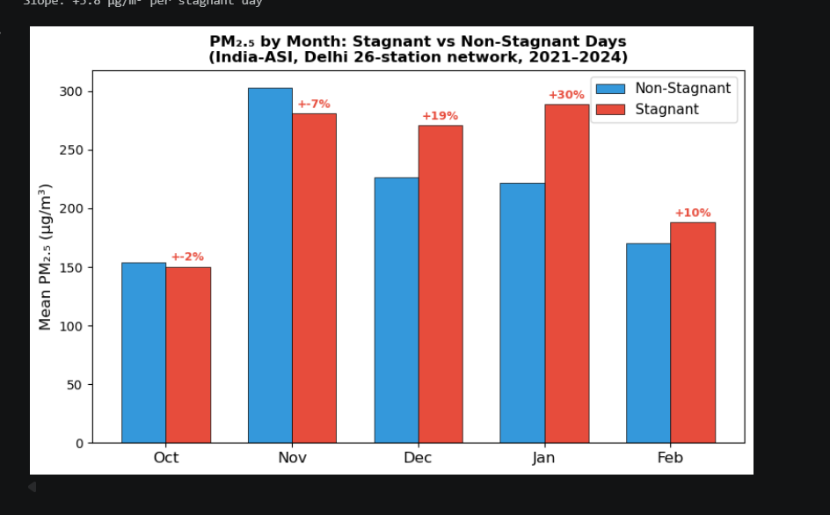
Month-by-Month Interpretation of the Stagnant vs Non-Stagnant PM₂.₅ Plot
The important point is not only that stagnation matters, but that it matters differently in each month.
What each month tells us
The bars compare average PM₂.₅ on stagnant and non-stagnant days. The gap between the bars tells us whether meteorological trapping is stronger than the emission signal in that month.
October
~+2%: almost no difference. Stagnation has little power because the transition from monsoon to winter has just begun, so very few stagnant days exist.
November
−7%: the unusual month. Pollution is dominated by stubble-burning emissions, so even non-stagnant days remain very polluted. This is why the red bar is not higher here.
December
+19%: the stagnation signal becomes clear. Calm winds, weaker mixing, and dry conditions begin to trap pollutants and push the red bar above the blue bar.
January
+30%: the strongest effect. Winter inversions and shallow boundary layers are most intense, so stagnant days accumulate much more PM₂.₅ than non-stagnant days.
February
+10%: a weaker but still visible effect. Winter is relaxing, ventilation slowly improves, and the stagnation penalty remains moderate rather than extreme.
Conclusion: stagnation is a strong PM₂.₅ amplifier in December–January, while November is controlled mainly by emissions rather than dispersion.

Slide 44
WEEK 6 — TASK 1
Annual PM₂.₅ Spatial Distribution across Delhi (2021–2024)
METHODOLOGY
Data: Hourly PM₂.₅ from 26 CPCB CAAQMS stations across Delhi (2021–2024), pre-cleaned in Weeks 1–4 (≥70% data availability, ≤3-hr gap-fill).
Aggregation: Per-station annual mean of all hourly observations, computed independently for each year.
Visualisation: Cartopy scatter on Delhi NCR base map; shared color scale across all 4 years (P5–P95 of pooled annual means → 87–251 µg/m³) to enable direct year-to-year comparison.

Slide 45
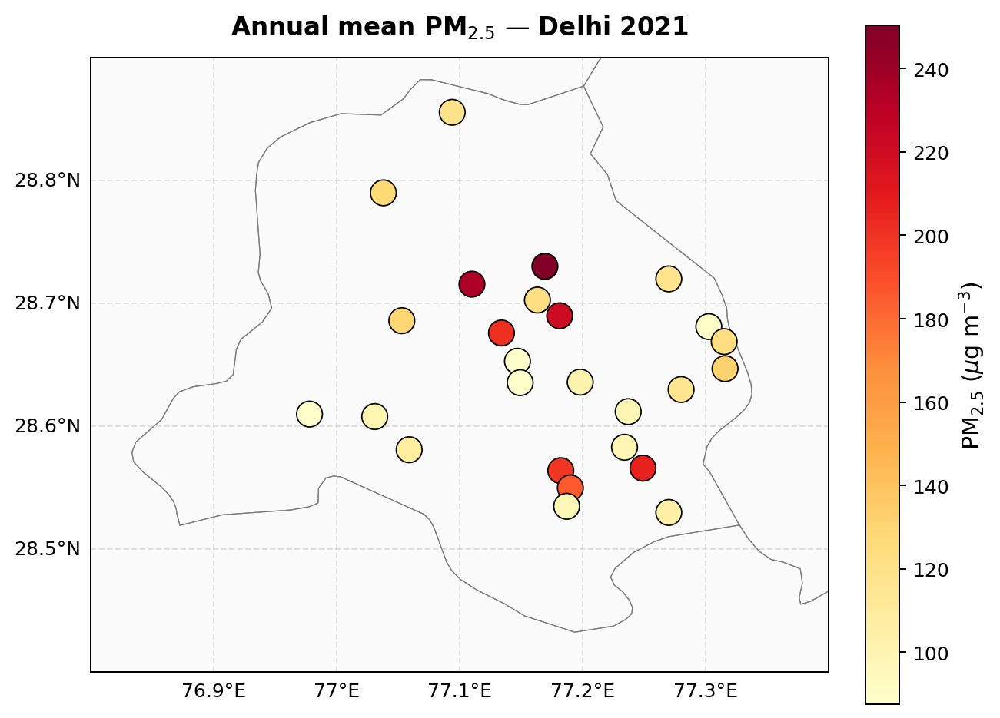
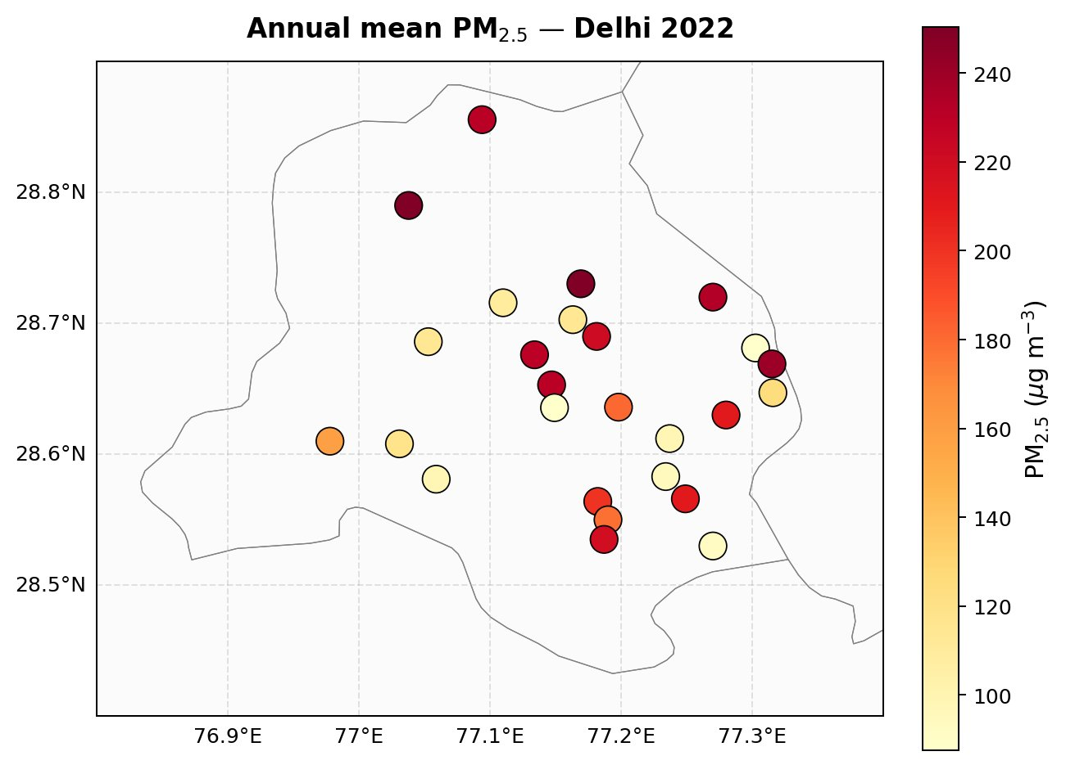
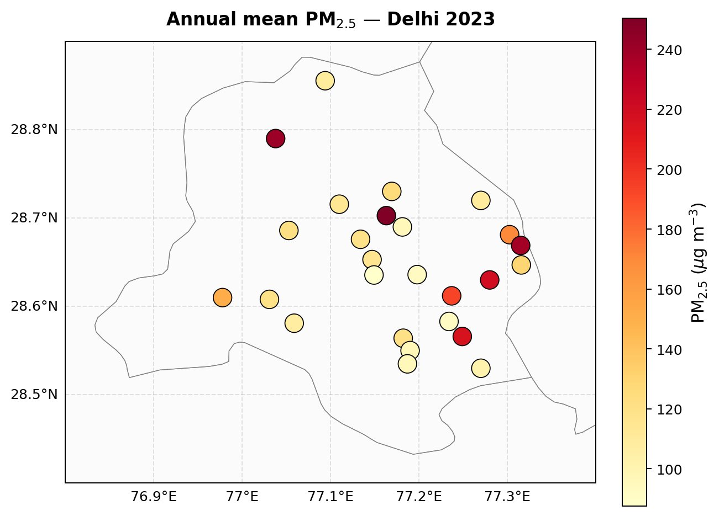
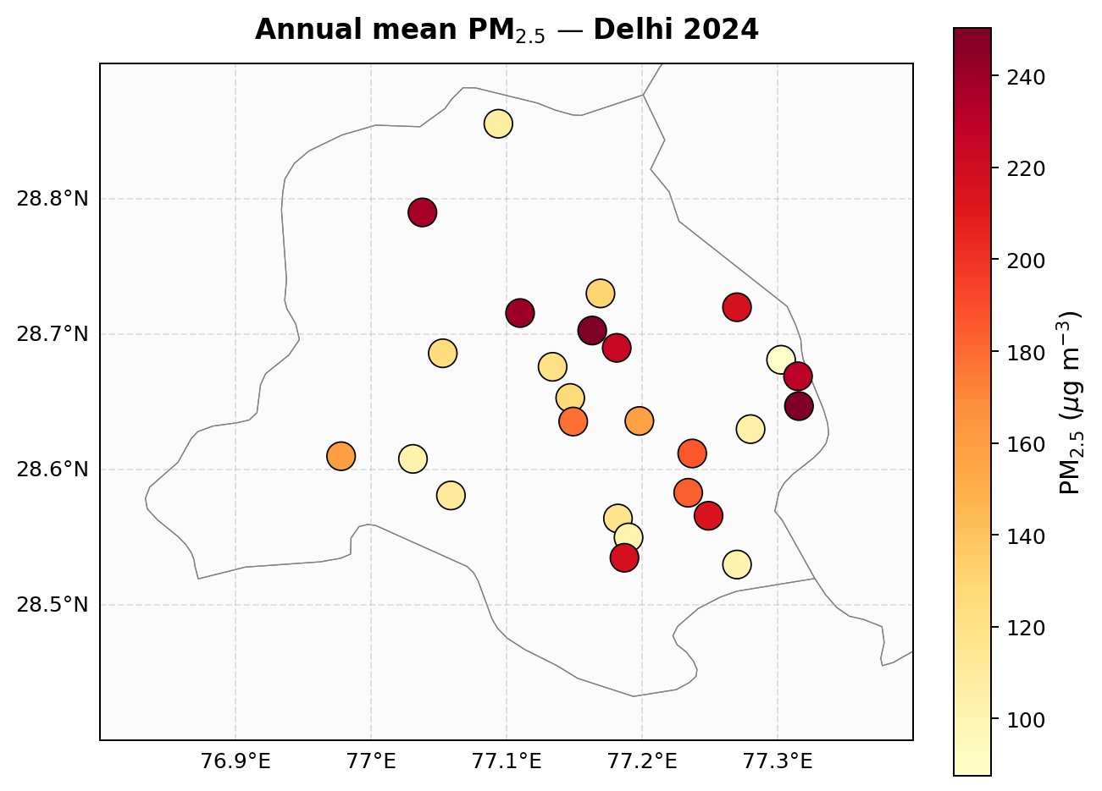
Annual Mean PM₂.₅ — Delhi Network (2021–2024)
26 CPCB stations · shared color scale (87–251 µg/m³) · YlOrRd colormap
Each dot represents one CAAQMS station; color = mean PM₂.₅ for that calendar year. Coverage: ~8,000+ valid hours per station per year.

Slide 46
Year-by-Year Observations
What changes between 2021 and 2024 across Delhi's monitoring network
2021
2022
Lowest year of the four. Most stations sit in the 90–150 µg/m³ band (yellow). Even the persistent eastern hotspots (Patparganj, Anand Vihar) only reach ~200 µg/m³. NW Delhi (Bawana) is comparatively moderate — ~140 µg/m³.
Sharp rebound. Roughly half the stations push into the orange/red (180–230 µg/m³) range. Hotspots intensify across the north-central corridor (Wazirpur, Jahangirpuri, Ashok Vihar). Bawana jumps to the highest in the network (~245 µg/m³).
→ Network mean: lowest of the 4 years
→ Notable network-wide deterioration vs 2021
2023
2024
Partial recovery. Most stations drop back to the 100–150 µg/m³ yellow band, similar to 2021. Bawana remains anomalously high (~240 µg/m³). Eastern hotspots ease somewhat but Patparganj area still leads at ~210 µg/m³.
Re-deterioration. Pattern resembles 2022 but slightly worse in the east — Vivek Vihar joins the dark-red cluster (~240 µg/m³). The east-central pollution belt (Patparganj → Anand Vihar → Vivek Vihar) is now the most consistent feature of the network.
→ Improvement over 2022, not as clean as 2021
→ Network mean comparable to 2022; eastern belt worsening

Slide 47
Synthesis: Persistent Spatial Pattern Across All 4 Years
Year-to-year fluctuations are large; spatial structure is stable
Eastern industrial belt = consistent hotspot
Why this matters for the stagnation analysis
Patparganj, Anand Vihar, and Vivek Vihar appear in the upper quartile every year. Heavy traffic on NH-9, industrial clusters in Sahibabad/Ghaziabad, and the east-Delhi power-corridor emissions all contribute to a stable east-central PM₂.₅ maximum.
The annual maps show that the spatial PM₂.₅ pattern is largely fixed by emission geography (industry, traffic corridors, land use). Year-to-year variations in absolute concentrations come from a different source: meteorological dispersion conditions (stagnation, mixing height, ventilation).
Key implications:
• Spatial baseline established. Tasks 2–3 build on this map by overlaying monthly variation (Task 2) and meteorological condition anomalies (Task 3).
• Hotspots persist regardless of year. Suggests emission control (not just meteorology) is needed to structurally reduce the eastern belt's PM₂.₅.
• Year-to-year network mean fluctuates ~30%. This variability is what stagnation/mixing analysis explains.
Bawana — isolated NW outlier
Bawana (28.79°N, 77.04°E) sits in the dark-red bin in 3 of 4 years despite being far from central Delhi. Likely driven by the Bawana Industrial Area and proximity to Haryana stubble-burning transport corridor in winter.
West/SW Delhi — consistently cleaner
NSIT Dwarka, Najafgarh, and Dwarka Sec-8 stay in the lowest quartile across all 4 years. Lower industrial density + cleaner fetch from open Haryana plains. Confirms Week 4 finding that regional grouping captures real meteorology.

Slide 48
WEEK 6 — TASK 2
Monthly PM₂.₅ Spatial Distribution October–February (2021–2024 pooled)
METHODOLOGY
Why Oct–Feb: Delhi's high-pollution season, when stagnation events drive extreme PM₂.₅ episodes. This is the same window used in the India-ASI analysis, enabling direct cross-reference.
Two-step aggregation: (1) compute monthly mean per station per year, then (2) average those 4 yearly means for each calendar month. Equal weighting per year — robust to data-availability variation.
Visualisation: Same Delhi NCR base map as Task 1; shared color scale across all 5 months (P5–P95 → ~115–355 µg/m³). Note: scale is different from Task 1 because monthly means span a much wider dynamic range than annual means.

Slide 49
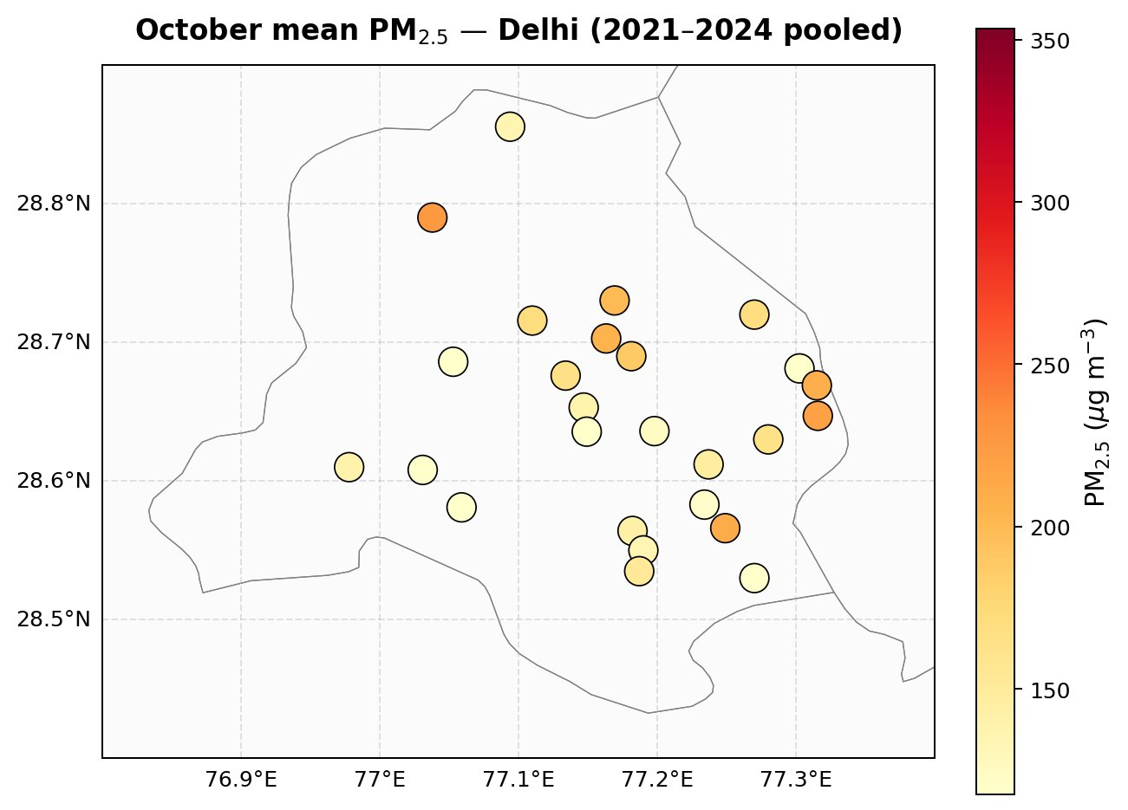
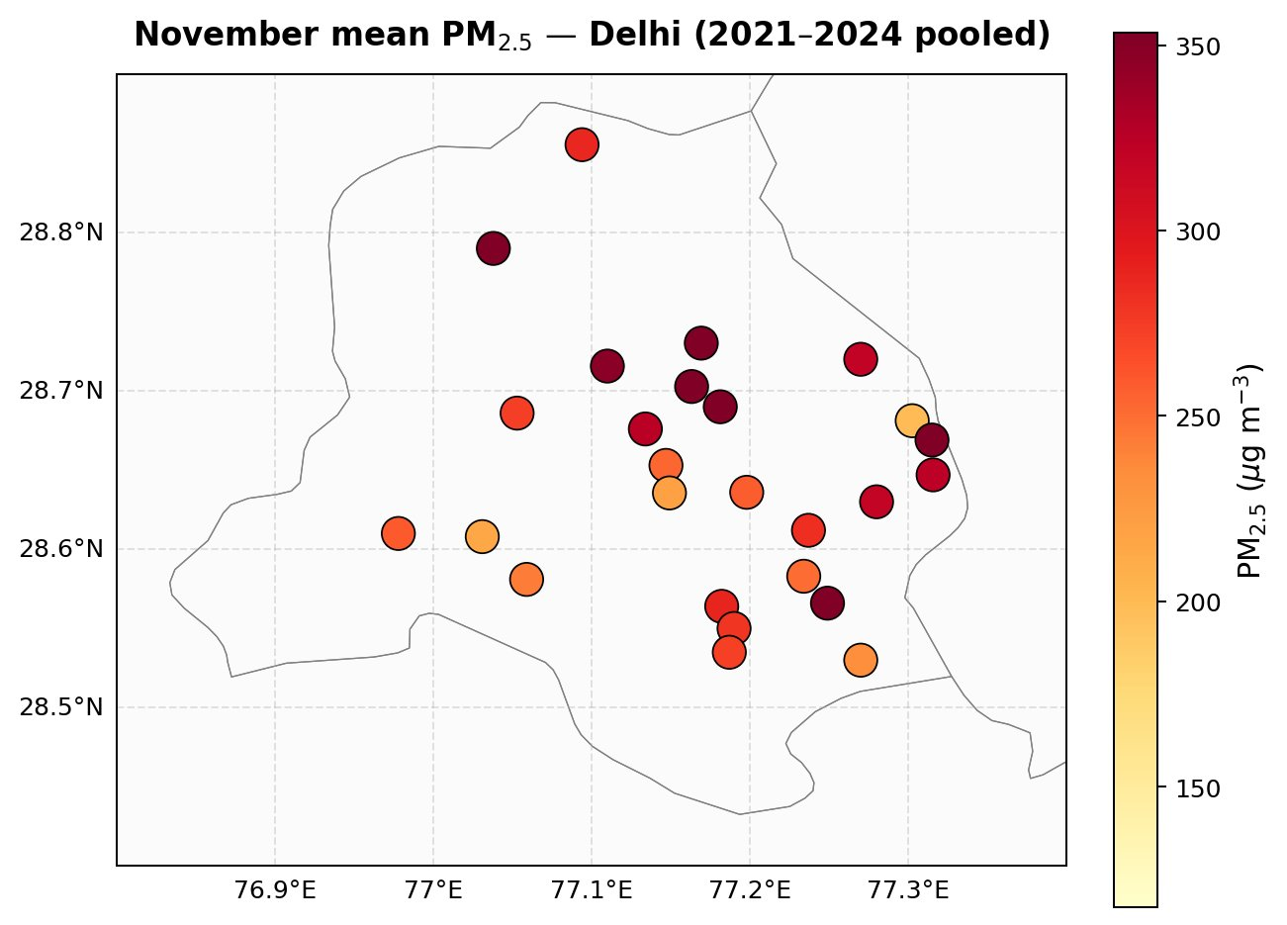
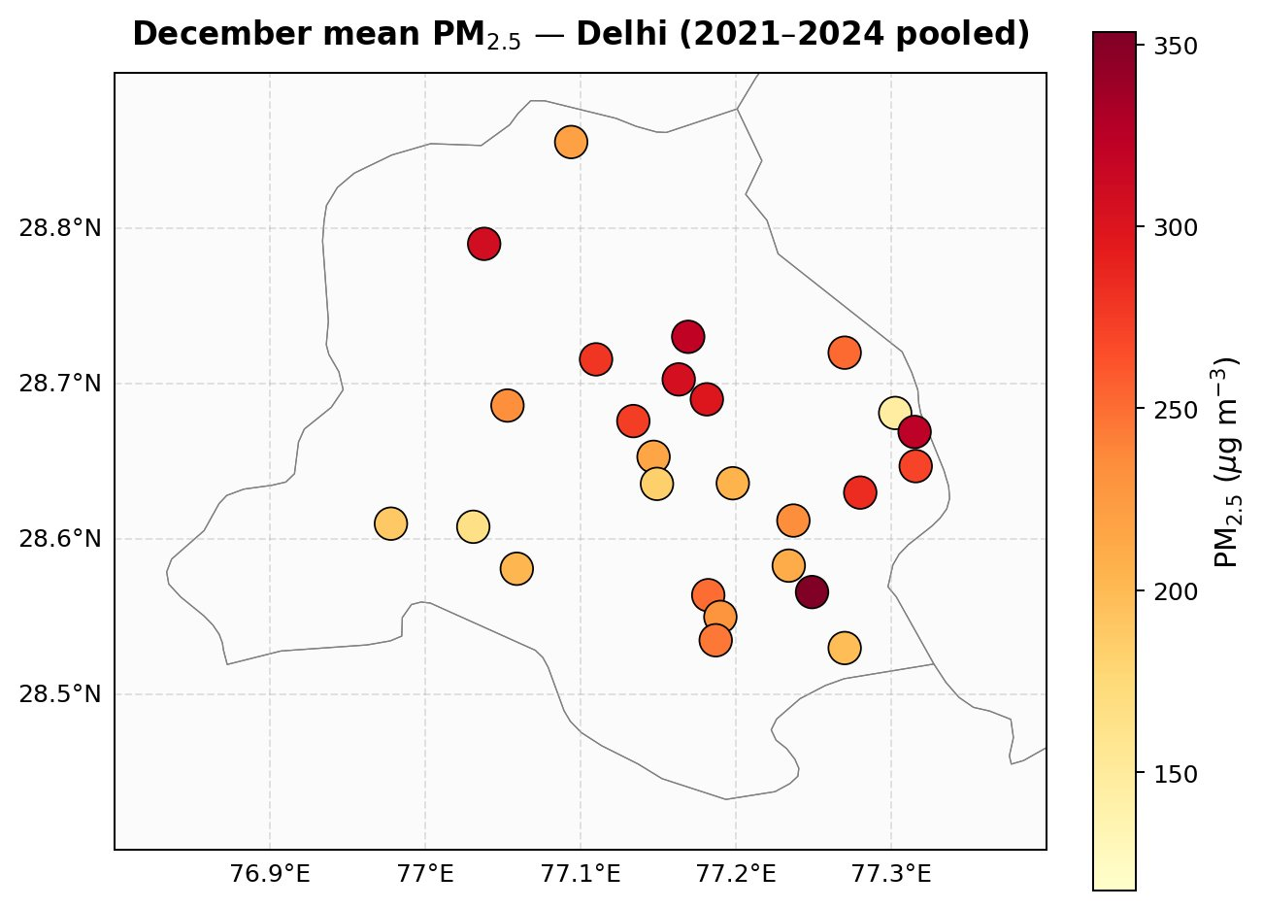


Monthly PM₂.₅ — All 5 Months Side-by-Side
Pooled across 2021–2024 · shared color scale (~115–355 µg/m³)
OCT
NOV
DEC
JAN
FEB
post-monsoon baseline
stubble-burning peak
deep winter stagnation
winter persists
transition out of winter
Key visual: November is unmistakably the darkest map — the stubble-burning fingerprint dominates the seasonal cycle.

Slide 50
November — The Stubble-Burning Signature
Why November dominates Delhi's seasonal PM₂.₅ cycle
Highest values across the entire 5-month set
Multiple stations reach 320–350 µg/m³ — peak values for any month of the year. Even the typically cleanest stations in SW Delhi (NSIT Dwarka, Najafgarh) climb to 200+ µg/m³.
Spatial pattern is unusually uniform
Compare to other months where east Delhi is much darker than west. In November, almost the entire map is in the red/dark-red band — the stubble-burning aerosol blanket affects all stations roughly equally, swamping local emission heterogeneity.
Bawana (NW) joins the dark-red bin
Bawana sits closest to the Punjab/Haryana fire belt and shows the highest values in the network for November (~340 µg/m³). The NW corner reflects the upwind transport gradient from agricultural burning regions.
→ This is why India-ASI shows no stagnation signal in November (your Week 5 finding): emissions, not meteorology, set the monthly mean.

Slide 51
Seasonal Progression: Two Distinct Regimes
October–February reveals an emission-driven peak followed by stagnation-driven persistence
Regime 1 — Emission Pulse (November)
Month-by-month seasonal arc
A 30-day surge driven primarily by paddy-residue burning in Punjab and Haryana, transported into Delhi by NW winds. Network mean jumps from ~150 µg/m³ in October to ~270+ µg/m³ in November. Spatial homogeneity is a tell-tale sign of regional transport rather than local sources.
OCTOBER
~140 µg/m³
Cleanest of the 5. Monsoon residue still present, no stagnation, no fires yet.
NOVEMBER
~270 µg/m³
Regime 2 — Stagnation Trapping (Dec–Feb)
PEAK. Stubble-burning transport dominates. Near-uniform high values across all stations.
Once stubble burning ends in late November, PM₂.₅ remains elevated for three more months — but for a different reason. Calm winds, low boundary layers, and persistent inversions trap local emissions (traffic, biomass cooking, industry). The east-Delhi belt re-emerges as the dominant spatial feature. February shows the cleanest of the four cold months as winds pick up and inversions weaken.
DECEMBER
~230 µg/m³
Stagnation regime begins. Eastern hotspots re-emerge; Bawana persists.
JANUARY
~225 µg/m³
Stagnation peak. Strongest east-west PM₂.₅ gradient. Western Disturbances bring sporadic relief.
FEBRUARY
~165 µg/m³
Cleanest of the 4 cold months. Inversions weaken; ventilation improves.

Slide 52





OCT_2021

Slide 53






NOV_2021

Slide 54






DEC_2021

Slide 55






JAN_2021

Slide 56






FEB_2021

Slide 57






OCT_2022

Slide 58






NOV_2022

Slide 59






DEC_2022

Slide 60






JAN_2022

Slide 61






FEB_2022

Slide 62






OCT_2023

Slide 63






NOV_2023

Slide 64






DEC_2023

Slide 65






JAN_2023

Slide 66






FEB_2023

Slide 67





OCT_2024

Slide 68






NOV_2024

Slide 69


Slide 70






JAN_2024

Slide 71






FEB_2024

