Slide 1
Logging & Monitoring
Kien Nguyen

Slide 2
Outline
Requirements.
The Solution.
Tuning & Optimizing.

Slide 3
1. Requirements.
Monitoring Physical resource (SNMP), virtualization, container (CoE integration).
Store & query metrics, event.
Alert via SMS, Mail, Slack, Telegram…
Logging management & analytics.
Ticks all the above boxes!
Addition:
Prefer Open Source tools.
Scalable.

Slide 4
1. Requirements.
Considerations:
Configuration & Management.
Cost: The cost of collecting & storing telemetry data may be high
Latency: Real-time? How “real-time” is the data that appears on the monitoring dashboard?
Storage.
Data fidelity: How accurate are the metric?
Dashboard & Visualization.
Integrate with legacy monitoring system.
Notes:
Configuration & management: Sử dụng dịch vụ hay là triển khai trong container.
Chi phí để thu thập và lưu trữ dữ liệu từ xa có thể cao.
Aggregate metrics – Tổng hợp, thống kê dữ liệu – tính trung bình, độ lệch chuẩn.
Downsample – Xử lý một phần dữ liệu.
Batch data – Giảm số lần gọi network đến monitoring service.
Lưu trữ logs lưu ở local sau đó đẩy log về 1 nơi lưu trữ ổn định. Cost of the storing data,
Độ trung thực và chính xác của dữ liệu, việc lấy trung bình, làm ẩn outliers (ngoại lệ) lấy một phần dữ liệu có thể ảnh hưởng đến độ chính xác của dữ liệu.

Slide 5
2. The Solution.
For physical, container & CoE metrics, consider exporting metrics to a time-series database.
My choice: Prometheus
Open-source system monitoring & alerting toolkit originally built at SoundCloud, which is now a project at Cloud-Native Computing Foundation.
It is a full monitoring & trending system that includes built-in & active scraping, storing, querying, graphing & alerting based on time series data.

Slide 6
2. The Solution.
Why I choose Prometheus over others?
It is the complete solution.
Time series database w/ powerful query language. Compare to alternatives & Open-source time series DB comparison.
Write Performance – Single Node: 800k metrics/sec.
Has a great list of exporters that especially well suited to monitor containerized environments. Can use Telegraf as collector but why not? Check One agent to rule them all article (Brian Brazil)
Notes:
It is a full monitoring & trending system that includes built-in & active scraping, storing, querying, graphing & alerting based on time series data.
- So sánh: InfluxQL kiểu SQL-like, PromQL kiểu C expression-like với added modifiers

Slide 7
2. The Solution.
Why I choose Prometheus over others?
Great integration w/ Kubernetes, Cloud,…
Fairly good integration with other monitoring systems (via exporters)
Customizable.

Slide 8
2. The Solution.
Why I choose Prometheus over others?
Can be made high available.
Run identical Prometheus servers on two or more separate machines.
Scale & Federating Prometheus.
Can push alert notifications to SMTP, HipChat, Slack, PagerDuty, PushOver & OpsGeni, VictorOps. Additionally, can use a web hook to send HTTP POST requests to a certain endpoint w/ the alert as JSON. Want more? Send alert to Telegram – Use unofficial Prometheus bot.
Notes:
Federation: Cho phép Prometheus server lấy dữ liệu từ 1 Prometheus server khác. -> hỗ trợ cho vụ scale (dạng phân cấp) 1 máy job-level , nhiều máy instance-level.
Endpoint – instance, tập hợp các instance cùng mục đích - job
Initial Deployment: Tạo 1 Prometheus server cho mỗi datacenter.
Splitting by Use: Chạy nhiều Prometheus server cho mỗi datacenter nhưng mỗi cái chỉ monitor 1 phần /1 ứng dụng
Horizontal Sharding: Recommend là không nên dung nếu còn có thể. Dạng master-slave, mỗi slave thu thập và tổng hợp dữ liệu của 1 nhóm target. Master tổng hợp lại

Slide 9

2. The Solution.
Why I choose Prometheus over others?
Data/Metrics cleanup & maintenance.
Configurable – by default it is 15 days. It is able to clear history for individual metrics as well.
Prometheus native storage was designed for only short period data. To store persistent data for longer periods, Prometheus has a set of interfaces that allow integrating w/ remote long-term storage systems.
Notes:
Storage.
Local storage
Chunks of constant size.

Slide 10
2. The Solution.
Storage:
Prometheus’s local storage isn’t intended as a long term data store, rather as more of an ephemeral cache.
Prometheus’s local storage is limited in its scalability & durability. Solutions?
Option 1: Still use local storage.
Increase retention time.
Write some scripts to backup data to object storage → Thanos – High available Prometheus setup with long term storage capabilities.
The extra cost Thanos adds to an existing Prometheus setup is essentially the price of storing & querying data from the object storage and running of the store node.
Notes:
https://www.slideshare.net/FabianReinartz/storing-16-bytes-at-scale-81282712
https://www.slideshare.net/FabianReinartz/prometheus-storage-57557499

Slide 11
2. The Solution.
Storage:
Option 2.1: Remote storage – InfluxDB.
Pricing: InfluxCloud – InfluxDB clusters hosted on AWS. Check pricing plan.
Option 2.1.1. Use remote_storage_adapter.
Option 2.1.2. Writing to InfuxDB directly.
Option 2.2: Remote storage – PostgreSQL/TimescaleDB.
TimescaleDB hasn’t supported clustered deployment. Still in development phase.
New – release year 2017.
Option 2.3: Remote storage – Chronix.
Chronix – write only.

Slide 12
2. The Solution.
Storage:
Option 2.4: Remote storage – Weave Cortex.
A multitenant, horizontally scalable Prometheus as a Service.
Data it collects from the Prometheus retriever is then pushed by Cortex to Weave Cloud. (*)
Historical metric collected by Prometheus are processed through a series of distributors, rings & ingesters then flushed to a set of storage services provided.
All Prometheus metrics collected from data centre are backed up to Dynmamo & S3 for long time storage, & are quickly retrieved using a combination of Memcache & Consul.
Quite new, lack of documentations & references.
(*) In Weave Cloud case, can run Cortex yourself.

Slide 13
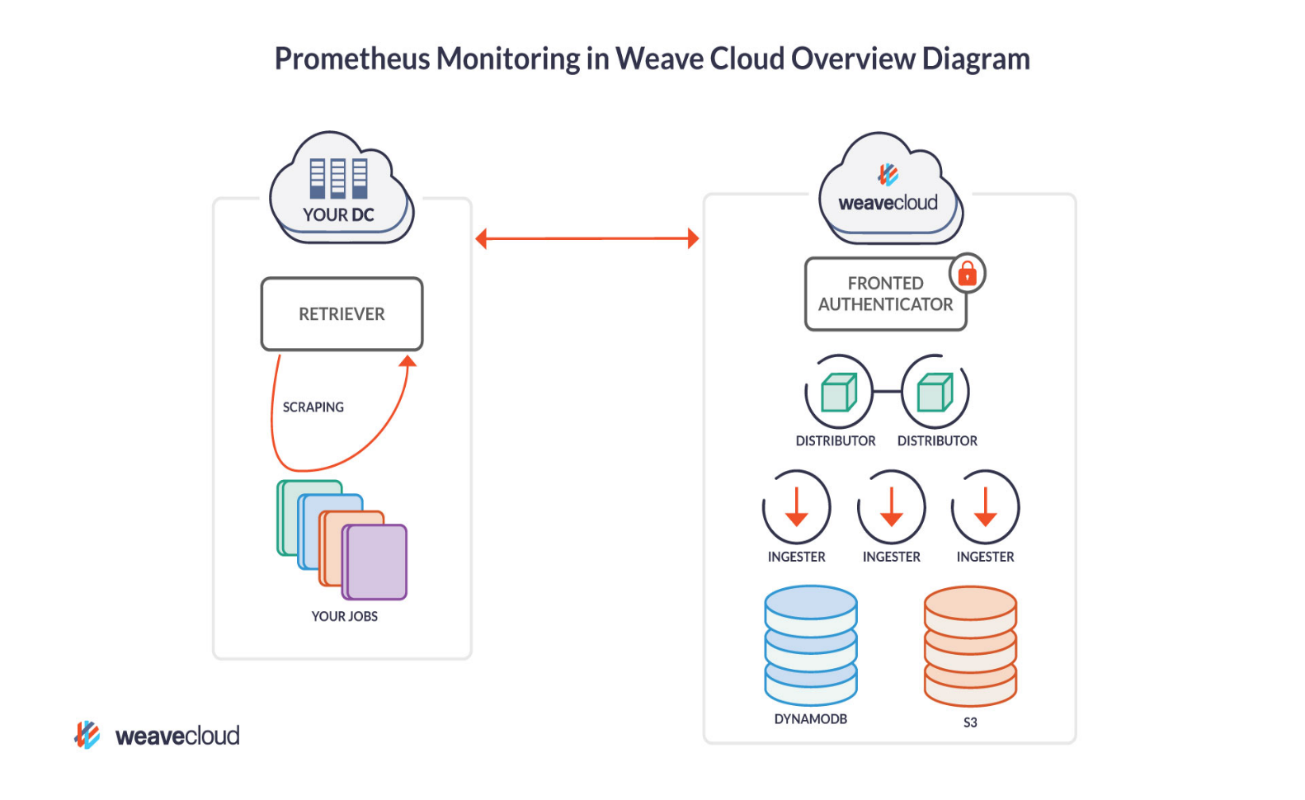
2. The Solution.
Storage:
Option 2.4: Remote storage – Weave Cortex.

Slide 14
2. The Solution.
Other candidates:
InfluxDB
Time Series Database. Open-source & commercial offering.
Open-source InfluxDB does not support clustering
Graphite
Focuses on being a passive time series database with a query language and graphing features.
Nagios
More recommended for hardware-only monitoring.
The GUI lacks user-friendliness.
Zabbix
Open-source enterprise-level software designed for real-time monitoring…
Use a traditional database.
More recommended for hardware-only monitoring.

Slide 15
2. The Solution.
Other candidates:
Observium
Check Reddit post.
LibreNMS
A fully featured network monitoring system.
An Observium fork.
Icinga2
An Open-source monitoring system which checks availability of your network resources, notifies users of outages & generates performance data for reporting.
Scalable & extensible.
Good looking UI & Has native support for Graphite.
…

Slide 16
2. The Solution.
Visualization tool: Grafana.
Grafana supports querying Prometheus. One more reason to choose Prometheus.

Slide 17
2. The Solution.
For application & system logs, we have many options:
ElasticSearch + Logstash + Kibana.
ElasticSearch + Fluentd + Kibana.
→ ElasticSearch + Fluentd + Kibana.

Slide 18
2. The Solution.
Why choose Fluentd over Logstash?
Both are an Open-source data collector. But Fluentd is written by CRuby, while Logstash is written in JRuby. As a result the overhead of running a JVM the log shipper translates in large memory consumption. Logstash is know to consume at around 120MB compared to Fluentd’s 40MB.
Although Logstash has a solution (Instead of running of the fully featured Logstash, Elastic recommends that run Elastic Beats), I still take Fluentd.
Offers Enterprise support.

Slide 19
2. The Solution.
Why choose Logstash over Fluentd?
Fluentd: Decentralized plugin repository - > 500 plugins (but only 10 official).
Logstash: Centralized plugin repository - 200 plugins.
Logstash is Elastic’s product so it can more compatible w/ ElasticSearch or Kibana.
After all, I decided to choose Fluentd as Log collector.
[1] A comparison of Fluentd vs Logstash log collector.
[2] Fluentd vs Logstash
[3] Fluentd vs Logstash: A comparison of Log collectors.
[4] Log aggregration with Fluentd, ElasticSearch & Kibana.

Slide 20
2. The Solution.
Visualize logging: Kibana. Can use Grafana but I prefer Kibana for logging visualization & Grafana for metrics visualization.

Slide 21
2. The Solution.
Finally, ElasticSearch – the heart of stack.
It is a document database that is optimized to act as a search engine.
An Open-source, RESTful, distributed search & analytics engine built on Apache Lucene.
Data compression & retention:
All data is compressed by default.
Use Curator to manage data retention policies.
[1] https://discuss.elastic.co/t/how-to-auto-delete-the-old-data/1053
[2] https://www.elastic.co/blog/curator-tending-your-time-series-indices
[3] https://discuss.elastic.co/t/indices-deleting-using-curator-different-retention-period-for-different-index/77792

Slide 22
2. The Solution.
Other candidates:
Splunk.
The “Google for log files” heavyset enterprise tool.
Built-in alerting & reporting.
Real-time search, analyze & visualize.
Limit of 500MB/day is not enough to use it for free, whereas 1GB/day will cost 2700$/year.
Splunk & the ELK stack: A side-by-side comparison.
Graylog.
An Open-source log management platform which allows to search, analyze & alert cross all log files.
Easy setup, RESTful API.
Graylog only has support for syslog & GELF (Graylog Extended Log Format).

Slide 23
2. The Solution.
Other candidates:
Papertrail.
Real-time functionality from browser, command line or API.
Custom alerts.
Backup feature to S3 bucket or MapReduce.
Free plan comes with only 100MB/month.
There’s no built-in way to visualize data.
Logentries.
More…

Slide 24



2. The Solution.
Combination:
Logs

Slide 25
2. The Solution.
Additional: Sentry.
Open-source error tracking that helps developers monitor & fix crashes in real time.
Sentry vs logging?
Logging provides you with a trail of events. Often those events are errors, but many time they’re simply informational. Sentry is fundamentally different, focus on exception, or in other words, capture application crashes.
Sentry won’t store the full details of every error that comes in if it’s one that already exists.
Use Logstash/Fluentd to log everything, but send errors/exception events to Sentry.

Slide 26






2. The Solution.
Overall architecture(Local storage).
Service discovery
AlertManager
Push alerts
Jobs/Exporters
Retrieval
Storage
PromQL
Pull metrics
Grafana
HDD/SSD
Prometheus Server

Slide 27
2. The Solution.
Service discovery
AlertManager
Overall architecture(Remote storage).
Push alerts
Jobs/Exporters
Retrieval
Storage
PromQL
Pull metrics
Grafana
Prometheus Server
3rd party Storage
Notes:
Can use InfluxDB, PostgreSQL…

Slide 28
3. Tuning & Optimizing.
Links
Recommend hardware.
Assume 50GB metrics/day.
needed_disk_space = retention_time_seconds * ingested_samples_per_second * bytes_per_sample

Slide 29
3. Tuning & Optimizing.
In Prometheus 2.0, its team do quite good at optimize. Check this video & recap.

Slide 30
Bonus
Prometheus + OpenStack.
Prometheus OpenStack exporter.
18 metrics currently collected by Prometheus OpenStack exporter:
neutron_public_ip_usage
neutron_net_size
Hypervisor_vcpus_total
…
more
Notes:
\

Slide 31
References.
[1] Designing microservices: Logging & monitoring.
[2] Reddit subreddit – sysadmin.
[3] Prometheus documentations.
[4] Robust Perception Blog.
[5] OpenStack Performance documentation.
[6] Prometheus Storage.
[7] Storing 16 bytes at Scale.
[8] Time-series Database Benchmarks.

