Slide 1
M2: Memorable Moments
Group Members:
- TYiMCA 04. Tulsi Barot
- TYiMCA 48. Archan Ranade
- TYiMCA 61. Shilpi Sharma

Slide 2
Introduction
A software application for an Online Personal Diary.
User can upload Thoughts.
User can also upload Images.
User can share on Social Media like: Facebook, Twitter, Google+

Slide 3
Technologies Used
Client Side :-
HTML 5.0 , CSS3, JavaScript for designing website and making website interactive and user-friendly.
Database :-
SQL Server Express Edition 2012 (Integrated in Visual Studio Community Edition 2015)
Server Side :-
.NET Framework 4.5.2
C#.NET 6.0 (Enabled by default in VS Community 2015)

Slide 4
Technologies Used
Developed In :-
VS Community 2015, Windows 10 Home Single Language
Will Work Efficiently In :-
IE 9-11/ Microsoft Edge, Stable releases of Mozilla Firefox, Google Chrome, Opera (Not in Safari)
Other Technologies Used :-
Bootstrap v3.0.0, Microsoft AJAX 4.5.1 (On Client and Server sides)

Slide 5
Modules Used
Guest visitor
Guest can only Register
Guest can only View the home page
User
User can Login
User can upload thoughts
User can upload images
User can also share thoughts/images on social media

Slide 6
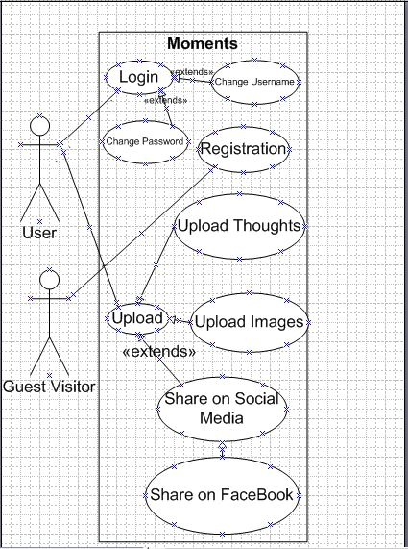
Use Case Diagram

Slide 7
Default Table – Register User
Sr No | Field Name | Data Type | Description | Constraint
1. | Id | nvarchar(128) | Unique Hashed ID of the Username | PK
2. | PasswordHash | nvarchar(MAX) | Hashed Password of the User | Not Null
3. | Email | nvarchar(256) | Email ID of the user | Unique, Not Null
4. | Username | nvarchar(20) | Unique Username of the User | Unique, Not Null

Slide 8
Table - UploadThoughts
Sr No | Field Name | Data Type | Description | Constraint
1. | User_ID | nvarchar(128) | Unique User ID of the user (Default Template) | FK
2. | Thought_ID | nvarchar(128) | Unique ID for every uploaded Thought | PK, Identity(1,1)
3. | Thought_Text | nvarchar(512) | Text of the thought | Less than or equal to 512 characters, Not Null
4. | Date | DateTime | Date and time of uploading | Not Null
User_ID is the default User_ID provided by ASP.Net default website template.
Thought_ID is nvarchar(128) because it is in encrypted form (using Microsoft.AspNet.Identity.PasswordHasher which uses PBKDF2 algorithm).

Slide 9
Table - UploadImages
Sr No | Field Name | Data Type | Description | Constraint
1. | User_ID | nvarchar(128) | Unique User ID of the user (Default Template) | FK
2. | ImageID | nvarchar(128) | Unique ID for every uploaded Image | PK
3. | Image | varbinary(MAX) | Image will be stored in binary format | Must be less than 5 MB, Not Null
4. | ImageSize | Long | Size of Image | Not Null
5. | Date | DateTime | Date and time of uploading | Not Null
For security purposes, we are storing images in binary format in database rather than in standard picture formats.
Size of image is stored explicitly as metadata and for simplicity purposes.
User_ID is the default User_ID provided by ASP.Net default website template.
Thought_ID is nvarchar(128) because it is in encrypted form (using Microsoft.AspNet.Identity.PasswordHasher which uses PBKDF2 algorithm).

Slide 10
Table - ShareOnMedia
Sr No | Field Name | Data Type | Description | Constraint
1. | User_ID | nvarchar(128) | Unique User ID of the user (Default Template) | FK
2. | Share_ID | nvarchar(128) | Thought or Image ID being shared | FK
3. | Media | varchar(20) | Name of Media being shared on | Not Null, Default ‘FaceBook’
4. | ShareDate | DateTime | Date and time of sharing | Not Null
User_ID is the default User_ID provided by ASP.Net default website template.
Currently, we are allowing sharing on FaceBook,

Slide 11
Integration With FaceBook
Register on developers.facebook.com
Create an application with FaceBook Wizard for Web Applications.
Add JavaScript snippets on ASP.NET page.
Application is now successfully integrated with FaceBook.

Slide 12
Thank You

