Slide 1


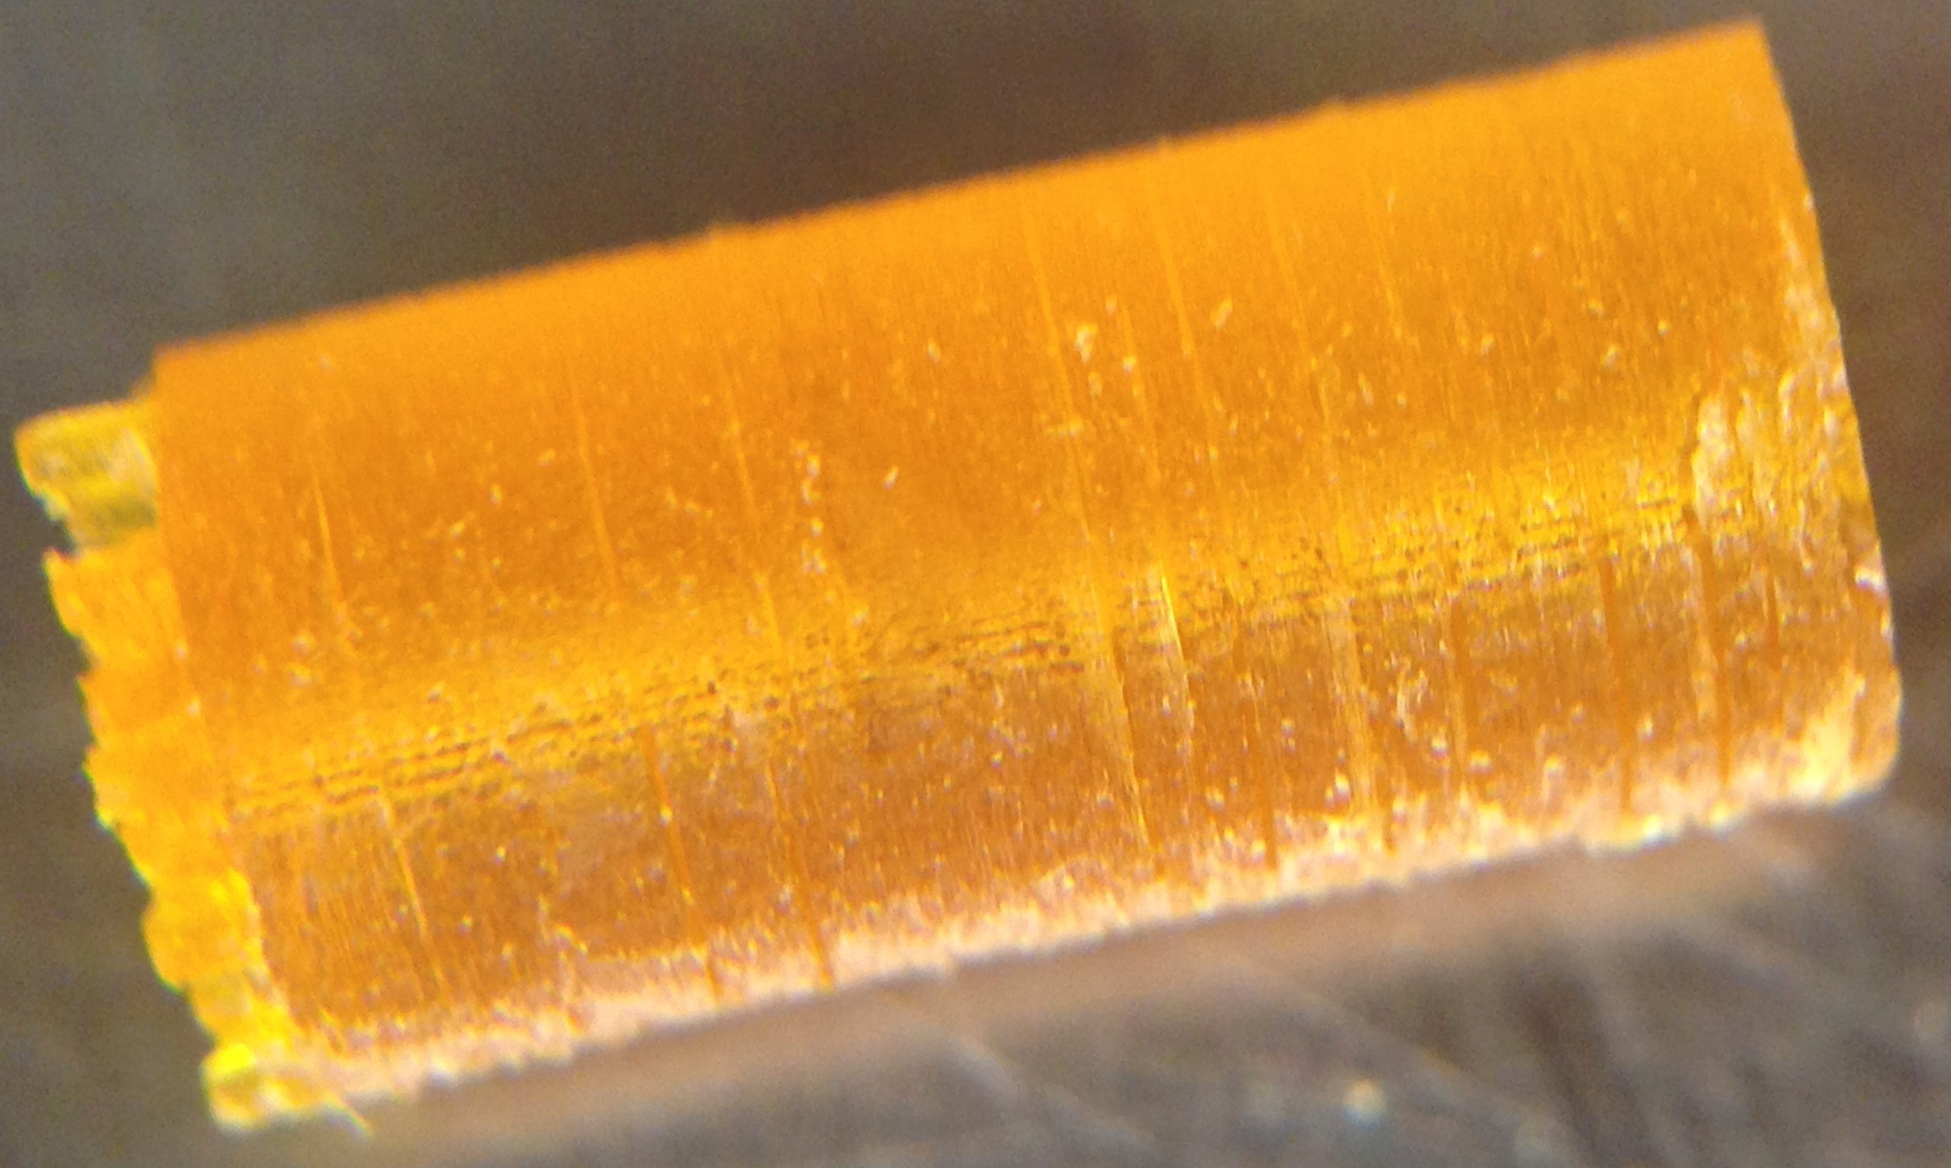
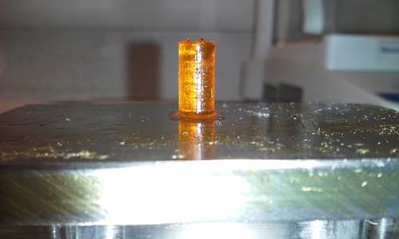
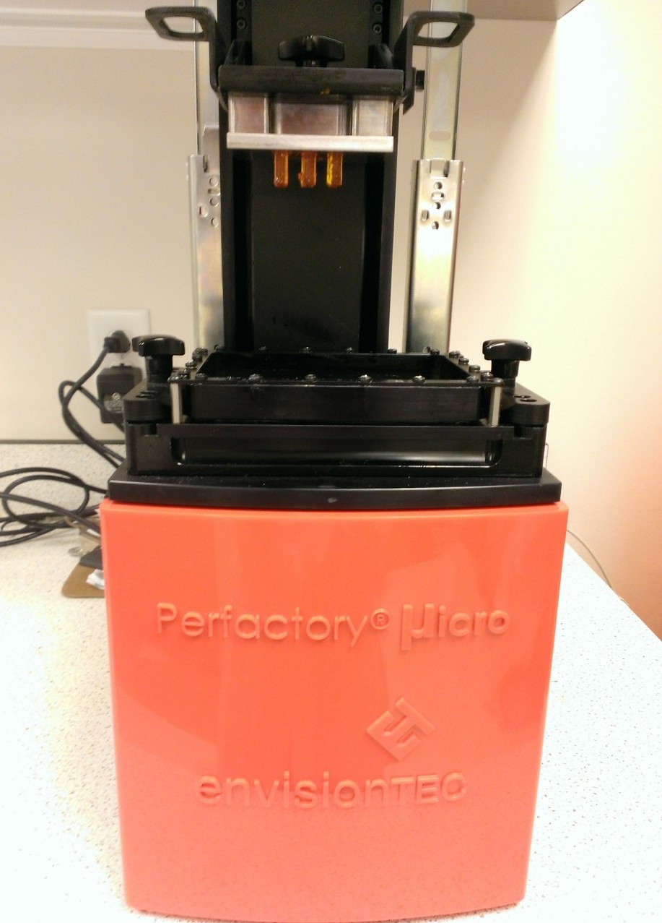
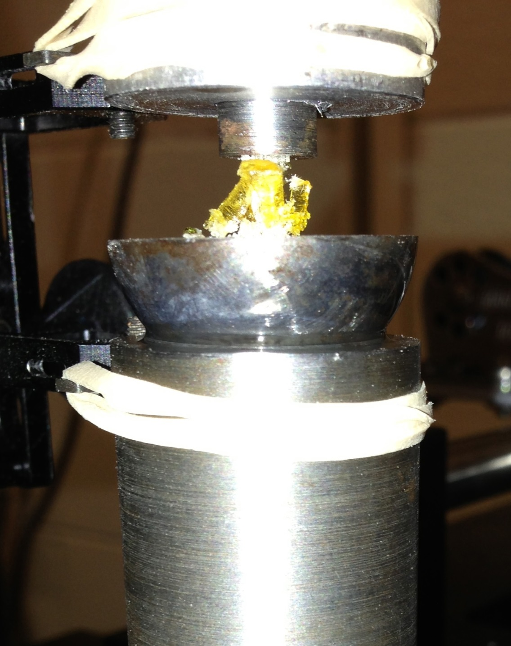
3D-Printing Resin Component Optimization for Mechanical Properties Characterization of Photocrosslinked Resorbable Bone Tissue Engineering Scaffolds
RETREAT 2013 at MOCA
Eric Mott², Xinyi Luo¹, Mallory Busso¹, David Dean²
¹Dept. of Neurological Surgery, Case Western Reserve University, Cleveland, OH 44106;
²Dept. of Plastic Surgery, The Ohio State University, Columbus, OH 43210
Introduction
Results
Specimens were tested to failure in an Instron rigged with a self-aligning fixture as in Figure 2b. Load was recorded through a load cell and strain was recorded using an externally mounted extensometer due to the specimen being too small to attach directly to. Results of this testing can be seen in Figure 3, which plots load versus displacement. From the slope, stiffness can be examined, which can then be correlated to modulus.
Discussion
High resolution 3D printing allowing the production of thin walls in any orientation can help to ensure the in vivo resorption of polymeric scaffolds. Prior to fabrication, the orientation of porous spaces may be designed on computer to facilitate the formation and ingrowth of host tissue and vasculature within the defect site. However, reliable resorption of the scaffold may be necessary for sufficient neo-tissue material properties, vascularization, and prevention of compartmentalizing the defect site.
3D printing can be used to achieve this however, competing needs on the material are such that it is strong enough for processing and implantation, yet weak enough to resorb by the time the neo-tissue filling the defect site must remodel.
Current studies in this lab have been aimed at better understanding the outcome of 3D-printed poly(propylene fumarate) (PPF) scaffolds with regard to strength, resolution, and design.
Cylinders as in Figure 1 were 3D printed (Figure 2a) to varying degrees of yield.
The interaction of resin components (e.g., polymer, initiator, and dye), influences green strength, post-cured strength, and resolution. In our preparation of scaffolds from poly(propylene fumarate) (PPF), we have found that Irgacure 784 appears to act primarily as a dye allowing highly accurate scaffold fabrication. After clearing the pores, Irgacure 784 appears to act as an initiator during post-curing. Exposure time is correlated with gradually increasing green strength. Strength (Figure 1) increased dramatically, from under 200 MPa to almost 700 MPa, following post-curing.
References
1. Daicho Y, Murakami T, Hagiwara T, Maruo S. Opt Mater Exp 3(6), dx.doi.org/10.1364/OME.3.000875, 2013.
2. Kasper FK, Tanahashi K, Fisher JP, Mikos AG. Nat Protoc 4, 518, 2009.
Acknowledgements
Partial support for this research was provided by the Dept. of Neurological Surgery Research Foundation, Case Western Reserve University (CWRU) and NIH grants R01-DE013740 and R01-AR061460. Compression tests were done by Jay Bensusan in Dr. Clare Rimnac’s laboratory, Dept. of Mechanical and Aerospace Engineering, CWRU.
Disclosures
DD, EM, MOW, AS, and JPF have submitted patent applications on these topics. DD received compensation from, and has an ownership stake in, Osteoplastics LLC.
Corresponding Author:
David Dean, Ph.D.
Associate Professor, Department of Plastic Surgery
The Ohio State University
460 West 12th Ave., 10th Floor, Rm. 1004
Columbus, OH 43210
Telephone: (614) 688-9044
E-mail: David.Dean@osumc.edu
Figure 1. (left) Example 3 x 6 mm 3D-printed cylinder. Note that the supports have not yet been removed. (right) Example 6 x 12 mm cylinder attached to build platform.
Materials and Methods
PPF was prepared as previously described.² Diethyl fumarate (diluent) was added in a 1.5:1 PPF:DEF ratio, then combined with 3% Irgacure 819 (initiator) and 3% Irgacure 784 (dye). Cylinders (3 mm diameter, 6 mm length) were rendered in an EnvisionTEC Perfactory Micro at 90, 180, and 210 s exposure/layer and set aside for mechanical testing without post-curing. One specimen (6 mm diameter, 12 mm length) was post-cured in a 3D systems ProCure 350 for 480 min. Compression testing utilized an Instron 8501 (Figure 2).
Figure 2. (a) Cylinder test specimens after being 3D printed in Perfactory Micro. (b) Specimen after being tested to failure under compression.
Exposure Time | Layer Thickness | Avg. Modulus (sample size)
90 s | 120 micron | 23.7 MPa (1)
180 s | 150 micron | 124.8 MPa (3)
210 s | 180 micron | 188.5 Mpa (5)
Figure 3. Mechanical Testing of 3D Printed PPF Cylinders: Strength vs. Exposure Time. MPa = megapascals.

