Slide 1
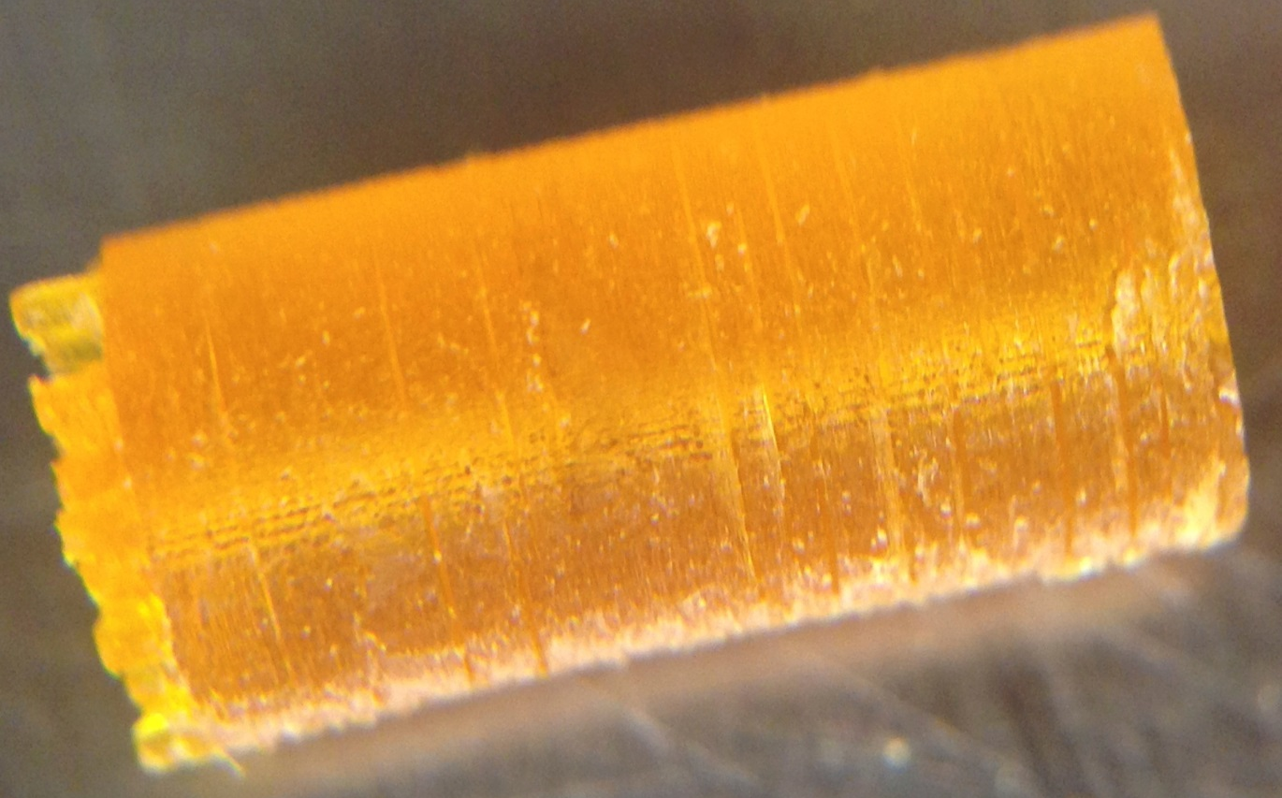
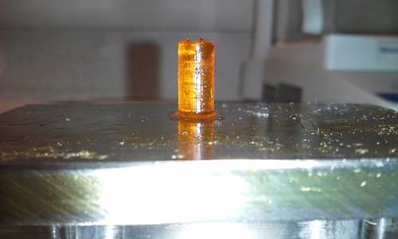
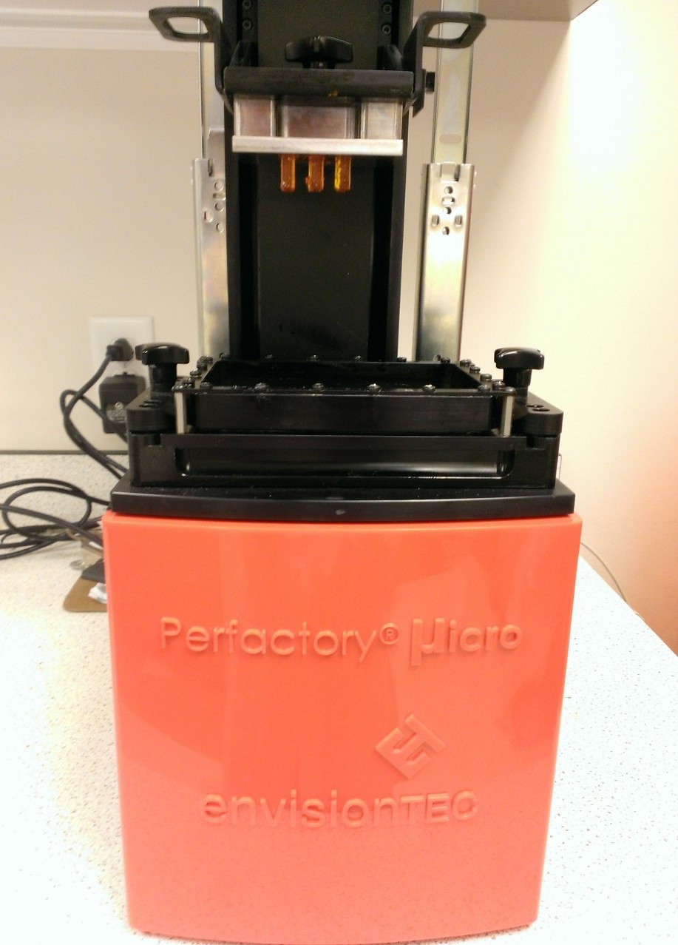
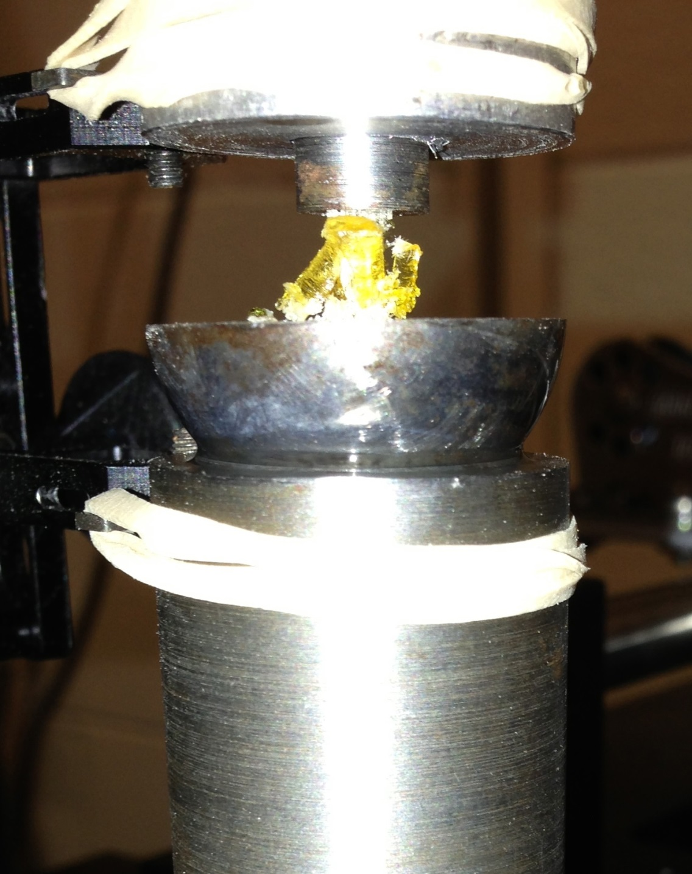
Tuning 3D Printed Resorbable Scaffold Strength and Resorption
2
2014
C
T
Eric J. Mott¹, Xinyi Luo², Mallory Busso², Martha O. Wang³, Charlotte E. Vorwald³, Ali Siblani⁴, John P. Fisher³, David Dean¹
TRANSITIONAL TO CLINICAL
¹Dept. of Plastic Surgery, The Ohio State University, Columbus, OH 43210; ²Dept. of Neurological Surgery, Case Western Reserve University, Cleveland, OH 44106; ³Fischell Department of Bioengineering, University of Maryland, College Park, MD 20742; ⁴EnvisionTEC, Inc., Dearborn, MI 48120
Introduction
Results
Discussion
Predictable and reliable resorption of scaffolds to treat bone defects is needed if remodeling of the tissue is required to enable the growth of neo-tissue. This neo-tissue must provide mechanical strength, vascularization, and defect site compartmentalization prevention. Thus, 3D printing resorbable scaffolds creates an optimization and control problem for material properties. First, it is necessary to have sufficient “green strength” (i.e., scaffold strength prior to post-fabrication curing) for adequate rendering and to clear unpolymerized polymer from the porous space without destroying the scaffold. Second, it is necessary for the scaffold to be weak enough to resorb by the time the neo-tissue filling the defect site must remodel.
Cylinders as in Figure 1 were 3D printed (Figure 2a) to varying degrees of yield.
The interaction of resin components, especially polymer, initiator, and dye, is critical to scaffold green strength, post-cured strength, and resolution. Irgacure 784 appears to act primarily as a dye during 3D printing allowing highly accurate scaffold fabrication. After clearing the pores, Irgacure 784 appears to act as an initiator during post-curing. Exposure time is correlated with gradually increasing green strength, thereby allowing us to tune the scaffold's strength and, as we expect, its resorption profile.
References
1. Daicho Y, Murakami T, Hagiwara T, Maruo S. Opt Mater Exp 3(6), dx.doi.org/10.1364/OME.3.000875, 2013.
2. Kasper FK, Tanahashi K, Fisher JP, Mikos AG. Nat Protoc 4, 518, 2009.
Acknowledgements
Partial support for this research was provided by the Dept. of Neurological Surgery Research Foundation, Case Western Reserve University (CWRU) and NIH grants R01-DE013740 and R01-AR061460. Compression tests were done by Jay Bensusan in Dr. Clare Rimnac’s laboratory, Dept. of Mechanical and Aerospace Engineering, CWRU.
Disclosures
DD, EJM, MOW, AS, and JPF have submitted patent applications on these topics. DD received compensation from, and has an ownership stake in, Osteoplastics LLC.
Corresponding Author:
David Dean, Ph.D.
Associate Professor, Department of Plastic Surgery
The Ohio State University
460 West 12th Ave., 10th Floor, Rm. 1004
Columbus, OH 43210
Telephone: (614) 688-9044
E-mail: David.Dean@osumc.edu
Exposure Time | Layer Thickness | Avg. Modulus (sample size)
90 s | 120 micron | 23.7 MPa (1)
180 s | 150 micron | 124.8 MPa (3)
210 s | 180 micron | 188.5 Mpa (5)
Figure 1. (left) Example 3 x 6 mm 3D-printed cylinder. Note that the supports have not yet been removed. (right) Example 6 x 12 mm cylinder attached to build platform just after printing.
Figure 3. Mechanical Testing of 3D Printed PPF Cylinders: Strength vs. Exposure Time. MPa = megapascal.
Specimens were tested to failure in an Instron rigged with a self-aligning fixture (Figure 2b). Load was recorded through a load cell and strain was recorded using an externally mounted extensometer due to the specimen being too small to attach directly to. Figure 3 shows results of this testing, which plots load versus displacement. From the slope, stiffness can be examined, which can then be correlated to modulus though knowing the cylinder cross-sectional area.
Materials and Methods
Poly(propylene fumarate) (PPF) was prepared as previously described. Diethyl fumarate, the monomer precursor to PPF, was used as a solvent in a 1.5:1 PPF:DEF ratio. These were combined with 3% Irgacure® 819 (BASF, Florham Park, NJ) and 3% Irgacure 784 (BASF). Cylinders (3 mm diameter, 6 mm length) were rendered in an envisionTEC (Dearborn, MI) Perfactory Micro EDU via Continuous Digital Light Processing (cDLP). These cylinders were 3D printed using 90 (N=1), 180 (N=3), and 210 (N=5) seconds exposure per layer and set aside for mechanical testing without post-curing. One specimen (6 mm diameter, 12 mm length) was post-cured in a 3D systems (Rock Hill, SC) ProCureTM 350 UV chamber. Compression testing utilized an Instron (Norwood, MA) 8501.
Second test, specimen reached failure.
First test, specimen did not fail.
Figure 4. Compression testing of a 480 min post-cured 6 x 12 mm PPF cylinder. Initial linear slope corresponds to 868 MPa.
Figure 4 shows the compression testing of the one 6 x 12 mm solid cylinder produced. The initial test was surprising as the specimen did not fail at maximum test-strain. Therefore the test was repeated with the maximum test-strain doubled. Failure was found at 40% strain with a maximum stress of 171 MPa. The initial linear slope corresponding to the linearly elastic region yielded a modulus of 868 MPa, which may be the highest ever recorded for a PPF formulation. The average modulus was 334 MPa, a 77% increase over the highest green strength modulus.
Figure 2. (a) Cylinder test specimens after being 3D printed in Perfactory Micro. (b) Specimen after being tested to failure under compression.

