Slide 1

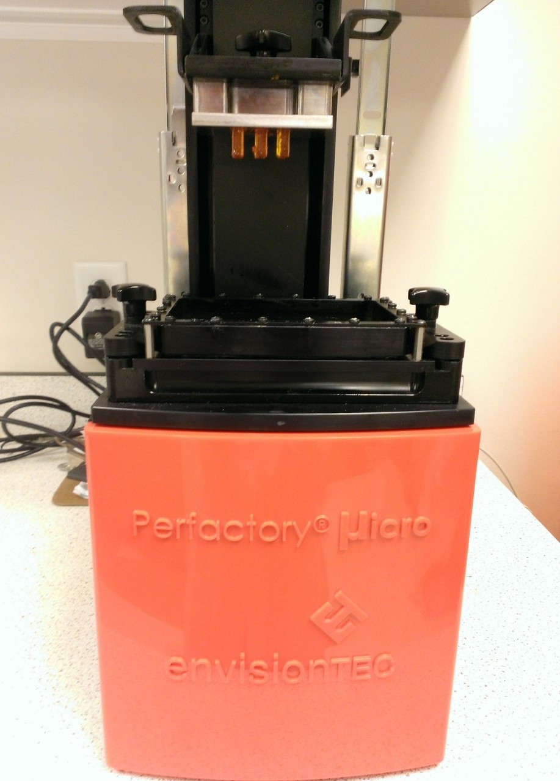
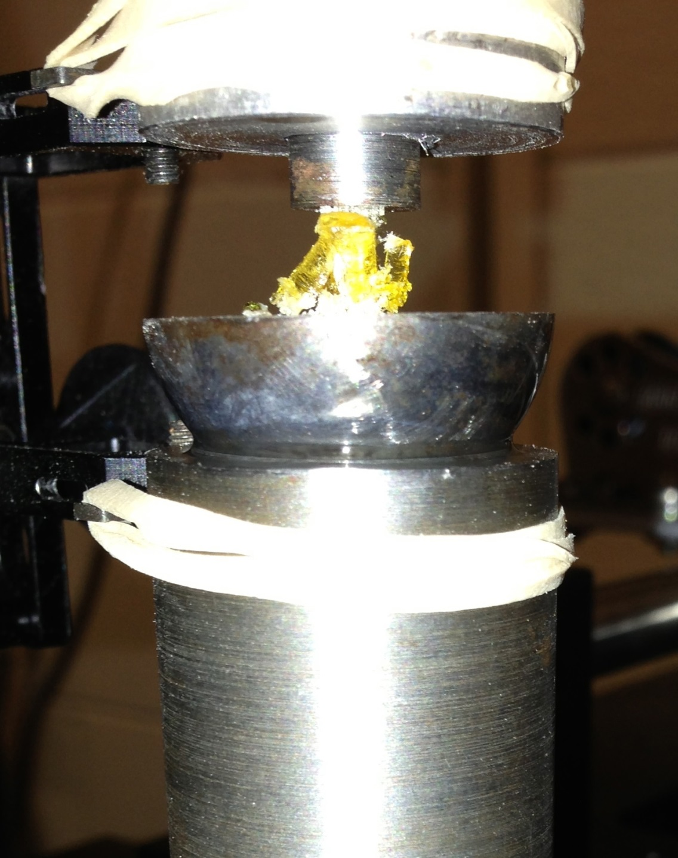
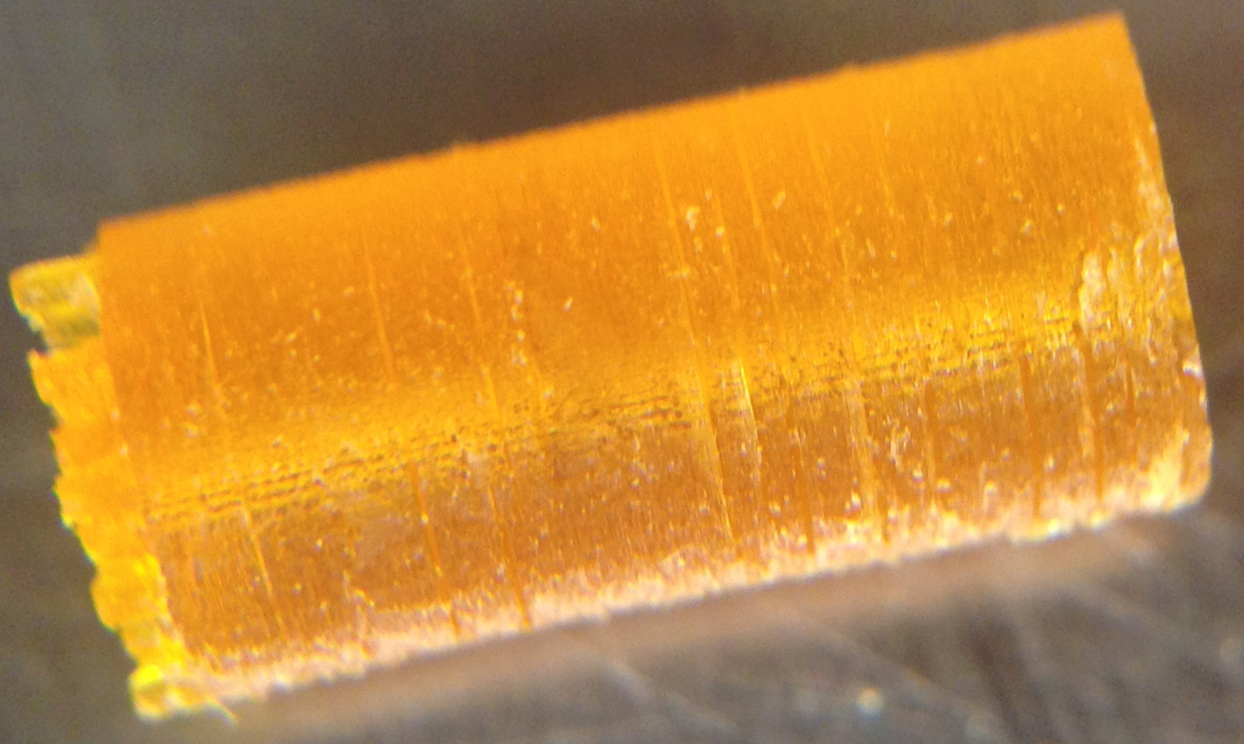
Resin Component Optimization for Green Strength of Photocrosslinked Resorbable Scaffolds Prepared by Continuous Digital Light Processing (cDLP) Additive Manufacturing
David Dean¹, Eric Mott¹, Xinyi Luo¹, Martha O. Wang², Charlotte E. Vorwald², Ali Siblani³, John P. Fisher²
¹Department of Neurological Surgery, Case Western Reserve University, Cleveland, OH 44106; ²Fischell Department of Bioengineering, University of Maryland, College Park, MD 20742; ³envisionTEC, Inc., Dearborn, MI 48120
Introduction
Materials and Methods
Specimens were tested to failure in an Instron rigged with self aligning fixture such as in Figure 2b. This ensured that compression occurred axially. Load was recorded through a load cell and strain was recorded using an externally mounted extensometer due to the specimen being too small to attach directly to. Results of this testing can be seen in Figure 3, which plots load versus displacement. From the slope, stiffness can be examined, which can then be correlated to modulus.
Discussion
High resolution is one of the most important benefits of photocrosslinking methods for the additive manufacture of resorbable tissue engineering scaffolds.¹ High resolution 3D printing allowing the production of thin walls in any orientation can help to ensure the in vivo resorption of polymeric scaffolds. Prior to fabrication, the orientation of porous spaces may be designed on computer to facilitate the formation and ingrowth of host tissue and vasculature within the defect site. However, a predicted and reliable resorption of the scaffold may be needed if remodeling of the tissue is necessary for sufficient neo-tissue material properties, vascularization, and prevention of compartmentalizing the defect site.
Thus, the additive manufacture of resorbable scaffolds may create competing demands on material properties. First, it is necessary to have sufficient “green strength” (i.e., scaffold strength prior to post-fabrication curing) to clear unpolymerized polymer from the porous space without deforming the scaffold. Second, it is necessary for the scaffold to be weak enough to resorb by the time the neo-tissue filling the defect site must remodel.
High resolution photocrosslinked additive manufacture of resorbable polymeric scaffolds requires one or more Type I or Type II initiators and possibly co-initiators to produce free radicals to sufficiently cause crosslinking both within and between layers. While within layer resolution is primarily dependent on pixel size, between-layer resolution commonly depends on the power of the mechanism used to deliver light and the use of light-blocking and/or –absorbing dyes.
PPF was prepared as previously described.² Diethyl fumarate, the monomer precursor to PPF, was used as a diluent in a 1.5:1 PPF:DEF ratio. These ingredients were combined with 3% Irgacure® 819 (BASF, Florham Park, NJ), the primary initiator, and 3% Irgacure 784 (BASF), a dye. Cylinders (3 mm diameter, 6 mm length) were rendered in an EnvisionTEC (Dearborn, MI) Perfactory Micro EDU via Continuous Digital Light Processing (cDLP). These cylinders were 3D printed using 90 (N=1), 180 (N=3), and 210 (N=5) seconds exposure per layer and set aside for mechanical testing without post-curing. One specimen (6 mm diameter, 12 mm length) was post-cured in a 3D systems (Rock Hill, SC) ProCureTM 350 UV chamber. Compression testing utilized an Instron (Norwood, MA) 8501 (Figure 1).
The interaction of resin components (e.g., polymer, initiator, and dye), influences green strength, post-cured strength, and resolution. In our preparation of scaffolds from poly(propylene fumarate) (PPF), we have found that Irgacure 784 appears to act primarily as a dye allowing highly accurate scaffold fabrication. After clearing the pores, Irgacure 784 appears to act as an initiator during post-curing. Exposure time is correlated with gradually increasing green strength. Strength (Figure 1) increased dramatically, from under 200 MPa to almost 700 MPa, following post-curing.
References
1. Daicho Y, Murakami T, Hagiwara T, Maruo S. Opt Mater Exp 3(6), dx.doi.org/10.1364/OME.3.000875, 2013.
2. Kasper FK, Tanahashi K, Fisher JP, Mikos AG. Nat Protoc 4, 518, 2009.
Acknowledgements
Partial support for this research was provided by the Dept. of Neurological Surgery Research Foundation, Case Western Reserve University (CWRU) and NIH grants R01-DE013740 and R01-AR061460. Compression tests were done by Jay Bensusan in Dr. Clare Rimnac’s laboratory, Dept. of Mechanical and Aerospace Engineering, CWRU.
Disclosures
DD, EM, MOW, AS, and JPF have submitted patent applications on these topics. DD received compensation from, and has an ownership stake in, Osteoplastics LLC.
Corresponding Author:
David Dean, Ph.D.
Associate Professor, Department of Plastic Surgery
The Ohio State University
460 West 12th Ave., 10th Floor, Rm. 1004
Columbus, OH 43210
Telephone: (614) 688-9044
E-mail: David.Dean@osumc.edu
Results
Cylinders such as in Figure 1 were 3D printed (Figure 2a) to varying degrees of yield. The yield was observed to increase with exposure time.
Figure 2. (a) Cylinder test specimens after being 3D printed in Perfactory Micro. (b) Specimen after being tested to failure under compression.
Exposure Time | Layer Thickness | Avg. Modulus (sample size)
90 s | 120 micron | 23.7 MPa (1)
180 s | 150 micron | 124.8 MPa (3)
210 s | 180 micron | 188.5 Mpa (5)
Figure 1. Example of 3mm x 6mm cylinder part 3D printed. Note that the supports have not yet been removed.
Figure 3. Mechanical Testing of 3D Printed PPF Cylinders: Strength vs. Exposure Time. MPa = megapascals.

